Slide 1
Lecture 3. Processor Microarchitecture and Design (4)
CMPE 200 Computer Architecture & Design
Haonan Wang

Slide 2
Cause of Data Hazards
Stalling the pipeline to prevent error:
All instructions in front of the stalled instruction can continue
All instructions behind the stalled instruction must also stall
Stalling inserts “bubbles” / nops (no-operations) into the pipeline
A “nop” is an actual instruction in the MIPS ISA that does NOTHING

Slide 3
Pipeline Stall for Data Hazards
ADD can read the updated register value from the register file in the same cycle as LW writes the loaded data to register
Do we really need to wait until LW updates the register file?
Why don’t we use this data directly?
 | CC1 | CC2 | CC3 | CC4 | CC5 | CC6 | CC7 | CC8 | CC9 | CC10 | CC11 | CC12 | CC13
LW | IF | ID | EXE | MEM | WB
ADD |  | IF | ID |  |  | EXE | MEM | WB
Next instr. |  |  | IF |  |  | ID | EXE | MEM | WB
Next+1 |  |  |  |  |  | IF | ID | EXE | MEM | WB
Next+2 |  |  |  |  |  |  | IF | ID | EXE | MEM | WB
Next+3 |  |  |  |  |  |  |  | IF | ID | EXE | MEM | WB
Next+4 |  |  |  |  |  |  |  |  | IF | ID | EXE | MEM | WB
nop
nop
nop
nop

Slide 4
Data Hazards Solutions
Compiler
Reorder Code
Hardware
Use forwarding / bypassing
Data forwarding
Take results still in the pipeline (not yet written back to a register) and pass them to dependent instructions
Forwarding Path
Load instruction: from WB to EXE
R-type instructions: from MEM to EXE

Slide 5
Data Forwarding
As far as earlier instruction’s result is in pipeline, the result value can be forwarded to the following instructions
In arithmetic operations, no stall is needed
 | CC1 | CC2 | CC3 | CC4 | CC5 | CC6 | CC7 | CC8 | CC9 | CC10
ADD | IF | ID | EXE | MEM | WB
SUB |  | IF | ID | EXE | MEM | WB
XOR |  |  | IF | ID | EXE | MEM | WB
Next+1 |  |  |  | IF | ID | EXE | MEM | WB
Next+2 |  |  |  |  | IF | ID | EXE | MEM | WB
Next+3 |  |  |  |  |  | IF | ID | EXE | MEM | WB
ADD $t3,$t1,$t2
SUB $t5,$t3,$t4
XOR $t7,$t5,$t3

Slide 6
Forwarding Logic
Forwarding from MEM
if (we_regM and (rsE ≠ 0) and (rf_waM = rsE)) ForwardAE = 10
if (we_regM and (rtE ≠ 0) and (rf_waM = rtE)) ForwardBE = 10
rsE & rtE
: source register id in EXE stage
rf_waM
: destination register id in MEM stage
we_regM
: register file write enable in MEM stage
 | CC1 | CC2 | CC3 | CC4 | CC5 | CC6 | CC7 | CC8 | CC9 | CC10
ADD | IF | ID | EXE | MEM | WB
SUB |  | IF | ID | EXE | MEM | WB
XOR |  |  | IF | ID | EXE | MEM | WB
Next+1 |  |  |  | IF | ID | EXE | MEM | WB
Next+2 |  |  |  |  | IF | ID | EXE | MEM | WB
Next+3 |  |  |  |  |  | IF | ID | EXE | MEM | WB
ADD $t3,$t1,$t2
SUB $t5,$t3,$t4
XOR $t7,$t5,$t3

Slide 7
Forwarding Logic
Forwarding from WB
if (we_regW and (rsE ≠ 0) and (rf_waW = rsE)) ForwardAE = 01
if (we_regW and (rtE ≠ 0) and (rf_waW = rtE)) ForwardBE = 01
rf_waW
: destination register id in WB stage
we_regW
: register file write enable in WB stage
 | CC1 | CC2 | CC3 | CC4 | CC5 | CC6 | CC7 | CC8 | CC9 | CC10
ADD | IF | ID | EXE | MEM | WB
SUB |  | IF | ID | EXE | MEM | WB
XOR |  |  | IF | ID | EXE | MEM | WB
Next+1 |  |  |  | IF | ID | EXE | MEM | WB
Next+2 |  |  |  |  | IF | ID | EXE | MEM | WB
Next+3 |  |  |  |  |  | IF | ID | EXE | MEM | WB
ADD $t3,$t1,$t2
SUB $t5,$t3,$t4
XOR $t7,$t5,$t3

Slide 8
Forwarding Path
IF/ID
ID/EX
EX/MEM
MEM/WB
Control
WB
WB
WB
M
M
EX
0
1
2
Register File
Read Reg. 1 #
I-Cache / I-MEM
Read data 1
Read Reg. 2 #
ForwardAE
ALU
D-Cache /
D-Mem
PC
Addr.
Res.
Addr.
0
1
Data
Write Reg. #
Read data 2
0
1
2
Read Data
Write Data
Write Data
ForwardBE
Forwarding Logic
25:21
rsE
20:16
rtE
0
1
rf_waE
rf_waM
rf_waW
15:11
rdE
Note: Logics for sign extensions and next pc calculation are omitted for simplicity

Slide 9
Stall With Forwarding
For LW sourced dependency, we still need to stall for one cycle
Freeze the PC and IF/ID pipeline register for one clock cycle
Flush the ID/EXE pipeline register
 | CC1 | CC2 | CC3 | CC4 | CC5 | CC6 | CC7 | CC8 | CC9 | CC10 | CC11 | CC12 | CC14
LW | IF | ID | EXE | MEM | WB
ADD |  | IF | ID | ID | EXE | MEM | WB
Next instr. |  |  | IF | IF | ID | EXE | MEM | WB
Next+1 |  |  |  |  | IF | ID | EXE | MEM | WB
Next+2 |  |  |  |  |  | IF | ID | EXE | MEM | WB
Next+3 |  |  |  |  |  |  | IF | ID | EXE | MEM | WB
Next+4 |  |  |  |  |  |  |  | IF | ID | EXE | MEM | WB
nop
nop

Slide 10
Forwarding Path
FlushE
IF/ID
ID/EX
EX/MEM
MEM/WB
StallIF
Hazard detection unit
StallID
Control
WB
WB
WB
M
M
EX
0
1
2
Register File
Read Reg. 1 #
I-Cache / I-MEM
Read data 1
Read Reg. 2 #
ForwardAE
ALU
D-Cache /
D-Mem
PC
Addr.
Res.
Addr.
0
1
Data
Write Reg. #
Read data 2
0
1
2
Read Data
en
Write Data
Write Data
ForwardBE
Forwarding Logic
25:21
rsE
20:16
rtE
0
1
rf_waE
rf_waM
rf_waW
15:11
rdE
Note: Logics for sign extensions and next pc calculation are omitted for simplicity

Slide 11
Stalling Condition
Stalling Logic
lwstall = ((rsD == rtE) or (rtD == rtE)) and dm2regE
stallF = stallD = FlushE = lwstall
rsD & rtD
: source register id in ID stage
rtE
: destination register in EXE stage
dm2regE
: data memory to register write signal of the instruction in EXE stage

Slide 12
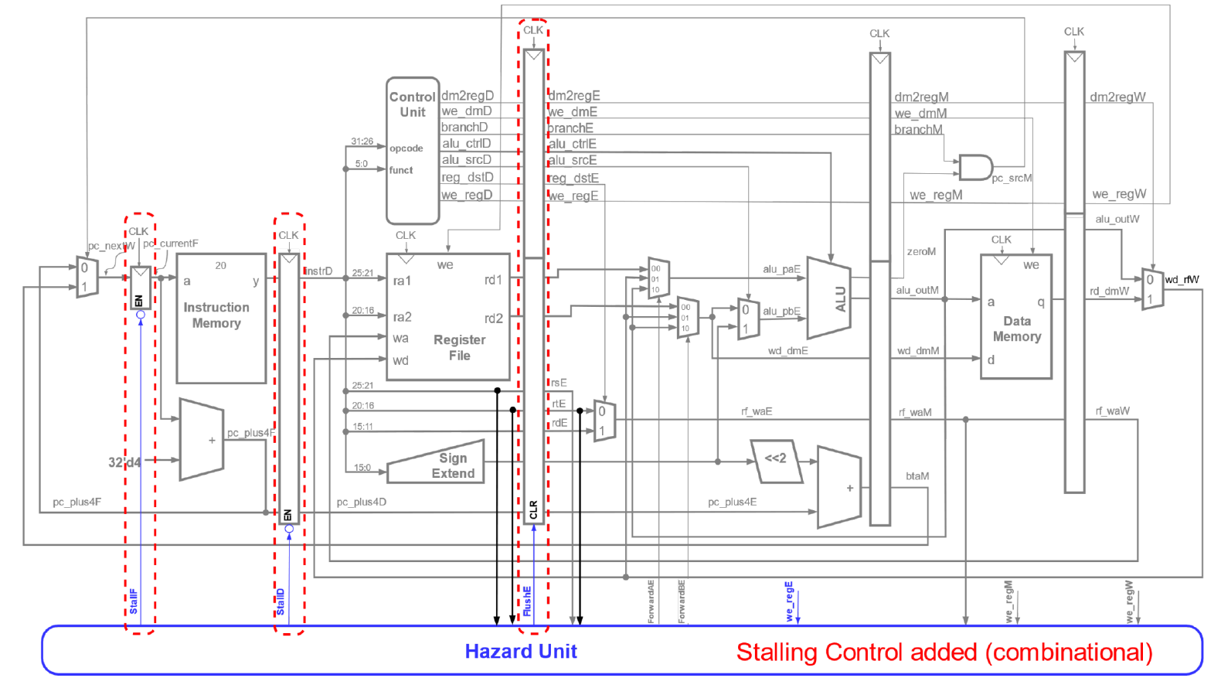
Current Design

Slide 13
Pipeline Latency with Forwarding/Stall
Number of cycles we must stall to execute a dependent instruction:
Instruction that is the dependency source | w/o Forwarding (cycles) | w/ Forwarding (cycles)
LW | 2 | 1
Other instructions that update register file | 2 | 0
Data Hazards Solutions:
- Hardware: stalling & forwarding
- Software: compiler -- code reordering

Slide 14
Code Scheduling to Avoid Stalls
Compiler can reorder code to avoid the stalls
C code for A = B + E; C = B + F;
lw $t1, 0($t0)
lw $t2, 4($t0)
add $t3, $t1, $t2
sw $t3, 12($t0)
lw $t4, 8($t0)
add $t5, $t1, $t4
sw $t5, 16($t0)
Find RAW dependencies and check if stall is needed

Slide 15
Code Scheduling to Avoid Stalls
Compiler can reorder code to avoid the stalls
C code for A = B + E; C = B + F;
lw $t1, 0($t0)
lw $t2, 4($t0)
add $t3, $t1, $t2
sw $t3, 12($t0)
lw $t4, 8($t0)
add $t5, $t1, $t4
sw $t5, 16($t0)
Find RAW dependencies and check if stall is needed
When forwarding is used,
only lw instruction causes stall
Leave lw instructions only

Slide 16
Code Scheduling to Avoid Stalls
Compiler can reorder code to avoid the stalls
C code for A = B + E; C = B + F;
lw $t1, 0($t0)
lw $t2, 4($t0)
add $t3, $t1, $t2
sw $t3, 12($t0)
lw $t4, 8($t0)
add $t5, $t1, $t4
sw $t5, 16($t0)
Find RAW dependencies and check if stall is needed
lw instructions cause 1-cycle stalls
Leave instructions that are executed back-to-back only

Slide 17
Code Scheduling to Avoid Stalls
Compiler can reorder code to avoid the stalls
C code for A = B + E; C = B + F;
lw $t1, 0($t0)
lw $t2, 4($t0)
add $t3, $t1, $t2
sw $t3, 12($t0)
lw $t4, 8($t0)
add $t5, $t1, $t4
sw $t5, 16($t0)
Now, check if the lw and dependent instructions must be executed back-to-back

Slide 18
Code Scheduling to Avoid Stalls
Compiler can reorder code to avoid the stalls
C code for A = B + E; C = B + F;
lw $t1, 0($t0)
lw $t2, 4($t0)
add $t3, $t1, $t2
sw $t3, 12($t0)
lw $t4, 8($t0)
add $t5, $t1, $t4
sw $t5, 16($t0)
lw $t1, 0($t0)
lw $t2, 4($t0)
lw $t4, 8($t0)
add $t3, $t1, $t2
sw $t3, 12($t0)
add $t5, $t1, $t4
sw $t5, 16($t0)

Slide 19
Code Scheduling to Avoid Stalls
Compiler can reorder code to avoid the stalls
C code for A = B + E; C = B + F;
lw $t1, 0($t0)
lw $t2, 4($t0)
add $t3, $t1, $t2
sw $t3, 12($t0)
lw $t4, 8($t0)
add $t5, $t1, $t4
sw $t5, 16($t0)
lw $t1, 0($t0)
lw $t2, 4($t0)
lw $t4, 8($t0)
add $t3, $t1, $t2
sw $t3, 12($t0)
add $t5, $t1, $t4
sw $t5, 16($t0)
stall
stall
Total
execution time
5 cycles for the first inst +
6 cycles for the remaining insts +
2 x 1 stall cycles = 13 cycles
5 cycles for the first inst +
6 cycles for the remaining insts +
0 stall cycles = 11 cycles

Slide 20
Control Hazard
Branch outcomes: Taken (T) or Not-Taken (NT)
Not known until late in the pipeline
Prevents us from fetching future instructions
Solution: rather than stall, we can predict the outcome and keep fetching
We only need to correct the pipeline if we guess wrong
Static Predictions
Predict Taken
Predict Not Taken
T
--- beq L1 L2 --- --- --- --- beq L2 L1 ---
NT
T
NT

Slide 21
Statically Predict Not Taken
Keep fetching instructions from the PC + 4 by assuming that the branch will be not taken
Once branch is turned out to be taken, flush the incorrectly fetched instructions
In the following cycle, fetch the instruction from the branch target address

Slide 22
Statically Predict Not Taken: Issues
Next instr. + 2
-- fetch
Next instr. + 1
-- decode
Next instr.
-- execute
BEQ -- If condition
satisfied, update PC
Control / Displacement
Next instr. + 1
Next instr.
EX/MEM
MEM/WB
IF/ID
ID/EX
4
A
Branch outcome only available in MEM stage
→ Incorrect instructions already in pipeline
+
Adder
S
Shift Left 2
Sum
B
Register File
0
1
CLK
Read Reg. 1 #
I-Cache / I-MEM
Read Reg. 2 #
PC
Addr.
Data
Read data 1
Write Reg. #
Zero
ALU
Res.
D-Cache /
D-Mem
Write Data
Read data 2
0
1
Addr.
0
1
Read Data
Write Data
Sign Extend
16
32
0
1

Slide 23
Statically Predict Not Taken: Issues
Fetch from Branch Target Addr.
Flush
Flush
Flush
BEQ
IF/ID
ID/EX
EX/MEM
MEM/WB
4
A
+
Adder
S
Shift Left 2
Sum
B
Register File
0
1
CLK
Read Reg. 1 #
I-Cache / I-MEM
Read Reg. 2 #
PC
Addr.
Data
Read data 1
Write Reg. #
Zero
ALU
Res.
D-Cache /
D-Mem
Write Data
Read data 2
0
1
Addr.
0
1
Read Data
Write Data
Sign Extend
16
32
0
1

Slide 24
Static Branch Prediction Penalty
Penalty = number of instructions that need to be flushed on misprediction
For static branch prediction:
The branch outcome and target address is available at the MEM stage and passed back to the Fetch stage
If mispredicted, instructions of the correct path will be fetched on the next cycle
A 3-cycle branch penalty when mispredicted

Slide 25
Statically Predict Not Taken
 | CC1 | CC2 | CC3 | CC4 | CC5 | CC6 | CC7 | CC8 | CC9 | CC10
BEQ | IF | ID | EXE | MEM
ADD |  | IF | ID | EXE
SUB |  |  | IF | ID
OR |  |  |  | IF
NT!
Actual Branch Outcome
BEQ $a0,$a1,L1 (NT)
L2: ADD $s1,$t1,$t2
SUB $t3,$t0,$s0
OR $s0,$t6,$t7
BNE $a0,$s1,L2 (T)
L1: AND $t3,$t6,$t7
SW $t5,0($s1)
LW $s2,0($s5)

Slide 26
Statically Predict Not Taken
 | CC1 | CC2 | CC3 | CC4 | CC5 | CC6 | CC7 | CC8 | CC9 | CC10
BEQ | IF | ID | EXE | MEM | WB
ADD |  | IF | ID | EXE | MEM
SUB |  |  | IF | ID | EXE
OR |  |  |  | IF | ID
BNE |  |  |  |  | IF
Actual Branch Outcome
BEQ $a0,$a1,L1 (NT)
L2: ADD $s1,$t1,$t2
SUB $t3,$t0,$s0
OR $s0,$t6,$t7
BNE $a0,$s1,L2 (T)
L1: AND $t3,$t6,$t7
SW $t5,0($s1)
LW $s2,0($s5)

Slide 27
Statically Predict Not Taken
 | CC1 | CC2 | CC3 | CC4 | CC5 | CC6 | CC7 | CC8 | CC9 | CC10
BEQ | IF | ID | EXE | MEM | WB
ADD |  | IF | ID | EXE | MEM | WB
SUB |  |  | IF | ID | EXE | MEM
OR |  |  |  | IF | ID | EXE
BNE |  |  |  |  | IF | ID
AND |  |  |  |  |  | IF
Actual Branch Outcome
BEQ $a0,$a1,L1 (NT)
L2: ADD $s1,$t1,$t2
SUB $t3,$t0,$s0
OR $s0,$t6,$t7
BNE $a0,$s1,L2 (T)
L1: AND $t3,$t6,$t7
SW $t5,0($s1)
LW $s2,0($s5)

Slide 28
Statically Predict Not Taken
 | CC1 | CC2 | CC3 | CC4 | CC5 | CC6 | CC7 | CC8 | CC9 | CC10
BEQ | IF | ID | EXE | MEM | WB
ADD |  | IF | ID | EXE | MEM | WB
SUB |  |  | IF | ID | EXE | MEM | WB
OR |  |  |  | IF | ID | EXE | MEM | WB
BNE |  |  |  |  | IF | ID | EXE | MEM
AND |  |  |  |  |  | IF | ID | EXE
SW |  |  |  |  |  |  | IF | ID
LW |  |  |  |  |  |  |  | IF
Actual Branch Outcome
BEQ $a0,$a1,L1 (NT)
L2: ADD $s1,$t1,$t2
SUB $t3,$t0,$s0
OR $s0,$t6,$t7
BNE $a0,$s1,L2 (T)
L1: AND $t3,$t6,$t7
SW $t5,0($s1)
LW $s2,0($s5)
T!
Flush

Slide 29
Statically Predict Not Taken
 | CC1 | CC2 | CC3 | CC4 | CC5 | CC6 | CC7 | CC8 | CC9 | CC10
BEQ | IF | ID | EXE | MEM | WB
ADD |  | IF | ID | EXE | MEM | WB
SUB |  |  | IF | ID | EXE | MEM | WB
OR |  |  |  | IF | ID | EXE | MEM | WB
BNE |  |  |  |  | IF | ID | EXE | MEM | WB
AND |  |  |  |  |  | IF | ID | EXE
SW |  |  |  |  |  |  | IF | ID
LW |  |  |  |  |  |  |  | IF
ADD |  |  |  |  |  |  |  |  | IF | ID
SUB |  |  |  |  |  |  |  |  |  | IF
Actual Branch Outcome
BEQ $a0,$a1,L1 (NT)
L2: ADD $s1,$t1,$t2
SUB $t3,$t0,$s0
OR $s0,$t6,$t7
BNE $a0,$s1,L2 (T)
L1: AND $t3,$t6,$t7
SW $t5,0($s1)
LW $s2,0($s5)
nop
nop
nop
nop
nop
nop
Instruction in the
target address (L2)

Slide 30
Predict Taken?
It is not possible to statically predict all the branches to be taken
The branch target address is not computed until the EX stage, so we don’t have the PC values even needed to predict taken
Dynamic branch prediction + branch target buffer enables to predict taken
Predict untaken a few times to collect branch target address of each branch and then predict taken based on the history
Can we reduce branch penalty with change of datapath?

Slide 31
Early Branch Determination
Target address can be calculated earlier by moving shift-left-2 and Adder
IF/ID
ID/EX
EX/MEM
MEM/WB
4
A
+
Adder
S
Shift Left 2
Sum
B
Register File
0
1
CLK
Read Reg. 1 #
I-Cache / I-MEM
Read Reg. 2 #
PC
Addr.
Data
Read data 1
Write Reg. #
Zero
ALU
Res.
D-Cache /
D-Mem
Write Data
Read data 2
0
1
Addr.
0
1
Read Data
Write Data
Sign Extend
16
32
0
1

Slide 32
Early Branch Determination
Target address can be calculated earlier by moving shift-left-2 and Adder
IF/ID
Adder
ID/EX
EX/MEM
MEM/WB
4
A
The comparison result is passed to control logic to take branch target address as next PC
+
Shift Left 2
Sum
S
B
Register File
0
1
CLK
Read Reg. 1 #
I-Cache / I-MEM
Read Reg. 2 #
PC
Addr.
Data
Read data 1
Write Reg. #
Zero
=
ALU
Res.
D-Cache /
D-Mem
Write Data
Read data 2
0
1
Addr.
0
1
Read Data
Write Data
Sign Extend
16
32
0
1

Slide 33
Early Determination w/ Predict NT
 | CC1 | CC2 | CC3 | CC4 | CC5 | CC6 | CC7 | CC8 | CC9 | CC10
BEQ | IF | ID | EXE | MEM | WB
ADD |  | IF | ID | EXE | MEM | WB
SUB |  |  | IF | ID | EXE | MEM
OR |  |  |  | IF | ID | EXE
BNE |  |  |  |  | IF | ID
AND |  |  |  |  |  | IF
Actual Branch Outcome
BEQ $a0,$a1,L1 (NT)
L2: ADD $s1,$t1,$t2
SUB $t3,$t0,$s0
OR $s0,$t6,$t7
BNE $a0,$s1,L2 (T)
L1: AND $t3,$t6,$t7
SW $t5,0($s1)
LW $s2,0($s5)
T!
Flush

Slide 34
Early Determination w/ Predict NT
 | CC1 | CC2 | CC3 | CC4 | CC5 | CC6 | CC7 | CC8 | CC9 | CC10
BEQ | IF | ID | EXE | MEM | WB
ADD |  | IF | ID | EXE | MEM | WB
SUB |  |  | IF | ID | EXE | MEM | WB
OR |  |  |  | IF | ID | EXE | MEM | WB
BNE |  |  |  |  | IF | ID | EXE | MEM | WB
AND |  |  |  |  |  | IF
ADD |  |  |  |  |  |  | IF | ID | EXE | MEM
SUB |  |  |  |  |  |  |  | IF | ID | EXE
Actual Branch Outcome
BEQ $a0,$a1,L1 (NT)
L2: ADD $s1,$t1,$t2
SUB $t3,$t0,$s0
OR $s0,$t6,$t7
BNE $a0,$s1,L2 (T)
L1: AND $t3,$t6,$t7
SW $t5,0($s1)
LW $s2,0($s5)
T!
Flush
nop
nop
nop
nop
Instruction in the
target address (L2)

Slide 35
Early Branch Determination: Issues
Target address can be calculated earlier by moving shift-left-2 and Adder
IF/ID
Adder
ID/EX
EX/MEM
MEM/WB
4
A
Shift Left 2
Sum
This may need extra data forwarding and stall
because now the operand value is needed in ID stage (not in EXE stage)
+
S
B
Register File
0
1
CLK
Read Reg. 1 #
I-Cache / I-MEM
Read Reg. 2 #
PC
Addr.
Data
Read data 1
Write Reg. #
Zero
=
ALU
Res.
D-Cache /
D-Mem
Write Data
Read data 2
0
1
Addr.
0
1
Read Data
Write Data
Sign Extend
16
32
0
1

Slide 36
Early Determination w/ Predict NT
 | CC1 | CC2 | CC3 | CC4 | CC5 | CC6 | CC7 | CC8 | CC9 | CC10
BEQ | IF | ID | EXE | MEM | WB
ADD |  | IF | ID | EXE | MEM | WB
SUB |  |  | IF | ID | EXE | MEM
OR |  |  |  | IF | ID | EXE
BNE |  |  |  |  | IF | ID
AND |  |  |  |  |  | IF
Actual Branch Outcome
BEQ $a0,$a1,L1 (NT)
L2: ADD $s1,$t1,$t2
SUB $t3,$t0,$s0
OR $s0,$t6,$t7
BNE $s0,$s1,L2 (T)
L1: AND $t3,$t6,$t7
SW $t5,0($s1)
LW $s2,0($s5)

Slide 37
Early Determination w/ Predict NT
 | CC1 | CC2 | CC3 | CC4 | CC5 | CC6 | CC7 | CC8 | CC9 | CC10
BEQ | IF | ID | EXE | MEM | WB
ADD |  | IF | ID | EXE | MEM | WB
SUB |  |  | IF | ID | EXE | MEM | WB
OR |  |  |  | IF | ID | EXE | MEM
BNE |  |  |  |  | IF | ID | ID
AND |  |  |  |  |  | IF | IF
Actual Branch Outcome
BEQ $a0,$a1,L1 (NT)
L2: ADD $s1,$t1,$t2
SUB $t3,$t0,$s0
OR $s0,$t6,$t7
BNE $s0,$s1,L2 (T)
L1: AND $t3,$t6,$t7
SW $t5,0($s1)
LW $s2,0($s5)
T!

Slide 38
Early Determination w/ Predict NT
If BNE has dependency with its preceding instruction, OR, one cycle stall is required to get the OR’s result value
→ Still better than normal 3 cycle flushing
 | CC1 | CC2 | CC3 | CC4 | CC5 | CC6 | CC7 | CC8 | CC9 | CC10
BEQ | IF | ID | EXE | MEM | WB
ADD |  | IF | ID | EXE | MEM | WB
SUB |  |  | IF | ID | EXE | MEM | WB
OR |  |  |  | IF | ID | EXE | MEM | WB
BNE |  |  |  |  | IF | ID | ID | EXE | MEM | WB
AND |  |  |  |  |  | IF | IF
ADD |  |  |  |  |  |  |  | IF | ID | EXE
SUB |  |  |  |  |  |  |  |  | IF | ID
Actual Branch Outcome
BEQ $a0,$a1,L1 (NT)
L2: ADD $s1,$t1,$t2
SUB $t3,$t0,$s0
OR $s0,$t6,$t7
BNE $s0,$s1,L2 (T)
L1: AND $t3,$t6,$t7
SW $t5,0($s1)
LW $s2,0($s5)
T!
nop
nop
nop
Instruction in the
target address (L2)

Slide 39
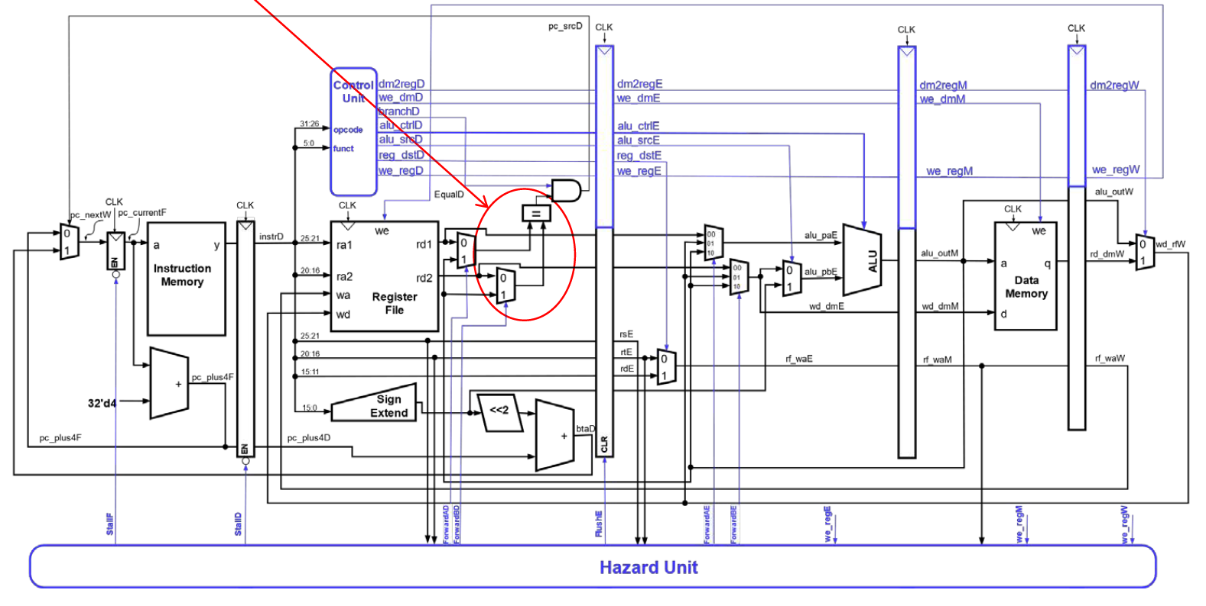
Early Branch Determination
Forwarding logic for early branch determination
ForwardAD = branchD and we_regM and (rsD ≠ 0) and (rf_waM == rsD)
ForwardBD = branchD and we_regM and (rtD ≠ 0) and (rf_waM == rtD)

Slide 40
Early Branch Determination
Stalling logic for early branch determination
branchstall =
branchD and we_regE and ((rf_waE == rsD) or (rf_waE == rtD))
or
branchD and dm2regM and ((rf_waM == rsD) or (rf_waM == rtD))
StallF = StallD = FlushE = lwstall OR branchstall

Slide 41
Branch Delay Slot
 | CC1 | CC2 | CC3 | CC4 | CC5 | CC6 | CC7 | CC8 | CC9 | CC10
BEQ | IF | ID | EXE | MEM | WB
ADD |  | IF | ID | EXE | MEM | WB
SUB |  |  | IF | ID | EXE | MEM | WB
OR |  |  |  | IF | ID | EXE | MEM | WB
BNE |  |  |  |  | IF | ID | EXE | MEM | WB
AND |  |  |  |  |  | IF
ADD |  |  |  |  |  |  | IF | ID | EXE | MEM
SUB |  |  |  |  |  |  |  | IF | ID | EXE
Actual Branch Outcome
Find an instruction that
1) has to be executed regardless branch outcome
2) independent to branch
BEQ $a0,$a1,L1 (NT)
L2: ADD $s1,$t1,$t2
SUB $t3,$t0,$s0
OR $s0,$t6,$t7
BNE $a0,$s1,L2 (T)
L1: AND $t3,$t6,$t7
SW $t5,0($s1)
LW $s2,0($s5)
T!
Flush
The instruction will be placed in the branch delay slot (right after branch instruction) instead of fetching wrong instruction and flushing
nop
nop
nop
nop
Instruction in the
target address (L2)

Slide 42
Branch Delay Slot
 | CC1 | CC2 | CC3 | CC4 | CC5 | CC6 | CC7 | CC8 | CC9 | CC10
BEQ | IF | ID | EXE | MEM | WB
ADD |  | IF | ID | EXE | MEM | WB
SUB |  |  | IF | ID | EXE | MEM | WB
BNE |  |  |  | IF | ID | EXE | MEM | WB
OR |  |  |  |  | IF | ID | EXE | MEM | WB
ADD |  |  |  |  |  | IF | ID | EXE | MEM | WB
SUB |  |  |  |  |  |  | IF | ID | EXE | MEM
Actual Branch Outcome
No Flush
& Better Performance
BEQ $a0,$a1,L1 (NT)
L2: ADD $s1,$t1,$t2
SUB $t3,$t0,$s0
BNE $a0,$s1,L2 (T)
OR $s0,$t6,$t7
L1: AND $t3,$t6,$t7
SW $t5,0($s1)
LW $s2,0($s5)
Instruction in the
target address (L2)

Slide 43
Branch Delay Slot
Require implementation on both the CPU and the compiler
If no suitable instruction can be found for the slot, then a NOP will be filled
Branch delay slot is more beneficial for unconditional branches such as j, jal, jr because they are always taken
For example, if jal uses branch delay slot,
After jal, $ra is updated with PC + 8
The instruction in PC + 4 is executed after jal before entering the subfunction
Does branch delay slot make branch prediction useless?

Slide 44
Conclusion Time
What is the use of ForwardAE and ForwardBE Muxes?
Selecting ALU input from different stages
How many cycles can be saved from data forwarding?
1 or 2

Slide 45


