Slide 1
Lecture 3. Processor Microarchitecture and Design (5)
CMPE 200 Computer Architecture & Design
Haonan Wang

Slide 2
Dynamic Branch Prediction
Monitor the branch patterns for better prediction
i.e. loops usually have a few iterations, so the branch in the loop is likely to be not taken at least for a few times
Branch Prediction Buffer (branch history buffer) is used to maintain each branch’s outcome history
Small storage space indexed with certain bits of branch instruction’s PC value
Each entry maintains the previous outcome of each branch
Once the branch outcome is available, the corresponding entry is updated

Slide 3
Branch Prediction Buffer
Aliasing issue
Different branch instructions may map to the same branch prediction buffer entry if their PC values have the same LSBs, affecting each others’ predictions
E.g., 0x8004 and 0x8104 will access the same entry if [3:2] bits are used for indexing
Inevitable but can be alleviated with larger buffer
Branch Prediction Buffer
Branch instruction’s PC value (i.e. 0x8004)
 | prediction bit
0 | 1
1 | 0
2 | 1
3 | 1
1: Predict Taken
0: Predict Not Taken
1000 0000 0000 0100
[3:2] bits
The bits to be included to the prediction
may be different depending on the prediction buffer size
Prediction bit field can have multiple bits to record more history
→ PC can be recorded to predict Taken

Slide 4


1-bit Predictor
Each entry of branch prediction buffer is 1-bit (1: Taken, 0: Not Taken)
The entry value is the latest outcome of the branch
Next outcome of the branch is predicted based on current value
Example: Assume that the actual outcomes of the branches at 0xDC04, 0xDC08, and 0xDC20 are untaken, taken, and untaken, respectively
0xDC04 for(i=0;i<10000;i++)
{
0xDC08 if( ( i % 100) == 0 )
tick( );
0xDC20 if( (i % 2) == 0)
even();
}
prediction bit
0
1
0
..
predicted NT
Actual result: NT
0
predicted T
Actual result: NT
1
predicted NT
Actual result: T

Slide 5
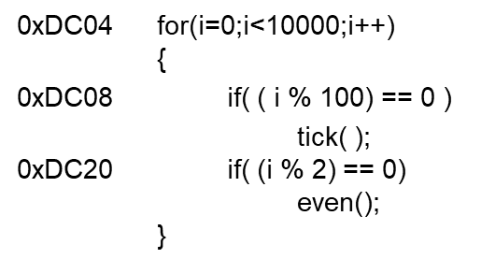
Is 1 bit Enough?
Taken to exit the loop
Not taken and continue to the loop body
NT
TN
DC04: NNNNNNN ... NNNNNNNNNNT
NNNNNNNNN …
10,000 iterations
10,000 iterations …
Mis-predictions for every
first and last iterations
→ 99.998% Correct Prediction
Mis-predictions: 2 / 10,000
DC08: TTTTT ... TNTTTTT … TNTTTTT …
98.0% Correct Prediction
Mis-predictions: 2 / 100
DC20: TNTNTNTNTNTNTNTNTNTNTNTNTNTNT …
0.0% Correct Prediction
Mis-predictions: 2 / 2

Slide 6
Using 2-bit History
2-bit Saturating Counter in each branch prediction buffer entry
Could have more than two bits but two bits cover most patterns (i.e. loops)
Predict NT
Predict T
Transition on T outcome
11
10
Transition on NT outcome
0
1
00
01
FSM for 1-bit
Prediction
FSM for 2-bit
Saturating Counter

Slide 7
Example
Initial Training/Warm-up
1-bit
Predictor
0
1
1
1
1
…
1
1
0
1
1
…
T
T
T
T
T
T
N
T
T
T
✗
✓
✓
✓
✓
✓
✗
✗
✓
✓
2-bit
Predictor
0
1
2
3
3
…
3
3
2
3
3
…
T
T
T
T
T
T
N
T
T
T
✗
✗
✓
✓
✓
✓
✗
✓
✓
✓
Only 1 Misprediction per N branches now!
Correct prediction rates:
DC04: 99.999% , DC08: 99.0%, DC20: 50%

Slide 8
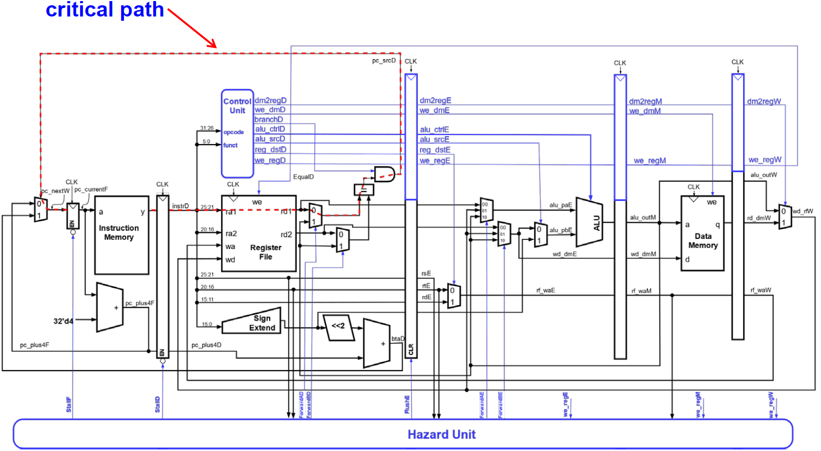
Pipelined CPU Performance Analysis
Function Unit | Parameter | Delay (ps)
Register clock-to-Q | T_{pcq} | 30
Clock setup time | T_{setup} | 20
MUX | T_{MUX} | 25
Sign-extend | T_{s_ext} | 25
ALU | T_{ALU} | 200
Mem read | T_{mem} | 250
AND | T_{AND} | 15
EQ | T_{eq} | 40
Register file read | T_{RFread} | 150
Register file write | T_{RFwrite} | 20
RF write and read need to be finished in the first and second half of each cycle, respectively
Critical path = max {
T_{pcq} + T_{i-mem} + T_{setup},
2 ( T_{RFread} + T_{mux} + T_{eq} + T_{AND} + T_{mux} + T_{setup} ),
T_{pcq} + T_{mux} + T_{mux} + T_{ALU} + T_{setup},
T_{pcq} + T_{memread} + T_{setup},
2 ( T_{pcq} + T_{mux} + T_{RFwrite} )
}

Slide 9
Pipelined CPU Performance Analysis
Function Unit | Parameter | Delay (ps)
Register clock-to-Q | T_{pcq} | 30
Clock setup time | T_{setup} | 20
MUX | T_{MUX} | 25
Sign-extend | T_{s_ext} | 25
ALU | T_{ALU} | 200
Mem read | T_{mem} | 250
AND | T_{AND} | 15
EQ | T_{eq} | 40
Register file read | T_{RFread} | 150
Register file write | T_{RFwrite} | 20
Critical path = 2 ( T_{RFread} + T_{mux} + T_{eq} + T_{AND} + T_{mux} + T_{setup} )
= 2 ( 150 + 25 + 40 + 15 + 25 + 20 ) = 550 ps

Slide 10
Pipelined CPU Performance Analysis
SPECINT2000 benchmark:
25% loads, 10% stores, 11% branches, 2% jumps, 52% R-type
Assume:
40% of loads used by next instruction
25% of branches mispredicted
All jumps flush next instruction
Average CPI calculation:
Load/Branch CPI = 1 when no stalling, 2 when stalling
CPI_{lw} = 1(0.6) + 2(0.4) = 1.4
CPI_{beq} = 1(0.75) + 2(0.25) = 1.25
Overall average CPI = (0.25 x 1.4) + (0.1 x 1) + (0.11 x 1.25) + (0.02 x 2) + (0.52 x 1) = 1.15

Slide 11
Pipelined CPU Performance Analysis
For a program with 100 billion instructions executing on the pipelined MIPS processor under discussion, execution time is
CPU time = # instructions x CPI x cycle time
= (100 x 10⁹) x 1.15 x (550 x 10⁻¹² sec)
= 63 seconds
Recall: when we ran the same code on a single-cycle processor (Lecture 4 – (3)), CPU time was 92.5 seconds.
Speedup of pipelined architecture = 92.5 / 63 = 1.47x

Slide 12
Question
Suppose we are writing code for a machine with unknown branch predictor. We found that certain loops containing branch instructions have long execution times. What can we do?
Swap the branches

Slide 13


