Slide 1
Lecture 4. Memory Hierarchy (1)
CMPE 200 Computer Architecture & Design
Haonan Wang

Slide 2
Computer Architecture Overview
Software/Applications
Operating System
Compiler
Firmware
Instruction Set
Architecture
Processor
Registers
Cache
Memory
Memory Hierarchy
HDD/SSD

Slide 3
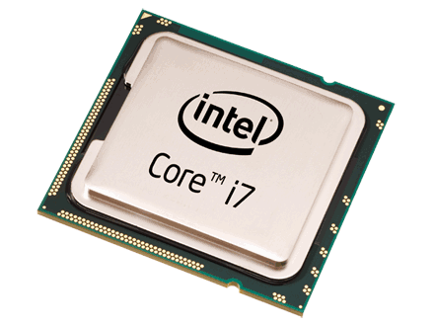
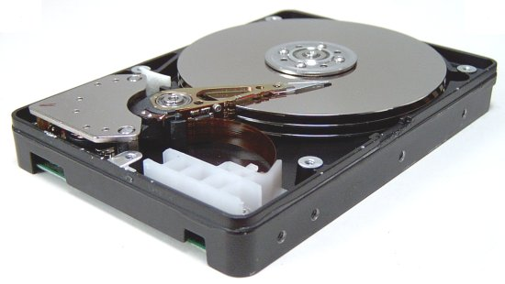
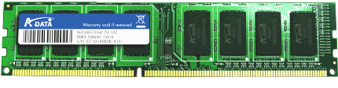
Memory Hierarchy
Example: a C program that reads
two integer values from “file.txt” file
and prints the sum of them.
Processor
(CPU)
Understands and executes each line of the code.
Uses fast on-chip memories
Memory
(DRAM)
Provides operands to CPU
(*fp, size, sum, numbers[2])
Storage
(HDD)
Provides file inputs and program code
(file.txt)
#include <stdio.h>
#include <string.h>
int numbers[2];
void myfunction(void)
{
FILE *fp;
int size = 2;
int sum = 0;
/* Open file for reading */
fp = fopen(“mynumbers.txt", “r");
/* Read and display data */
fread(numbers, sizeof(int), size, fp);
fclose(fp);
sum = numbers[0] + numbers[1];
printf(“Sum = %d\n”, sum);
}
int main (void) {
myfunction();
return(0);
}

Slide 4
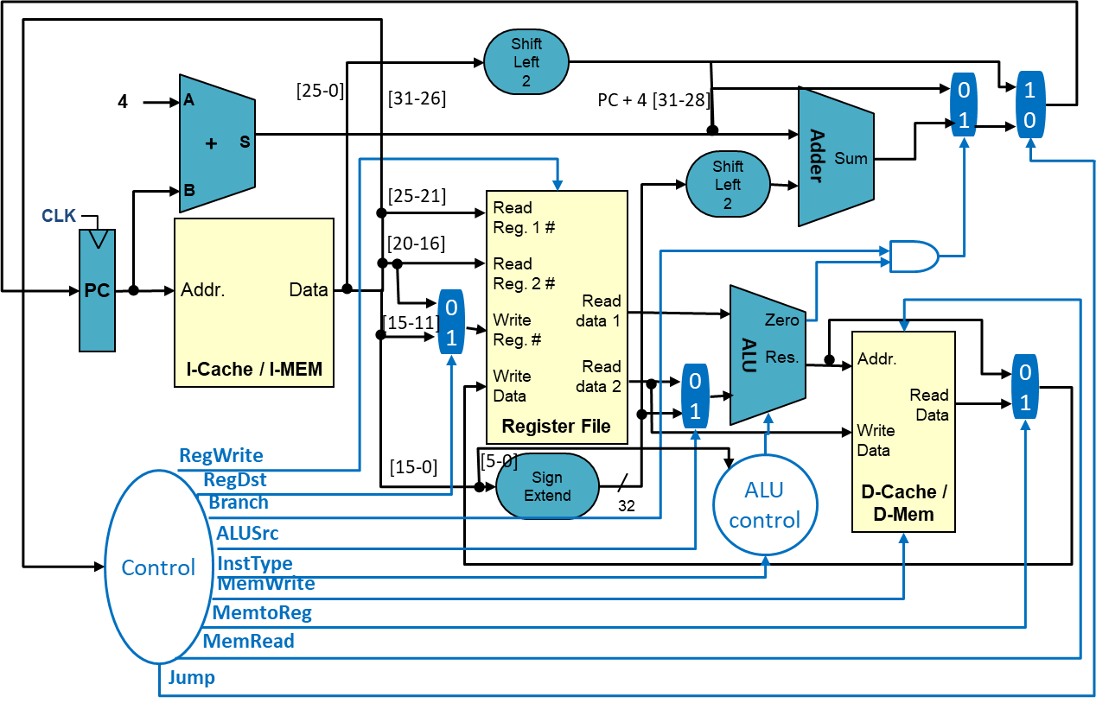
Memory Hierarchy
On-chip Memories (Memories inside of CPU)
Register file, Caches
Small but Fast
CPU
Instruction
Cache
Data
Cache
Register File

Slide 5
Memory Hierarchy
Off-chip Memories (Memories outside CPU)
System Memory, Storage
Large but Slow
CPU
System Memory
Storage

Slide 6
Memory Hierarchy
Hardware managed
1 block = multiple words
Software managed
1 register = 1 word
Access
Speed
Price/unit
Processor
Fast
Expensive
Registers
On-chip:
Subset of memory
0.5ns ~ 2.5ns
$2000 ~ $5000 per GB
Cache
Volatile Memory
50ns ~ 200ns
$20 ~ $75 per GB
Memory
Off-chip:
full memory
5ms ~ 20ms
$0.2 ~ $2 per GB
HDD/SSD
Non-volatile Memory
(NVM)
Slow
Cheap

Slide 7
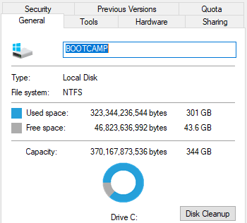
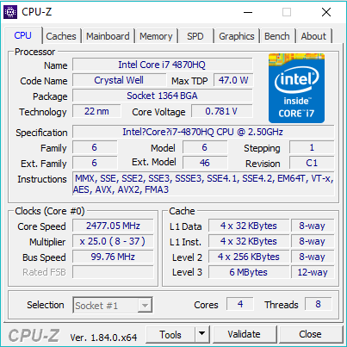
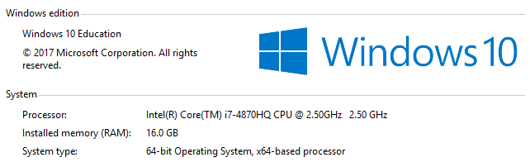
Memories in Your PC
Windows
This PC → Properties
cmd window → wmic
3rd party tool like CPU-Z
Linux
lscpu
cat /proc/cpuinfo
etc.
Storage
Caches
System Memory

Slide 8
Discussion
How would you design the memory system?
Single piece of memory that does everything
Vs.
Multiple levels of memories
Why should we use this hierarchy design?

Slide 9
Why?
Two Types of Locality:
Temporal Locality (Locality in Time): If an address is referenced, it tends to be referenced again (e.g., loops, variable reuse)
Spatial Locality (Locality in Space): If an address is referenced, neighboring addresses tend to be referenced (e.g., array, stack, etc.)
On-chip
Off-chip

Slide 10
The “Memory Wall”
CPU ~55%/year
(2X/1.5yr)
“Moore’s Law”
Processor-Memory
Performance Gap (grows 50%/year)
DRAM
7%/year
(2X/10yrs)

Slide 11
The Memory Hierarchy Goal
How do we create a memory system that gives the illusion of being large, cheap and fast (most of the time)?
With hierarchy
try the fast parts first -- most of the time, this works well
if not, move the data so it works well the next time
With parallelism
use multiple identical parts operating simultaneously
for large quantities of data, this works well
Example – keep a subset of the data in fast memory
Example – 1-byte-wide memory ➔ 4 × 1-byte-wide memory ➔ 4-byte-wide memory
load word takes 4 memory cycles vs. 1 memory cycle

Slide 12
Let us Conclude
What is cache?
Fast memory
What are the two types of data localities?
Temporal & Spatial
What are the two memory design directions inspired by the principle of locality?
Hierarchy & parallelism

Slide 13


