Slide 1
Lecture 4. Memory Hierarchy (5)
CMPE 200 Computer Architecture & Design
Haonan Wang

Slide 2
DRAM Subsystem Organization
Dram: Dynamic RAM
DRAM Organization:
Channel
DIMM
Rank
Chip
Bank
Row/Column
Connected to an on-die memory controller

Slide 3
DRAM Cells
wordline
(row enable)
row
bitline
bitline
bitline
column
column
column
A DRAM cell consists of a capacitor and an access transistor
It stores data in terms of charge in the capacitor
Cheaper and larger than SRAM
A DRAM chip consists of (10s of 1000s of) rows of such cells

Slide 4
DRAM Refresh
DRAM capacitor charge leaks over time
The memory controller needs to refresh each row periodically to restore charge
Dynamic (i.e., never in a stable state)
Activate each row every N ms (e.g., typical N = 64)
Downsides of refresh
Energy consumption: Each refresh consumes energy
Performance degradation: DRAM rank/bank unavailable while refreshed
QoS/predictability impact: (Long) pause times during refresh
Refresh rate limits DRAM capacity scaling

Slide 5
Recall: SRAM Cache Design
bit (data) lines
Each row holds a data block
Column address selects the requested word from block
r
o
w
d
e
c
o
d
e
r
word (row)
select line
SRAM Cell
Array
Each intersection represents a
6-T SRAM cell
Column Selector &
I/O Circuits
column
address
row
address
4-bit data word

Slide 6
DRAM Design 1: The Classical
bit (data) lines
Each intersection represents a 1-T DRAM cell
. . .
DRAM Bank
r
o
w
d
e
c
o
d
e
r
word (row) select line
DRAM Cell Array
m planes
column
Address
(CAS)
Column Selector &
I/O Circuits
row
Address
(RAS)
The column address selects the requested bit from the row in each plane
. . .
data bit
data bit
data bit
data word

Slide 7
DRAM Performance Metrics
DRAM addresses are divided into 2 halves (row and column)
RAS or Row Access Strobe that triggers the row decoder
CAS or Column Access Strobe that triggers the column selector
Latency: Time to access one word
Access Time: time taken when word is read or written
read access and write access times can be different
Cycle Time: time between successive (read or write) requests
Bandwidth: How much data can be supplied per unit time
Width of the data channel * channel usage frequency

Slide 8
DRAM Design 1: The Classical
DRAM Organization:
N rows x N column x M-bit (planes)
Reads or Writes M-bit at a time
Each M-bit access requires a RAS / CAS cycle
Cycle Time
Access Time
1st M-bit
2nd M-bit
RAS
CAS
Row Address
Col Address
Row Address
Col Address

Slide 9
DRAM Design 1: The Classical
Page Mode: A row is kept “open” by keeping the RAS asserted
Pulse CAS to access other M-bit blocks on that row
Successive reads or writes within the row are faster since don’t have to precharge and (re)access that row
Cycle Time
1st M-bit
2nd M-bit
3rd M-bit
4th M-bit
RAS
CAS
Row Address
Col Address
Col Address
Col Address
Col Address

Slide 10
DRAM Design 2: Synchronous DRAMs
Like page mode DRAMs, synchronous DRAMs (SDRAMs) can transfer a burst of data from a series of sequential addresses in the same row
For words in the same burst, don’t have to provide the complete (row and column) addresses
The entire row is loaded into a row buffer (SRAM).
Specify the starting (row+column) address and the burst length (burst must be in the same row).
Data words in the burst are then accessed from that SRAM under control of a clock signal.

Slide 11
Synchronous DRAM (SDRAM) Operation
After RAS loads a row into the SRAM cache
Input CAS as the starting “burst” address along with a burst length to read a burst of data from a series of sequential addresses within that row on the clock edge
clock
RAS
CAS
Row Address
Col Address
1st
M-bit
2nd
M-bit
3rd
M-bit
…
http://en.wikipedia.org/wiki/DDR_SDRAM

Slide 12
DDR (Double Data Rate) SDRAMs
Transfers burst data on both the rising and falling edge of the clock (so twice fast)
2n core prefectch
clock
RAS
CAS
Row Address
Col Address
Row Address
1st
M-bit
2nd
M-bit
3rd
M-bit
4th
M-bit
http://en.wikipedia.org/wiki/DDR_SDRAM

Slide 13
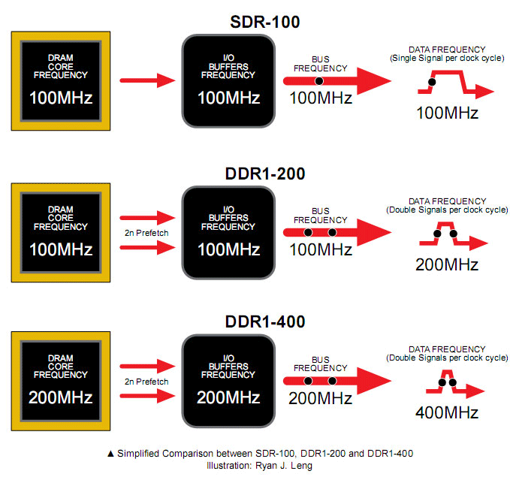
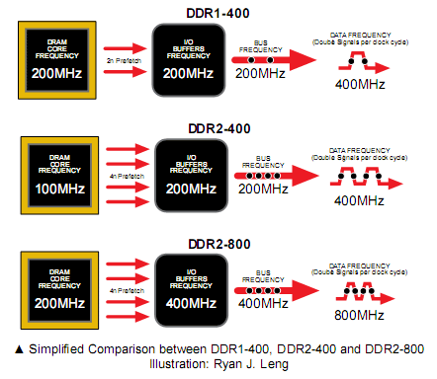
DDR (Double Data Rate) SDRAMs
DDR1 VS DDR1+:
DDR2 vs. QDR

Slide 14
DRAM Subsystem Organization
Dram: Dynamic RAM
DRAM Organization:
Chip:
Consists of multiple banks (2-16 in Synchronous DRAM)
Banks works in parallel to overlap delay
Banks share command/address/data buses
The chip itself has a narrow interface (4-16 bits per read)
Channel
DIMM
Rank
Chip
Bank
Row/Column

Slide 15
DRAM Subsystem Organization
Dram: Dynamic RAM
DRAM Organization:
Rank:
Multiple chips operated together to form a wide interface
All chips comprising a rank are controlled at the same time
Respond to a single command
Share address and command buses, but provide different data
E.g., Using 8 chips with 8-bit interface to form a 64-bit wide Rank
Channel
DIMM
Rank
Chip
Bank
Row/Column

Slide 16
DRAM Subsystem Organization
Dram: Dynamic RAM
DRAM Organization:
DIMM (dual inline memory module):
A DRAM module consists of one or more ranks
This is what you plug into your motherboard
Channel
DIMM
Rank
Chip
Bank
Row/Column

Slide 17
DIMM (Dual Inline Memory Module)
Contains DRAM chips each have data widths of x4 or x8
Can be on both sides
Can have more than one rank
Increase storage capacity
Only one rank accessible at a time
SIMM vs DIMM
DIMM has separate contacts on each side of the board to provides twice as much data rate.

Slide 18
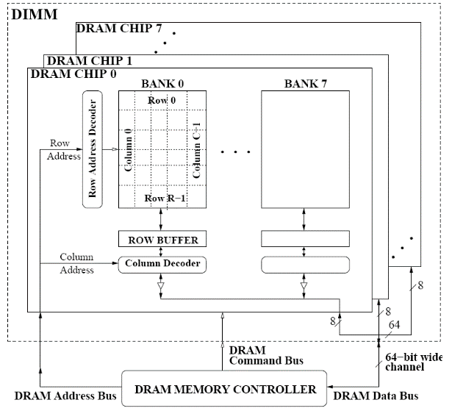
A 64-bit Wide DIMM (One Rank)
Advantages:
Acts like a high-capacity DRAM chip with a wide interface
Flexibility: memory controller does not need to deal with individual chips
Disadvantages:
Granularity: Accesses cannot be smaller than the interface width

Slide 19
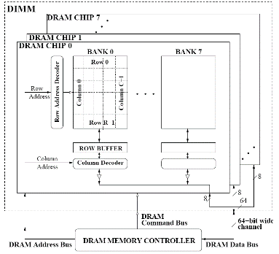
DRAM Subsystem Organization
Dram: Dynamic RAM
DRAM Organization:
Channel: Independent memory subsystem
E.g., 2 independent Channels:
Channel
DIMM
Rank
Chip
Bank
Row/Column

Slide 20

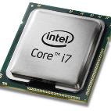
The DRAM subsystem
“Channel”
DIMM (Dual in-line memory module)
Processor
Memory channel
Memory channel
Each channel is connected to its own on-die memory controller

Slide 21
Row Operations & Row Buffer Locality
Access Address: Row Operation:
Columns
(Row 0, Column 0)
Activation
RBL=2
(Row 0, Column 1)
No operation
RBL=1
(Row 1, Column 0)
Restore, Precharge, Activation
Row address 0
Row address 1
Row decoder
R1
R0
R0
Rows
Row Buffer
CONFLICT !
Row 1
HIT
Row 0
Empty
Column address 0
Column mux
Column address 0
Column address 1
Improving Row Buffer Locality (RBL) is the key to improve DRAM efficiency
Data
Credit: Onur Mutlu.

Slide 22
RBL & Memory Scheduling Schemes
Visible to the memory scheduler
In-order scheduling
(FIFO):
Activation Counter:
R1: Activation = 1
R5: Activation = 2
R1: Activation = 3
R5: Activation = 4
R5: Activation = 4
Avg RBL = 5 / 4 = 1.25
future
requests
requests currently
in the pending queue
oldest
request
Same
activation
Request Stream
……
……
R4
R3
R2
R5
R5
R1
R5
R1
Out-of-order scheduling
(FR-FCFS):
Activation Counter:
R1: Activation = 1
R1: Activation = 1
R5: Activation = 2
R5: Activation = 2
R5: Activation = 2
Avg RBL = 5 / 2 = 2.5
future
requests
requests currently
in the pending queue
Same
activation
oldest
request
Same
activation
Request Stream
……
……
R4
R3
R2
R5
R5
R1
R5
R1

Slide 23
DRAM Milestones
 | DRAM | Page DRAM | Page DRAM | Page DRAM | SDRAM | DDR SDRAM
Module Width | 16b | 16b | 32b | 64b | 64b | 64b
Year | 1980 | 1983 | 1986 | 1993 | 1997 | 2000
Mb/chip | 0.06 | 0.25 | 1 | 16 | 64 | 256
Die size (mm²) | 35 | 45 | 70 | 130 | 170 | 204
Pins/chip | 16 | 16 | 18 | 20 | 54 | 66
BWidth (MB/s) | 13 | 40 | 160 | 267 | 640 | 1600
Latency (nsec) | 225 | 170 | 125 | 75 | 62 | 52
In the time that the memory to processor bandwidth has more than doubled the memory latency has improved by a factor of only 1.2 to 1.4
Patterson, CACM Vol 47, #10, 2004

Slide 24
Review: DRAM vs. SRAM
DRAM
Slower access (capacitor)
Higher density (1T 1C cell)
Lower cost
Requires refresh (power, performance, circuitry)
Manufacturing requires putting capacitor and logic together
SRAM
Faster access (no capacitor)
Lower density (6T cell)
Higher cost
No need for refresh
Manufacturing compatible with logic process (no capacitor)

Slide 25
Conclusion Time
What are the levels in the DRAM organization?
Channel, DIMM, Rank, Chip, Bank, Row, Column
What is the idea behind having multiple memory banks?
Hiding latency
What is row buffer?
Cache for DRAM rows

Slide 26


