Slide 1
Lecture 4. Memory Hierarchy
CMPE 200 Computer Architecture & Design
Haonan Wang

Slide 2
Computer Architecture Overview
Software/Applications
Operating System
Compiler
Firmware
Instruction Set
Architecture
Processor
Registers
Cache
Memory
Memory Hierarchy
HDD/SSD

Slide 3
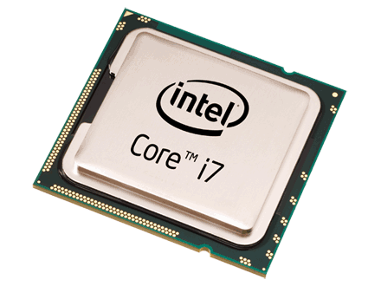
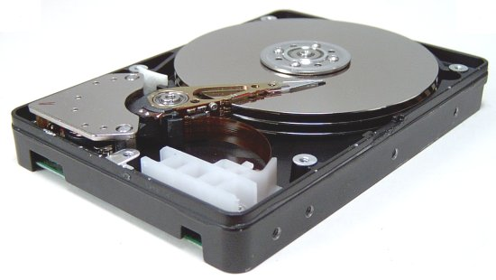
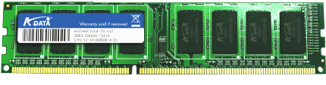
Memory Hierarchy
Example: a C program that reads
two integer values from “file.txt” file
and prints the sum of them.
Processor
(CPU)
Understands and executes each line of the code.
Uses fast on-chip memories
Memory
(DRAM)
Provides operands to CPU
(*fp, size, sum, numbers[2])
Storage
(HDD)
Provides file inputs and program code
(file.txt)
#include <stdio.h>
#include <string.h>
int numbers[2];
void myfunction(void)
{
FILE *fp;
int size = 2;
int sum = 0;
/* Open file for reading */
fp = fopen(“mynumbers.txt", “r");
/* Read and display data */
fread(numbers, sizeof(int), size, fp);
fclose(fp);
sum = numbers[0] + numbers[1];
printf(“Sum = %d\n”, sum);
}
int main (void) {
myfunction();
return(0);
}

Slide 4
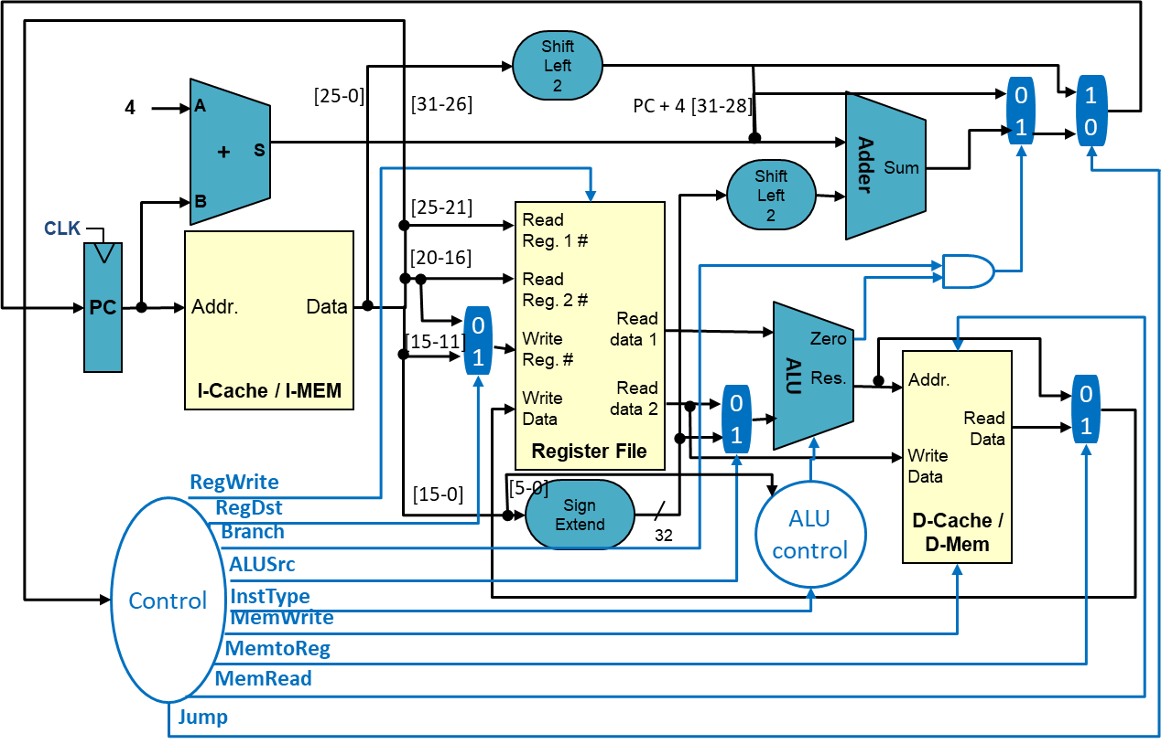
Memory Hierarchy
On-chip Memories (Memories inside of CPU)
Register file, Caches
Small but Fast
CPU
Instruction
Cache
Data
Cache
Register File

Slide 5
Memory Hierarchy
Off-chip Memories (Memories outside CPU)
System Memory, Storage
Large but Slow
CPU
System Memory
Storage

Slide 6
Memory Hierarchy
Hardware managed
1 block = multiple words
Software managed
1 register = 1 word
Access
Speed
Price/unit
Processor
Fast
Expensive
Registers
On-chip:
Subset of memory
0.5ns ~ 2.5ns
$2000 ~ $5000 per GB
Cache
Volatile Memory
50ns ~ 200ns
$20 ~ $75 per GB
Memory
Off-chip:
full memory
5ms ~ 20ms
$0.2 ~ $2 per GB
HDD/SSD
Non-volatile Memory
(NVM)
Slow
Cheap

Slide 7
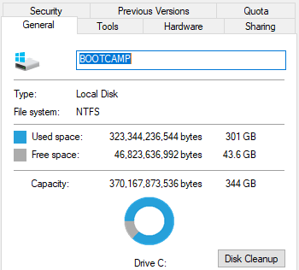
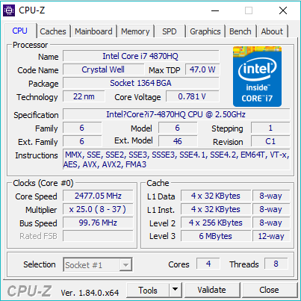
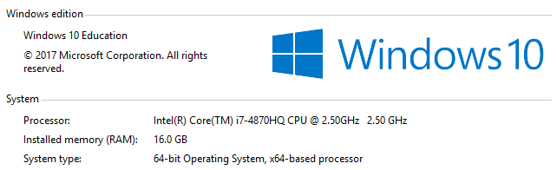
Memories in Your PC
Windows
This PC → Properties
cmd window → wmic
3rd party tool like CPU-Z
Linux
lscpu
cat /proc/cpuinfo
etc.
Storage
Caches
System Memory

Slide 8
Why?
Two Types of Locality:
Temporal Locality (Locality in Time): If an address is referenced, it tends to be referenced again (e.g., loops, variable reuse)
Spatial Locality (Locality in Space): If an address is referenced, neighboring addresses tend to be referenced (e.g., array, stack, etc.)
On-chip
Off-chip

Slide 9
The “Memory Wall”
CPU ~55%/year
(2X/1.5yr)
“Moore’s Law”
Processor-Memory
Performance Gap (grows 50%/year)
DRAM
7%/year
(2X/10yrs)

Slide 10
The Memory Hierarchy Goal
How do we create a memory system that gives the illusion of being large, cheap and fast (most of the time)?
With hierarchy
try the fast parts first -- most of the time, this works well
if not, move the data so it works well the next time
With parallelism
use multiple identical parts operating simultaneously
for large quantities of data, this works well
Example – keep a subset of the data in fast memory
Example – 1-byte-wide memory ➔ 4 × 1-byte-wide memory ➔ 4-byte-wide memory
load word takes 4 memory cycles vs. 1 memory cycle

Slide 11
Cache Design
Caches use SRAM for speed and technology compatibility
Low density (6 transistor cells), high power, expensive, fast
Static: content will last “forever” (until power turned off)
Example: A (2M X 16 bit) SRAM logic
21
Address
Chip select
SRAM
2M x 16
16
Output enable
Dout[15-0]
Write enable
Din[15-0]
16

Slide 12
SRAM Cache Design
bit (data) lines
Each row holds a data block
Column address selects the requested word from block
r
o
w
d
e
c
o
d
e
r
word (row)
select line
SRAM Cell
Array
Each intersection represents a
6-T SRAM cell
Column Selector &
I/O Circuits
column
address
row
address
4-bit data word

Slide 13
Cache Hit and Miss
Hit: Data appears in some block of the cache
Hit Rate: # hits / total accesses on the cache
Hit Time: Time to access the cache
Miss: Data needs to be retrieved from the lower level (and stored in cache)
Miss Rate: 1 - (Hit Rate)
Miss Penalty: Average delay in the processor caused by each miss
Miss
Lower Level Memory
(cache/main memory)
Cache
Can’t find!
read
read
From Processor
data block X
data block Y
Hit
Hit
To Processor

Slide 14
Principle of Locality
Temporal Locality: If an address is referenced, it tends to be referenced again
Spatial Locality: If an address is referenced, neighboring addresses tend to be referenced
How to create a memory system that gives the illusion of being large, cheap and fast?
With hierarchy
With parallelism
On-chip
Off-chip

Slide 15
SRAM Cache Design
bit (data) lines
Each row holds a data block
Column address selects the requested word from block
r
o
w
d
e
c
o
d
e
r
word (row)
select line
SRAM Cell
Array
Each intersection represents a
6-T SRAM cell
Column Selector &
I/O Circuits
column
address
row
address
4-bit data word

Slide 16
Cache Hit and Miss
Hit: Data appears in some block of the cache
Hit Rate: # hits / total accesses on the cache
Hit Time: Time to access the cache
Miss: Data needs to be retrieved from the lower level (and stored in cache)
Miss Rate: 1 - (Hit Rate)
Miss Penalty: Average delay in the processor caused by each miss
Miss
Lower Level Memory
(cache/main memory)
Cache
Can’t find!
read
read
From Processor
data block X
data block Y
Hit
Hit
To Processor

Slide 17
Memory Hierarchy Performance
1 cycle
300 cycles
First-level
Cache
Hit Time
Miss penalty
Main
Memory
(DRAM)
Average Memory Access Time (AMAT)
= Hit Time + Miss rate x Miss Penalty
Example:
Cache Hit = 1 cycle
Miss rate = 10% = 0.1
Miss penalty = 300 cycles
AMAT = T_{hit}(L1) + Miss_rate(L1) x T(Memory) = 1 + 0.1 x 300 = 31 cycles
Due to long-latency memory, AMAT is 30 cycles longer than cache latency.
Can we reduce the overhead?

Slide 18
Reducing Penalty: Multi-Level Cache
1 cycle
10 cycles
Second
Level
Cache
20 cycles
300 cycles
First-level
Cache
Third
Level
Cache
Hit Time
Main
Memory
(DRAM)
L1
L2
On Processor Die
L3
Off-Chip

Slide 19
Reducing Penalty: Multi-Level Cache
1 cycle
10 cycles
Second
Level
Cache
20 cycles
300 cycles
First-level
Cache
Third
Level
Cache
Hit Time
Main
Memory
(DRAM)
L1
L2
On Processor Die
L3
AMAT in multi-level cache organization
= T_{hit}(L1) + Miss_rate(L1) x Miss_penalty(L1)
Off-Chip

Slide 20
Reducing Penalty: Multi-Level Cache
1 cycle
10 cycles
Second
Level
Cache
20 cycles
300 cycles
First-level
Cache
Third
Level
Cache
Hit Time
Main
Memory
(DRAM)
L1
L2
On Processor Die
L3
AMAT in multi-level cache organization
= T_{hit}(L1) + Miss_rate(L1) x
[ T_{hit}(L2) + Miss_rate(L2) x Miss_penalty(L2) ]
Off-Chip

Slide 21
Reducing Penalty: Multi-Level Cache
1 cycle
10 cycles
Second
Level
Cache
20 cycles
300 cycles
First-level
Cache
Third
Level
Cache
Hit Time
Main
Memory
(DRAM)
L1
L2
On Processor Die
L3
AMAT in multi-level cache organization
= T_{hit}(L1) + Miss_rate(L1) x
[ T_{hit}(L2) + Miss_rate(L2) x
{ T_{hit}(L3) + Miss_rate(L3) x Miss_penalty(L3) } ]
Off-Chip

Slide 22
Reducing Penalty: Multi-Level Cache
1 cycle
10 cycles
Second
Level
Cache
20 cycles
300 cycles
First-level
Cache
Third
Level
Cache
Hit Time
Main
Memory
(DRAM)
L1
L2
On Processor Die
L3
AMAT in multi-level cache organization
= T_{hit}(L1) + Miss_rate(L1) x
[ T_{hit}(L2) + Miss_rate(L2) x
{ T_{hit}(L3) + Miss_rate(L3) x T(memory) } ]
Off-Chip

Slide 23
Reducing Penalty: Multi-Level Cache
1 cycle
10 cycles
Second
Level
Cache
20 cycles
300 cycles
First-level
Cache
Third
Level
Cache
Hit Time
Main
Memory
(DRAM)
L1
L2
On Processor Die
L3
AMAT in multi-level cache organization
= T_{hit}(L1) + Miss_rate(L1) x
[ T_{hit}(L2) + Miss_rate(L2) x
{ T_{hit}(L3) + Miss_rate(L3) x T(memory) } ]
Example:
Miss rate of L1, L2, L3 = 10%, 5%, 1%, respectively
AMAT = 1 + 0.1 x [ 10 + 0.05 x { 20 + 0.01 x 300 } ] = 2.115 cycles
Are more levels always good?
Off-Chip
Vs. 31 cycles
14.7x speedup!

Slide 24
What to Keep in Caches?
It depends on the cache organization and replacing policy
Cache organization:
Cache line (block): The basic unit of data replacement. A longer cache line fetches and replaces more data per miss.
Set: An entry that one cache line is mapped to according to certain bits of its address.
Way: A slot within a cache set to hold one history cache line.
Cache line replacing policy: which history line should be replaced?
In a set entry, each cache line can be identified with a Tag (a portion of its address).
Least recently used (LRU), First-in first-out (FIFO), Random, etc.

Slide 25
Cache Indexing
Example: a simple 2-set x 2-way cache
Way 0
Way 1
Set 0
block 0
block 2
Set 1
block 1
block 3
Address decoding:
Used for tag compare
Selects the set
Selects the word in the block
Tag
Index
Block offset
Byte offset

Slide 26
Cache Types
N-way Set-Associative: Number of ways > 1 & Number of sets > 1
Slightly complex searching mechanism
Direct Mapped: Number of ways = 1
Fast indexing mechanism
Fully-Associative: Number of sets = 1
Extensive hardware resources required to search
Way 0
Way 1
…
Set 0
block 0
block 2
Set 1
block 1
block 3
…
Used for tag compare
Selects the set
Selects the word in the block
Tag
Index
Block offset
Byte offset
Assuming fixed sized cache:
Increasing associativity
Decreasing associativity
Fully associative (only one set)
Direct mapped (only one way)

Slide 27
MIPS Direct Mapped Cache Example
32bit address from the PC (Instr Fetch) or ALU (load, store addr)
Byte offset
31 30 . . . 13 12 11 . . . 2 1 0
Hit
Tag
20
10
Data
Index
Index
Valid
Tag
Data
0
1
2
.
.
.
1021
1022
1023
20
32

Slide 28
Multiword Block Direct Mapped Cache
Byte offset
Hit
31 30 . . . 13 12 11 . . . 4 3 2 1 0
Data
Tag
20
8
Block offset
Index
Index
Valid
Tag
Data
0
1
2
.
.
.
253
254
255
20
32

Slide 29
Four-Way Set Associative Cache
31 30 . . . 11 10 9 . . . 2 1 0
Byte offset
Tag
22
8
Index
Index
V
Tag
Data
V
Tag
Data
V
Tag
Data
V
Tag
Data
0
1
2
.
.
.
253
254
255
0
1
2
.
.
.
253
254
255
0
1
2
.
.
.
253
254
255
0
1
2
.
.
.
253
254
255
32
4x1 select
Hit
Data

Slide 30
Costs of Set Associative Caches
Must have hardware to keep track of when each way’s block was used relative to the other blocks in the set (for replacement policy)
E.g., for 2-way set associative, takes one bit per set → set the bit when a block is referenced (and reset the other way’s bit)
N-way set associative cache costs
N comparators (delay and area)
MUX delay (set selection) before data is available
Data is available after set selection (and Hit/Miss decision). In a direct mapped cache, the cache block is available before the Hit/Miss decision
So its not possible to just assume a hit and continue and recover later if it was a miss
Total cache line size = valid field size + tag size + block data size + data for cache policy (e.g., time stamp, modified bit, etc.)

Slide 31
Cache Miss Classification: The 3 C’s
Compulsory (cold) Misses
On the 1st reference to a block
Related to # blocks accessed by a code, not related to the configuration of a cache
Capacity Misses
The program’s working set size exceeds the cache capacity
Conflict Misses
Multiple memory blocks map to the same set in set-associative caches

Slide 32
More Detailed Mapping Example
We have a cache that has following configuration
Consists of 8 cache blocks (lines)
A data word is 4-byte
A block is 32-byte (8 words per block)
Direct mapped
We load a word from 0x77FF1C68
cache blocks
0 | 1 | 2 | 3 | 4 | 5 | 6 | 7
1st step: Find data block no. that the word belongs to
Offset within a data word
0x77FF1C68 = 0111 0111 1111 1111 0001 1100 0110 1000
Block no.
Each data word’s offset
within a block
(2nd word in a block)

Slide 33
More Detailed Mapping Example
We have a cache that has following configuration
Consists of 8 cache blocks (lines)
A data word is 4-byte
A block is 32-byte (8 words per block)
Direct mapped
We load a word from 0x77FF1C68
cache blocks
0 | 1 | 2 | 3 | 4 | 5 | 6 | 7
2nd step: Map the block no. to cache block no.
Offset within a data word
0x77FF1C68 = 0111 0111 1111 1111 0001 1100 0110 1000
Block no.
Each data word’s offset
within a block
(2nd word in a block)
% 8 blocks
= cache block no. 3

Slide 34
More Detailed Mapping Example
We have a cache that has following configuration
Consists of 8 cache blocks (lines)
A data word is 4-byte
A block is 32-byte (8 words per block)
4-way Set-Associative
We load a word from 0x77FF1C68
cache blocks
cache blocks
0 |  |  |  | 1
0 | 1 | 2 | 3 | 4 | 5 | 6 | 7
set no.
1st step: Calculate how many sets exist
8 blocks / 4 entries per set = 2 sets

Slide 35
More Detailed Mapping Example
We have a cache that has following configuration
Consists of 8 cache blocks (lines)
A data word is 4-byte
A block is 32-byte (8 words per block)
4-way Set-Associative
We load a word from 0x77FF1C68
cache blocks
0 |  |  |  | 1
set no.
2nd step: Find data block no. that the word belongs to
Offset within a data word
0x77FF1C68 = 0111 0111 1111 1111 0001 1100 0110 1000
Block no.
Each data word’s offset
within a block
(2nd word in a block)

Slide 36
More Detailed Mapping Example
pick any available block within set 1
We have a cache that has following configuration
Consists of 8 cache blocks (lines)
A data word is 4-byte
A block is 32-byte (8 words per block)
4-way Set-Associative
We load a word from 0x77FF1C68
cache blocks
0 |  |  |  | 1
set no.
3rd step: Map the block no. to cache block no.
Offset within a data word
0x77FF1C68 = 0111 0111 1111 1111 0001 1100 0110 1000
Block no.
Each data word’s offset
within a block
(2nd word in a block)
% 2 sets
= cache block no. 1

Slide 37
More Detailed Mapping Example
pick any available block
We have a cache that has following configuration
Consists of 8 cache blocks (lines)
A data word is 4-byte
A block is 32-byte (8 words per block)
Fully-Associative
We load a word from 0x77FF1C68
cache blocks
0 | 1 | 2 | 3 | 4 | 5 | 6 | 7
1st and all step: Find any available cache block and map

Slide 38
Cache Replacement Policy
When loading a new block (on miss), if the cache is already full, which block should be replaced (in the set)?
Random: Replace a randomly chosen line
FIFO: Replace the oldest line
LRU (Least Recently Used): Replace the least recently used line
Many others: Round Robin, LIFO, MRU, etc..

Slide 39
LRU Example
Cache configuration:
Size: 4 blocks
Mapping: fully-associative
Replacement: LRU
Mem access sequence: (each character indicates a block address)
ABCDCDECG
Accesses |  | A | B | C | D | C | D | E | C | G
priority order (LRU) | 0 (MRU) | A
 | 1
 | 2
 | 3 (LRU)
cache miss |  | m

Slide 40
LRU Example
Cache configuration:
Size: 4 blocks
Mapping: fully-associative
Replacement: LRU
Mem access sequence: (each character indicates a block address)
ABCDCDECG
Accesses |  | A | B | C | D | C | D | E | C | G
priority order (LRU) | 0 (MRU) | A | B
 | 1 |  | A
 | 2
 | 3 (LRU)
cache miss |  | m | m

Slide 41
LRU Example
Cache configuration:
Size: 4 blocks
Mapping: fully-associative
Replacement: LRU
Mem access sequence: (each character indicates a block address)
ABCDCDECG
Accesses |  | A | B | C | D | C | D | E | C | G
priority order (LRU) | 0 (MRU) | A | B | C
 | 1 |  | A | B
 | 2 |  |  | A
 | 3 (LRU)
cache miss |  | m | m | m

Slide 42
LRU Example
Cache configuration:
Size: 4 blocks
Mapping: fully-associative
Replacement: LRU
Mem access sequence: (each character indicates a block address)
ABCDCDECG
Accesses |  | A | B | C | D | C | D | E | C | G
priority order (LRU) | 0 (MRU) | A | B | C | D
 | 1 |  | A | B | C
 | 2 |  |  | A | B
 | 3 (LRU) |  |  |  | A
cache miss |  | m | m | m | m

Slide 43
LRU Example
Cache configuration:
Size: 4 blocks
Mapping: fully-associative
Replacement: LRU
Mem access sequence: (each character indicates a block address)
ABCDCDECG
Accesses |  | A | B | C | D | C | D | E | C | G
priority order (LRU) | 0 (MRU) | A | B | C | D | C
 | 1 |  | A | B | C | D
 | 2 |  |  | A | B | B
 | 3 (LRU) |  |  |  | A | A
cache miss |  | m | m | m | m | h

Slide 44
LRU Example
Cache configuration:
Size: 4 blocks
Mapping: fully-associative
Replacement: LRU
Mem access sequence: (each character indicates a block address)
ABCDCDECG
Accesses |  | A | B | C | D | C | D | E | C | G
priority order (LRU) | 0 (MRU) | A | B | C | D | C | D
 | 1 |  | A | B | C | D | C
 | 2 |  |  | A | B | B | B
 | 3 (LRU) |  |  |  | A | A | A
cache miss |  | m | m | m | m | h | h
LRU to be replaced for E

Slide 45
LRU Example
Cache configuration:
Size: 4 blocks
Mapping: fully-associative
Replacement: LRU
Mem access sequence: (each character indicates a block address)
ABCDCDECG
Accesses |  | A | B | C | D | C | D | E | C | G
priority order (LRU) | 0 (MRU) | A | B | C | D | C | D | E
 | 1 |  | A | B | C | D | C | D
 | 2 |  |  | A | B | B | B | C
 | 3 (LRU) |  |  |  | A | A | A | B
cache miss |  | m | m | m | m | h | h | m

Slide 46
LRU Example
Cache configuration:
Size: 4 blocks
Mapping: fully-associative
Replacement: LRU
Mem access sequence: (each character indicates a block address)
ABCDCDECG
Accesses |  | A | B | C | D | C | D | E | C | G
priority order (LRU) | 0 (MRU) | A | B | C | D | C | D | E | C
 | 1 |  | A | B | C | D | C | D | E
 | 2 |  |  | A | B | B | B | C | D
 | 3 (LRU) |  |  |  | A | A | A | B | B
cache miss |  | m | m | m | m | h | h | m | h
LRU to be
replaced for G

Slide 47
LRU Example
Cache configuration:
Size: 4 blocks
Mapping: fully-associative
Replacement: LRU
Mem access sequence: (each character indicates a block address)
ABCDCDECG
Accesses |  | A | B | C | D | C | D | E | C | G
priority order (LRU) | 0 (MRU) | A | B | C | D | C | D | E | C | G
 | 1 |  | A | B | C | D | C | D | E | C
 | 2 |  |  | A | B | B | B | C | D | E
 | 3 (LRU) |  |  |  | A | A | A | B | B | D
cache miss |  | m | m | m | m | h | h | m | h | m

Slide 48
Cache Policies
Read policies:
Read Hit: this is what we want
Read Miss: replacement policy
Write policies (L1D only): consistency issues & performance tradeoffs
Write-through vs. write-back vs. write-evict (no-write)
also slightly different between write hit and write miss
Write Hit: write policy
Write Miss: write allocation policies (2 policies to categorize 3 write policies) + replacement policy

Slide 49
Cache Write Policy
Write-through: consistent with lower level
The value is written to both the cache line and the lower-level memory.
No need to write a full block
Write buffer can be used so cache does not need to wait for the write to lower level
stall only if the write buffer is full
Example: assume cache block containing word address A is initially in the cache
SW to A
A
A
A
A

Slide 50
Cache Write Policy
Write-through: consistent with lower level
The value is written to both the cache line and the lower-level memory.
No need to write a full block
Write buffer can be used so cache does not need to wait for the write to lower level
stall only if the write buffer is full
Example: assume cache block containing word address A is initially in the cache
A
A
A

Slide 51
Cache Write Policy
Write-back: inconsistent with lower level
The value is written only to the cache line. The modified (dirty) cache line is written to main memory only when it is evicted.
1 dirty bit is needed for each cache line.
A write-back buffer to update lower level with evicted dirty blocks
Must write a full block at this point since we do not know which word is modified
Example: assume cache block containing word address A is initially in the cache
dirty bit (A) = 0
SW to A
dirty bit (A) = 1
A
A
A
B

Slide 52
Cache Write Policy
Write-back: inconsistent with lower level
The value is written only to the cache line. The modified (dirty) cache line is written to main memory only when it is evicted.
1 dirty bit is needed for each cache line.
A write-back buffer to update lower level with evicted dirty blocks
Must write a full block at this point since we do not know which word is modified
Example: assume cache block containing word address A is initially in the cache
LW B
dirty bit (A) = 1
If A was not modified (dirty bit = 0) when replaced, A is not updated to lower mem.
A few cycles later...
A
A
B
L1 is full and A is selected to be replaced by B

Slide 53
Cache Write Policy
Write-evict (no-write/bypassing): no consistency issue
The value is written only to the lower level.
If the block containing the write address exists in the cache, evict it.
The write only need to send the data specified by the store instruction.
A write buffer can also be used to reduce the delay.

Slide 54
Cache Policies
Read policies:
Read Hit: this is what we want
Read Miss: replacement policy
Write policies: consistency issues & performance tradeoffs
Write-through vs. write-back vs. write-evict (no-write)
also slightly different between write hit and write miss
Write Hit: write policy
Write Miss: write allocation policy (+ replacement policy)
+ write policy of evicted data
+ write policy of evicted data

Slide 55
Cache Write Policy
Read miss:
Write-through: find victim block + fetch block from lower level
write-back: find victim block + write back evicted block if dirty + fetch block from lower level
No-write: find victim block + fetch block from lower level
Write miss: write allocation policies
Write-allocate:
Write-through: find victim block + fetch block from lower level + store value to block and lower level
write-back: find victim block + write back evicted block if dirty + fetch block from lower level + store value to block
No-write-allocate: bypass the cache, store value to lower level directly
Write hit and write miss can use different policies
e.g., write-hit write-evict + write-miss write-allocate-write-back

Slide 56
Reduce Miss Rate (1): Code Optimization
Misses occur if sequentially accessed array elements come from different cache blocks
Code optimizations → No hardware change
Rely on programmers or compilers
Examples:
Loop interchange: In nested loops, outer loop becomes inner loop and vice versa
Loop blocking: partition large array into smaller blocks, thus fitting the accessed array elements into cache size

Slide 57
Loop Interchange
Assume: cache line size = 5 words
What addresses are accessed in each iteration of inner loop?
five consecutive words belong to a cache line
j
i
each loop iteration accesses different cache line
/* Before */
for (j=0; j<5; j++)
for (i=0; i<5; i++)
x[i][j] = 2*x[i][j]
Column-major ordering
j
Row-major ordering
i
The same cache line is accessed for a couple of iterations
/* After */
for (i=0; i<5; i++)
for (j=0; j<5; j++)
x[i][j] = 2*x[i][j]

Slide 58
Loop Blocking
In the traditional matrix multiplication:
/* Before */
for (i=0; i<N; i++)
for (j=0; j<N; j++)
for (k=0; k<N; k++)
C[i][j] = C[i][j] + A[i][k] * B[k][j];
X
=
To generate one output element (red color), the 6 elements of each input matrix (gray color) will be accessed.

Slide 59
Loop Blocking
In the traditional matrix multiplication:
/* Before */
for (i=0; i<N; i++)
for (j=0; j<N; j++)
for (k=0; k<N; k++)
C[i][j] = C[i][j] + A[i][k] * B[k][j];
X
=
To generate one output element (red color), the 6 elements of each input matrix (gray color) will be accessed.

Slide 60
Loop Blocking
In the traditional matrix multiplication:
/* Before */
for (i=0; i<N; i++)
for (j=0; j<N; j++)
for (k=0; k<N; k++)
C[i][j] = C[i][j] + A[i][k] * B[k][j];
X
=
To generate one output element (red color), the 6 elements of each input matrix (gray color) will be accessed.

Slide 61
Loop Blocking
In the traditional matrix multiplication:
/* Before */
for (i=0; i<N; i++)
for (j=0; j<N; j++)
for (k=0; k<N; k++)
C[i][j] = C[i][j] + A[i][k] * B[k][j];
X
=
To generate one output element (red color), the 6 elements of each input matrix (gray color) will be accessed.

Slide 62
Loop Blocking
In the traditional matrix multiplication:
/* Before */
for (i=0; i<N; i++)
for (j=0; j<N; j++)
for (k=0; k<N; k++)
C[i][j] = C[i][j] + A[i][k] * B[k][j];
X
=
To generate one output element (red color), the 6 elements of each input matrix (gray color) will be accessed.

Slide 63
Loop Blocking
In the traditional matrix multiplication:
The second matrix may always encounter misses because individual data are from different cache blocks
/* Before */
for (i=0; i<N; i++)
for (j=0; j<N; j++)
for (k=0; k<N; k++)
C[i][j] = C[i][j] + A[i][k] * B[k][j];
X
=
To generate one output element (red color), the 6 elements of each input matrix (gray color) will be accessed.

Slide 64
Loop Blocking
In the traditional matrix multiplication:
If N is large, the cache line that has been accessed is likely to be replaced before next access
/* Before */
for (i=0; i<N; i++)
for (j=0; j<N; j++)
for (k=0; k<N; k++)
C[i][j] = C[i][j] + A[i][k] * B[k][j];
X
=
To generate one output element (red color), the 6 elements of each input matrix (gray color) will be accessed.

Slide 65
Loop Blocking
In the block-based matrix multiplication:
/* After (block size = 4) */
for (i=0; i<N; i=i+b)
for (j=0; j<N; j=j+b)
for (k=0; k<N; k=k+b)
for (ii=i; ii<i+b; ii++)
for (jj=j; jj<j+b; jj++)
for (kk=k; kk<k+b; kk++)
C[ii][jj] = C[ii][jj] + A[ii][kk] * B[kk][jj];
Matrix is computed in a smaller block unit
→ higher locality
X
=

Slide 66
Loop Blocking
In the block-based matrix multiplication:
/* After (block size = 4) */
for (i=0; i<N; i=i+b)
for (j=0; j<N; j=j+b)
for (k=0; k<N; k=k+b)
for (ii=i; ii<i+b; ii++)
for (jj=j; jj<j+b; jj++)
for (kk=k; kk<k+b; kk++)
C[ii][jj] = C[ii][jj] + A[ii][kk] * B[kk][jj];
X
=

Slide 67
Loop Blocking
In the block-based matrix multiplication:
/* After (block size = 4) */
for (i=0; i<N; i=i+b)
for (j=0; j<N; j=j+b)
for (k=0; k<N; k=k+b)
for (ii=i; ii<i+b; ii++)
for (jj=j; jj<j+b; jj++)
for (kk=k; kk<k+b; kk++)
C[ii][jj] = C[ii][jj] + A[ii][kk] * B[kk][jj];
X
=

Slide 68
Loop Blocking
In the block-based matrix multiplication:
/* After (block size = 4) */
for (i=0; i<N; i=i+b)
for (j=0; j<N; j=j+b)
for (k=0; k<N; k=k+b)
for (ii=i; ii<i+b; ii++)
for (jj=j; jj<j+b; jj++)
for (kk=k; kk<k+b; kk++)
C[ii][jj] = C[ii][jj] + A[ii][kk] * B[kk][jj];
X
=

Slide 69
Loop Blocking
In the block-based matrix multiplication:
/* After (block size = 4) */
for (i=0; i<N; i=i+b)
for (j=0; j<N; j=j+b)
for (k=0; k<N; k=k+b)
for (ii=i; ii<i+b; ii++)
for (jj=j; jj<j+b; jj++)
for (kk=k; kk<k+b; kk++)
C[ii][jj] = C[ii][jj] + A[ii][kk] * B[kk][jj];
X
=

Slide 70
Loop Blocking
In the block-based matrix multiplication:
/* After (block size = 4) */
for (i=0; i<N; i=i+b)
for (j=0; j<N; j=j+b)
for (k=0; k<N; k=k+b)
for (ii=i; ii<i+b; ii++)
for (jj=j; jj<j+b; jj++)
for (kk=k; kk<k+b; kk++)
C[ii][jj] = C[ii][jj] + A[ii][kk] * B[kk][jj];
X
=

Slide 71
Loop Blocking
In the block-based matrix multiplication:
/* After (block size = 4) */
for (i=0; i<N; i=i+b)
for (j=0; j<N; j=j+b)
for (k=0; k<N; k=k+b)
for (ii=i; ii<i+b; ii++)
for (jj=j; jj<j+b; jj++)
for (kk=k; kk<k+b; kk++)
C[ii][jj] = C[ii][jj] + A[ii][kk] * B[kk][jj];
X
=

Slide 72
Reduce Miss Rate (2): Reduce the 3 C’s
Increase Cache Size
Reduce miss for: capacity miss, conflict miss
But has many limitations
Increase Associativity
Reduce miss for: conflict miss
But may increase access latency
Increase Cache Block Size
Reduce miss for: compulsory
But may increase miss penalty (more data will be evicted and fetched)
Very large blocks could increase miss rate

Slide 73
Miss Rate vs Block Size vs Cache Size
Cache size – the larger the better
Block size – tradeoffs

Slide 74
Block Size Tradeoff
Average
Access
Time
Miss
Rate
Miss
Penalty
Exploits Spatial Locality
Increased Miss Penalty
& Miss Rate
Fewer blocks -- increases capacity misses
Block Size
Block Size
Block Size
Average Memory Access Time = Hit Time + Miss Penalty x Miss Rate

Slide 75
Benefits of Set Associative Caches
Largest gains when going from direct mapped to 2-way (20%+ reduction in miss rate)
Data from Hennessy & Patterson, Computer Architecture

Slide 76
Reduce Miss Rate (3): Policies
Use appropriate policies
LRU + write-back works for most applications
Many GPUs use write-hit write-evict + write-miss no-write-allocate
Can even dynamically change policy according to profiling
Use more advanced policies
E.g., ML based

Slide 77
Reduce Miss Rate (4): Multi-level Caches
Having a unified L2 cache (i.e., it holds both instructions and data) and in some cases even a unified L3 cache
L1 cache should focus on minimizing hit time in support of a shorter clock cycle
Secondary cache(s) should focus on reducing miss rate to reduce the penalty of long main memory access times

Slide 78
Split vs. Unified Caches
Split L1I$ and L1D$: to optimize t_{hit}
Low capacity/associativity/block size (reduce t_{hit})
Minimize structural hazards
Can optimize L1I$ for wide output and no writes
Unified L2: to optimize hit rate
t_{hit} is less important due to less frequent accesses & long delay already
High capacity/associativity/block size (reduce %_{miss})
Unused instr capacity can be used for data (fewer capacity misses)
Instr / data conflicts (small to no increase for conflict misses in a large cache)
Instr / data structural hazards are rare (would take a simultaneous L1I$ and L1D$ miss)

Slide 79
Reduce Miss Rate (5): Prefetching
Hardware prefetching
Fetch blocks into the cache proactively (speculatively)
Key is to anticipate the upcoming miss addresses accurately
Relies on having unused memory bandwidth available
A simple case is to use next block prefetching
Miss on address X → anticipate next reference miss on X + block-size
Works well for instr’s (sequential execution) and for arrays of data
Need to initiate prefetches sufficiently in advance
If prefetched instr/data is not used, the cache is polluted with unnecessary data (possibly evicting useful data)

Slide 80
Measuring Performance with Caches
Assuming cache hit costs are included as part of the normal CPU execution cycle, then
CPU time = IC × CPI × CP
= IC × (CPI_{ideal} + Memory-stall cycles) × CP
CPI_{stall}
Note: this is miss ratio with regard to all instructions
= read ratio * cache miss rate
Memory-stall cycles come from cache misses (a sum of read-stalls and write-stalls)
Read-stall cycles = read miss ratio × read miss penalty
Write-stall cycles = write miss ratio × write miss penalty + write buffer stalls
For write-through caches, we can simplify this to
Memory-stall cycles = miss ratio × miss penalty

Slide 81
Impacts of Cache Performance
Relative cache penalty increases as processor performance improves (faster clock rate and/or lower CPI)
The memory speed is unlikely to improve as fast as processor cycle time. When calculating CPI_{stall}, the cache miss penalty is measured in processor clock cycles needed to handle a miss
The lower the CPI_{ideal}, the higher the impact of stalls
Example: A processor with a CPI_{ideal} of 2, a 100 cycle miss penalty, 36% load/store instructions, and 2% I$ and 4% D$ miss rates
Memory-stall cycles = 2% × 100 + 36% × 4% × 100 = 3.44
CPI_{stalls} = 2 + 3.44 = 5.44
What if the CPI_{ideal} is reduced to 1? Or the processor clock rate is doubled (doubling the miss penalty)?

Slide 82
Other than Miss Rates
Cache bypassing (e.g., L1D)
Reduce latency if L1 misses
Sector cache
Fetch only a portion of the cache line
Not the same as reducing cache line size
Value prediction
Using history value to predict future values
Roll back if predict wrong
Or accept a certain quality loss if the application is error tolerant

Slide 83
DRAM Subsystem Organization
Dram: Dynamic RAM
DRAM Organization:
Channel
DIMM
Rank
Chip
Bank
Row/Column
Connected to an on-die memory controller

Slide 84
DRAM Cells
wordline
(row enable)
row
bitline
bitline
bitline
column
column
column
A DRAM cell consists of a capacitor and an access transistor
It stores data in terms of charge in the capacitor
Cheaper and larger than SRAM
A DRAM chip consists of (10s of 1000s of) rows of such cells

Slide 85
DRAM Refresh
DRAM capacitor charge leaks over time
The memory controller needs to refresh each row periodically to restore charge
Dynamic (i.e., never in a stable state)
Activate each row every N ms (e.g., typical N = 64 ms)
Downsides of refresh
Energy consumption: Each refresh consumes energy
Performance degradation: DRAM rank/bank unavailable while refreshed
QoS/predictability impact: (Long) pause times during refresh
Refresh rate limits DRAM capacity scaling

Slide 86
DRAM Design 1: The Classical
bit (data) lines
Each intersection represents a 1-T DRAM cell
. . .
DRAM Bank
r
o
w
d
e
c
o
d
e
r
word (row) select line
DRAM Cell Array
m planes
column
Address
(CAS)
Column Selector &
I/O Circuits
row
Address
(RAS)
The column address selects the requested bit from the row in each plane
. . .
data bit
data bit
data bit
data word

Slide 87
DRAM Performance Metrics
DRAM addresses are divided into 2 halves (row and column)
RAS or Row Access Strobe that triggers the row decoder
CAS or Column Access Strobe that triggers the column selector
Latency: Time to access one word
Access Time: time between request and when word is read or written
read access and write access times can be different
Cycle Time: time between successive (read or write) requests
Usually, cycle time > access time
Bandwidth: How much data can be supplied per unit time
Width of the data channel * channel usage frequency

Slide 88
DRAM Performance Metrics
DRAM addresses are divided into 2 halves (row and column)
RAS or Row Access Strobe that triggers the row decoder
CAS or Column Access Strobe that triggers the column selector
Latency: Time to access one word
Access Time: time between request and when word is read or written
read access and write access times can be different
Cycle Time: time between successive (read or write) requests
Usually, cycle time > access time
Bandwidth: How much data can be supplied per unit time
Width of the data channel * channel usage frequency

Slide 89
DRAM Design 1: The Classical
DRAM Organization:
N rows x N column x M-bit (planes)
Reads or Writes M-bit at a time
Each M-bit access requires a RAS / CAS cycle
Cycle Time
Access Time
1st M-bit
2nd M-bit
RAS
CAS
Row Address
Col Address
Row Address
Col Address

Slide 90
DRAM Design 1: The Classical
Page Mode: A row is kept “open” by keeping the RAS asserted
Pulse CAS to access other M-bit blocks on that row
Successive reads or writes within the row are faster since don’t have to precharge and (re)access that row
Cycle Time
1st M-bit
2nd M-bit
3rd M-bit
4th M-bit
RAS
CAS
Row Address
Col Address
Col Address
Col Address
Col Address

Slide 91
DRAM Design 2: Synchronous DRAMs
Like page mode DRAMs, synchronous DRAMs (SDRAMs) can transfer a burst of data from a series of sequential addresses in the same row
For words in the same burst, don’t have to provide the complete (row and column) addresses
Specify the starting (row+column) address and the burst length (burst must be in the same row). The row is accessed from the DRAM and loaded into a row buffer (SRAM).
Data words in the burst are then accessed from that SRAM under control of a clock signal.

Slide 92
Synchronous DRAM (SDRAM) Operation
After RAS loads a row into the SRAM cache
Input CAS as the starting “burst” address along with a burst length to read a burst of data from a series of sequential addresses within that row on the clock edge
clock
RAS
CAS
Row Address
Col Address
1st
M-bit
2nd
M-bit
3rd
M-bit
…
http://en.wikipedia.org/wiki/DDR_SDRAM

Slide 93
DDR (Double Data Rate) SDRAMs
Transfers burst data on both the rising and falling edge of the clock (so twice fast)
2n core prefectch
clock
RAS
CAS
Row Address
Col Address
Row Address
1st
M-bit
2nd
M-bit
3rd
M-bit
4th
M-bit
http://en.wikipedia.org/wiki/DDR_SDRAM

Slide 94
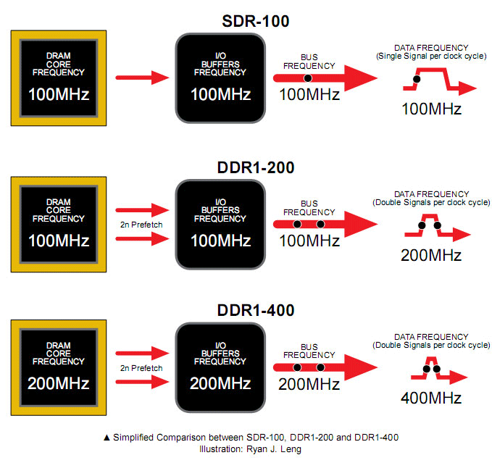
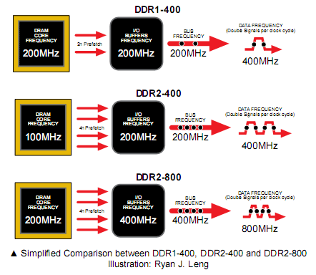
DDR (Double Data Rate) SDRAMs
DDR1 VS DDR1+:
DDR2 vs. QDR

Slide 95
DRAM Subsystem Organization
Dram: Dynamic RAM
DRAM Organization:
Chip:
Consists of multiple banks (2-16 in Synchronous DRAM)
Banks works in parallel to overlap delay
Banks share command/address/data buses
The chip itself has a narrow interface (4-16 bits per read)
Channel
DIMM
Rank
Chip
Bank
Row/Column

Slide 96
DRAM Subsystem Organization
Dram: Dynamic RAM
DRAM Organization:
Rank:
Multiple chips operated together to form a wide interface
All chips comprising a rank are controlled at the same time
Respond to a single command
Share address and command buses, but provide different data
E.g., Using 8 chips with 8-bit interface to form a 64-bit wide Rank
Channel
DIMM
Rank
Chip
Bank
Row/Column

Slide 97
DRAM Subsystem Organization
Dram: Dynamic RAM
DRAM Organization:
DIMM (dual inline memory module):
A DRAM module consists of one or more ranks
This is what you plug into your motherboard
Channel
DIMM
Rank
Chip
Bank
Row/Column

Slide 98
DIMM (Dual Inline Memory Module)
Contains DRAM chips each have data widths of x4 or x8
Can be on both sides
Can have more than one rank
Increase storage capacity
Only one rank accessible at a time
SIMM vs DIMM
DIMM has separate contacts on each side of the board to provides twice as much data rate.

Slide 99
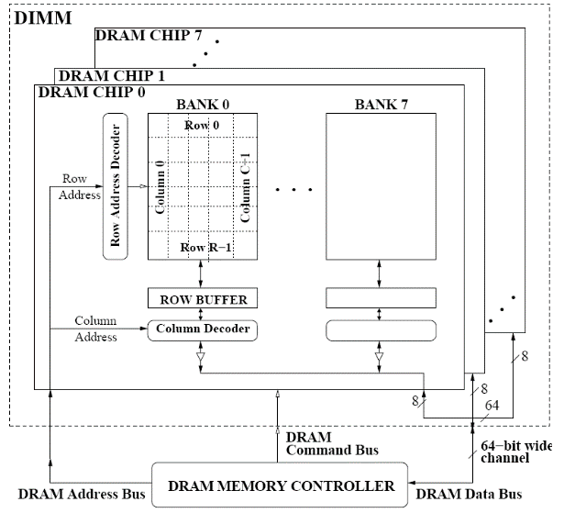
A 64-bit Wide DIMM (One Rank)
Advantages:
Acts like a high-capacity DRAM chip with a wide interface
Flexibility: memory controller does not need to deal with individual chips
Disadvantages:
Granularity: Accesses cannot be smaller than the interface width

Slide 100
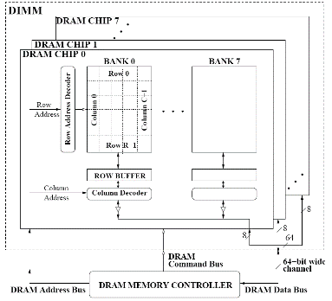
DRAM Subsystem Organization
Dram: Dynamic RAM
DRAM Organization:
Channel: Independent memory subsystem
E.g., 2 independent Channels:
Channel
DIMM
Rank
Chip
Bank
Row/Column

Slide 101

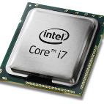
The DRAM subsystem
“Channel”
DIMM (Dual in-line memory module)
Processor
Memory channel
Memory channel
Each channel is connected to its own on-die memory controller

Slide 102
Row Operations & Row Buffer Locality
Access Address: Row Operation:
Columns
(Row 0, Column 0)
Activation
RBL=2
(Row 0, Column 1)
No operation
RBL=1
(Row 1, Column 0)
Restore, Precharge, Activation
Row address 0
Row address 1
Row decoder
R1
R0
R0
Rows
Row Buffer
CONFLICT !
Row 1
HIT
Row 0
Empty
Column address 0
Column mux
Column address 0
Column address 1
Improving Row Buffer Locality (RBL) is the key to reduce DRAM energy consumption
Data
Credit: Onur Mutlu.

Slide 103
RBL & Memory Scheduling Schemes
Visible to the memory scheduler
In-order scheduling
(FIFO):
Activation Counter:
R1: Activation = 1
R5: Activation = 2
R1: Activation = 3
R5: Activation = 4
R5: Activation = 4
Avg RBL = 5 / 4 = 1.25
future
requests
requests currently
in the pending queue
oldest
request
Same
activation
Request Stream
……
……
R4
R3
R2
R5
R5
R1
R5
R1
Out-of-order scheduling
(FR-FCFS):
Activation Counter:
R1: Activation = 1
R1: Activation = 1
R5: Activation = 2
R5: Activation = 2
R5: Activation = 2
Avg RBL = 5 / 2 = 2.5
future
requests
requests currently
in the pending queue
Same
activation
oldest
request
Same
activation
Request Stream
……
……
R4
R3
R2
R5
R5
R1
R5
R1

Slide 104
DRAM Milestones
 | DRAM | Page DRAM | Page DRAM | Page DRAM | SDRAM | DDR SDRAM
Module Width | 16b | 16b | 32b | 64b | 64b | 64b
Year | 1980 | 1983 | 1986 | 1993 | 1997 | 2000
Mb/chip | 0.06 | 0.25 | 1 | 16 | 64 | 256
Die size (mm²) | 35 | 45 | 70 | 130 | 170 | 204
Pins/chip | 16 | 16 | 18 | 20 | 54 | 66
BWidth (MB/s) | 13 | 40 | 160 | 267 | 640 | 1600
Latency (nsec) | 225 | 170 | 125 | 75 | 62 | 52
In the time that the memory to processor bandwidth has more than doubled the memory latency has improved by a factor of only 1.2 to 1.4
To deliver such high bandwidth, the internal DRAM has to be organized as interleaved memory banks
Patterson, CACM Vol 47, #10, 2004

Slide 105
Memory (DRAM) + Caches
It is important to match the cache characteristics
Caches want information provided to them one block at a time (and a block is usually more than one word)
Memory design considerations:
With the main memory characteristics
Use DRAMs that support fast multiple word accesses, preferably ones that match the block size of the cache
With the memory-bus characteristics
Make sure the memory-bus can support the DRAM access rates and patterns
With the goal of increasing the Memory-Bus-to-Cache bandwidth

Slide 106
Review: DRAM vs. SRAM
DRAM
Slower access (capacitor)
Higher density (1T 1C cell)
Lower cost
Requires refresh (power, performance, circuitry)
Manufacturing requires putting capacitor and logic together
SRAM
Faster access (no capacitor)
Lower density (6T cell)
Higher cost
No need for refresh
Manufacturing compatible with logic process (no capacitor)

Slide 107
Magnetic Disk
Track
Controller
+
Cache
Purpose: Long term, nonvolatile storage
Lowest level in the memory hierarchy: large, cheap, slow
General structure
1 to 4 rotating platter coated with a magnetic surface (2 sides recordable)
Rotational speeds of 5,400 to 15,000 RPM
Moveable read/write head to access the information for each platter
10,000 to 50,000 tracks per surface
Cylinder - all the tracks under the head at a given point on all surfaces
100 to 500 sectors per track
The smallest unit that can be read/written (typically 512B)
Outer tracks hold more sectors than the inner tracks
Sector
Cylinder
Platter
Head

Slide 108
Magnetic Disk Characteristic
Track
Seek time: position the head over the proper track
3 to 12/15 ms on average
Due to locality of disk references, the actual average seek time may be only 25% to 33% of the advertised number
Controller
+
Cache
Sector
Cylinder
Platter
Rotational latency: wait for the desired sector to rotate under the head
½ of 1/RPM converted to ms: 0.5R/5400RPM = 5.6ms to 0.5R/15000RPM = 2.0ms
Transfer time: transfer a block of bits (one or more sectors) under the head to the disk controller’s cache (70 to 125 MB/s are typical disk transfer rates)
the disk controller’s “cache” takes advantage of spatial locality in disk accesses
cache transfer rates are much faster (e.g., 375 MB/s)
Controller time: the overhead the disk controller imposes in performing a disk I/O access (typically < 0.2 ms)
Head

Slide 109
Typical Disk Access Time
The average time to read or write a 512B sector for a disk rotating at 15,000 RPM with average seek time of 4 ms, a 100MB/sec transfer rate, and a 0.2 ms controller overhead
Avg disk read/write
= 4.0 ms + 0.5/(15,000RPM/(60sec/min)) + 0.5KB/(100MB/sec) + 0.2 ms
= 4.0 + 2.0 + 0.005 + 0.2 = 6.2 ms
If the measured average seek time is 25% of the advertised average seek time, then
Avg disk read/write = 1.0 + 2.0 + 0.005 + 0.2 = 3.2 ms

Slide 110
Disk Latency & Bandwidth Improvement
Disk latency = average seek time + rotational latency.
Disk bandwidth is the peak transfer speed of formatted data from the media (not from the cache).
Patterson, CACM Vol 47, #10, 2004

Slide 111
Flash Storage
Flash memory is the first credible challenger to disks. It is semiconductor memory that is nonvolatile like disks but has latency 100 to 1000 times lower and is smaller, more power efficient, and more shock resistant.
Flash memory bits wear out. But with wear leveling it is unlikely that the write limits of the flash will be exceeded.
Example:
Storage | Write throughput | Read throughput | Latency
SSD | 2,500 MB/S | 3,500 MB/S | 0.025 ms
DISK | 250 MB/S | 250 MB/S | 5 ms

Slide 112
Flash Storage Characteristics
Flash memory is organized into blocks of pages
page size 512B to 4KB, block size 32 to 128 pages (typical)
“read” is page read
“write” is block erase (~ 1 ms) followed by page write (and additional copying of other pages in that block)
Typically a type of Electrically Erasable PROGRAMMABLE Read-Only Memory (EEPROM)
Comes in two flavors: NOR Flash and NAND Flash
NOR Flash is randomly addressable (Minimum access size 512 bytes)
NAND Flash is less expensive (greater storage density) and is not randomly addressable (minimum access size 2048 bytes); so more popular

Slide 113
Dependability, Reliability, Availability
Reliability – measured by the mean time to failure (MTTF). Service interruption is measured by mean time to repair (MTTR)
Availability – a measure of service accomplishment
Availability = MTTF / (MTTF + MTTR)
To increase MTTF, either improve the quality of components or design the system to continue operating in the presence of faulty components
Fault avoidance: preventing fault occurrence by construction
Fault tolerance: using redundancy to correct or bypass faulty components (hardware)

Slide 114
RAID: Redundant Array of Independent Disks
Arrays of independent physical disks working together as one logical disk
Increase potential throughput by having many disk drives
Data can be spread across multiple disk
Multiple disk accesses can be made simultaneously for higher throughput
Reliability for the array is lower than for a single disk
Availability can be improved by adding redundant disks
Lost information can be reconstructed from redundant information
MTTR: mean time to repair is in the order of hours
MTTF: mean time to failure of disks is tens of years
RAID Disk Array

Slide 115
RAID: Level 0 (Striping, No Redundancy)
sec1
sec2
sec3
sec4
Assumes one stripe = four blocks
sec1,b0
sec1,b1
sec1,b2
sec1,b3
Multiple smaller disks as opposed to one big disk
Multiple blocks can be accessed in parallel to increase the performance
Works well for large data requests
E.g., a 4-disk system gives four times the throughput (R/W) of a 1-disk system
Same cost as one big disk – assuming 4 small disks cost the same as one big disk
What if one disk fails?
No redundancy, data is lost
More likely to fail as the number of disks increases

Slide 116
RAID: Level 1 (Redundancy via Mirroring)
sec1
sec2
sec3
sec4
sec1m
sec2m
sec3m
sec4m
redundant (check) data
# redundant disks = # of data disks, so always two copies of the data
Twice the cost of one big disk
Writes are made to both sets of disks and have no speed improvement
Reads can be 2 times faster
If a disk fails, the system just goes to the “mirror” for the data

Slide 117
RAID: Design Choices
Category | Level | Disks | Features
Striping | 0 | N | No fault tolerance
Mirroring, no striping | 1 | 2N | Expensive
Striping Rarely used | 2 3 | N + m N + 1 | Hamming code Parity disk
Block level Striping Parity | 4 5 6 | N + 1 N + 1 N + 2 | Parity disk Distributed parity Dual distributed parity
Parity: used for error detection
E.g., data: 00001111, parity bit: 0
Hamming code: limited error correction
Using multiple parity bits to locate 1 error bit

Slide 118
How is the Hierarchy Managed?
registers ↔ memory
by compiler (or programmer)
registers ↔ cache ↔ main memory
by the cache & memory controller hardware
main memory ↔ external storage (flash, disk)
Static: by the programmer with OS support (files)
Dynamic: by the operating system (virtual memory)
virtual address to physical address mapping
assisted by the hardware (TLB, page tables)

Slide 119
Virtual Memory
31 30 . . . 12 11 . . . 0
Virtual page number
Page offset
Virtual Address (VA)
Translation
Physical page number
Page offset
Physical Address (PA)
29 . . . 12 11 0
A virtual address must first be translated to a physical address to access memory
Basic unit: page (e.g., 1KB to 64KB)
Virtual memory size can be larger than physical memory size
Pages can be stored in the secondary storage

Slide 120
Address Space Isolation
Allows efficient and safe sharing of main memory among multiple processes
The starting location of each page is contained in the program’s page table
Create the illusion that each program has a large consecutive memory space
Improving memory utilization: code can be loaded anywhere the OS can find space
Program 1 page table
Main (physical) memory
Virtual address space
Program 2 page table

Slide 121
Address Translation Mechanisms
Virtual page #
Offset
virtual address
Physical page #
physical address
Offset
Physical page
base addr
Main memory
V
1
1
1
1
1
1
0
1
0
1
0
Page table register
Page fault: a DRAM miss for the page
→ Page in disk
Page walk: Search (walk) the page table
Disk storage
Page Table (in main memory)

Slide 122
Virtual Addressing with a Cache
It takes an extra memory access to translate a VA to a PA
VA
PA
miss
Trans-
lation
Cache
Main
Memory
CPU
hit
data
This makes memory (cache) accesses very expensive
The hardware solution is to use a Translation Lookaside Buffer (TLB)
A small cache that keeps track of recently used address mappings to avoid having to do a page table lookup in main memory

Slide 123
Making Address Translation Fast
Virtual page #
Physical page
base address
V
Tag
1
1
1
0
1
TLB
Main memory
Physical page
base address
V
1
1
1
1
1
1
0
1
0
1
0
Page table register
Disk storage
Page Table (in physical memory)

Slide 124
A TLB in the Memory Hierarchy
¼ t
hit
¾ t
VA
PA
miss
TLB
Lookup
Cache
Main
Memory
CPU
miss
hit
Trans-
lation
data
A TLB miss – is it a page fault or merely a TLB miss?
If the page is loaded into main memory, then the TLB miss can be handled by loading the translation information from the page table into the TLB (10’s of cycles )
If the page is not in main memory, then it’s a true page fault (1,000,000’s)
TLB misses are much more frequent than true page faults

Slide 125
Why Not a Virtually Addressed Cache?
A virtually addressed cache would only require address translation on cache misses
VA
Trans-
lation
PA
Main
Memory
CPU
Cache
hit
data
Aliasing issue:
Two programs which are sharing data will have two different VA for the same PA
Two copies of the data in cache and two entries in the TLB → coherence issues
Must update all cache entries with the same physical address or the memory becomes inconsistent
No address space isolation: data can be corrupted

Slide 126
Reducing Translation Time
Overlapping the cache access with the TLB access
Higher bits for TLB; lower bits for cache.
Virtual page #
Page offset
2-way Set Associative Cache
Byte offset
Block offset
Index
Tag
Data
Tag
Data
PA
Tag
VA Tag
PA Tag
=
=
TLB Hit
Cache Hit
Desired word

Slide 127


