Slide 1
Lecture 5. Parallel Processing (1)
CMPE 200 Computer Architecture & Design
Haonan Wang

Slide 2
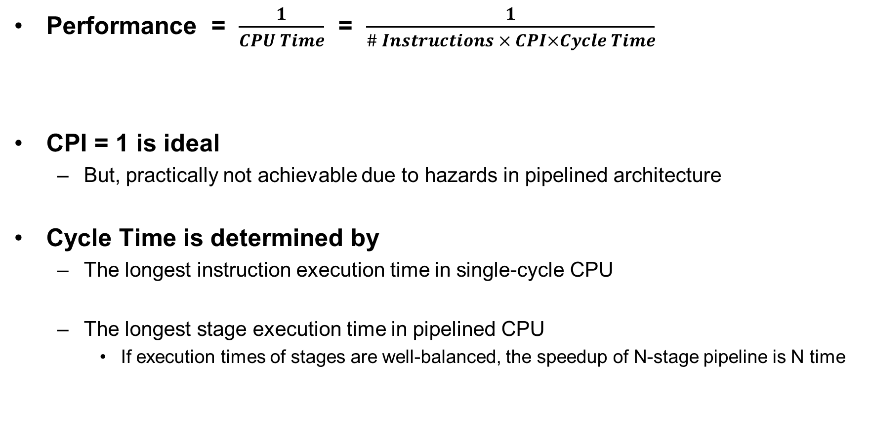
Processor Performance Analysis
Performance = $\frac{1}{CPU Time}$ = $\frac{1}{\# Instructions × CPI×Cycle Time}$
CPI = 1 is ideal
But, practically not achievable due to hazards in pipelined architecture
Cycle Time is determined by
The longest instruction execution time in single-cycle CPU
The longest stage execution time in pipelined CPU
If execution times of stages are well-balanced, the speedup of N-stage pipeline is N time
Decided by Microarchitecture design

Slide 3
Can We Do Better?
Latency vs. throughput
Levels of Parallelism:
Instruction-level Parallelism (ILP)
Executing independent instructions (in one thread) in parallel
Data-level Parallelism (DLP)
Executing the same instruction on different data subsets
Thread-level Parallelism (or Task-level Parallelism, TLP)
Executing independent computing tasks in parallel (on same or different data)

Slide 4
Instruction Level Parallelism (ILP)
Basic idea: Execute several instructions in parallel
Pipelining is one example
But it can only push through at most 1 inst/cycle
How about multiple instruction/cycle?
More complicated and more transistors/logic (e.g., superscalar)
Simple ILP recipe
Read and decode a few instructions each cycle
If instructions are independent, do them at the same time
If not, do them one at a time

Slide 5
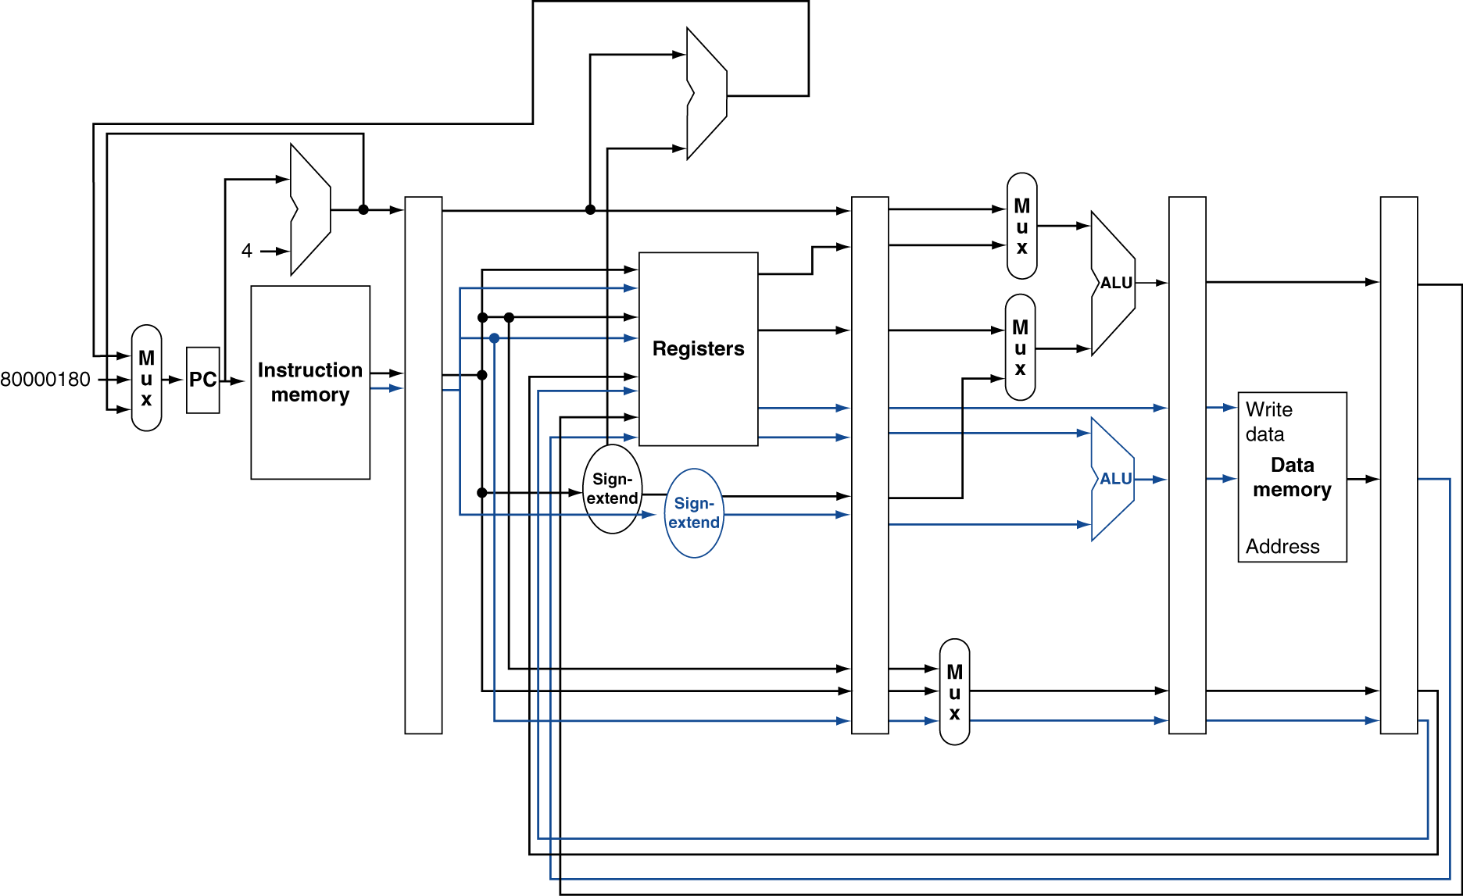
Example-1: MIPS with Dual Issue
Issue an arithmetic and a memory instruction concurrently
At most 2x speedup
8

Slide 6
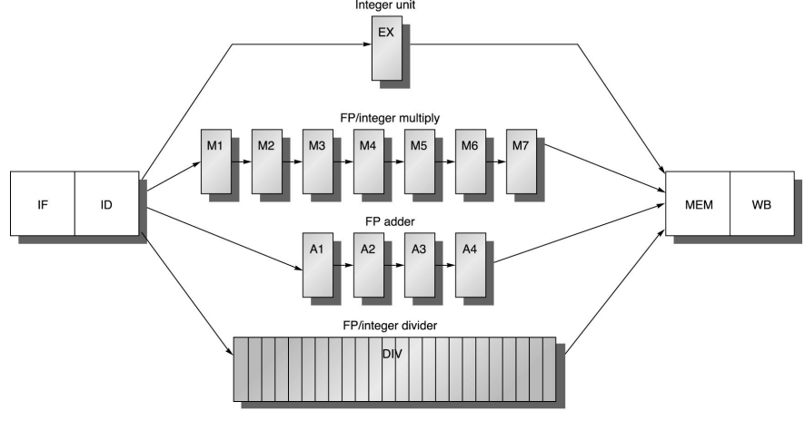
Example-2: Floating-point Pipeline
MIPS has separate pipeline for floating-point operations

Slide 7
Issue Multiple Instructions
Static multiple issue
Compiler groups instructions to be issued together
Packages them into “issue slots”
Compiler detects and avoids hazards
Dynamic multiple issue
CPU examines instruction stream and chooses instructions to issue each cycle
Compiler can help by reordering instructions
CPU resolves hazards using advanced techniques at runtime

Slide 8
2-way Superscalar Example
IF
ID
EX
ME
Forwarding paths:
MEM → EX & FP1
WB → EX & FP1
WB
IF
ID
FP1
FP2
FP3
FP4
FP5
Code
ld.s $f0, 0($t1)
ld.s $f1, 0($t2)
subi $t3, $t3, 1
add.s $f2, $f1, $f0
addi $t1, $t1, 4
 | CC1 | CC2 | CC3 | CC4 | CC5 | CC6 | CC7 | CC8 | CC9 | CC10 | CC11
ld.s $f0, 0($r1) | IF | ID | EXE | MEM | WB
ld.s $f1, 0($t2) |  | IF | ID | EXE | MEM | WB
subi $t3, $t3, 1 |  |  | IF | ID | EXE | MEM | WB
add.s $f2, $f1, $f0 |  |  | IF | ID | ID | FP1 | FP2 | FP3 | FP4 | FP5 | WB
addi $t1, $t1, 4 |  |  |  | IF | ID | EXE | MEM | WB
ld.s : load single precision data to fp reg
st.s : store single precision data from fp reg
add.s : add two single precision fp data

Slide 9
Enhance Compiler Scheduling Performance
Loop Unrolling: transforms an M-iteration loop to a M/N-iteration loop
“Loop has been unrolled N times”
Effectively decrease the number of branches from M to M/N
If the loop is short (i.e. 4 iterations in this code), it can even be eliminated
for(i=0;i<100;i+=4){
a[i]*=2;
a[i+1]*=2;
a[i+2]*=2;
a[i+3]*=2;
}
for(i=0;i<100;i++)
a[i]*=2;

Slide 10
More Aggressive Method?
Static pipelines can only exploit ILP exposed by the compiler
Instructions are stalled in ID stage until they are hazard free
Must search for the ILP across branches
Dynamic pipeline scheduling
Allow out-of-order (OOO) execution to avoid stalls
Keeps track of dependency (commit result to registers in order)
Decoded instructions wait in queues for operands (stall only when queues are full)
Example
lw $t0, 20($s2) addu $t1, $t0, $t2 sub $s2, $s4, $t3 slti $t0, $s2, 20
Why should sub wait for lw and addu?

Slide 11
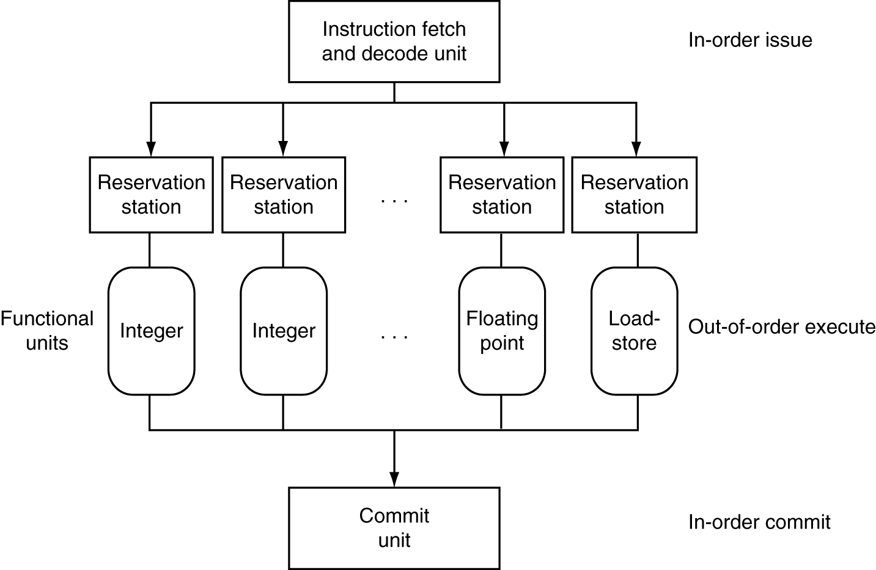
Dynamically Scheduled CPU
Preserves dependencies
Hold pending operands
Results also sent to any waiting reservation stations
Reorders buffer for register writes
Can supply operands for issued instructions

Slide 12
Dynamic Pipeline Scheduling
Challenges
All data hazards (memory and registers) must be resolved by hardware
Data Dependencies
RAW (Read After Write) : True dependency
Dynamic pipeline preserves only this dependency
WAR (Write After Read) & WAW (Write After Write) : False dependencies
Dynamic pipeline removes false dependencies by using register renaming

Slide 13
Dependencies Among Instructions
RAW
WAW
WAR
lw $t0, 20($s2) addu $t1, $t0, $t2 sub $s2, $s4, $t3 slti $t0, $s2, 20
lw $t0, 20($s2) addu $t1, $t0, $t2 sub $s2, $s4, $t3 slti $t0, $s2, 20
lw $t0, 20($s2) addu $t1, $t0, $t2 sub $s2, $s4, $t3 slti $t0, $s2, 20
Preserve only RAW and remove false dependencies by renaming destination registers of each instruction
P1
lw $t0, 20($s2) addu $t1, $t0, $t2 sub $s2, $s4, $t3 slti $t0, $s2, 20
P2
P1
lw P1, 20($s2) addu P2, P1, $t2 sub P3, $s4, $t3 slti P4, P3, 20
P3
P4
P3
Now can sub execute before lw and addu?

Slide 14
Dependencies Among Instructions
Mapping table status
Free list status
Logical | initial | lw | addu | sub | slti
l1 | t0 | P1 | P1 | P1 | P4
l2 | t1 | t1 | P2 | P2 | P2
l3 | t2 | t2 | t2 | t2 | t2
l4 | t3 | t3 | t3 | t3 | t3
l5 | s2 | s2 | s2 | P3 | P3
l6 | s4 | s4 | s4 | s4 | s4
initial | lw | addu | sub | slti
P1 | P2 | P3 | P4 | P5
P2 | P3 | P4 | P5 | …
P3 | P4 | P5 | …
P4 | P5 | …
P5 | …
P1
lw $t0, 20($s2) addu $t1, $t0, $t2 sub $s2, $s4, $t3 slti $t0, $s2, 20
P2
P1
lw P1, 20($s2) addu P2, P1, $t2 sub P3, $s4, $t3 slti P4, P3, 20
P3
P4
P3

Slide 15
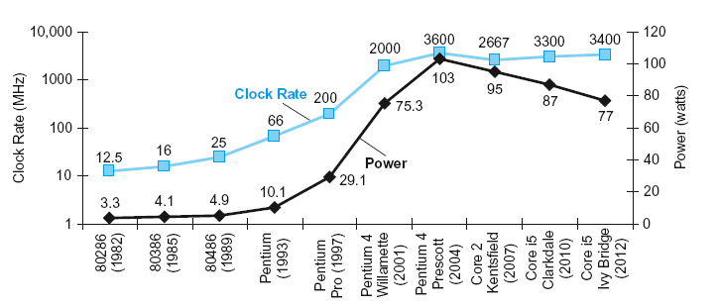
Recall Power Wall
With super-pipelining, super-scalar, and dynamic pipelining, CPU performance was easily increased alongside higher clock frequency until early 2000s
Power = Capacitive load x Voltage² x Frequency
Solution: Add more cores with the same frequency instead (DLP & TLP)

Slide 16
Concurrency vs. Parallelism
Programs: sequential or concurrent
Sequential: only one activity during a period of time
Concurrent: multiple independent or cooperating activities during a period, but not necessarily simultaneous (e.g., multithreading on 1 core)
Computers: serial or parallel
Parallel: multiple instructions or multiple operations per cycle (ILP, DLP, TLP)
Key challenge: Scalability of programs
Issues: scheduling, load balancing, synchronization, communication overhead

Slide 17
Concurrency and Parallelism Examples
Matrix addition
matrix A, B, C; // dimensions m × n
C = A + B;
for (i = 0; i < m; i++) for (j = 0; j < n; j++) C[i][j] = A[i][j] + B[i][j];
Database search
find an item with a given property by examining all items
Web search
Google’s MapReduce algorithm

Slide 18
Conclusion Time
What is the key idea behind register renaming?
Prevent overwriting
What are the three levels of parallelism?
ILP, DLP, TLP

Slide 19


