Slide 1
Lecture 5. Parallel Processing (3)
CMPE 200 Computer Architecture & Design
Haonan Wang

Slide 2
Multi-core CPUs, Multiprocessors, and GPUs
Multi-core CPUs, Multiprocessors
Individual cores are fine-tuned for high ILP
Good for Task-level parallelism (TLP)
However, it is hard to employ hundreds of cores in one system
Cache coherence, control, power, cost …
For specific tasks, Graphics Processing Unit (GPU) can be an alternative solution
For tasks with high Data-Level parallelism
E.g., particle simulation, image/video processing, games, machine learning …
The usage of GPU is common now
Instruction & Data level parallelism combinations
SISD: Classical Von Neumann machine
MISD: NA
SIMD: GPU
MIMD: multi-core & multiprocessor

Slide 3
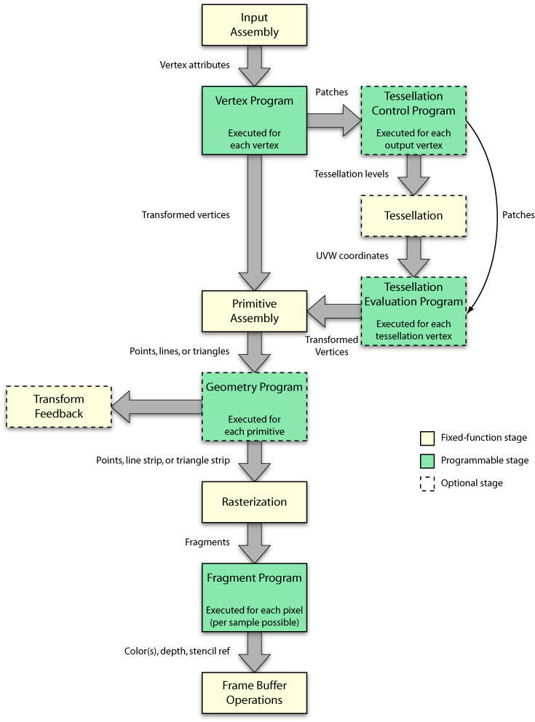
Isn’t GPU used for graphics processing?
Recent GPUs employ regular ALUs for programmable stages, which can be used for general purpose computing not only for the graphics applications
GPGPU
Programming language support: CUDA, OpenCL, …
GPU is efficient
High performance
hundreds of TFLOPS (floating point operations per second)
CPU: hundreds of GFLOPS
Energy/cost efficient by design
Used in Top 500 Supercomputers in the world
https://commons.wikimedia.org/wiki/File:The_OpenGL_-_DirectX_graphics_pipeline.png

Slide 4

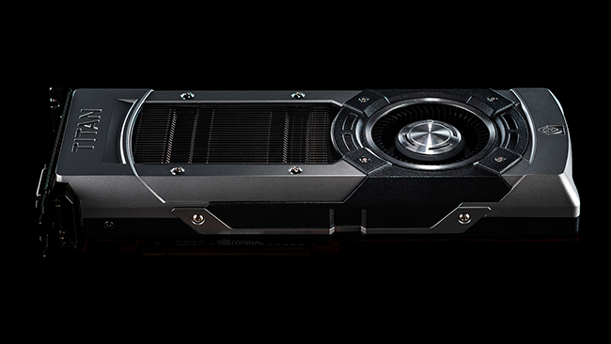
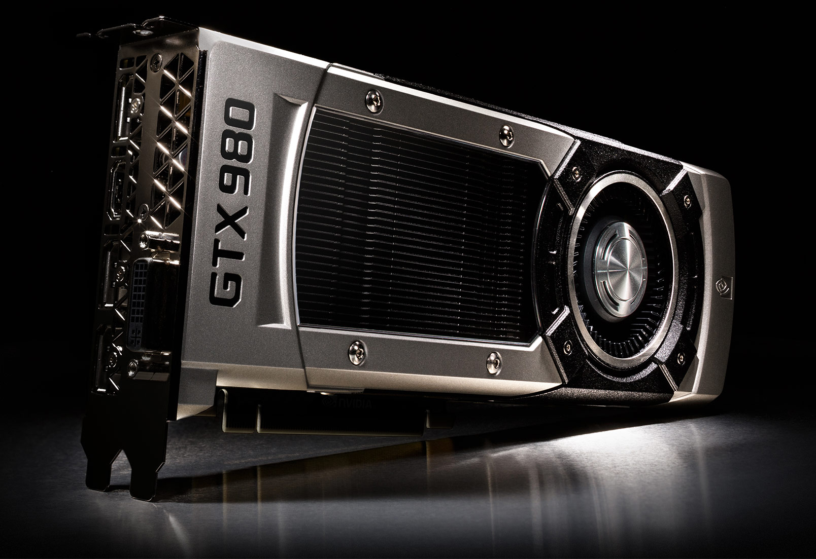
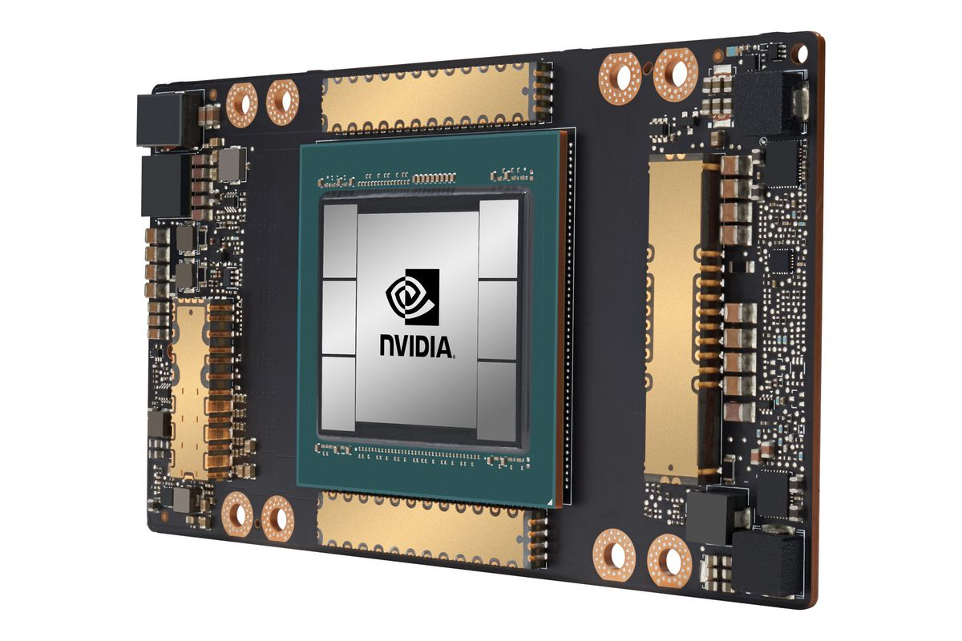
GPU Scaling Trends
GTX 480
(Fermi)
448
CUDA
Cores
(139 GB/sec)
2010
GTX 680
(Kepler)
1536
CUDA
Cores
(192 GB/sec)
2012
GTX 980
(Maxwell)
2048
CUDA
Cores
(224 GB/sec)
2014
GP 100
(Pascal)
3584
CUDA
Cores
(720 GB/sec)
2016
GV 100
(Volta)
5120
CUDA
Cores
(900 GB/sec)
2017
GA 100
(Ampere)
8192
CUDA
Cores
(1555 GB/sec)
2020

Slide 5
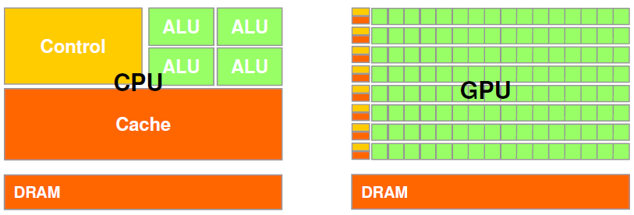
Why is GPU so Efficient?
GPU is specialized for compute-intensive, highly data parallel computation (owing to its graphics rendering origin)
More transistors can be devoted to data processing rather than caching and control
At peak performance GPU uses order of magnitude less energy per operation than CPU
Working with suitable applications: high arithmetic intensity (the ratio between arithmetic operations and memory operations), high DLP, not too sensitive to latency
Credit: Dan Negrut, ME964 UW-Madison

Slide 6
Classical GPGPU Architecture (Nvidia)
Warp contains 32 threads that execute the same instruction with different data - SIMD
SM/Core
SM/Core
Threads
PE
…
PE
…
PE
…
PE
W
W
W
W
W
W
warps
L1 Caches
Register File
L1 Caches
Register File
Interconnect
Warp Scheduler
L2 Cache
L2 Cache
L2 Cache
Memory Controller
Memory Controller
…
Memory Controller
DRAM
Module
DRAM
Module
DRAM
Module
Memory Array
Memory
Partition
Row open:
Activation
Row close:
Restore & Precharge
Row Buffer

Slide 7
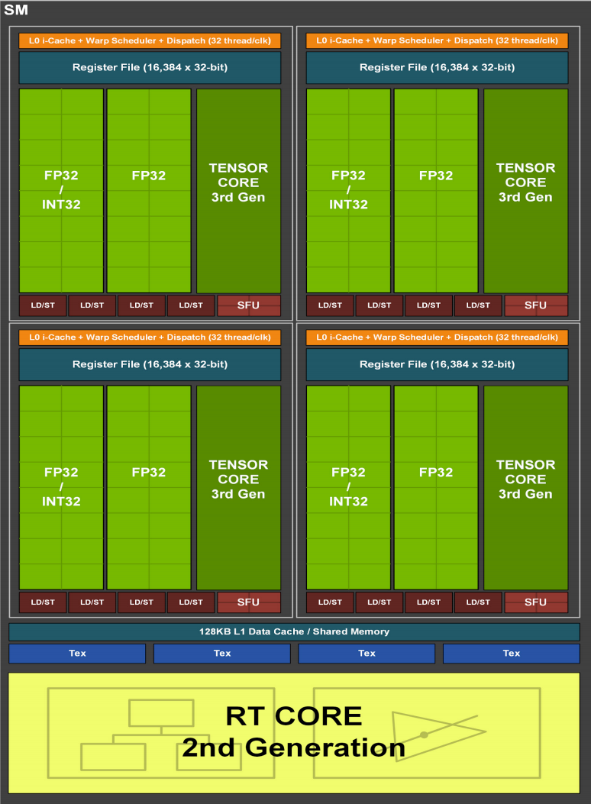
State-Of-The-Art GPU (Ampere)

Slide 8

Working Philosophy (1): SIMD
(0 = black, 255 = white)
0 | 0 | 0 | 0
64 | 64 | 64 | 0
128 | 192 | 192 | 0
192 | 192 | 128 | 64
Individual Pixels
GPU Shader
Image taken from the photo "Robin Jeffers at Ton House" (1927) by Edward Weston

Slide 9
Working Philosophy (1): SIMD
(0 = black, 255 = white)
0 | 0 | 0 | 0
64 | 64 | 64 | 0
128 | 192 | 192 | 0
192 | 192 | 128 | 64
Individual Pixels
GPU Shader
Image taken from the photo "Robin Jeffers at Ton House" (1927) by Edward Weston

Slide 10
Working Philosophy (1): SIMD
(0 = black, 255 = white)
0 | 0 | 0 | 0
64 | 64 | 64 | 0
128 | 192 | 192 | 0
192 | 192 | 128 | 64
+ Brightness
20 | 20 | 20 | 20
84 | 84 | 84 | 20
148 | 212 | 212 | 20
212 | 212 | 148 | 84
Individual Pixels
0
0
0
0
20
20
20
20
+ 20 (brightness factor)
64
64
64
0
84
84
84
20
128
192
192
0
148
212
212
20
192
192
128
64
212
212
148
84
Image taken from the photo "Robin Jeffers at Ton House" (1927) by Edward Weston

Slide 11
Working Philosophy (2): Hide Latency
GPU memory hierarchy provide high BW, but usually high latency
→ Hide long memory latency with computation from other thread warps
W3
Computation
W2
Waiting for Data from GPU Memory
W1

Slide 12
GPU Program Execution Flow
Host
Device
PCI-Express
CPU
GPU
Application
Execute a kernel in parallel
Sequential Part
Kernel with data
Parallel Part
...
Results
SM
System Memory
Global Memory

Slide 13
GPU Program Execution Flow
Host
Device
PCI-Express
CPU
GPU
Application
Execute a kernel in parallel
Sequential Part
Parallel Part
Sequential Part
Kernel with data
...
Parallel Part
SM
Sequential Part
Results
System Memory
Global Memory

Slide 14
CUDA Code Example: Vector Addition
C code
int main(){ // executed on CPU
...
for (int i=0; i<32; i++)
C[i] = A[i] + B[i];
}
CUDA C code
__global__ void vecAddCUDA (float* A, float* B, float* C){ // executed on the GPU
...
int i = threadIdx.x;
C[i] = A[i] + B[i];
}
int main(){ // executed on CPU
...
int numBlocks = 1;
int numThreads = 32;
vecAddCUDA <<<numBlock,numThreads>>>(A,B,C);
}

Slide 15
Multicore Performance: Amdahl’s Law
Speedup due to enhancement E:
Exec time w/o E
Speedup w/ E = ----------------------
Exec time w/ E
Suppose that enhancement E accelerates a fraction F (F <1) of the task by a factor S (S>1) and the remainder of the task is unaffected:
ExTime w/ E = ExTime w/o E × ((1-F) + F/S)
Speedup w/ E = 1 / ((1-F) + F/S)

Slide 16
Example 1: Amdahl’s Law
Speedup w/ E = 1 / ((1-F) + F/S)
Consider an enhancement that runs 20 times faster but is only usable 25% of the time
Speedup w/ E = 1/(.75 + .25/20) = 1.31
What if its usable only 15% of the time?
Speedup w/ E = 1/(.85 + .15/20) = 1.17
Amdahl’s Law tells us that to achieve linear speedup with 100 cores, none of the original computation can be scalar!
To get a speedup of 90 from 100 cores, the percentage of the original program that could be scalar would have to be 0.1% or less
Speedup w/ E = 1/(.001 + .999/100) = 90.99

Slide 17
Example 2: Amdahl’s Law
Speedup w/ E = 1 / ((1-F) + F/S)
Consider summing 10 scalar variables and two 10 by 10 matrices on 10 cores
Speedup w/ E = 1/(.091 + .909/10) = 1/0.1819 = 5.5
What if there are 100 cores?
Speedup w/ E = 1/(.091 + .909/100) = 1/0.10009 = 10.0
What if the matrices are 100 by 100 (or 10,010 adds in total) on 10 cores?
Speedup w/ E = 1/(.001 + .999/10) = 1/0.1009 = 9.9
What if there are 100 cores?
Speedup w/ E = 1/(.001 + .999/100) = 1/0.01099 = 91

Slide 18
Example 2: Amdahl’s Law
Speedup w/ E = 1 / ((1-F) + F/S)
Consider summing 10 scalar variables and two 10 by 10 matrices on 10 cores
Speedup w/ E = 1/(.091 + .909/10) = 1/0.1819 = 5.5
What if there are 100 cores?
Speedup w/ E = 1/(.091 + .909/100) = 1/0.10009 = 10.0
What if the matrices are 100 by 100 (or 10,010 adds in total) on 10 cores?
Speedup w/ E = 1/(.001 + .999/10) = 1/0.1009 = 9.9
What if there are 100 cores?
Speedup w/ E = 1/(.001 + .999/100) = 1/0.01099 = 91

Slide 19
Conclusion Time
What are the ways to do synchronization for multicore?
Barrier sync vs. MPP primitives
What are the key ideas of GPU?
SIMD & hiding latency

Slide 20


