Slide 1
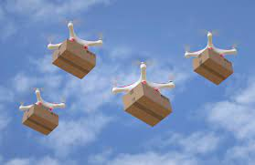
Service Oriented Mission Planner

Slide 2
Mission Planner
The mission planner is a key software component that allows users to set up and schedule drone surveillance missions.
Web application that provides an interface for admin users to create and manage missions.
Integrates with map data to allow users to visually set waypoints and define areas.
Notes:
Allows setting of all parameters for a mission - waypoints, actions, camera settings, etc.
Optimizes waypoint routes for efficiency - considers things like battery life, wind patterns, no-fly zones.
Allows setting timing and recurrence for missions - one time, recurring daily/weekly etc.
Interfaces with fleet management system to select which drone(s) will be assigned to a mission.
Sends final mission plans and waypoints to drones wirelessly.
Tracks mission status in real-time as drones execute flights.
Stores mission history data for reporting and analytics.
Allows dynamic re-tasking or pausing of in-progress missions.
APIs allow integrating with other systems like campus security software.

Slide 3
Overview
The system will consist of a fleet of drones with cameras that can fly pre-planned missions or be dynamically tasked.
The drones will stream video and telemetry data to the cloud.
Users can access and monitor the video feeds and data through a web application.
The mission planner will allow users to create and schedule surveillance missions.

Slide 4
Drone Missions
Pre-planned missions
On-demand missions
Random patrols
Reactive missions

Slide 5
Pre-planned missions
Admin scheduled recurring flights over key areas
Optimized flight plans for efficiency
Provides regular oversight for proactive monitoring
Use cases
Daily flyovers of parking lots to deter break-ins
Weekly quad monitoring to track gathering sizes
Nightly scans of buildings for security breaches
Recurring perimeter sweeps for suspicious activity
Monitor pathways during peak foot traffic
Weekend housing patrols for noise complaints
Notes:
Pre-planned drone missions allow for scheduled, recurring flights over key campus areas and buildings to enable regular proactive monitoring.
The flight plans are optimized for efficiency in route and energy use. Benefits include deterring crime through consistent presence, identifying issues early before escalation, efficient use of drone resources, and building knowledge of normal activity patterns. Specific use cases could include daily monitoring of parking lots, weekly quad surveillance, and nightly building scans to maintain security.
Pre-planned missions allow flexible flight scheduling that minimizes drone energy use and expenditures.

Slide 6
On-demand missions
Users can dynamically task drones via web app
Specify area on map to surveil
Mission planner generates waypoints
Set camera settings and actions
Use cases:
View large student gatherings
Inspect reported vandalism
Check buildings during breaks
Survey campus prior to events
Monitor protests or demonstrations
Respond to restricted access reports
Search for missing persons
Notes:
On-demand missions allow users to dynamically task drones to investigate situations as they arise. Users specify an area of interest on a map in the web application and the mission planner generates optimal waypoints for drone routing. Camera settings and other actions can also be configured by the user prior to launch. These customizable, adaptable missions enable rapid response surveillance of developing events, specific targets of opportunity, or other ad hoc concerns that require focused drone oversight. Example use cases include monitoring protests, surveying event venues, inspecting vandalism, and searching for missing persons on campus.

Slide 7
Random patrols
Patrols with randomized waypoints
Vary flight paths, avoid repetitive routes
Parameters set for area, duration, speed
Mission planner optimizes route and settings
Use Cases:
Irregular surveillance of recreational spaces
Randomized parking area oversight
Varying quad and open space flights
Frequent dorm patrols at irregular times
Notes:
Random patrol missions generate unpredictable drone routes by varying waypoints and flight paths to avoid repetitive routines. The mission planner optimizes randomized route parameters like area, duration and speed for efficient surveillance. The unpredictable coverage identifies incidents pattern analysis may miss and cost-effectively monitors large areas over time. Example use cases include irregular oversight of recreational spaces, parking lots, quads and unpredictable dorm patrols.

Slide 8
Reactive missions
Continuous monitoring of drones and sensors
Leverage sensor data like motion detection
Drone retasked if sensor threshold exceeded
New waypoints based on sensor location
Drone interrupts current mission
Use Cases:
Rapid dispatch to investigate sensor alerts like gunshots
Dynamically adapt to unfolding situations by responding to shouts
Flexible rerouting from ongoing missions to crashes
Real-time surveillance by retasking drones based on alerts
Generate new waypoints to efficiently investigate emerging incidents
Notes:
Reactive missions involve continuously monitoring drone sensors to leverage data like motion detection and retask drones if a threshold is exceeded, interrupting ongoing flights. New waypoints are generated based on the sensor location triggering the alert to redirect the drone and rapidly investigate incidents like gunshots, shouts, or crashes through efficient routing. Use cases demonstrate real-time adaptive surveillance by dynamically rerouting drones mid-flight to emerging events detected by the system, enabling automated responses that flexibly adapt missions as situations unfold for rapid eyes on developing incidents.

Slide 9
Way Point Actions
Navigation Actions
Camera Actions
Hover
Orbit
Change Altitude
Change Speed
Pause
Rotate
Return to Launch
Loiter
Take Photo
Start/Stop Video
Switch Camera
Aim Camera
Scan Area
Notes:
Hover - Drone holds position at set altitude over waypoint for configured duration
Orbit - Drone circles around waypoint at specified radius and speed
Change Altitude - Drone ascends/descends to predefined altitude upon reaching waypoint
Change Speed - Adjust cruise speed to new preset at waypoint
Pause - Drone pauses at waypoint for set time before proceeding
Rotate - Drone rotates or changes heading by specified degree amount
Return to Launch - Abort mission and return to takeoff point
Loiter - Drone lingers within set radius of waypoint until directed
Take Photo - Drone snaps still image using camera at waypoint
Start/Stop Video - Initiate or conclude video recording at waypoint
Switch Camera - Change between forward, downward, IR cameras at waypoint
Aim Camera - Point camera in specified direction relative to waypoint
Scan Area - Drone scans designated area with cameras at waypoint

Slide 10
Way Point Actions
Payload Actions
Mission Control Actions
Toggle Light
Drop Object
Speak Message
Engage/Disengage Payload
Abort/Resume Mission
Proceed to Next Waypoint
Hold at Waypoint
End Mission

Slide 11
Some other ideas:
Waypoints for recharging drone batteries between missions
Alternate landing sites if the drone charging station is blocked
Contingency waypoints in case of emergencies

Slide 12
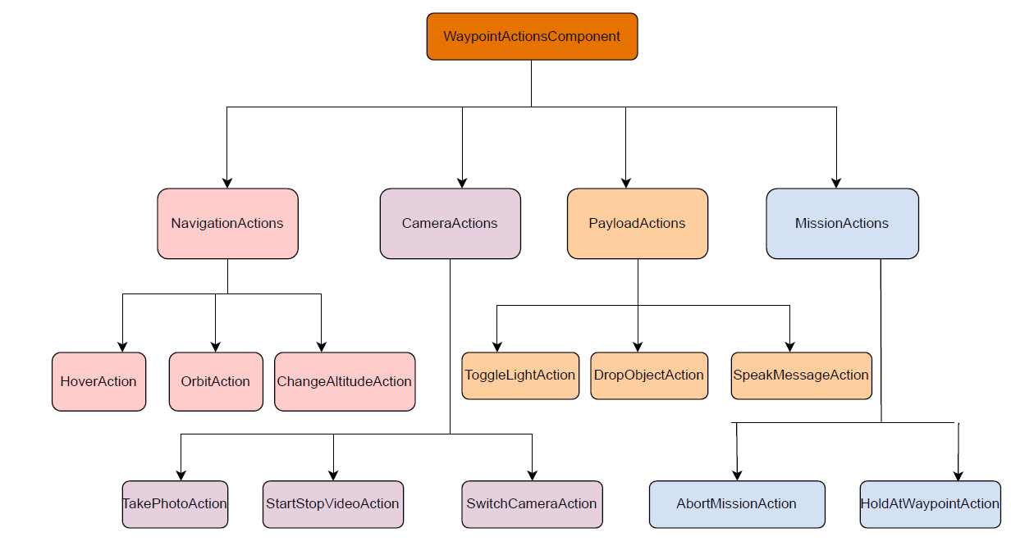
Modular Structure
Notes:
Main WaypointActionsComponent contains all action subcomponents
Each action is its own React component with internal state and methods
Navigation, Camera, Payload, Mission subgroups for organization

Slide 13
