Slide 1
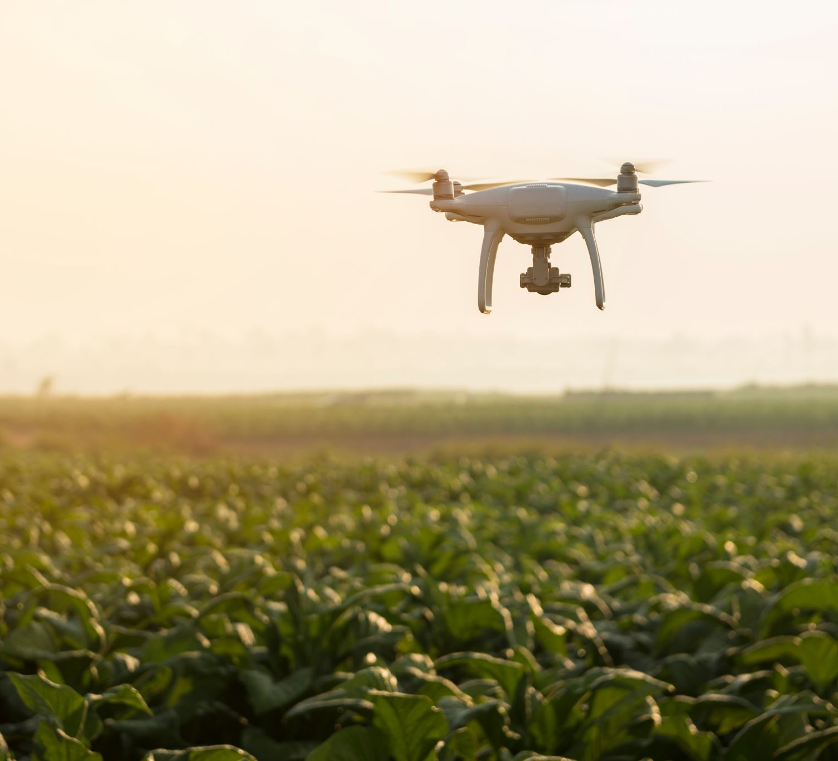
Surveillance Drone Cloud Platform
Tracking And Monitoring COMPONENT

Slide 2
Sub-Modules
Location Tracking (/trackDrone)
Drone Statistics (/dronestatistics)
Drone Service Status (/viewDrone)

Slide 3
WHAT HAS BEEN DONE – Location tracking
Drone Location Tracking:
Currently, we have a list of coordinates (lats and lngs) that is hardcoded in the code.
This list is given as input to the Map utility which marks the drone location according to the given coordinates.
Finally, we don’t seem to have the functionality that links a drone ID and its location data.

Slide 4
Design UPDATES – location tracking
UPDATE - 1
In the drone tracking UI page, for a selected drone id, we need to get the live location data from the backend.
After that we can inject this data to the Map Utility to show the live marker on the map.’
UPDATE – 2
As suggested by Michael, we can have 2 paths – the mission planned path and the actual path. To implement this, we can have two drone markers with different colors in the map.
First drone marker displays the Actual path (Lats and Longs) it is taking while on the mission.
Second drone marker displays the mission planned path that the pilot sets beforehand.
As a user, you can visualize the actual and planned paths in the map.

Slide 5
WHAT HAS BEEN DONE – DRONE STATISTICS
Drone Statistics:
The current UI shows a pie chart that shows the active to inactive drone ratio and a bar chart to view the scheduled time for each drone.
Currently, the data being injected into these charts is mock data.

Slide 6
DESIGN updates – DRONE STATISTICS
In drone statistics page, we can have a grid that contains the list of all drones. Each row can have below attributes:
DroneID
Its current mission details (current mission ID, total count of missions completed)
Current Battery Level
Drone Status (Active or Inactive or In-Repair)
If the drone is active, we can have the current surveillance action that it is performing such as In-flight, Recording, etc.
Again, for an active drone, we can have a link in the grid row to check the live video feed.
Other Attributes can be added as needed.

Slide 7
DRONE SERVICE STATUS
In View Drone Page (Service Status), currently the service status is hard-coded to be “completed”.
I think we don’t need to have Mission details such as Mission ID, Location, Status, Start time, End Time in the Drone Catalog page. A drone catalog page can have the list of all the drones we have, with details such as Manufacturer, Model, Type (is it a patrolling or hovering drone) and price.
We can include the mission related details into the drone statistics page as grid attributes.

Slide 8
My QUERIES
Do we have the figma designs for the tracking and monitoring component?

