Slide 1
University of Illinois Chicago
Presenter : Sai Teja Karnati
UIC
Dynamic Slicing for Android
Authors: Tanzirul Azim, Arash Alavi, Iulian Neamtiuz and Rajiv Gupta
Published in IEEE/ACM 41st ICSE 2019

Slide 2
Goals
Motivation
Background
Android Slicing Challenges
Algorithms Design
Applications
Evaluation
Related Work
Summary

Slide 3
Motivation
Android devices > 2 Billion+
Prone to development, testing and reliability issues.
Slicing can be used in many contexts. (from Security to Debugging to Testing).
No Slicing techniques for Android(smartphones in general)

Slide 4
Background
Android’s event-based model :
Consists of Components like Activities and one or more entry points.
Each Activity provide core set of Callbacks during it’s lifecycle.
Non-deterministic event can be touch, lifecycle event, message, etc.
Program Slicing:
Dynamic program slicing assists programmers in debugging.
Backward Dynamic slice at instance S w.r.t slicing criterion <t,s,value> contain instructions that have a direct or indirect effect on value.
In case of debugging, the slicing criterion means the instruction that causes a crash

Slide 5
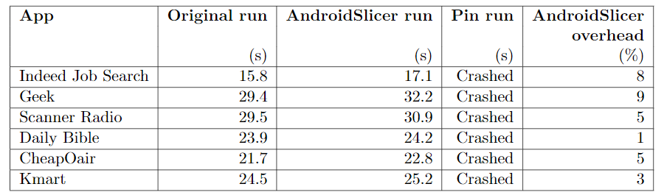
Android Slicing Challenges
Low Overhead:
Dynamic slicing should not interfere with execution of the app.
Resources are more precious in mobiles than in desktops/server programs.
Standard dynamic analyzer Pin crashed the 6 tested apps due to non-responsiveness.
AndroidSlicer had a low over head of around 5% with same 5000 UI events using Monkey setting.
Another issue is introducing delays in GUI event processing.(long swipe vs 2 small swipes).
Also, harmful interference due to GPS timings, or in event delivery and scheduling can derail an execution.

Slide 6
Solution for challenge 1
Optimizing register tracking at the Android Framework(AF)/library boundary
In runtime tracing phase, for a call into the AF/Library, live registers are tracked until boundary of AF/lib: resumed upon exiting the AF/lib.
In the Static analysis phase, we compute taint information(Source->sink) to identify those methods that take values upwards to the AF(sources) as well as those methods which return values downwards to the app code (Sink).
In trace processing phase, we instantiate the static taint information with the registers tracked into and out of the framework.

Slide 7
Android Slicing Challenges
High-throughput Wide-ranging output
Traditional applications take inputs from files, network, keyboard and mouse.
In contrast, Android apps have wide range of sources:
Touch-, sensor- oriented, receiving high throughout, time sensitive input.
Typical per-second event rates are:
70 for GPS
54 for Camera
386 for audio
250 for network
A simple swipe is 301 events per second.
Thus, we require low-overhead tracking of high-throughput multi-sourced input.

Slide 8
Solution for challenge 2
Intercepting the registers at event processing boundary
For example, swipes are series of touches, with event handler :
We intercept the event by tracking the registers that hold the event handler parameters, i.e., e1, e2, velocityX, velocityY, and tagging them as external inputs
2 advantages of this approach:
First, register tracking is efficient, ensuring scalability.
Second, being able to trace program behavior, e.g., helps in efficient and effective fault localization.

Slide 9
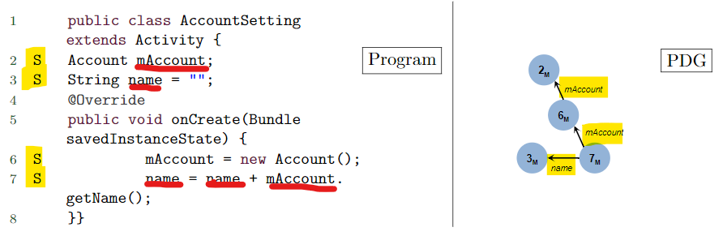
Android Slicing Challenges
3. Finding Program Starting Points
Unlike tradition Java programs, Android apps have multiple entry points.
Tracing back across multiple callbacks() like onCreate() when changing rotation of phone.
Without lifecycle-aware slicing approach i.e., onCreate is called upon restart, we won’t be able to construct the correct slice.
A traditional slicing approach cannot find the start point of slicing and returns empty slice {} instead of {7,6,3,2} when tracking value “name”.

Slide 10
Solution for challenge 3
To discover entry points, we use a fixpoint approach.
We start our analysis at home activity and create pseudo entry points that correspond to callbacks.
This approach is taken from FlowDruid but extended with some necessary callbacks( i.e., callbacks accepting no parameters) to increase precision, according to the following strategy:
Start with pseudo-entry points, including life-cycle callbacks i.e., onCreate(), onResume(), onStart().
Analyse the resulting callgraph using SOOT. If the callgraph contains calls to AF events, such as button clicks, add the corresponding event-handling callbacks to the list of entry points.
For outgoing calls, add the incoming callbacks e.g., for the outgoing call sendBroadcast() we add the corresponding callback onReceive() to the list of entry points.
Continue until convergence to a fixpoint ( no new callbacks to be added ).
Notes:
SOOT - bytecode manipulation and optimization framework consisting of intermediate languages for Java.
Broadcasts are data/information send to or from Android system

Slide 11
Android Slicing Challenges
4. Inter-App Communication
Android relies heavily on inter-process communication (IPC).
The fundamental IPC mechanism is called Intent: using an intent, an activity can start another activity, or ask another app for a service, receiving the result via intents as well.
Implicit Intent vs explicit intents -> No destination vs destination
Implicit intents and consequently, inter-app communications, complicate slicing.
Illustrated in next slide, GetContacts Activity that allows user to pick a contact.
An intent can launch an activity via the startActivity or startActivityforResult.
Without understanding the inter-app intents, traditional slicing would not find the complete slice containing {14,9,10,12,13,8,11,5,4}

Slide 12
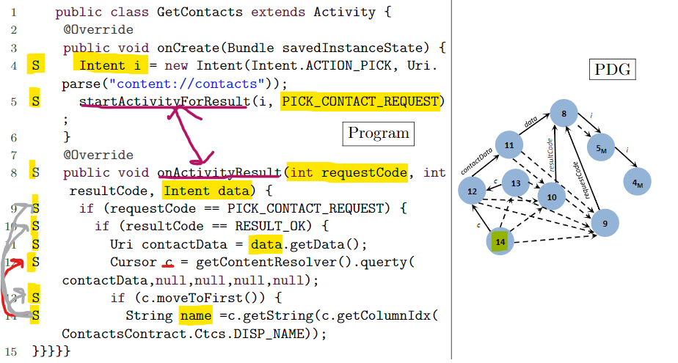

Slide 13
Solution for challenge 4
Analyse app inputs, internal callbacks to detect intents and dependence edges.
IPC message objects (i.e.,Intents) are processed by callbacks hence introduce asynchronous data dependences, which are naturally handled by our approach.

Slide 14
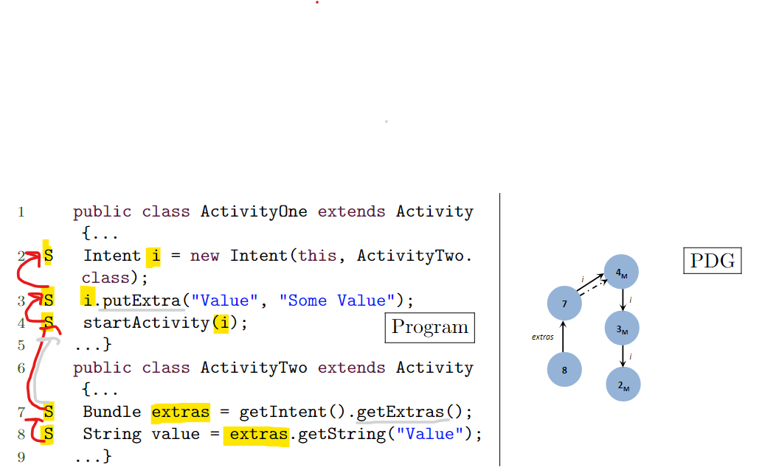
Android Slicing Challenges
5. Intra-App Communication
Explicit intents also complicate slicing.
The illustration below shows ActivityOne starting ActivityTwo. When the slice is computed using traditional slicing, we will get statements {8,7} instead of {8,7,4,3,2} since the traditional slicing ignores the Bundles putExtra and getExtra calls which is mediated by the system.

Slide 15
Solution for challenge 5
We track callbacks and Android Framework APIs
For example if an activity calls another activity through Android APIs startActivity or sendBroadcast by passing an intent, we trace the receiver callback and the parameter referencing the intent.
To summarize, by recording callbacks and intents, AndroidSlicer captures inter-app and intra-app communication precisely, with no under- or over-approximation.

Slide 16
Fixpoint approach, Tracking all Callbacks
Multiple entry points
Callbacks
Inter and Intra App communication issues
Intents
Issues with static analysis on
Android application
Lots of Inputs from wide range of sensors
Event Handlers
Low overhead
Register Tracking at boundary, inputs tracking

Slide 17
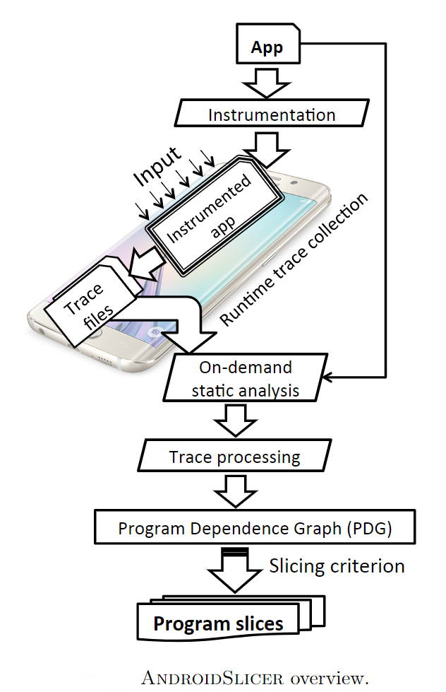
Algorithm Design
Offline Instrumentation Stage
App is instrumented to allow instruction tracing
Online Trace Collection Stage
As the app executes, runtime traces are collected
Final Offline Computation Stage
On-Demand Static analysis to optimize trace processing and then compute the PDG. Finally, we calculate slice for a given slicing criterion.
Compute PDG
Calculate Slices for a given slicing criterion.

Slide 18
Instrumentation Stage
This stage is three Fold
Identify app entry points,
Construct method summaries,
Add instructions/metadata tracing capabilities to the app.
Finding app entry points
Performed via a fix point Computation as discussed before in challenge 3
First, we use static analysis and create a “dummy” main method that systematically considers all system callbacks from a callback definition file.

Slide 19
2. Constructing method Summaries
Method summaries (which include in/out registers and method type) capture method information for the online trace collection phase.
We first build a callgraph for each app class from the analyzed app entry points to create method summaries (i.e., in/out registers and method type).
For each node graph, we add instrumentation tags that summarize that method.
We identify intents referenced through registers used as callback parameters and construct metadata such as caller information (i.e., name of the callback-generating and broadcasting the intent), as well as string properties associated with the intent’s action filter.
This information helps reveal callers and their callees during offline trace analysis.
3. Adding tracing instructions
We add tracing capabilities via Soot.
AndroidSlicer’s instrumenter takes the app binary as input; the output is the instrumented app, which we run on the phone.
To support tracing, we inject a new Dexcode instruction for every app instruction or callback routine.

Slide 20
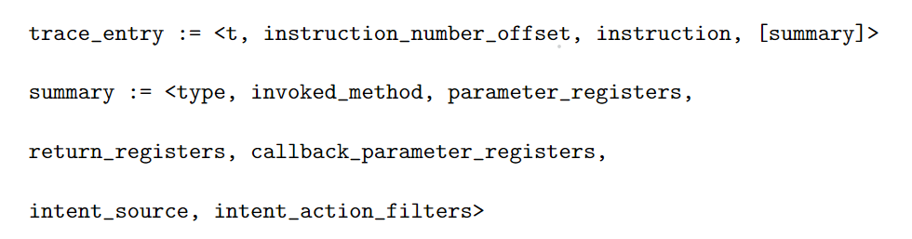
2. Runtime Trace Collection stage
Traces are collected when the instrumented app is running on the phone. Format of traces is as follows.
t – actual time the instruction was executed
Instuction_number_offset – relative line number in the printed dex code
Summary – for method invocations – method type(IPC or non IPC) , in/out register values
Intents and the action string associated with intent.

Slide 21
3. On-demand Static Analysis
PDG contains data and control dependence edge for regular and super nodes(Callbacks).
To construct PDG, we conduct a post-run on-demand static analysis that uses the collected runtime information to narrow down the scope of static analysis to those app parts that were exercised during run.
Instead of analyzing whole program which raises issues of scalability and precision, we only analyze those methods encountered during execution.

Slide 22



4. Trace processing and PDG construction
Static analysis produces StaticDatasi and StaticControlsi which essentially contain data and control dependence nodes for instruction si.
Constucting PDG
Sequential data dependence edges - add dd edges of instructions StaticDatasi for each si.
Sequential control dependence edges - add cd edges of instructions StaticDatasi for each si.
Asynch. data dependence superedges - add dd superedges of instructions to caller for each callback callee. Info from static analysis.
Asynch. Control dependence superedges – if there is no DD between two consecutive activity contexts i.e., callback callee and its caller (N1, N2 ), we add control dependence . Otherwise, we add control dependence superedge where N0 is the super node N1 is control dependent on.

Slide 23



5. Generating program Slices from PDG
Given slicing criterion and PDG, we extract OUTst of distinct node in the PDG we encounter while backward traversing from st to any of the app entry points affecting the value vs.
BFS traversal of nodes
For each node n’ in set , we add n’ to OUTst. If n’ is a supernode and , we expand on n’.
To reduce number of nodes in OUTst (to avoid repetition), we make 2 optimizations:
Node Merging:
Similar nodes -> merge,
Similar Super nodes with control dependencies -> merge
Similar Super nodes with data dependencies-> expand into instructions and merge them.
Loop Folding: merge two distinct nodes n,n’ in loop if n <-c n’ and n’ <-c n and .

Slide 24
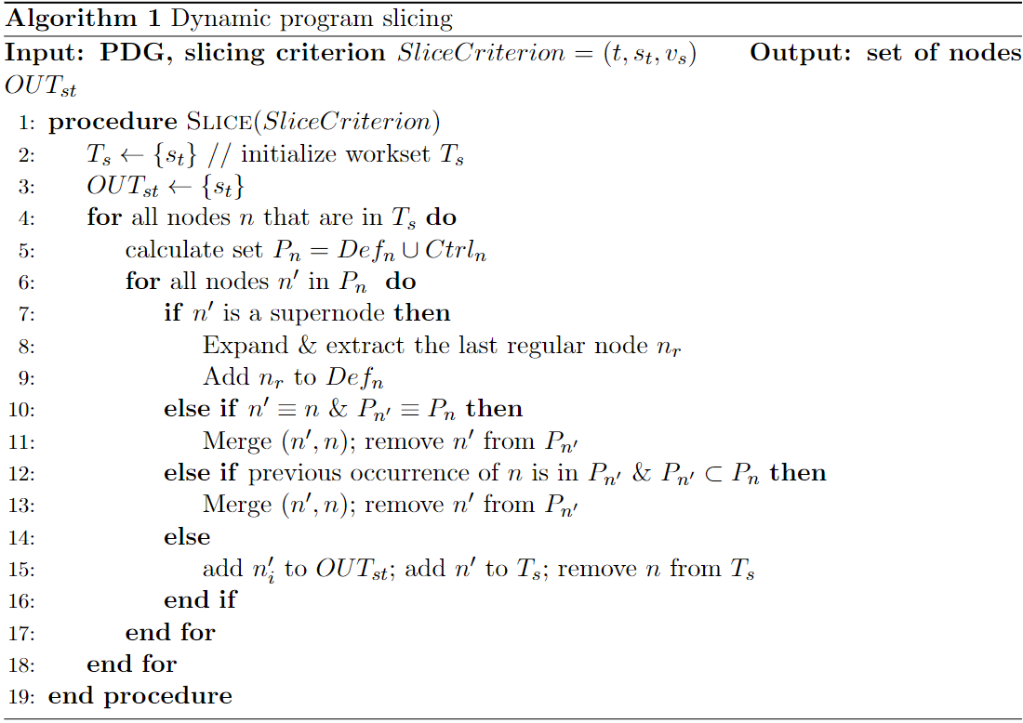

Slide 25
6. Limitation of Implementation
AndroidSlicer’s Intrumenter is based on SOOT, it inherits SOOT’s static analyse size limitations e.g., couldn’t handle large apps like Facebook.
Can be overcome with next-generation static analyzers.

Slide 26
Applications of AndroidSlicer
Three Applications:
Failure inducing input analysis
Fault localization
Regression test suite reduction

Slide 27


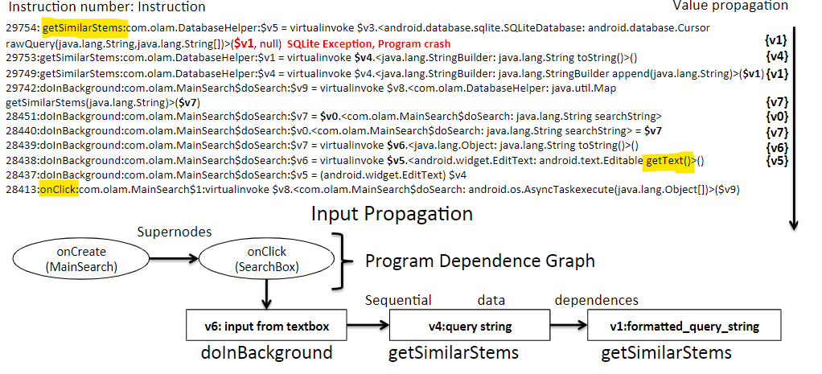
1. Failure-inducing Input Analysis
Finds input parts responsible for a crash or error.
Given , Output : along with their callbacks

Slide 28
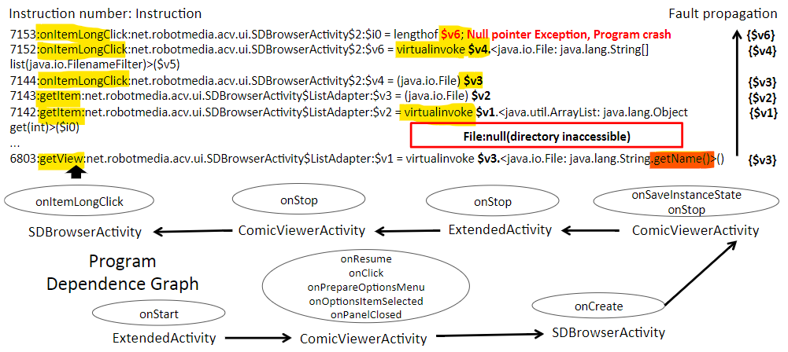
2. Fault Localization
detect and identify the location of a fault in an app
Given and Verror, output, set of instructions leading to the error.

Slide 29
3. Regression Test Suite Reduction
Regression testing validates that changes introducd in a new app do not “break” features that worked previously.
Give two apps V1 and V2, a test suite T1 that has run on V1:
We need to find T2, the minimal subset of T1, that needs to be rerun on V2 to ensure V2 preserves V1’s functionality.
Testcase selection: rerun only those test cases whose slices contain a modified statement.

Slide 30
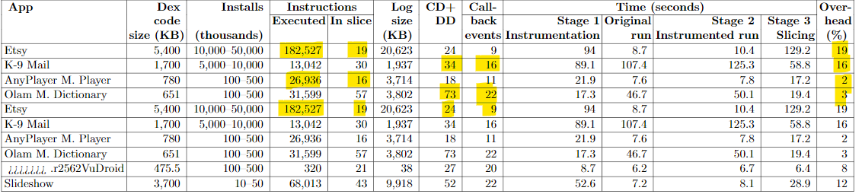
Evaluation
Core Slicing
App Dataset: 60 apps from play store
Generating inputs and slicing criteria : Monkey setting to send the app 1000 UI Events.
Correctness: Manual analysis of 10/60 apps. No omitions or incorrect additions
Efficient: Low overhead of around 4%
On 6 apps :
Failure-inducing input analysis: instructions 320-182,527 but slices 16-57 instructions

Slide 31
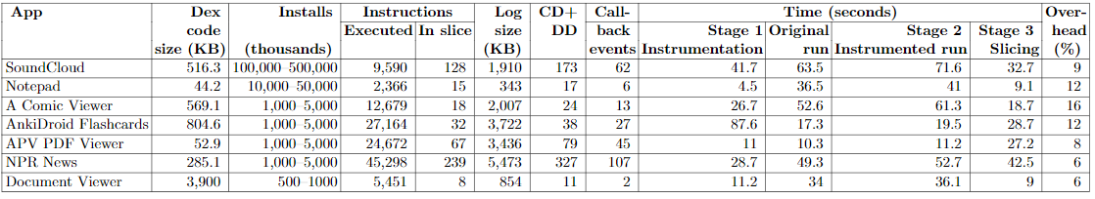
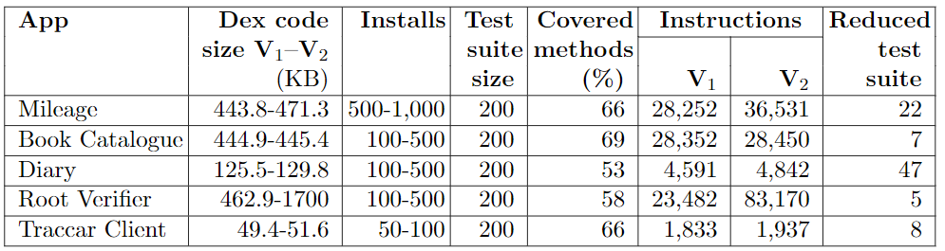
Fault Localization:
Regression Test Suite Reduction :

Slide 32
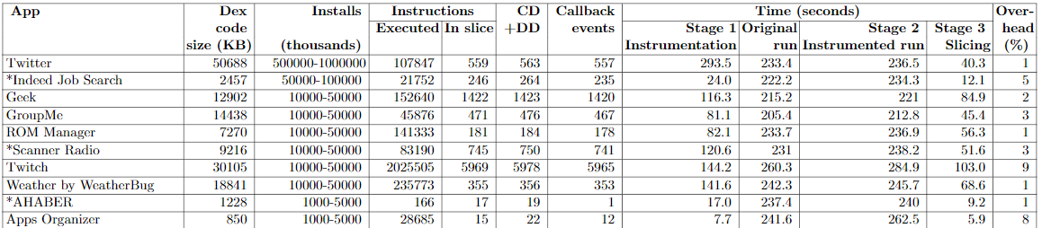

Slide 33
Related Work
In Web applications:
Slicing event-based programs -> Web applications (HTML,PHP,JS)
Both are event-based but Android App lifecycle causes apps to run in different scopes and handle different sets of requests while Web apps have different build phases.
Web app slicing tool (plugin) doesn’t require low overhead.
Android requires IPC tracking.
In Static Slicing for Android apps (SAAF):
Static slicing doesn’t consider many aspects like late binding to dynamic event order.

Slide 34
Summary
A new slicing approach and tool for Android that addresses challenges of event-based model.
Asynchronous slicing approach that is precise yet low-overhead
Experiments have been effective and efficient
Future work:
Forward Slicing
Language agnostic slicing (different programming languages)

Slide 35
Questions ?

