Slide 1



IMDb data into relational database management systems
Presented By: Sai Teja Tirunamala
Supervisor : Dr. Feng Gorge Yu

Slide 2
Outline
Collecting data
1)Getting the data from IMDB official website
2)Converting TSV formatted files to csv format
Coding and MySQL
3)Installing MYSQL and PYTHON and parsing data into MYSQL
4)Performing queries to check the 7 datasets
Exporting data
5)Exporting the datasets into .SQL files
6)Creating entity relationship model using 7 datasets

Slide 3
Requirements
MySQL workbench
MySQL command line client
Python
Excel
PuTTY
SSH

Slide 4
What is IMDB?
IMDB database is an online database of information related to movies ,tv shows, videos, streaming contents, reviews and ratings.
Till January 2020 they are 83 million registered users, 4.1 million titles and 10.4 million personalities of databases.
Large amount of data is contributed by volunteers with 24 hours or 72 hours of approval.
IMDb does not provide an API for automated queries. However, data can be downloaded as compressed files.

Slide 5
MYSQL and Relational Database management system
MySQL is a relational database management system based on SQL- Structured query language.
MySQL is widely used for a range of purposes including data warehousing, e-commerce and logging application. The most common use for MySQL is for web database
Relational databases consists of rows and columns.
SQL is the standard user and application program interface for a relational databases.
These are very easy to modify and join 2 or more tables using SQL queries.
Popular examples of standard relational databases include Microsoft SQL server, Oracle Database, MySQL and TBM DB2.

Slide 6
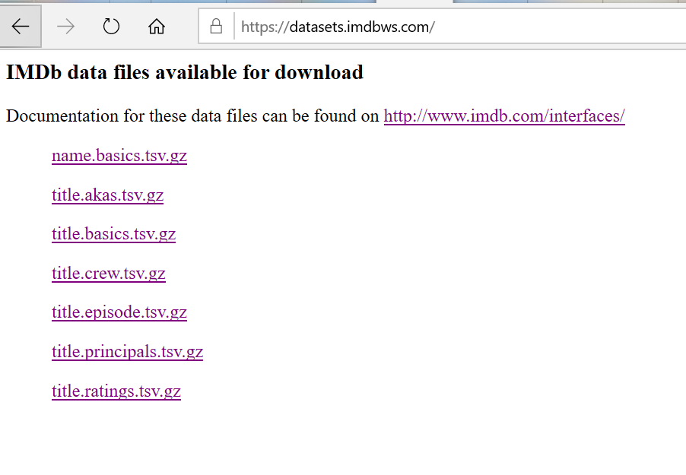
Getting the data from the IMDb website
https://datasets.imdbws.com/ this is the link which is provided by the IMDB website to download the 7 datasets for this project.
Each dataset is G-zipped which are tab- separated- value (TSV) UTF-8 Character set.

Slide 7
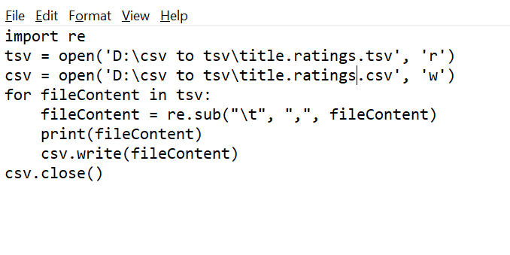
Converting tab separated values into comma-separated values using python
re
Import re – regular expressions
Python supports re through libraries
Re supports modifiers , Identifiers and white space charaters
‘r’ for read
‘w’ for write

Slide 8
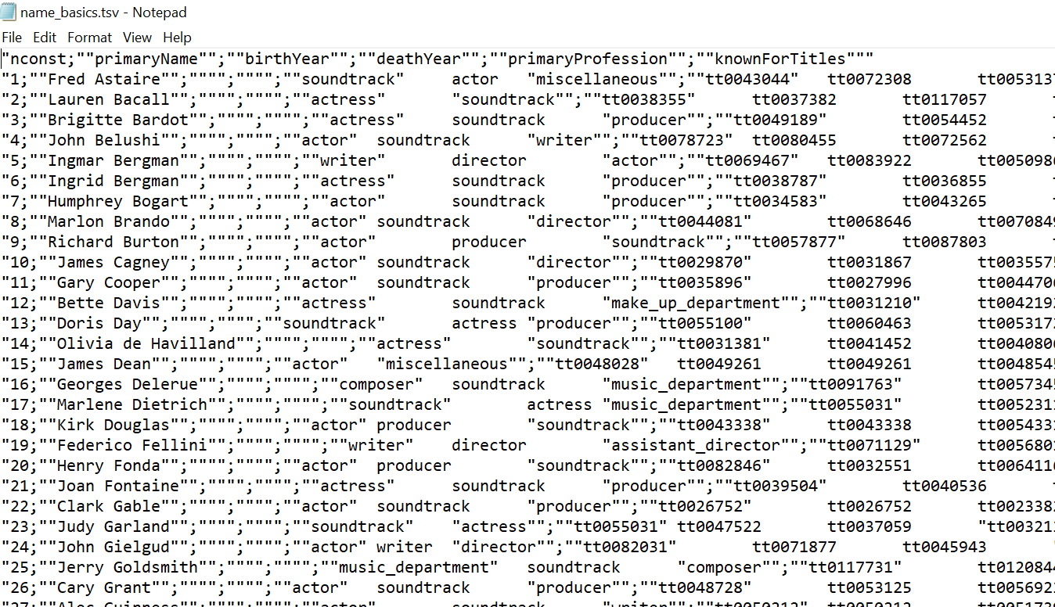
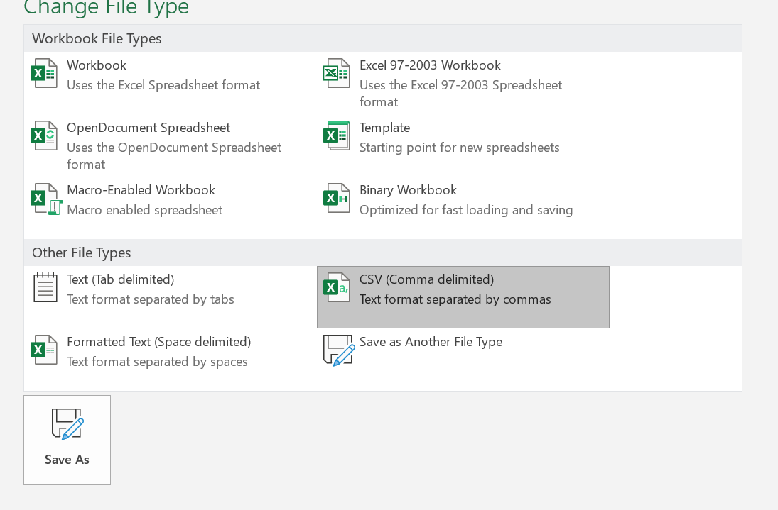
Converting the Tab separated values(TSV) to comma-separated values(CSV)
The dataset files are of G-zip compressed and to make the files readable we need to covert into CSV file. They are many ways to convert the data like using excel.

Slide 9
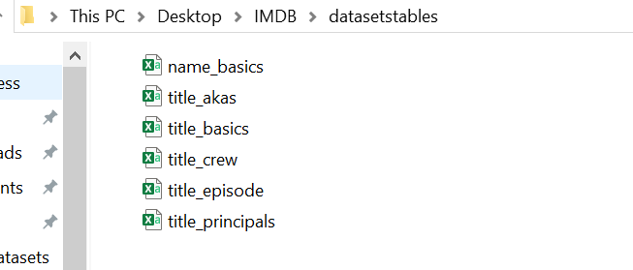
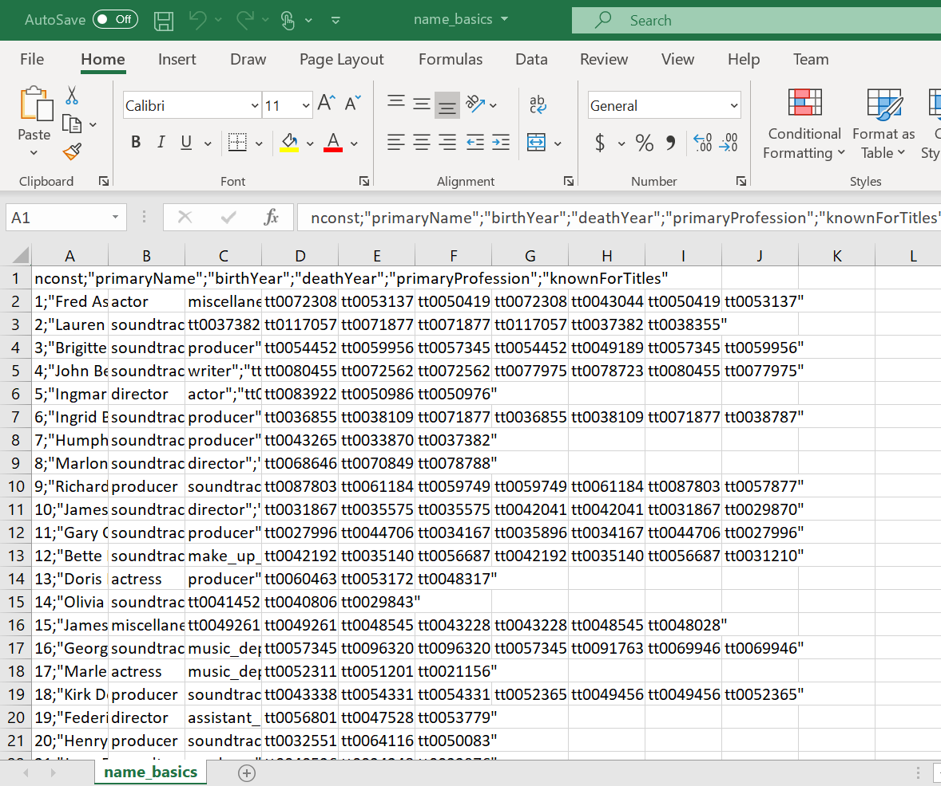
Datasets in comma separated values (csv)
Sample of one of the 7datasets of IMDB on excel

Slide 10
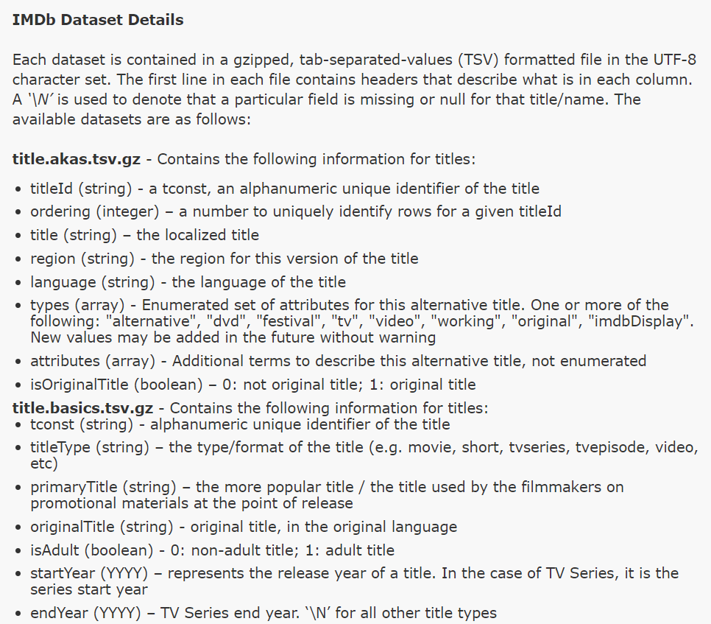
Analyzing the schemas of the datasets
The official website provides the information presented inside each titles and the datatype of each titles.

Slide 11
IMDB Dataset Details
Title.akas.tsv.gz
Title.basics.tsv.gz
Title ID
Ordering
Title
Region
Language
Types
Attributes
Is original title
T constant
Title type
Primary title
Original title
Is adult
Start year
End year
Run time
Genres
Name.basics.tsv.gz
N constant
Primary name
Birth year
Death year
Primary Professions
Know for titles

Slide 12
Title.ratings.tsv.gz
Title.principals.tsv.gz
T constant
Ordering
N constant
Category
Job
characters
T constant
Average rating
Num of Votes
Title.crew.tsv.gz
Title.episode.tsv.gz
T constant
Directors
Writers
T constant
Parent t constant
Season number
Episode number

Slide 13
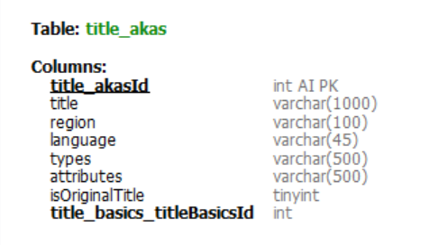
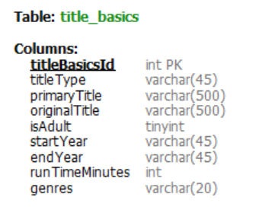
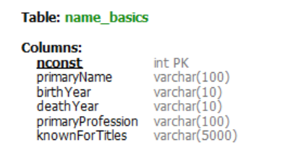
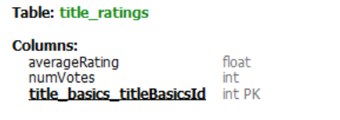

Slide 14
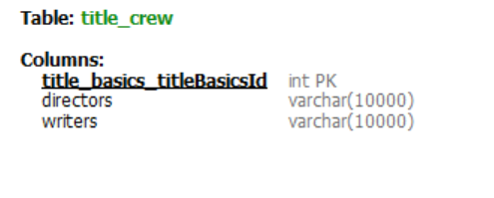
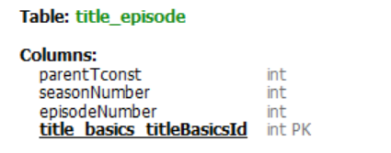
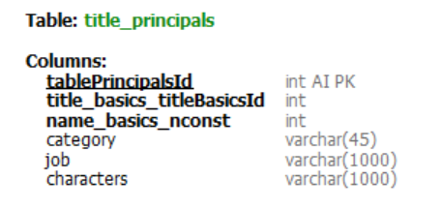

Slide 15
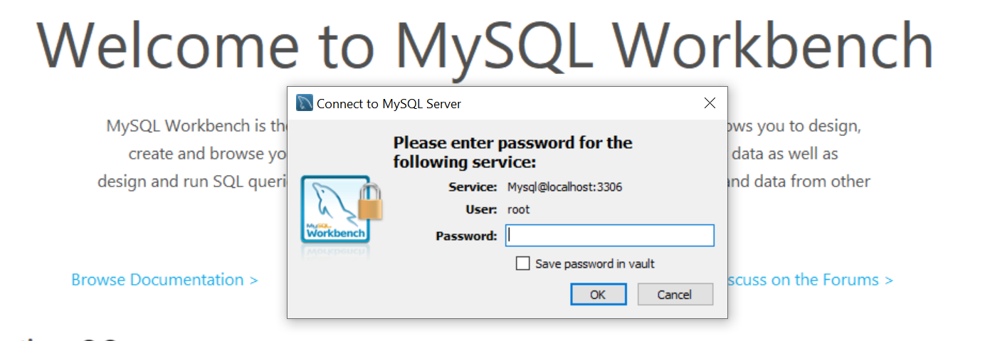
Installing MYSQL workbench and importing datasets into MYSQL workbench
After installation we need to connect it to the server and create a username and password.
Python code is used to parse the datasets into the MYSQL datasets.

Slide 16
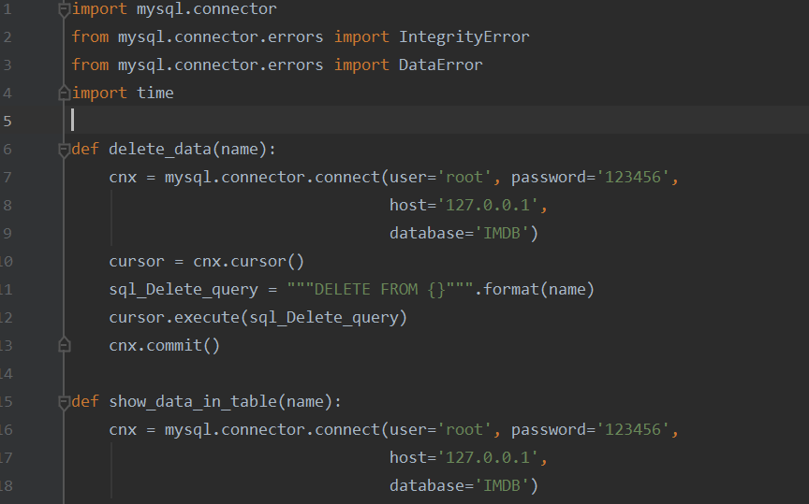
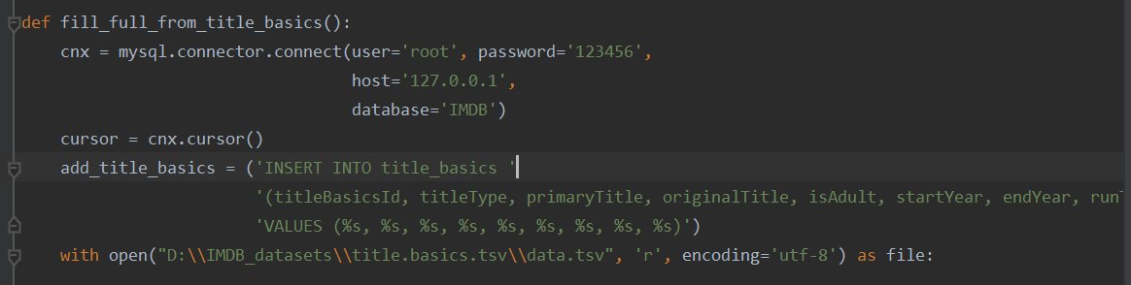
Python code for parsing the datasets into SQL databases
Import mysql.connector is used for the connection between module API and MySQL database.
IntegrityError and DataError modules defines expetion classes for errors and dataerrors.
Cursor = cnx.cursor() returns a MySQL cursor object.
Cnx = mysql.connector.connect(user=“”,Passwd =“”,database=“”) for establishing connection and using the database as specified.

Slide 17
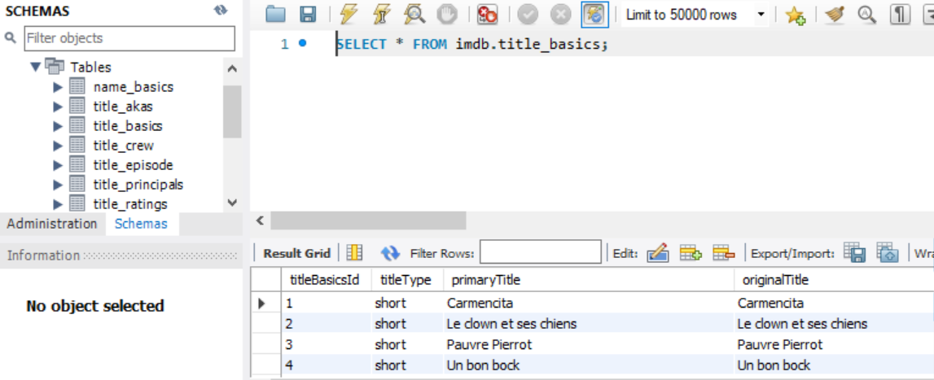
Basic query performed to select tables on MySQL workbench
7 Datasets of IMDb

Slide 18
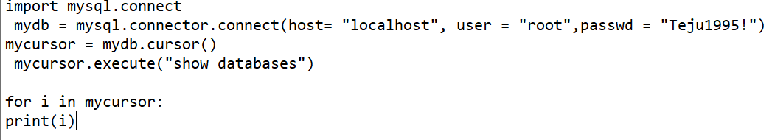
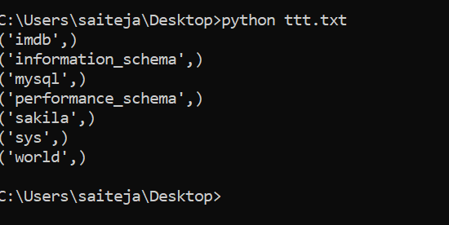
Python code to show the databases on command prompt
The above code establishes connection with MySQL and shows the databases available in it.

Slide 19
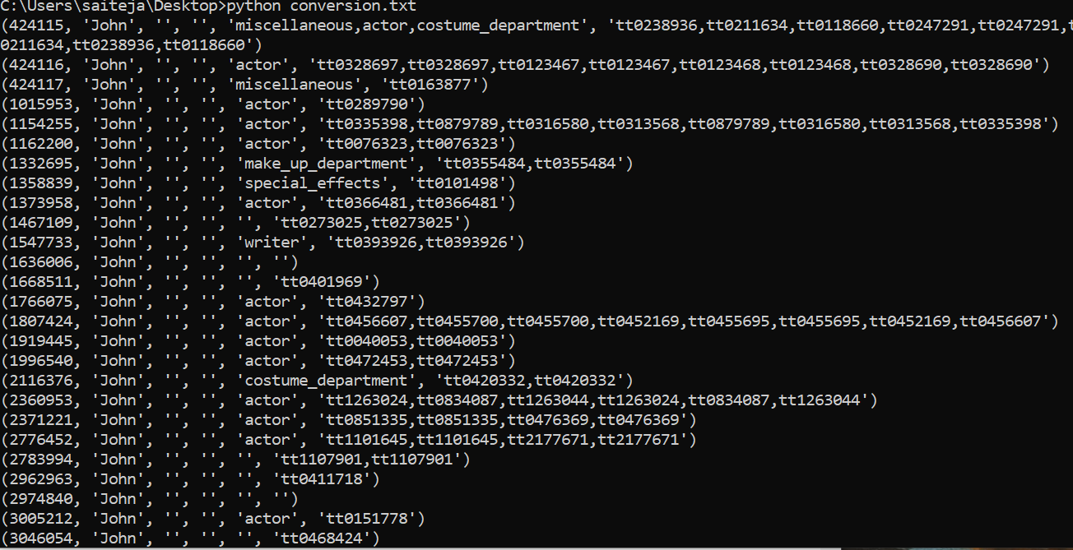
SELECT * FROM imdb.name_basics where primaryName ='john’; is the example chosen to display the data in command prompt.

Slide 20
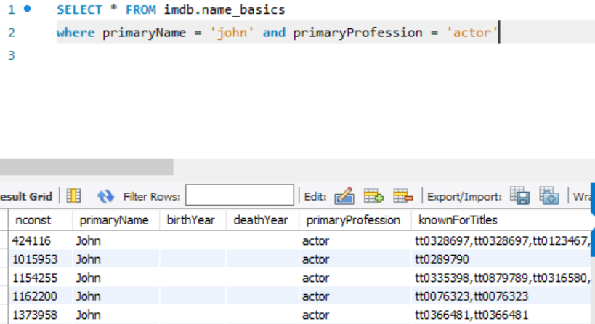
Query examples performed in MYSQL workbench

Slide 21
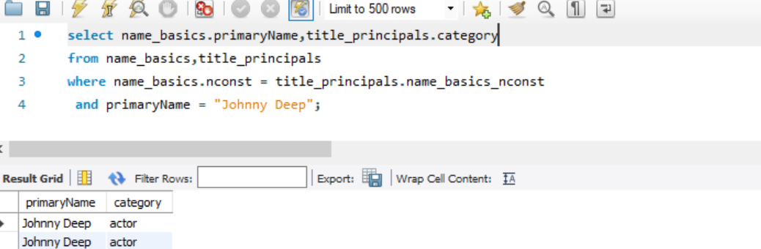
Query example: Joining 2 datasets

Slide 22
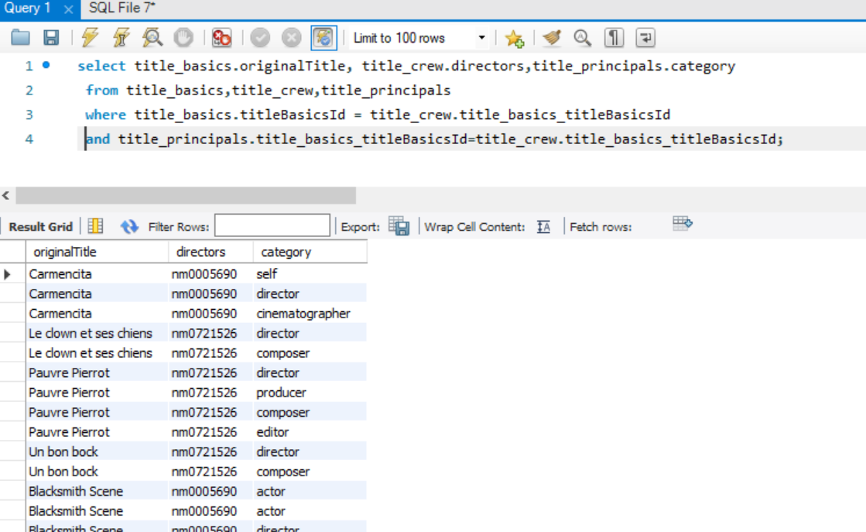
Joining 3 datasets

Slide 23
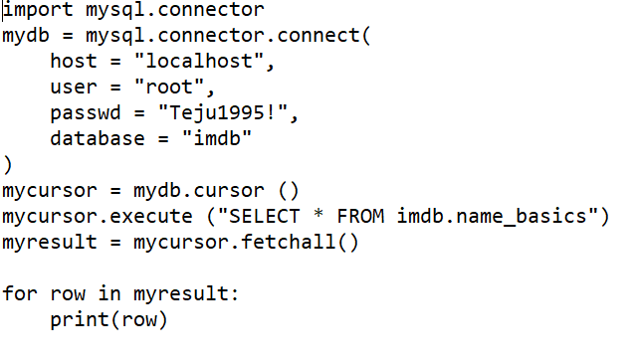
Python code for exporting MySQL tables
Establishing connection and giving access to the server by providing user and password details.
mycursor.execute gives the entire list of the data in imdb.name_basics.

Slide 24
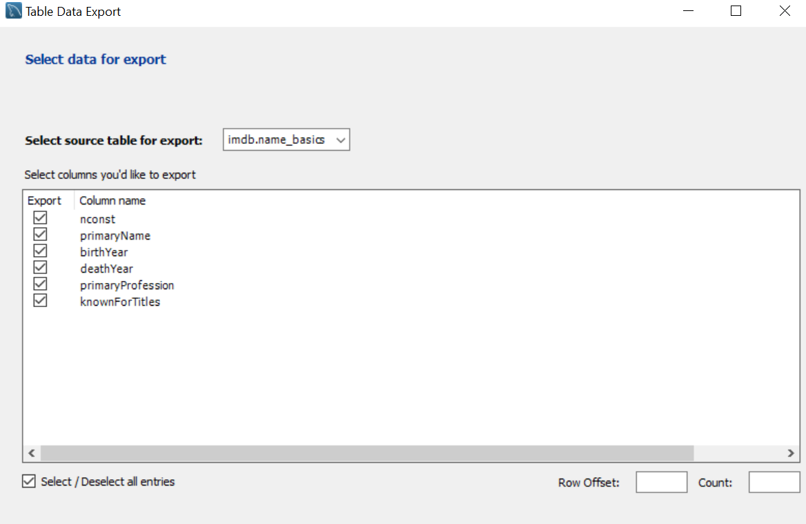
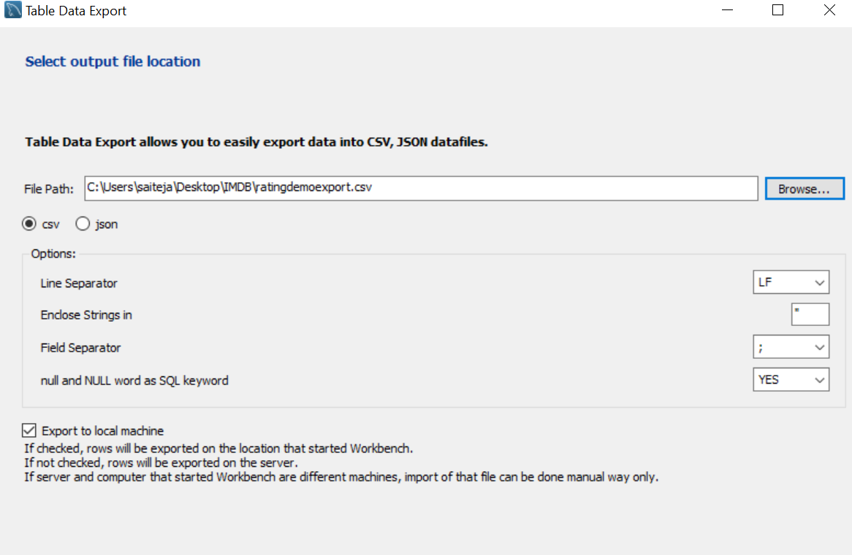
Right click on the table which needed to be exported and the click on the export wizard.
Select the required column name and click next.
Choose the file path and select the csv or Json options and click next and finish to export the table from the MySQL workbench.

Slide 25
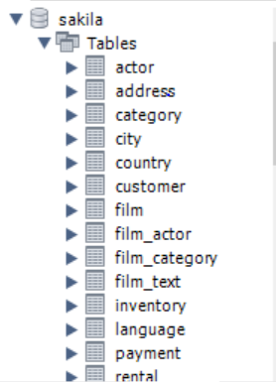
Importing open source database
https://dev.mysql.com/doc/index-other
MySQL provides an open source database for practice.
Its in TGZ and ZIP file format contains tables like actor, film, actors so on similar as IMDB datasets.

Slide 26
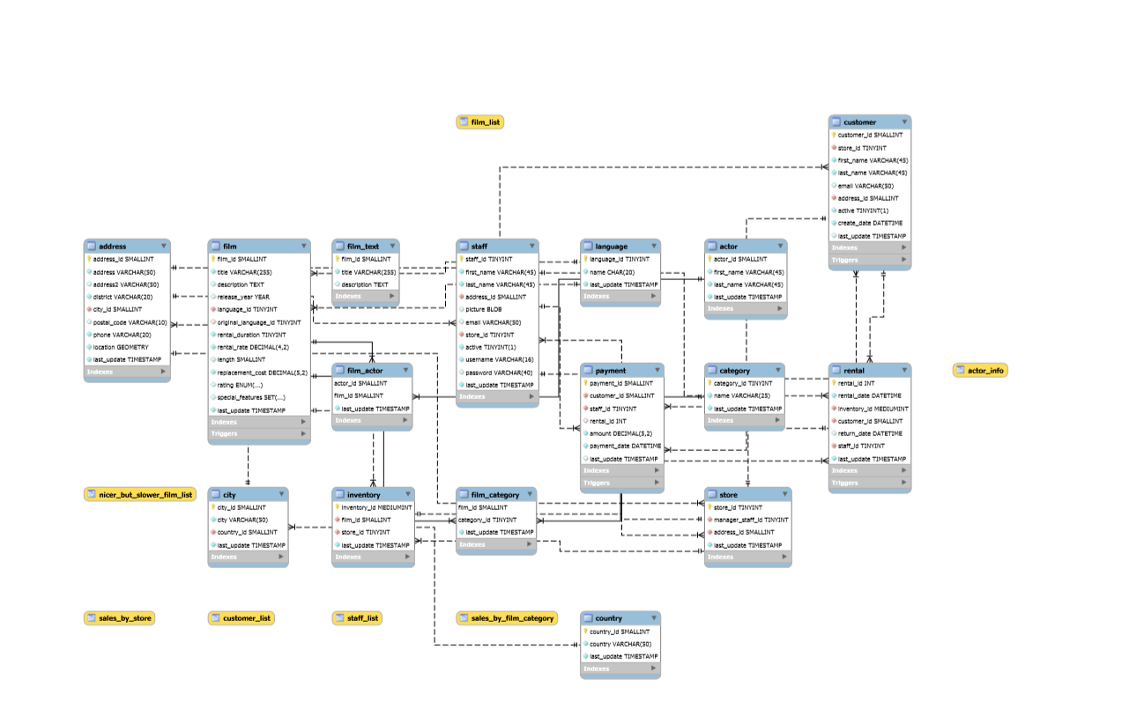
Entity relationship Diagram

Slide 27
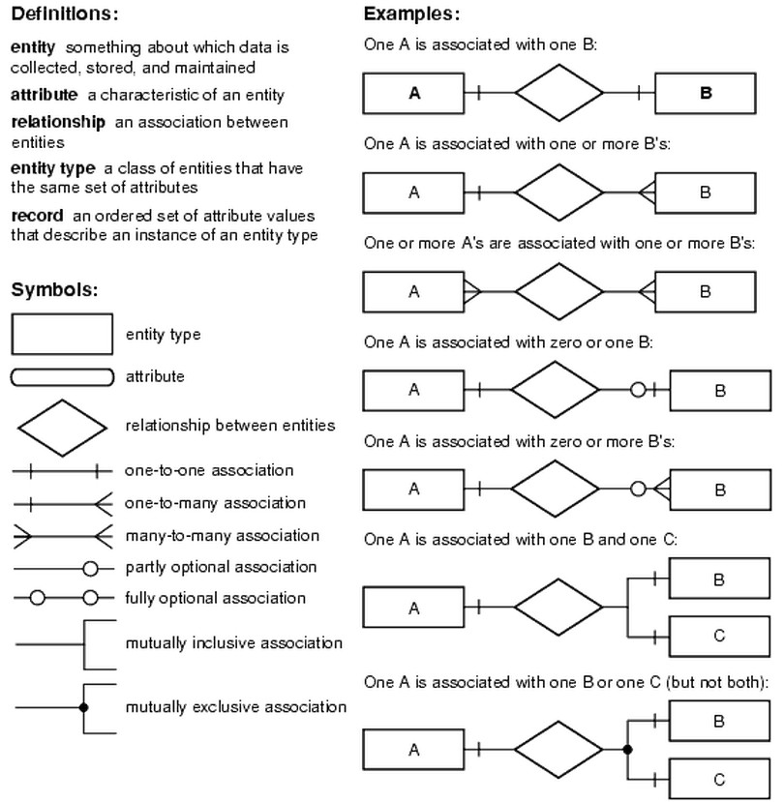
Entity-Relationship Model
An entity-relationship model describes interrelated things of interest in a specific domain of knowledge.
A basic ER model is composed of entity types and specifies relationships that can exist between entities.
ER diagrams are used to analyze existing databases to find and resolve problems in logic or deployment.

Slide 28
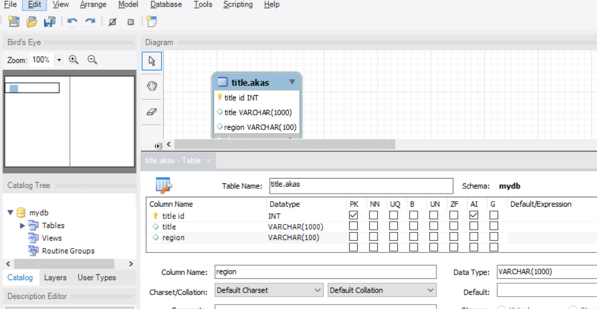
Creating ER diagram for the 7 datasets
The workbench provides the user to choose the table name, column name, data type.
Primary key , not null, unique index, binary column, unsigned data type, auto incremental and generated column to be provided .

Slide 29
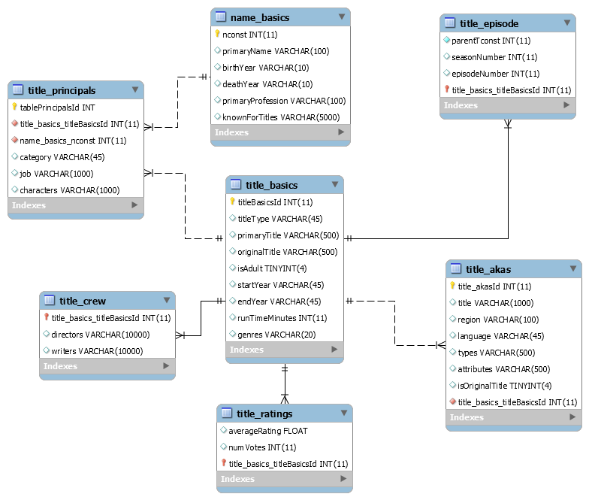
Entity relationship diagram of 7 IMDb datasets

Slide 30
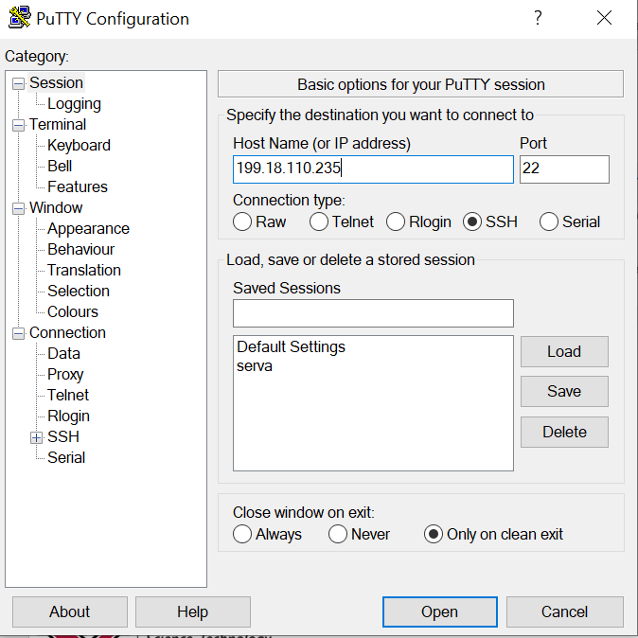
PuTTY Configuration
PuTTY is an open-source terminal emulator and network file transfer application
Includes SCP ,SSH
Provide the IP address and port number

Slide 31
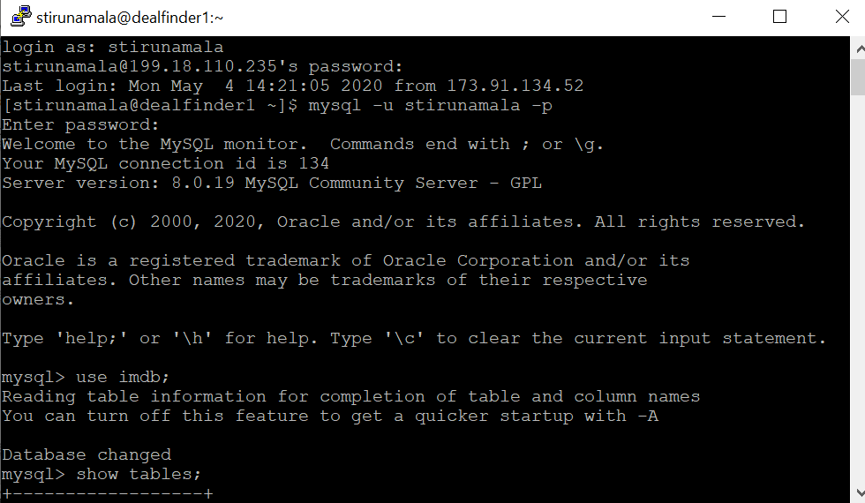
Login using the account name
Password and MySQL –u [username] –p to get into the MySQL server.

Slide 32
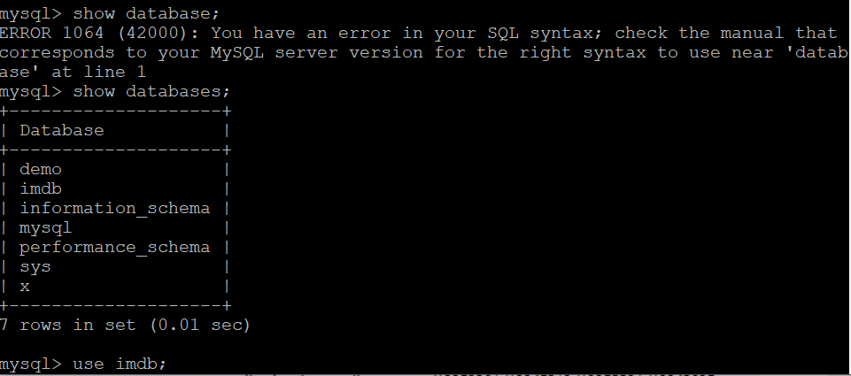
Importing .SQL files to the remote server MySQL
Once you obtain the IP address of the remote server, using PUTTY we need to get into the MySQL using the command mysql –u [username] –p and create a new database to import the datasets.
Use command mysqldump –u [username] –p[password] [database_name] >[dump_file.sql] . All the 7 datasets are imported into the remote server

Slide 33
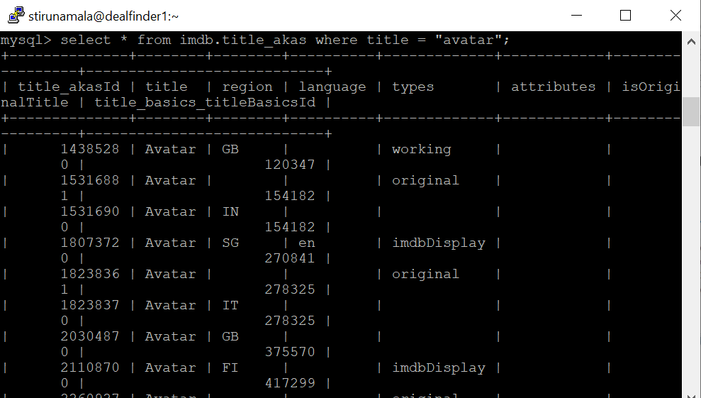
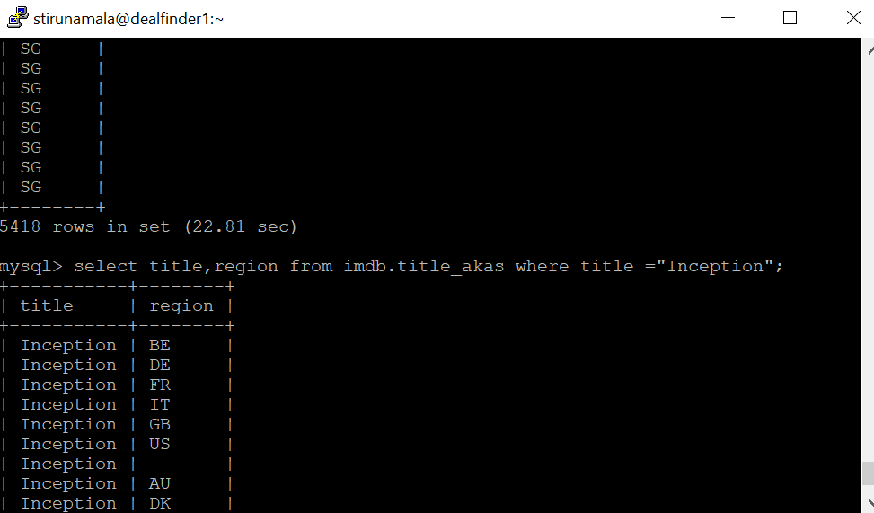
Performing a query to check the datasets in remote server

Slide 34
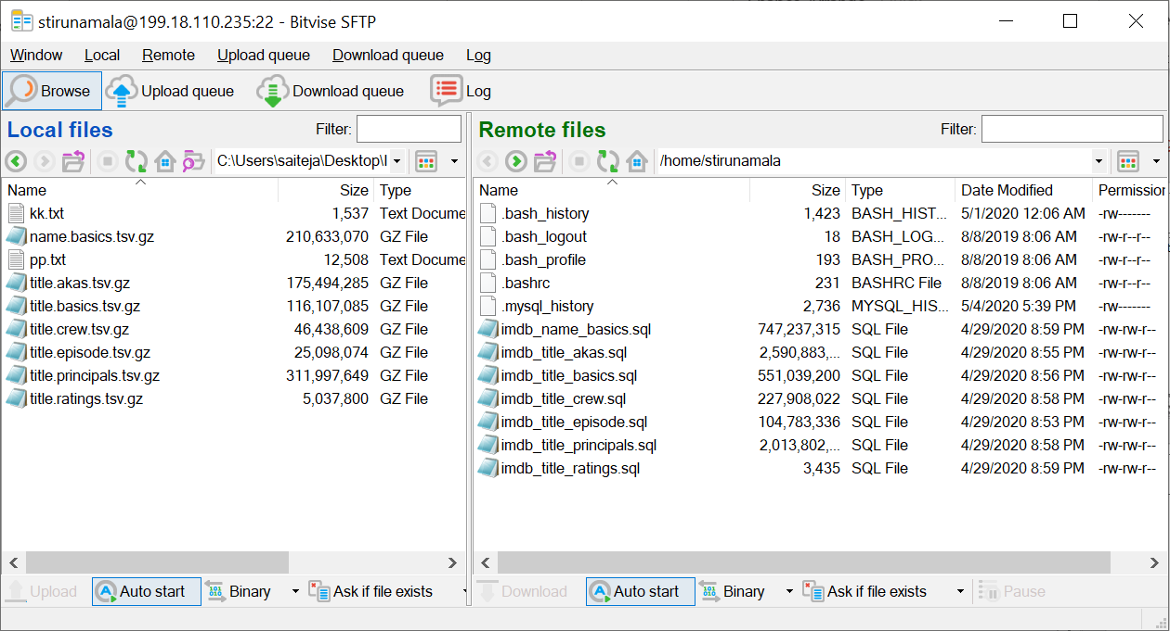
.SQL file path on remote server
Bitvise SSH server supports secure, encrypted file transfer using the protocols SFTP
I have created a folder name IMDb database and stored the 7 .SQL files in it.

Slide 35

Mail ID : Stirunamala@student.ysu.edu
GitHub link : https://github.com/saitejaleo/IMDB-datasets
THANK YOU

