Slide 1

JDBC(Java Database Connectivity)

Slide 2
Agenda
Introduction to JDBC
JDBC Driver
Types Of JDBC Drivers
JDBC API
DriverManger
Statement
PreparedStatement
DatabaseMetadata
ResultSetMetada
RowSet

Slide 3
What is JDBC?
JDBC stands for Java Database Connectivity.
JDBC is a Java API to connect and execute the query with the database.
JDBC API uses JDBC drivers to connect with the database.

Slide 4
What is JDBC Driver?
A JDBC driver is a software component enabling a Java application to interact with a database server.
Introduced by Sun Microsystem in 1997
JDBC Driver is platform independent.(Type IV).
Supports only java language.

Slide 5
Types of JDBC Driver
JDBC-ODBC Bridge Driver
Native-API driver
Network-Protocol driver (middleware driver)
Database-Protocol driver (Pure Java driver)

Slide 6
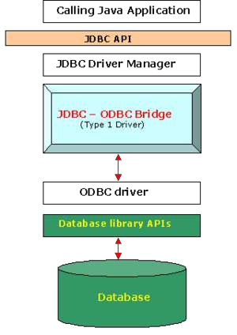
Type 1: JDBC-ODBC Bridge Driver
The JDBC-ODBC bridge driver uses ODBC driver to connect to the database. The JDBC-ODBC bridge driver converts JDBC method calls into the ODBC function calls.

Slide 7
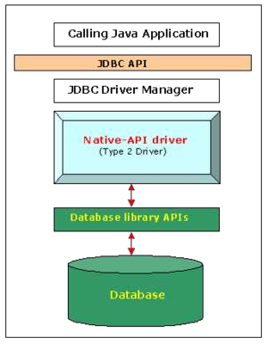
Type 2: JDBC-Native API Driver
It converts JDBC method calls into native C/C++ API calls, which are unique to the database. It is not written entirely in java.

Slide 8
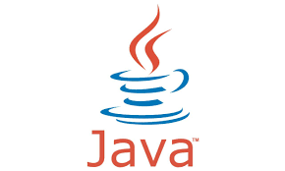
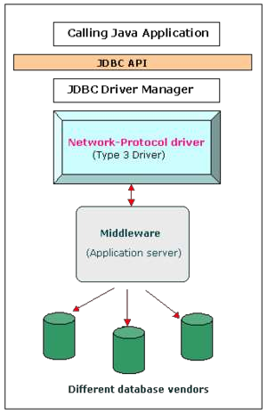
Type 3: Network-Protocol driver
The Network Protocol driver uses middleware (application server) that converts JDBC calls directly or indirectly into the vendor-specific database protocol.
It is fully written in java.
.

Slide 9
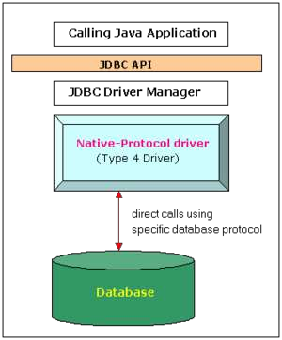
Type 4: Database-Protocol driver
In a Type 4 driver, a pure Java-based driver communicates directly with the vendor's database through socket connection.
This is the highest performance driver available for the database and is usually provided by the vendor itself.

Slide 10
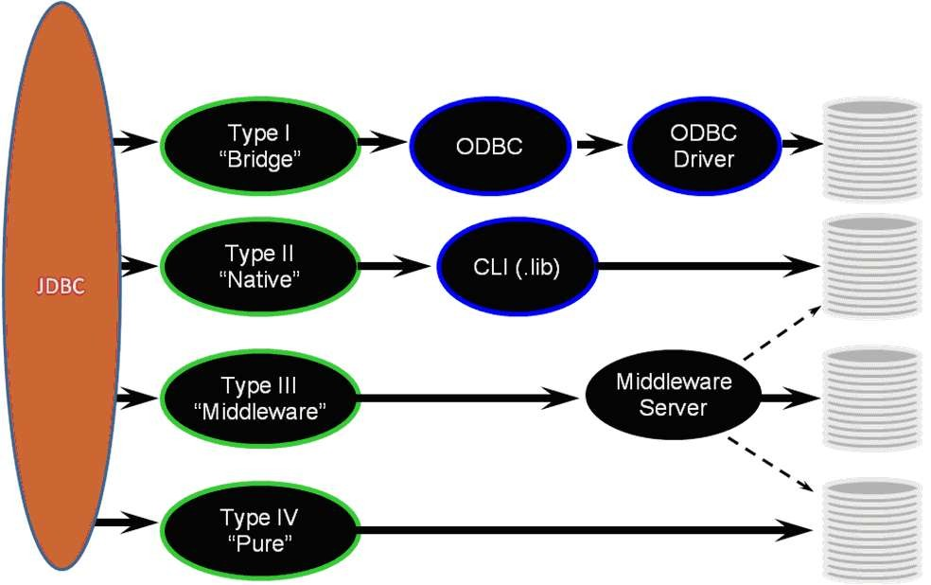
Architecture of JDBC Driver

Slide 11
JDBC API
Classes and interfaces of JDBC API
java.sql:package
Interfaces
Statement
PreparedStatement
CallableStatement
ResultSet

Slide 12
JDBC API(Contd….)
Classes
DriverManager
Date
Types

Slide 13
Statement
The Statement interface provides methods to execute queries with the database.
The statement interface is a factory of ResultSet i.e. it provides method to get the object of ResultSet.
Methods
1) public ResultSet executeQuery(String sql):
2) public int executeUpdate(String sql):
3) public boolean execute(String sql):
4) public int[] executeBatch():

Slide 14
ResultSet
The object of ResultSet maintains a cursor pointing to a row of a table.
Some Imp Method:-
1) public boolean next():
2) public boolean previous():
3) public boolean first():
4) public boolean last():
7) public int getInt(int columnIndex):
8) public int getInt(String columnName):
9) public String getString(int columnIndex):
10) public String getString(String columnName):

Slide 15
Example-JDBC
public class JdbcExample {
static final String DB_URL = "jdbc:mysql://localhost:3306/enfec";
static final String USERNAME = "root";
static final String PASSWORD = "root";
static final String SQL = "SELECT * FROM emp";
public static void main(String[] args) {
// Open a connection
try(Connection conn = DriverManager.getConnection(DB_URL, USER, PASS);
Statement stmt = conn.createStatement();
ResultSet rs = stmt.executeQuery(SQL);) {
// Extract data from result set
while (rs.next()) {
// Retrieve by column index
System.out.print("ID: " + rs.getInt(0));
System.out.print(", EmpName: " + rs.getInt(1));
System.out.print(", Salary " + rs.getString(2));
}
} catch (SQLException e) {
e.printStackTrace(); }} }

Slide 16
Preparedstatement
The PreparedStatement interface is a subinterface of Statement.
It is used to execute parameterized query.
Methods
public void setInt(int paramIndex, int value)
public void setString(int paramIndex, String value)
public void setFloat(int paramIndex, float value)
public void setDouble(int paramIndex, double value)
public int executeUpdate(String sql)
public ResultSet executeQuery(String sql).

Slide 17
Example - PreparedStatement
PreparedStatement stmt=con.prepareStatement("insert into Emp values(?,?)");
stmt.setInt(1,1001);//1 specifies the first parameter in the query
stmt.setString(2,"Meeta");
int i=stmt.executeUpdate();
System.out.println(i+" records inserted");
con.close();

Slide 18
Callablestatement
CallableStatement interface is used to call the stored procedures and functions
Get the Instance of Callable Statement
public CallableStatement prepareCall("{ call procedurename(?,?...?)}");

Slide 19
Example-CallableStatement
CallableStatement mcall;
try
{
con=DriverManager.getConnection("jdbc:mysql://localhost:3306/
enfec","root","root");
String str="{call inrStud(?,?)}";
mcall=con.prepareCall(str);
mcall.setInt(1,899);
mcall.setString(2,"Sumit");
boolean b=mcall.execute();
}
catch(SQLException sq){
……………..
…………….
}

Slide 20
ResultsetMetadata
The metadata means data about data i.e. we can get further information from the data table info like(column, column name,columntype etc. ).
ResultSetMetaData interface is useful because it provides methods to get metadata from the ResultSet object.

Slide 21
Example-ResultSetMetaData
Connection con=DriverManager.getConnection
("jdbc:mysql://localhost:3306/enfec","root","root");
Statement st=con.createStatement();
rs=st.executeQuery("select * from emp");
ResultSetMetaData resultsetmetadata = rs.getMetaData();
int i = resultsetmetadata.getColumnCount();
System.out.println("i"+" "+i);
String col1 = resultsetmetadata.getColumnName(1);
String col2 = resultsetmetadata.getColumnName(2);
System.out.println(col1 + " " +col2 +" ");

Slide 22
DatabaseMetadata
DatabaseMetaData interface provides methods to get meta data of a database such as database product name, database product version, driver name, name of total number of tables, name of total number of views etc.

Slide 23
Example-DatabaseMetaData
Connection con=DriverManager.getConnection("jdbc:mysql://
localhost:3306/n1","root","root");
DatabaseMetaData dbmd=con.getMetaData();
System.out.println("Driver Name :"+dbmd.getDriverName());
System.out.println("DatabaseProduct:"+dbmd.getDatabaseProductName());
System.out.println("Database ProductVersion"+dbmd.getDatabaseProductVersion());
System.out.println("Driver Version"+dbmd.getDriverVersion());
System.out.println("User name"+dbmd.getUserName());

Slide 24
Transaction Management
Transaction represents a single unit of work.
The ACID properties describes the transaction management well. ACID stands for Atomicity, Consistency, isolation and durability.

Slide 25
ACID Properties
Atomicity means either all successful or none.
Consistency ensures bringing the database from one consistent state to another consistent state.
Isolation ensures that transaction is isolated from other transaction.
Isolation ensures that transaction is isolated from other transaction.

Slide 26
Batch Processing in JDBC
Instead of executing a single query, we can execute a batch (group) of queries.
It makes the performance fast.
java.sql.Statement and java.sql.PreparedStatement interfaces provide methods for batch processing.

Slide 27
Methods for Batch Processing
void addBatch(String query)
int[] executeBatch()

Slide 28
Example – Batch Processing
Statement stmt = conn.createStatement();
conn.setAutoCommit(false);
String SQL = "INSERT INTO Employees VALUES(101,'Mona',9000)";
// Add above SQL statement in the batch.
stmt.addBatch(SQL);
SQL = "INSERT INTO Employees VALUES(201,'Sudha', 10000)";
// Add above SQL statement in the batch.
stmt.addBatch(SQL);
// Create an int[] to hold returned values
int[] count = stmt.executeBatch();
//Explicitly commit statements to apply changes
conn.commit();

Slide 29
RowSet Interface
A RowSet is an object that encapsulates a set of rows from either java Database Connectivity (JDBC) result sets or tabular data sources.
RowSets support component-based development models like JavaBeans, with a standard set of properties and an event notification mechanism

Slide 30
Implementation classes of RowSet
JdbcRowSet
CachedRowSet
WebRowSet
JoinRowSet
FilteredRowSet

Slide 31
Example-RowSet
JdbcRowSet jdbcRS = new JdbcRowSetImpl(conn);
jdbcRS.setType(ResultSet.TYPE_SCROLL_INSENSITIVE);
String sql = "SELECT * FROM customers";
jdbcRS.setCommand(sql);
jdbcRS.execute();
while (jdbcRS.next()) {
// each call to next, generates a cursorMoved event
System.out.println("id = " + jdbcRS.getString(1));
System.out.println("name = " + jdbcRS.getString(2));
}

Slide 32
Summary
JDBC stands for Java Database Connectivity.
A JDBC driver is a software component enabling a Java application to interact with a database server.
The Statement interface provides methods to execute queries with the database.
The object of ResultSet maintains a cursor pointing to a row of a table.
PreparedStatement is used to execute parameterized query.

Slide 33
Summary(Contd….)
CallableStatement is used to call Stored procedures and Functions.
Transaction represents a single unit of work.
Atomicity, Consistency, isolation and durability are ACID properties.

Slide 34
THANK YOU

