Slide 1



RETAIL SALES ANALYSIS
A Data Engineering Case Study
End-to-End Data Engineering Project Using Snowflake, Snowpipe, dbt, and Snowpark
Presented By:
Vishnu Kothapalle
Sai Teja Mudapalli
Chitti Babu
Nirja Gupta

Slide 2

PROJECT INTRODUCTION
This project builds a complete end-to-end retail data pipeline on Snowflake Project Explanation
.
  Ingest raw files from AWS S3 using Snowpipe
  Process through Bronze → Silver → Gold
  Apply cleaning using Snowpark, PySpark, dbt
  Maintain SCD Type-2 dimensions
  Automate with Streams & Tasks
  Power insights through dashboards

Slide 3

Problem Statement
Modern retail companies generate massive volumes of transactional data, which is often:
• Scattered across multiple sources
• Inconsistent and difficult to analyze
• Filled with quality issues
A scalable and structured data pipeline is required to:
• Clean and standardize data
• Maintain data quality
• Support analytics and reporting
• Automate updates and ensure accuracy

Slide 4
Project Objectives
Primary Objective:
To design and implement an end-to-end, scalable retail analytics platform on Snowflake using the Medallion Architecture.
Specific Objectives:
• Ingest raw data using External Stages + Snowpipe
• Clean and validate data using Snowpark, PySpark, and dbt
• Enforce data quality using dbt tests and custom validations
• Build fact and dimension tables in the Gold layer
• Implement incremental processing with Streams & Tasks
• Apply SCD Type-2 for historical tracking
• Enable analytics for pricing, returns, and customer behavior

Slide 5
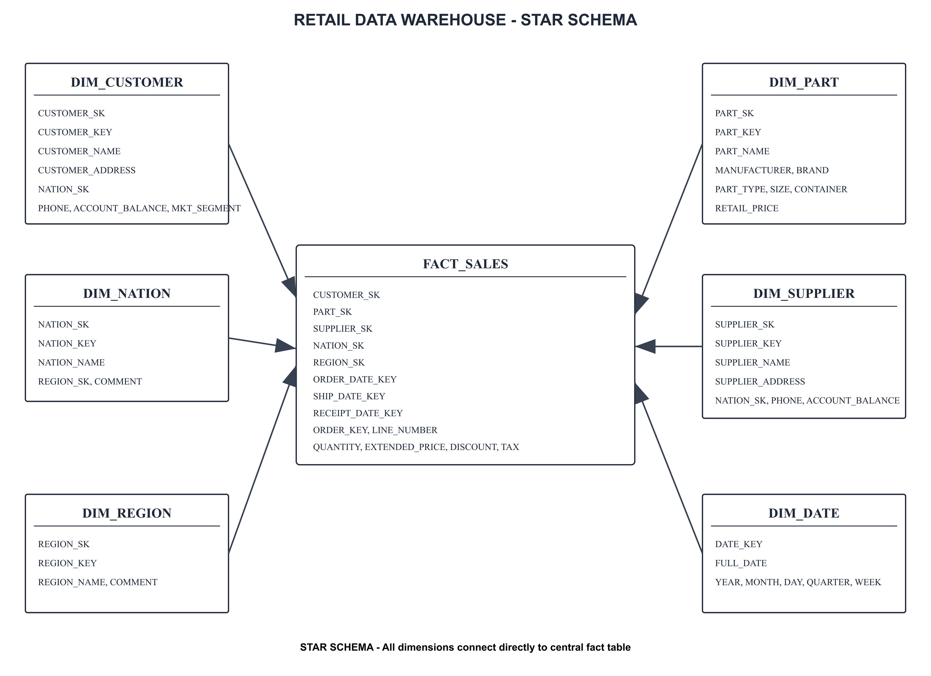
Data Modelling

Slide 6
High-Level Architecture
AWS S3 → Snowpipe → Bronze → Streams → Silver (Snowpark + dbt) → Streams →Gold (SCD2) → Analytical Views → Dashboard
Project Explanation
  Snowpipe auto-loads raw data
  Silver layer uses Snowpark cleaning + dbt modeling
  Gold layer maintains SCD2 dimensions + Fact_Sales
  Tasks automate end-to-end pipeline
  Dashboard analytical views
Tools & Technologies:
Cloud & Storage (AWS S3, Snowflake),
Data Ingestion (External Stage Parquet Format Snowpipe), Transformations (Snowpark (Python) PySpark ,SQL , dbt Cloud)

Slide 7
Medallion Architecture (Bronze, Silver, Gold)
Bronze – Raw Data
  Raw Parquet files
  Auto-ingestion via Snowpipe
  No transformations (source of truth) Project Explanation
Silver – Cleaned & Standardized
Includes 3 processing stages:
  Staging Load using Streams (Bronze → STG)
  Snowpark Cleaning: null handling, trimming, date parsing, negative → 0, phone cleaning, NET_PRICE calc, audit logs
  dbt Models: mode/median imputations, deduplication, FK checks, business rules
Gold – Business Layer
  SCD2 Dimensions (Customer, Supplier, Part)
  Fact_Sales built from all Silver tables
  Contains pricing, discount, tax, return info

Slide 8
End-to-End Data Pipeline Flow
1. Data Ingestion:
• Raw files stored in S3
• Loaded using Snowpipe
2. Transformation:
• Bronze → Silver cleaning via Snowpark/dbt
• Silver → Gold modeling via dbt
3. Data Quality:
• dbt tests: not_null, unique, relationships, numeric rules
4. Incremental Processing:
• Streams track changes
• Tasks automate refresh
5. Analytics:
• Pricing, discounts, returns, customer insights

Slide 9
Data Processing Approaches
(Batch + Streaming)
Batch Processing
Technologies: AWS Glue, AWS S3, PySpark, Snowflake, dbt
What Happens:
  Large files processed in scheduled batches
  Cleaning & transformations in Snowpark / dbt
  Gold tables refreshed periodically
Real-Time Streaming
Technologies: Snowflake Streams, Tasks, dbt incremental models
What Happens:
  Streams capture new/updated rows
  Tasks merge changes into SCD2 dimensions
  Near real-time analytics enabled

Slide 10
SCD Type-2 & Time Travel
SCD TYPE-2
Implemented for Customer, Supplier, Part:
  Streams detect changed records
  Procedure expires old row → CURRENT_FLAG = FALSE
  Inserts new row with CURRENT_FLAG = TRUE
  Maintains full historical tracking
Time Travel
Used for debugging & audit:
  Query past versions of tables
  Validate SCD2 behavior
  Restore accidental updates
Examples:
AT (TIMESTAMP => DATEADD(MINUTE,-10,CURRENT_TIMESTAMP()))
BEFORE (OFFSET => -3*60*60)

Slide 11
Data Quality
Applied at Silver layer using dbt + custom logic:
  Schema Tests: not-null, unique, FK
  Cleaning Rules: null fill, trimming, date parsing
  Business Rules:
    discount (0–1)
    tax ≥ 0
    non-negative price/quantity
  Custom Tests: digits_only (phone), non_negative, string cleanliness
  Audit Logs after every dbt model run

Slide 12
Dashboard Highlights
Metrics shown:
  Total revenue, quantity, avg discount
  Missing value summary
  Outlier detection & distribution
  Campaign performance (success vs failure)
  Monthly/Quarterly pricing charts
  Discount vs Sales impact
  Return rate heatmaps
  Line-item performance comparisons

Slide 13

THANK YOU
For Your Attention

