Slide 1

CUSTOMER LIFETIME VALUE
“Marketing is not the art of finding clever ways to dispose off what you make. It’s the art of creating genuine customer value.”
-Philip Kotler

Slide 2
Outline
Introduction
Approach
Results & Insights
Recommendations

Slide 3


INTRODUCTION
Expected customer churn: 26%
Expected loss in margin: $864,000
INTRODUCTION
RESULTS & INSIGHTS
APPROACH
RECOMMENDATIONS
Notes:
Current revenue

Slide 4




DATA DESCRIPTION
CHURN
MARGIN
DEMOGRAHPIC
%
Unique number of customers: 239,356
INTRODUCTION
RESULTS & INSIGHTS
APPROACH
RECOMMENDATIONS
Notes:
Current revenue

Slide 5
APPROACH
MODELING
ANALYSIS OF SEGMENTS
SEGMENTATION
MARKETING STRATEGY
INTRODUCTION
RESULTS & INSIGHTS
APPROACH
RECOMMENDATIONS

Slide 6
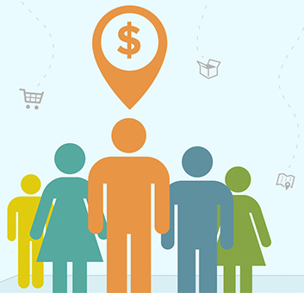
APPROACH
CHURN MODELING
MARGIN MODELING
CUSTOMER FUTURE VALUE
INTRODUCTION
RESULTS & INSIGHTS
APPROACH
RECOMMENDATIONS

Slide 7
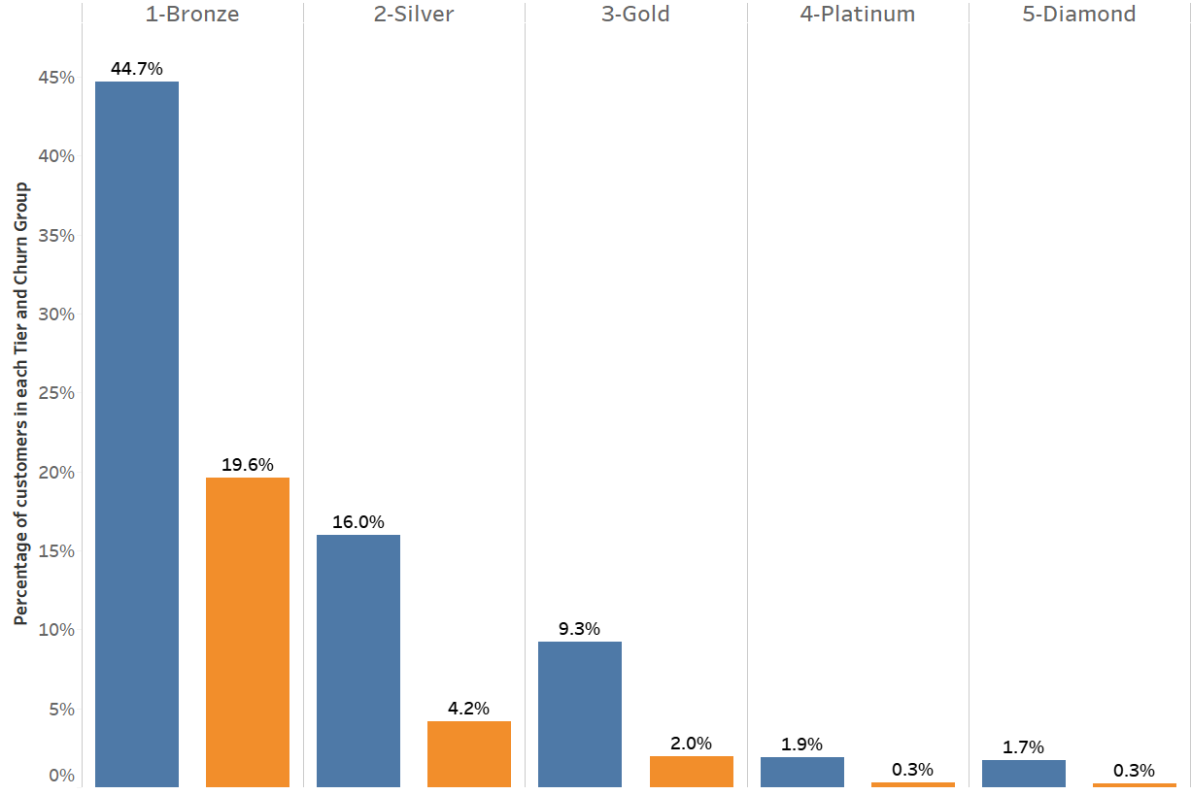

CHURN by TIER
INTRODUCTION
RESULTS & INSIGHTS
APPROACH
RECOMMENDATIONS

Slide 8
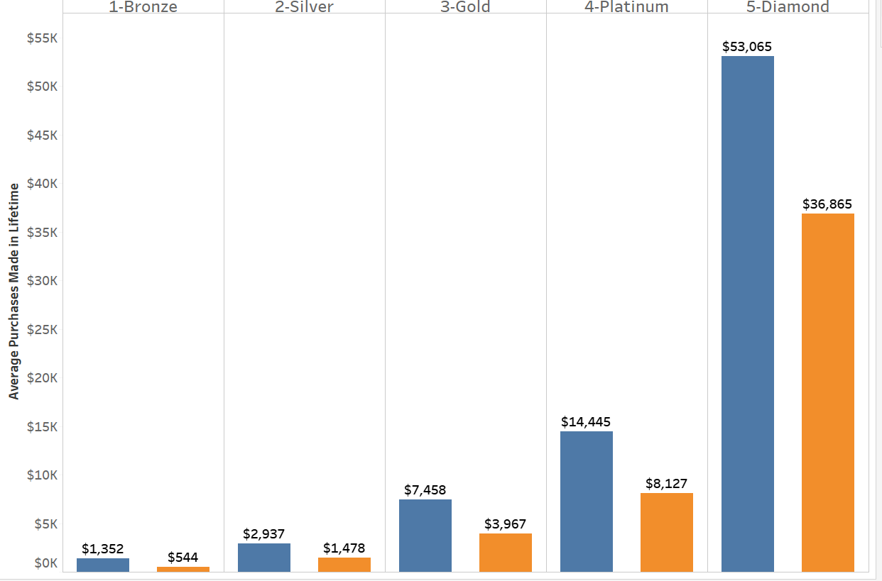
AVERAGE PURCHASE by TIER & CHURN
INTRODUCTION
RESULTS & INSIGHTS
APPROACH
RECOMMENDATIONS

Slide 9
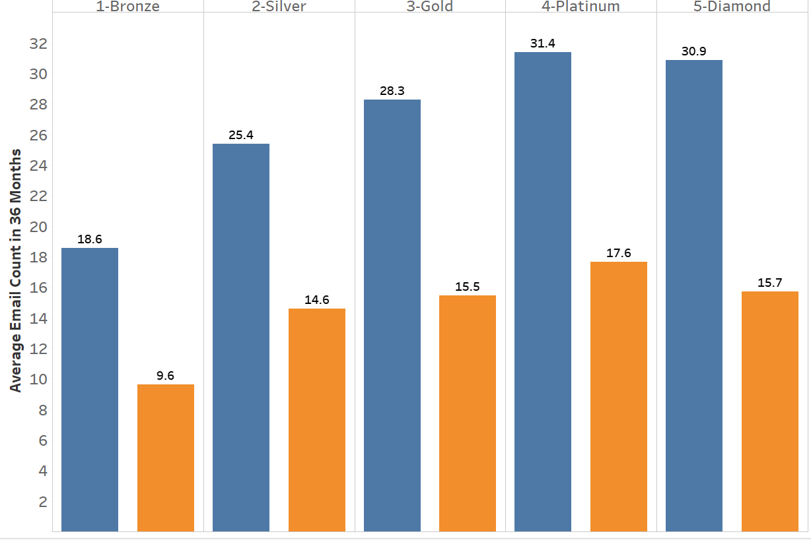
Average Email Count by TIER & CHURN
INTRODUCTION
RESULTS & INSIGHTS
APPROACH
RECOMMENDATIONS

Slide 10
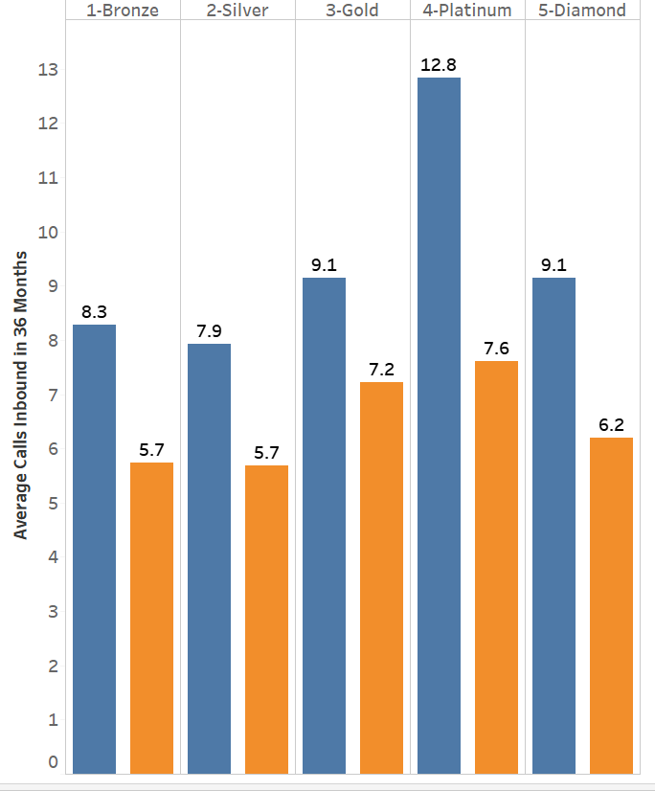
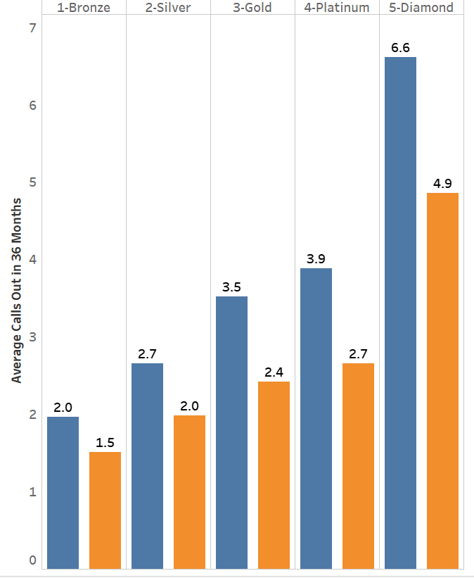
Call-in by Tier & Churn
Call-out by Tier & Churn
INTRODUCTION
RESULTS & INSIGHTS
APPROACH
RECOMMENDATIONS

Slide 11
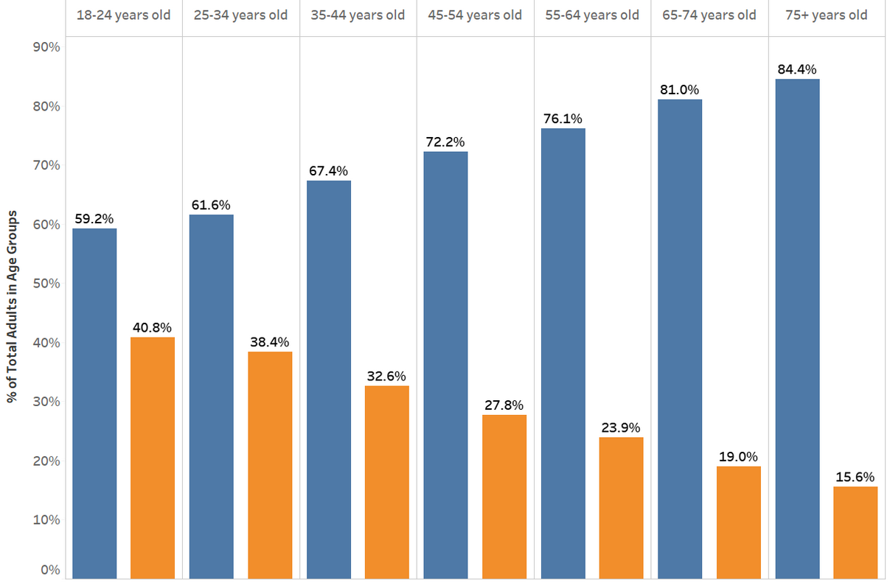
% of Adult Customers within Age Groups by Churn
INTRODUCTION
RESULTS & INSIGHTS
APPROACH
RECOMMENDATIONS

Slide 12
RESULTS & INSIGHTS
% Customers: 34.5%
% Margin: 7.64%
Recency: 5 months
Average Email Frequency:8
Dominant Age Group: 18 - 24
Average CFV Score: 106
Retention
Low Margin
Low Retention
Margin
INTRODUCTION
RESULTS & INSIGHTS
APPROACH
RECOMMENDATIONS

Slide 13
RESULTS & INSIGHTS
% Customers: 15%
% Margin: 21%
Recency: 3 months
Average Email Frequency: 17
Average CFV Score: 797
Retention
Low Margin
Low Retention
High Margin
Low Retention
Margin
INTRODUCTION
RESULTS & INSIGHTS
APPROACH
RECOMMENDATIONS

Slide 14
RESULTS & INSIGHTS
% Customers: 11%
% Margin: 2%
Recency: 1 month
Average Email Frequency:13
Average CFV Score: 349
Low Margin
High Retention
Retention
Low Margin
Low Retention
High Margin
Low Retention
Margin
INTRODUCTION
RESULTS & INSIGHTS
APPROACH
RECOMMENDATIONS

Slide 15
RESULTS & INSIGHTS
% Customers: 39%
% Margin: 70%
Recency: 1 month
Average Email Frequency:31
Dominant Age Group: 75+
Average CFV Score: 1,559
Low Margin
High Retention
High Margin
High Retention
Retention
Low Margin
Low Retention
High Margin
Low Retention
Margin
INTRODUCTION
RESULTS & INSIGHTS
APPROACH
RECOMMENDATIONS

Slide 16




RECOMMENDATIONS
Major contributors to business
Cross-sell | Nurture relationships
AGRESSIVELY TARGET
MAINTAIN
Potential high-spenders
Up-sell & cross-sell | Targeted marketing
Retention
High value customers
Build relationship | Cross-sell | Rebates
DIVEST ?
CULTIVATE
Profile customers for better decision making
Margin
INTRODUCTION
RESULTS & INSIGHTS
APPROACH
RECOMMENDATIONS

Slide 17
Thank You

Slide 18
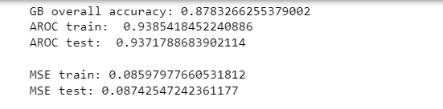
Appendix
Gradient Boosting came as the champion model with least MSE for both train and test data

Slide 19
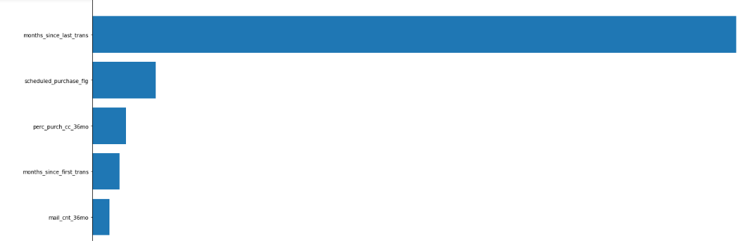
Appendix
Top 5 important variables for churn model when we choose Gradient Boosting as the final model

Slide 20
Appendix
Top 5 important variables for margin model when we choose Gradient Boosting as the final model

Slide 21
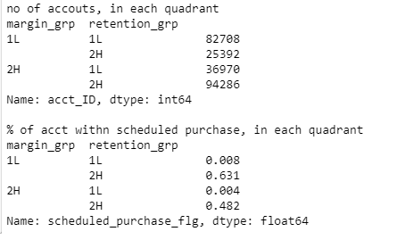
Appendix
Results for CFV score model

