Slide 1


Teradata Data Challenge
Data Vaders

Slide 2




Outline
Background
Data
Analysis
Conclusion
2

Slide 3


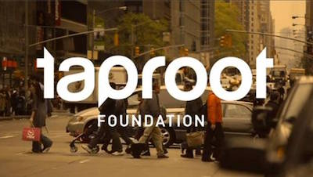




Introduction
Value of Service
# of service hours
# of organizations
# of engagements
$204M
1.7M Hrs
7,649
13,256
Background
Data
Analysis
Conclusion
3
Notes:
nourishes social change organizations by connecting them with the expertise and insights of skilled volunteers, enabling both to thrive

Slide 4
Problem Statement
Which project types produce the best outcomes in survey data?
How many sessions does a non-profit create before starting a project?
Which project types take the longest to complete? Shortest?
Average days to complete projects with multiple volunteers?
Background
Data
Analysis
Conclusion
4

Slide 5





About the Data
Email notifications
Sessions information
Projects information
User activity information
Project Recommendations
Data
Background
Analysis
Conclusion
5

Slide 6
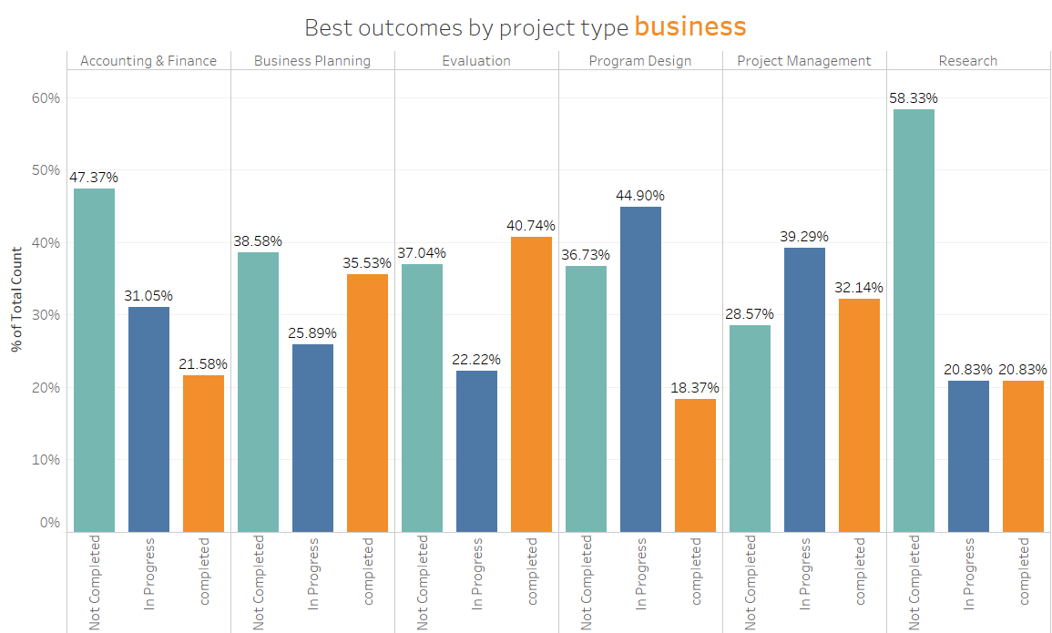
Project Types - Business
Analysis
Background
Data
Conclusion
6

Slide 7
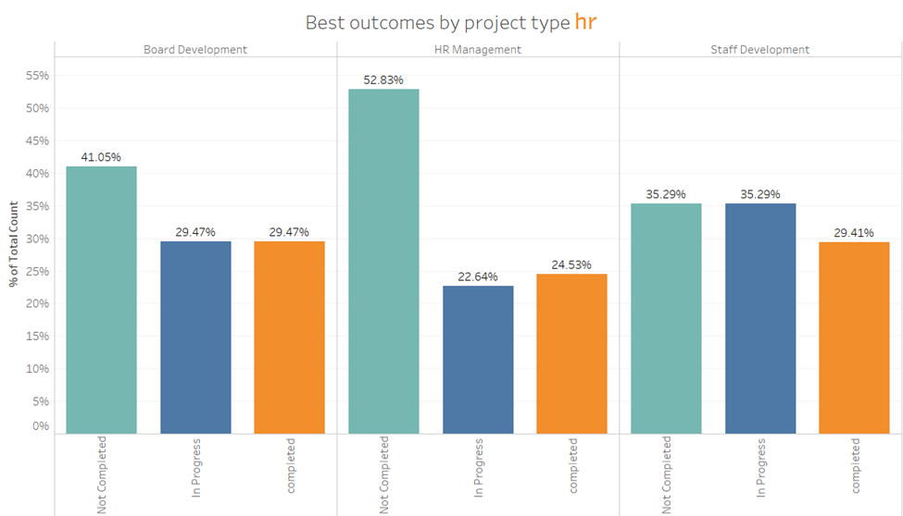
Project Types - HR
Analysis
Background
Data
Conclusion
7

Slide 8
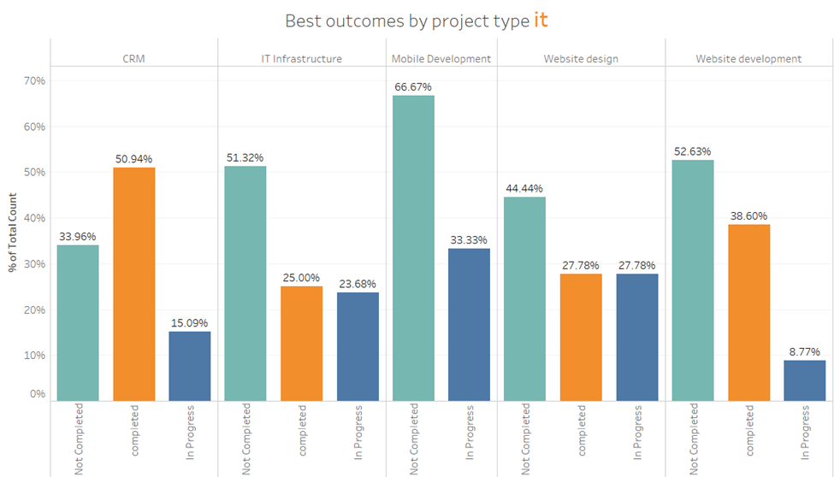
Project Types - IT
Analysis
Background
Data
Conclusion
8

Slide 9
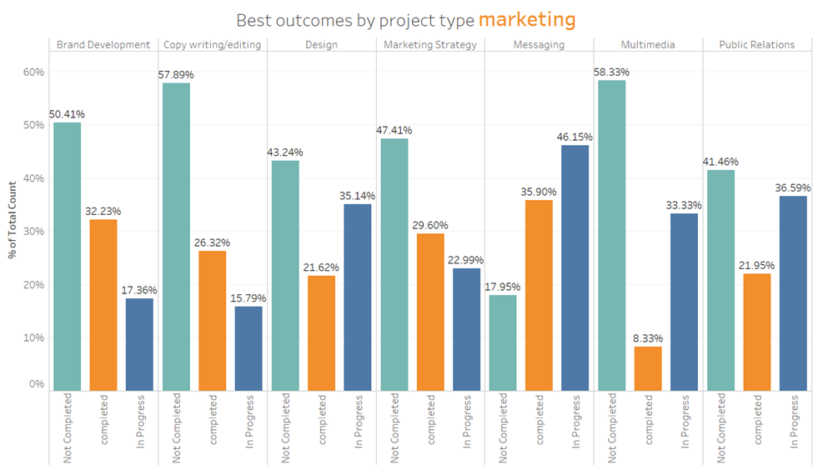
Project Types - Marketing
Analysis
Background
Data
Conclusion
9

Slide 10
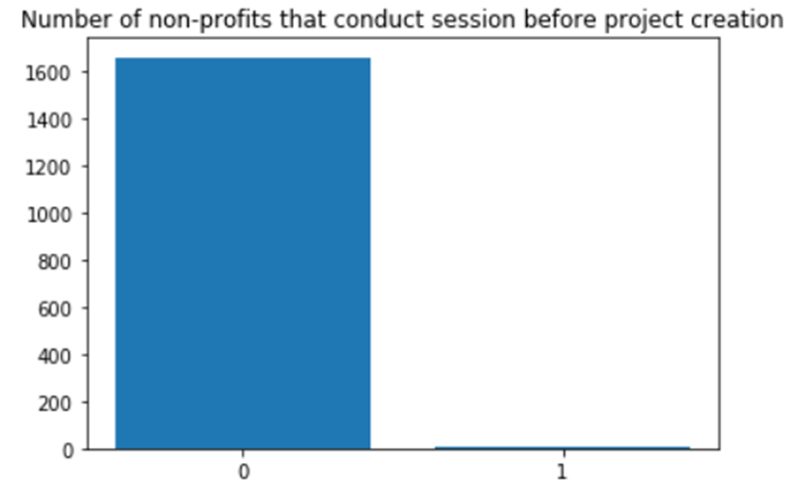
Number of Sessions
Number of non-profits
0.3% of the non-profits conduct at most one session before starting the project
Number of session
Analysis
Background
Data
Conclusion
10

Slide 11
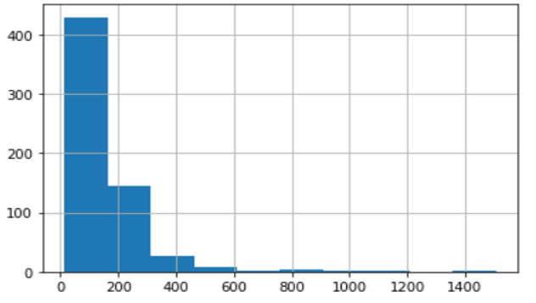
Project Duration - Shortest
Project type: Design
Number of projects
152 Days
Number of days to complete
Analysis
Background
Data
Conclusion
11

Slide 12
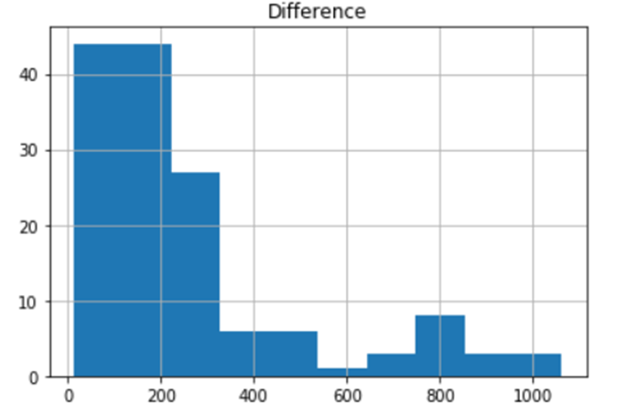
Project Duration - Longest
Project type: Public relations
Number of projects
257 Days
Number of days to complete
Analysis
Background
Data
Conclusion
12

Slide 13
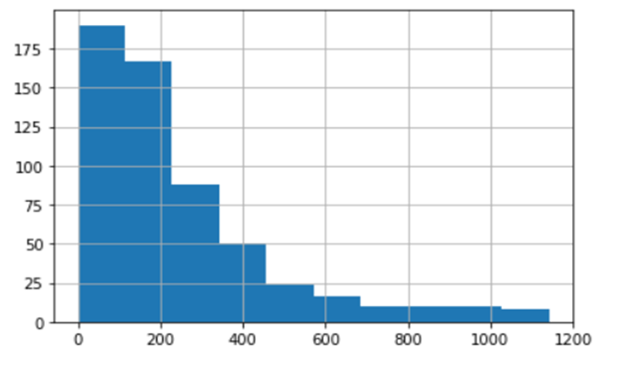
Project With Multiple Volunteers
Number of projects
247 Days
Number of days to complete
Analysis
Background
Data
Conclusion
13

Slide 14
Conclusion
Best outcomes by project type:
Evaluation (Business)
Staff & Board development (HR)
CRM (IT)
Messaging (Marketing)
0.3% of Non-Profits conduct sessions before start of the project
Project Duration
Shortest: Design (152 days)
Longest: Public Relations (257 days)
Projects with multiple volunteers take 247 days to complete
Conclusion
Background
Data
Analysis
14

Slide 15
Thank you

