Slide 1
ANALYSIS on US HONEY PRODUCTION 1995-2001
GROUP 36:
Mahesh Chillari
Tharun Sai Malireddy
Sri Hari Bommaraveni

Slide 2
MOTIVATION:
Honeybees are considered one of the most important species on the planet that have a lot of impact on humans
Honey is widely used and consumed as it contributes to many health benefits.
But years of research data show that the there is a significant decline in the honeybee population which in turn reduced the honey production.
Many factors such as pests, pesticides, pollutants, extreme weather conditions and nutritional deficits are causing this decline in the honeybee population.
Analyzing the Data set and visualizing the different parameters of data set to predict the parameters that are highly dependent in effecting overall honey production

Slide 3
Project Outline
Data Base creation with the data extracted in previous step
Final analysis of the data
DATA COLLECTION
DATA VISUALIZATION
DATA EXTRACTION and PROCESSING
DB Creation
Analyzing and understanding the data using SQL and Matplotlib of python
Conclusion

Slide 4
> state > Yield_per_colony > colonies_number > production > stocks > average_price > value_of_production > year
DATA EXPLORATION:

Slide 5
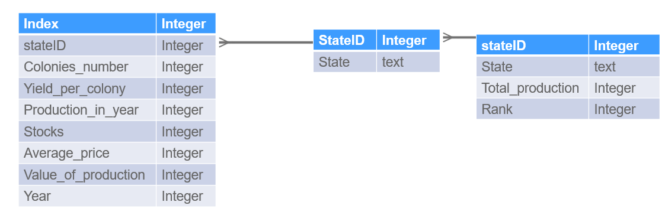
ER DIAGRAM
HoneyData
StateIDs
TotalProduction

Slide 6
DATA VISUALIZATION
Which state has the highest production?
State with best yield.
States maintaining the consistency in production.
Changes that can be done in order to improve honey production.

Slide 7
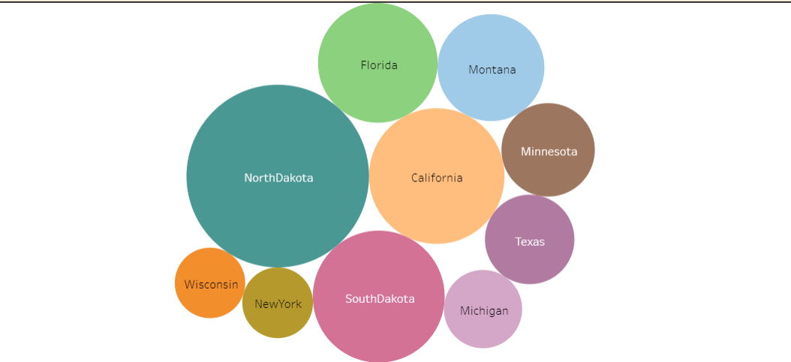
Top 10 states with highest honey production

Slide 8
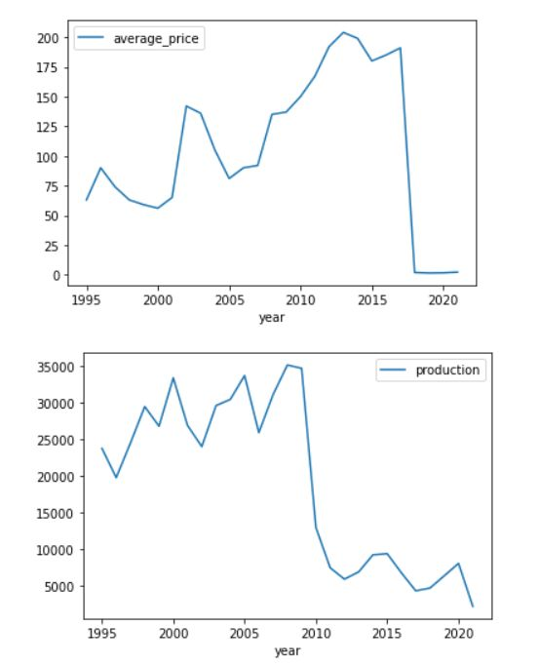
Story of North Dakota:
Despite of being the highest producer of honey, it failed to exhibit the raise in production. There is a sudden downfall in the year 2009 but it regained immediately.

Slide 9
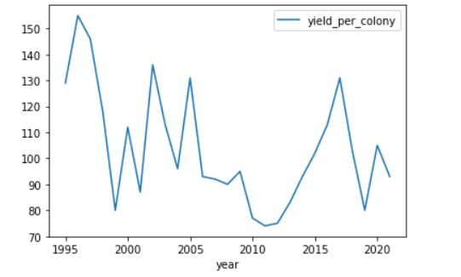
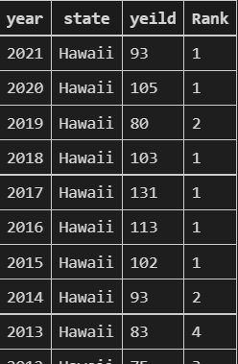
Yield per colony in HAWAII:
As of 2021 Hawaii has highest yield per colony (93) compared to North Dakota (55) but Hawaii has fewer colonies

Slide 10
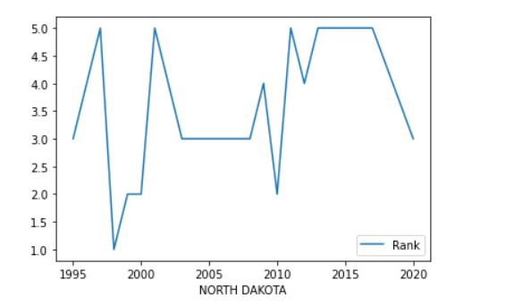
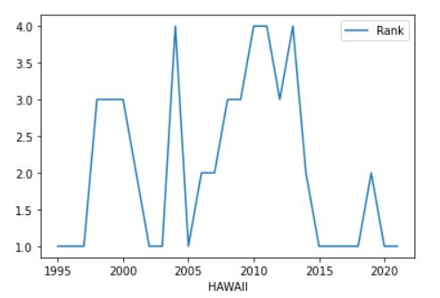
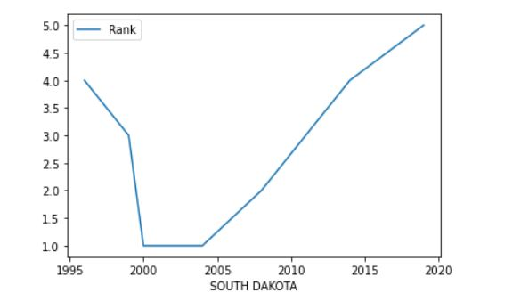
Top states with consistent honey production
NORTH DAKOTA
HAWAII
SOUTH DAKOTA

Slide 11
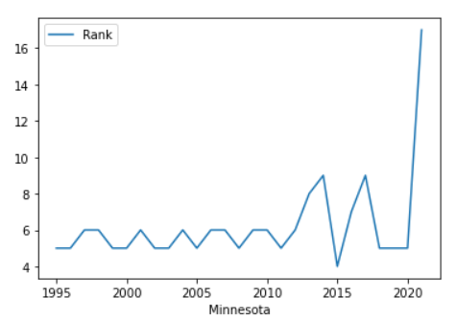
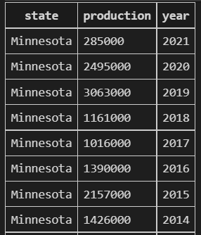
State with production effected badly in recent years:

Slide 12
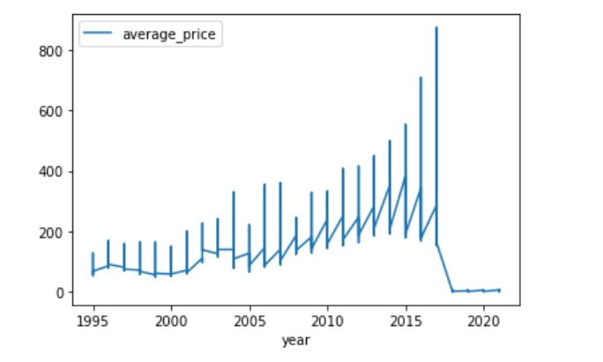
TREND IN AVERAGE PRICE /YEAR:

Slide 13
Conclusion
There is a sudden drop in production of honey for all states between 2009 and 2010.
As of 2021 Hawaii has highest yield per colony (93) compared to North Dakota (55) but Hawaii has fewer colonies
Hawaii has highest yield per colony. Increasing the number of colonies in Hawaii will give us highest ROI .
Increasing yield per colony will make South Dakota and California competitive to North Dakota.
There is a decline in honey production over years. It depends on multiple factors (land, bee population, yield, etc ) which must be considered to stop further decrease of honey production in coming years.
North Dakota and South Dakota are expected to produce more honey in 2022.Eventhough the colony count is higher; California might come third as the yield is less

Slide 14
THANKYOU

