Slide 1

MY DREAM JOB
Software Developer
Velagandula Saiteja(20186102)

Slide 2

Who is software developer?
One who is behind the computer applications.
They develop applications, software that does specific job.

Slide 3

Why did I chose this Profession?
My personal interest to develop applications that could help people work more efficiently.
Interest to work on different data structures to represent real world data.

Slide 4


Where would I love to work?
Any application development Organization.
Any startup that encourages the creative idea s to develop applications.

Slide 5
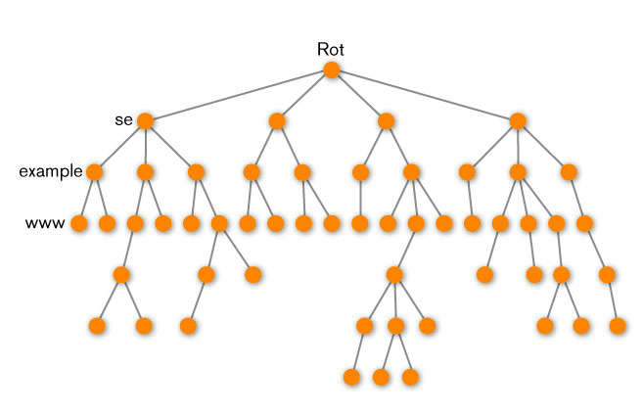

How should I get prepared?
Understand complex data structures.
Understand and implement complex algorithms to develop applications.
Web programming
Cloud Integration

Slide 6
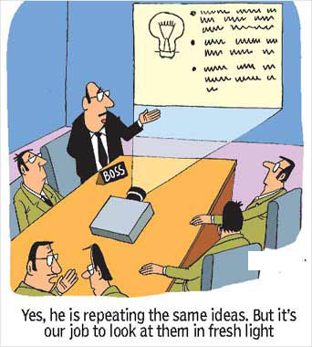

Where do I see myself 5 years down the line?
A senior software developer in MNC.
Project head in application development in any MNC

Slide 7
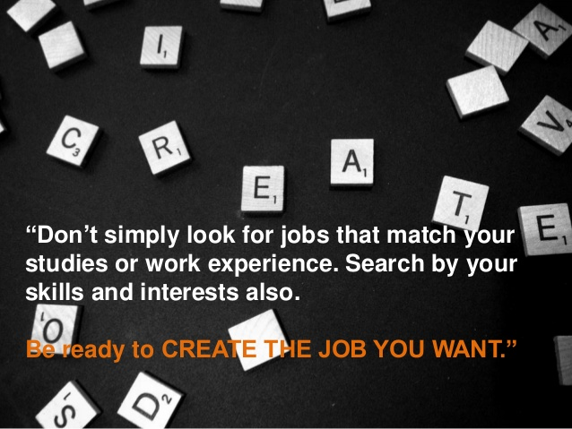
THANK YOU

