Slide 1

Web Scraping and Analysis of Internshala Job Listings

Slide 2
ABOUT US:
I am P.Abhi Rithvik, I’m recent graduate with a B.Tech degree in Mechanical Engineering.
I am S.Saiteja , I’m recent graduate with a Bse degree in Data Science.
I am V.Purnachendhra. I’m recent graduate with a B.Tech degree in EEE.
.
We want to learn data science because it helps get important information from the raw data. It's like solving puzzles to make smart decisions and discover new things. We believe it's a powerful tool to make a positive impact and solve real-world problems.

Slide 3
ABSRACT :
This project analyzes job data extracted from Internshala, focusing on company names, job roles, locations, salaries, and experience requirements. The analysis employs descriptive statistics, univariate, and bivariate visualizations to reveal insights into job market trends. The findings offer valuable information for job seekers and companies, aiding informed decision-making in the dynamic landscape of employment.

Slide 4
PROBLEM STATEMENT -
We want to explore job data from Internshala to help people find better jobs and companies connect with the right candidates. By looking at things like company names, job roles, locations, salaries, and experience needs, we aim to understand what's happening in the job market. Our goal is to make job searching and hiring easier by sharing useful insights.
OBJECTIVE -
Our goal is to study job data from Internshala, checking out things like company names, job roles, locations, salaries, and experience needs. We want to find patterns and trends in the information to help people looking for jobs and companies looking for employees. The aim is to provide helpful insights for smarter decision-making in the job market.

Slide 5







WEB SCRAPPING :
The modules which we are used for analysing the Internsala is,
The in information was scraped by using python modules :
Numpy
Pandas
matplotlib
Seaborn
Re and request
Selenium

Slide 6
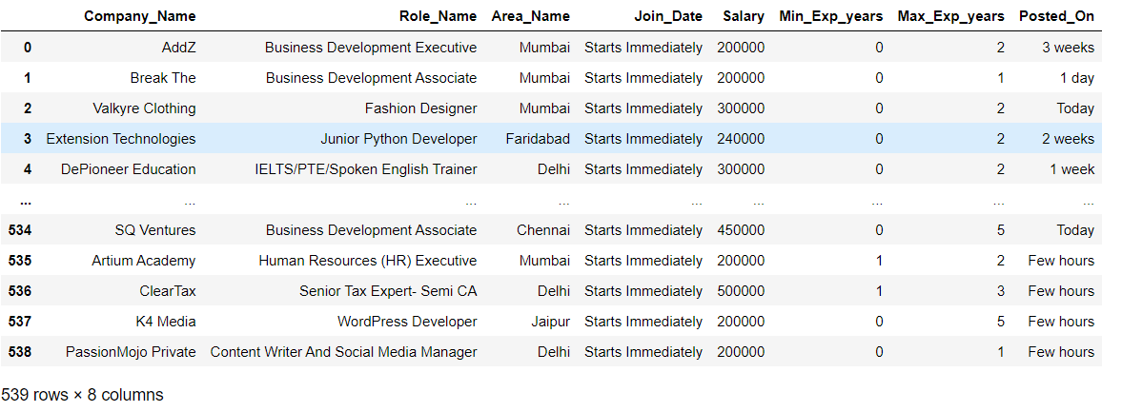
SUMMARY OF THE DATA :
The dataframe consists of the 8 columns which includes both numerical and categorical data
The data consists of the categorical columns like 'Company_Name', 'Role_Name', 'Area_Name', 'Join_Date', 'Posted_On’.
it also has numerical data columns like 'Salary', 'Min_Exp_years', 'Max_Exp_years’.

Slide 7
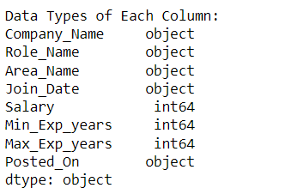
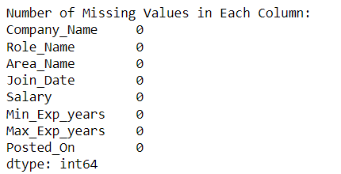
EXPLORATORY DATA ANALYSIS:
Data cleaning & Manipulation–
After forming the data frame the null values are
present in the numerical columns consultation fee,rating,
experience and stories .

Slide 8
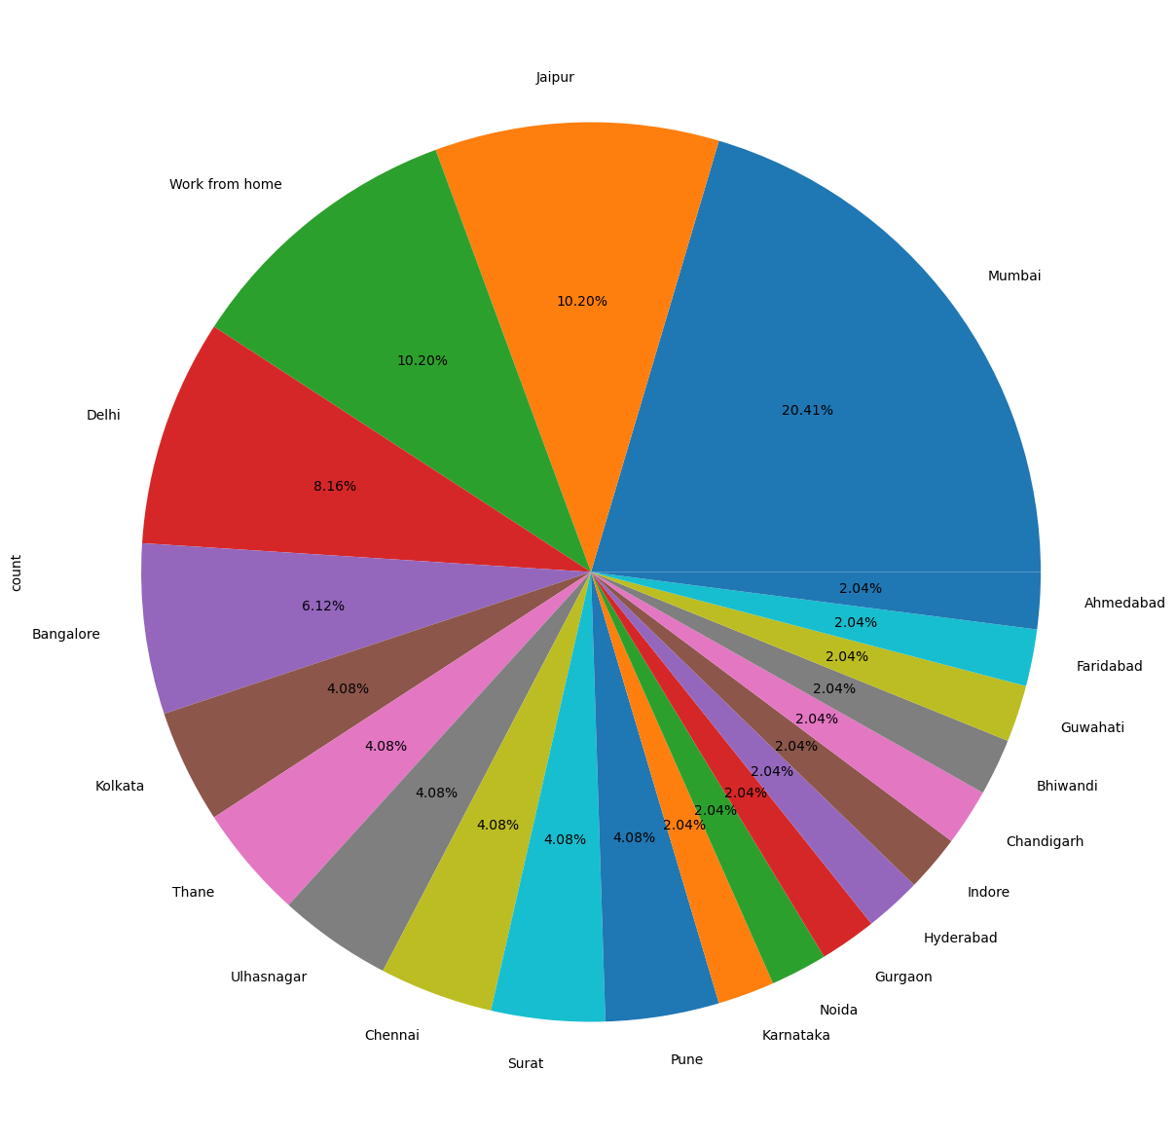
UNI-VARIATE ANALYSIS: ANALYSIS PERCENTAGE OF JOBS ON DIFFERENT AREAS:
This pie chart that visually represents the proportion of job opportunities in different areas, with each slice representing a unique area, and the size of each slice corresponds to the percentage of job opportunities in that area.

Slide 9
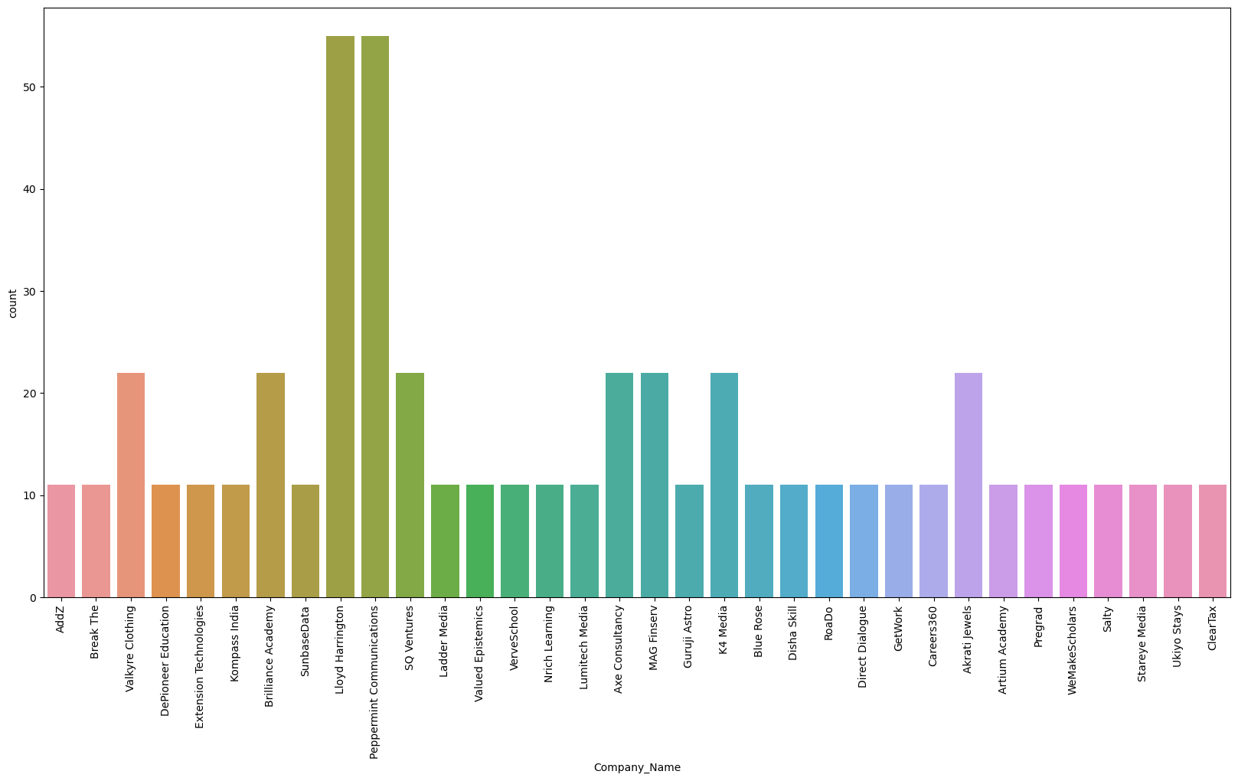
ANALYSIS OF COMPANY:
This count plot provides a visual representation of the number of job opportunities offered by each company. Each bar on the plot corresponds to a unique company, and the height of the bar represents the count of job opportunities associated with that company.

Slide 10
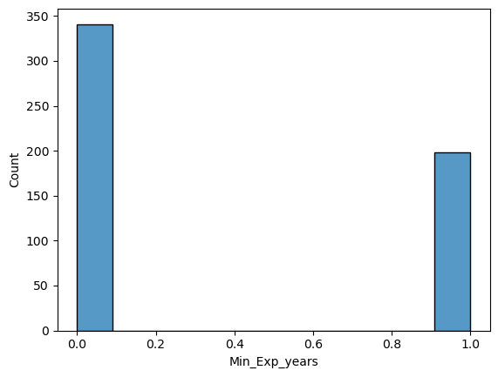
ANALYSIS ON MINIMUM EXPERIENCE REQUIRED:
This histogram provides a visual representation of how minimum experience requirements are distributed across the job opportunities in the 'Internsala' dataset. Each bar on the plot represents a range of minimum experience values, and the height of the bar indicates the frequency of job opportunities falling within that range.

Slide 11
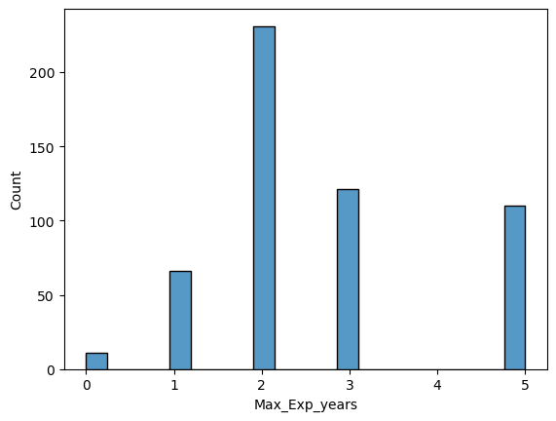
This histogram provides a visual representation of how maximum experience requirements are distributed across the job opportunities in the 'Internsala' dataset. Each bar on the plot represents a range of maximum experience values, and the height of the bar indicates the frequency of job opportunities falling within that range.
ANALYSIS ON MAXIMUM EXPERIENCE REQUIRED:

Slide 12
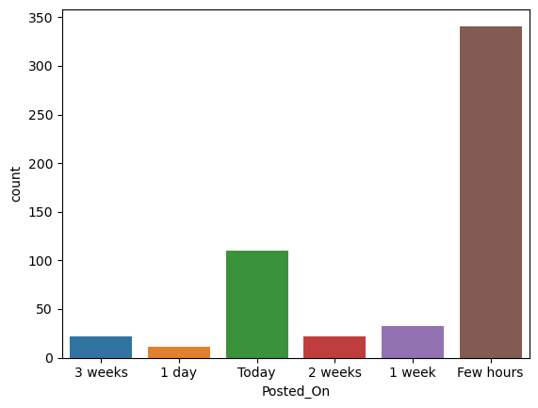
This plot provides insights into the distribution of job postings based on the "Posted_On" attribute. Each bar on the plot represents a unique value in the "Posted_On" column, and the height of the bar corresponds to the count of job postings associated with that particular time period.
ANALYSIS ON POSTED DAY OF JOBS:

Slide 13
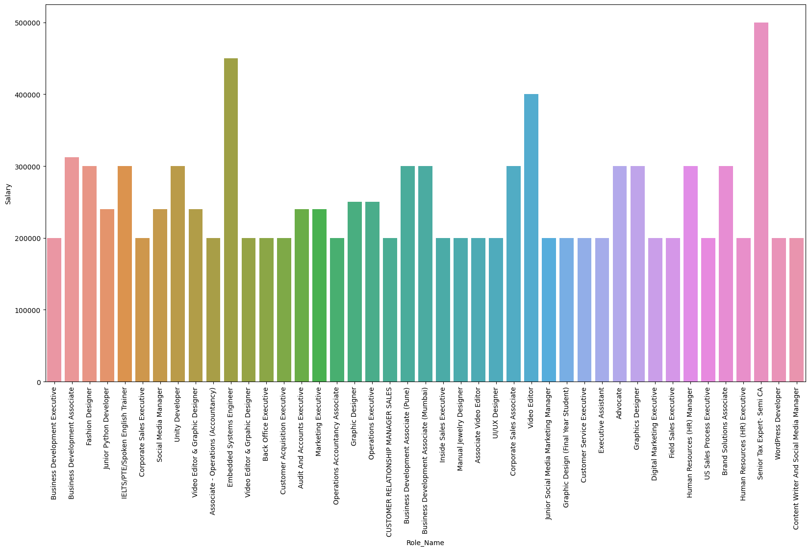
Bivariate Analysis -
ANALYSIS ON ROLE AND SALARY:
This bar plot allows you to visually compare the average salaries associated with different job roles. Each bar represents a unique job role, and the height of the bar corresponds to the average salary for that role.

Slide 14
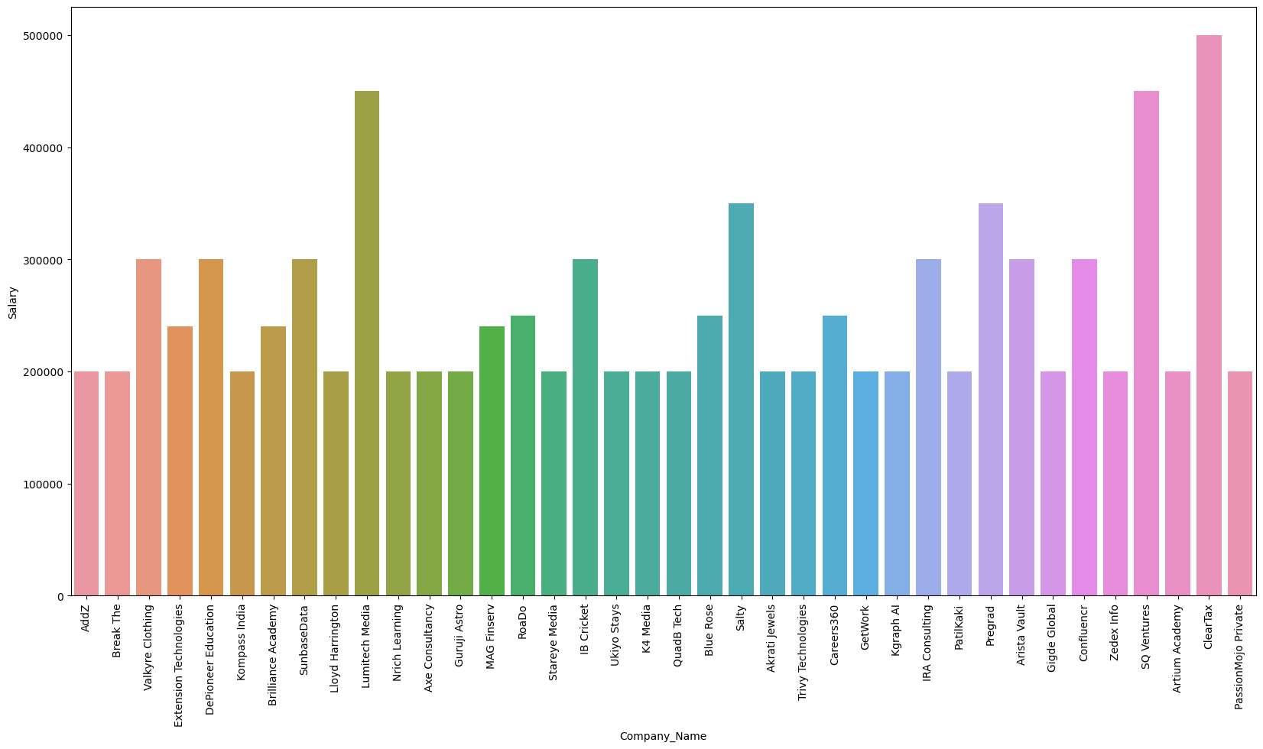
This bar plot allows you to visually compare the average salaries associated with different companies. Each bar represents a unique company, and the height of the bar corresponds to the average salary for that company.
ANALYSIS ON COMPANY AND SALARY:

Slide 15
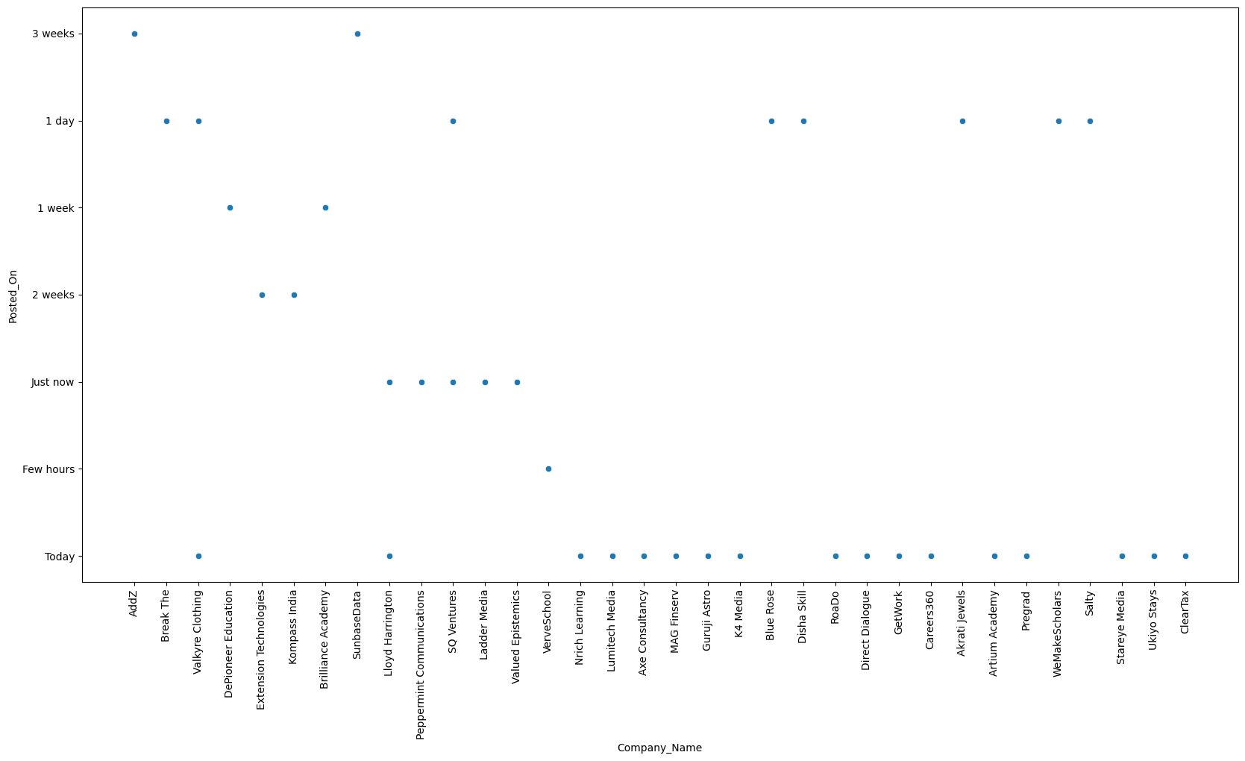
This scatter plot allows us to explore how the posting dates ("Posted_On") are distributed across different companies ("Company_Name"). Each point on the plot represents a combination of a company and the corresponding posting date.
ANALYSIS ON COMPANY AND POSTED ON:

Slide 16
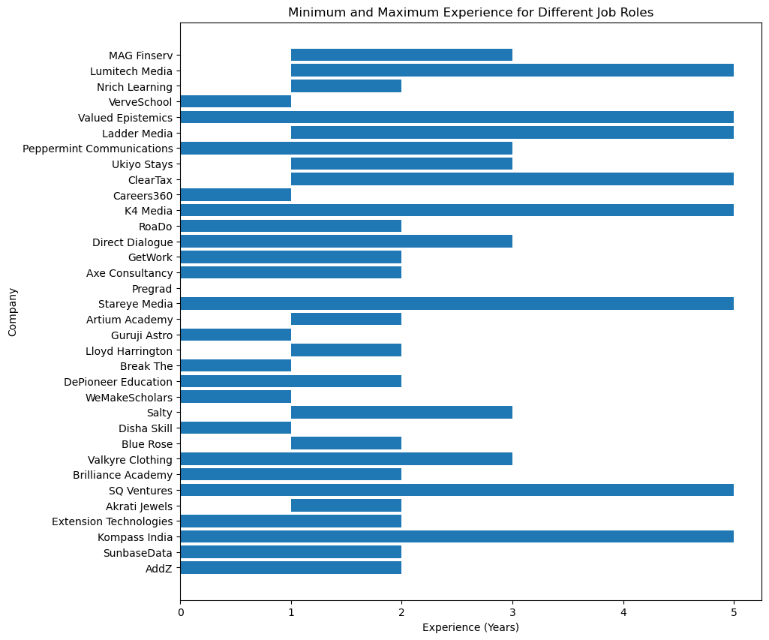
Horizontal bar chart that visually represents the minimum and maximum experience for different companies.
ANALYSIS ON COMPANY AND EXPERIENCE-

Slide 17
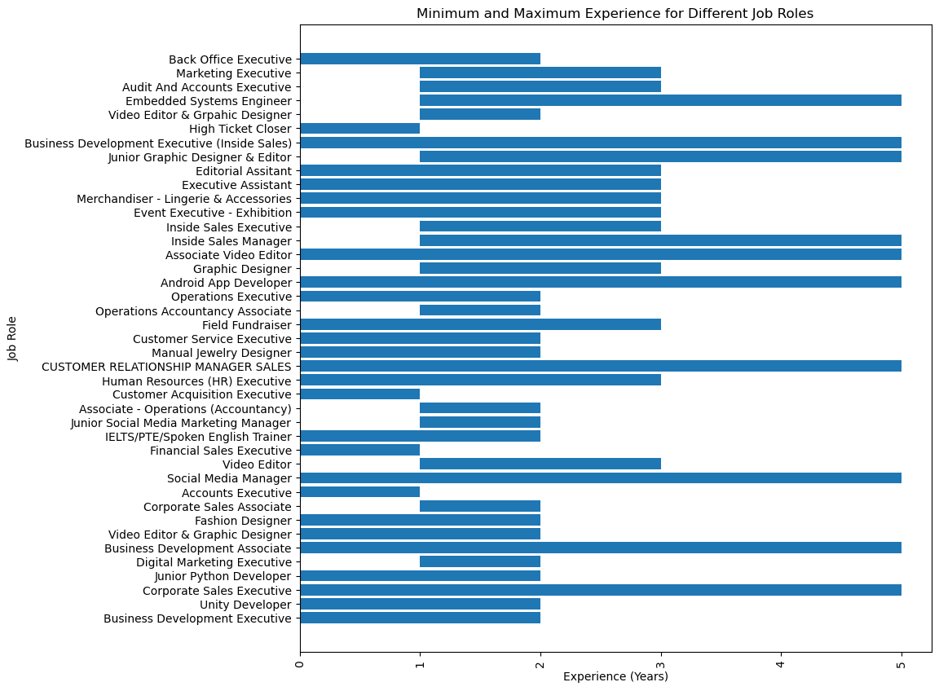
Horizontal bar chart that visually represents the minimum and maximum experience for different job roles.

Slide 18
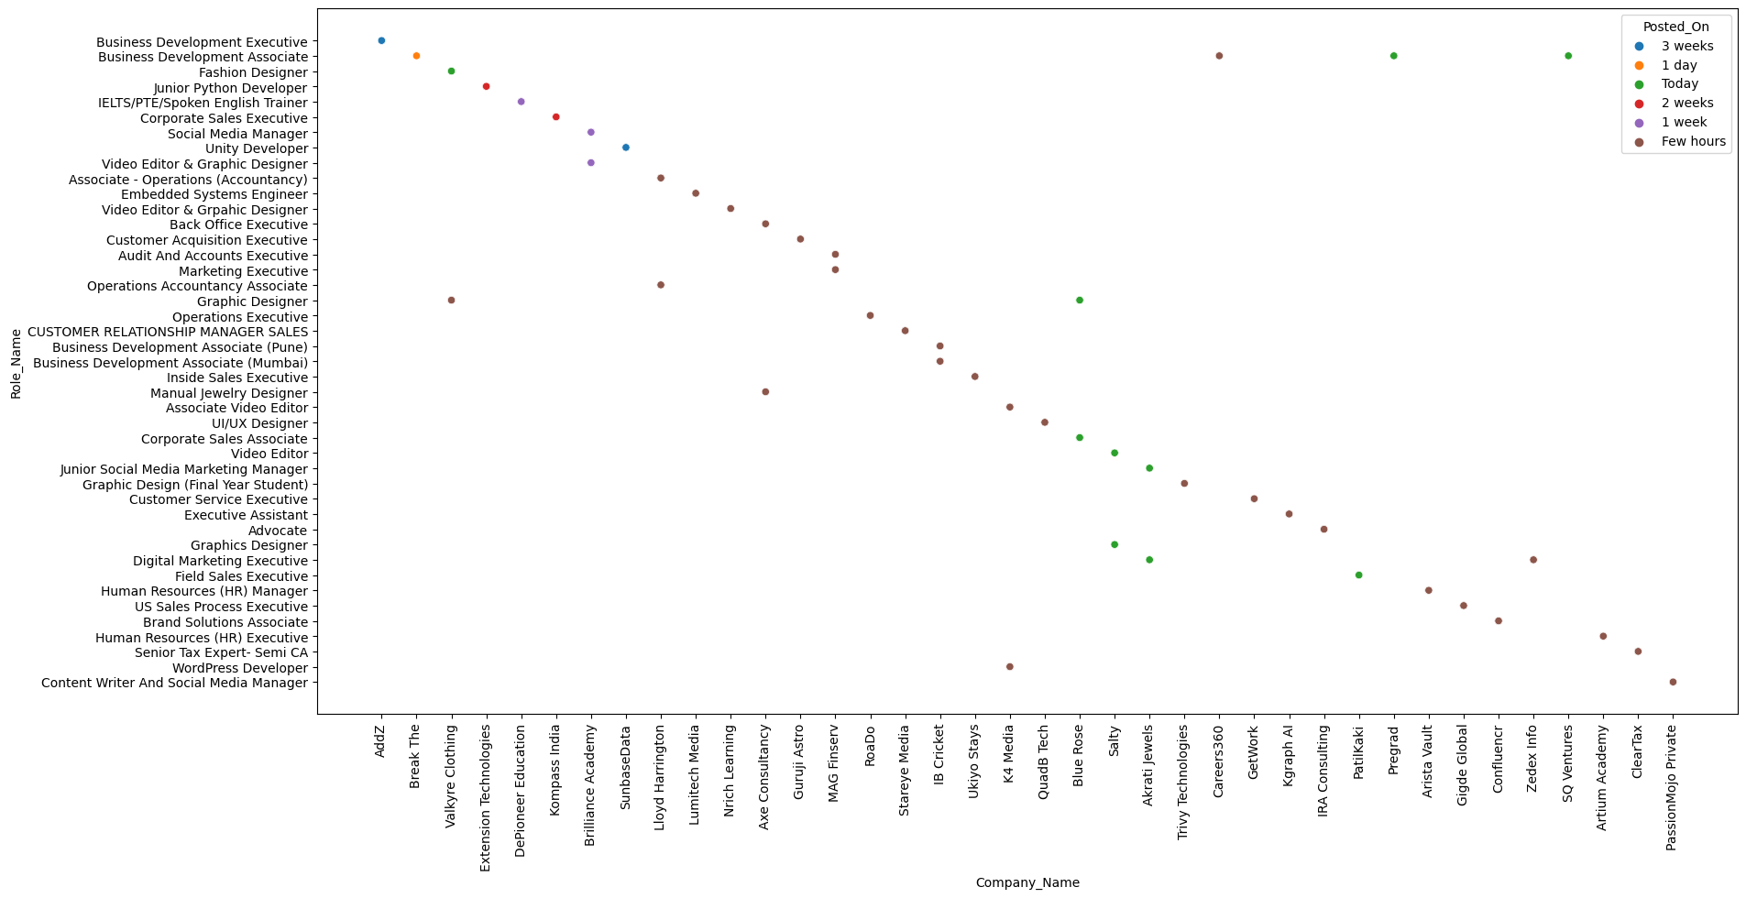
it visualizes the distribution of roles across different companies, with colors representing when the roles were posted.

Slide 19
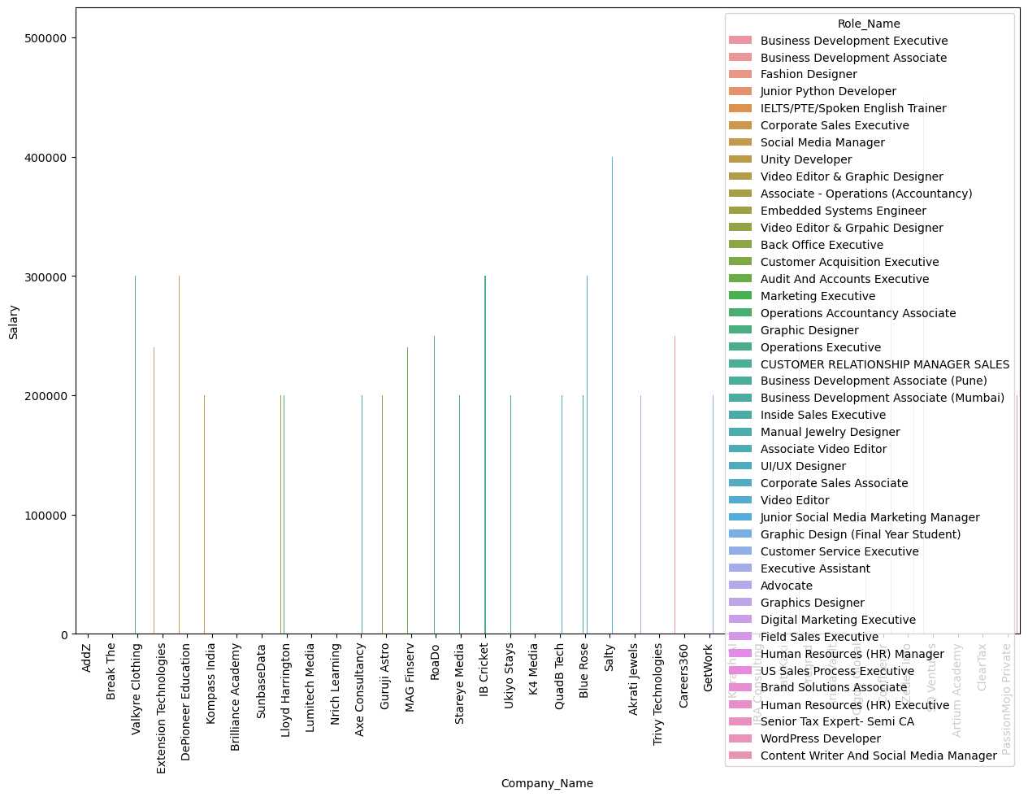
A bar plot to visualize the relationship between company names ("Company_Name"),salaries ("Salary"), and roles ("Role_Name"). Each bar represents a company, and the bars are further divided by roles, with colors indicating different roles.

Slide 20
Conclusion -
from this analysis can conclude that the doctors with high rating and all specialization are present Mumbai
Also that the experience does not effects the consultation fee
All the five cities consists of highest no of dentist
Dermatologist charges more consultation fee in all the cities
There are very less no of homoeopath doctors are present in all the cities it may be because less belief of people on homoeopath and there may be many other reasons like more healing time and no scientific evidences
but at some places like Mumbai homoeopathic doctors charges more it may be due to the less availability
Doctors from Mumbai city charges more consultation fee compared to other cities and doctors with good rating are also from Mumbai

Slide 21

THANK YOU

