Slide 1
PROJECT PRESENTATION
MegaVault
AI Powered E-Commerce Shopping Platform
A full-stack ai powered e-commerce application focused on seamless shopping, smart product discovery, secure access and efficient administration.
React.js • Spring Boot • Java • MySQL
TEAM MEMBERS
N. Sai Teja
B. Harsha vardhan Babu J. Bhargava Aditya CH. Tejas Kumar
01

Slide 2
01 / INTRODUCTION
MegaVault is designed as a modern digital shopping ecosystem for customers and administrators.
ABOUT THE PROJECT
CORE AREAS
MegaVault is a full-stack e-commerce platform that brings product discovery, shopping, authentication and administration into one integrated application.
• Product discovery and filtering
• Category and catalog management
• Cart and wishlist
• Google authentication
• REST APIs and database
• Secure admin operations
The platform is built to provide a responsive customer experience while maintaining secure, role-based control over business operations.
PRIMARY GOAL
Make online shopping faster, simpler, more secure and easier to manage.
02

Slide 3
02 / TECHNOLOGY USED
A layered architecture separates the frontend, backend services, persistence and database.
01
React.js
Responsive UI • product discovery • shopping
02
Spring Boot
REST controllers • business services • security
03
Spring Data JPA / Hibernate
ORM • repositories • transactions
04
MySQL
megavault_db • relational data
03

Slide 4
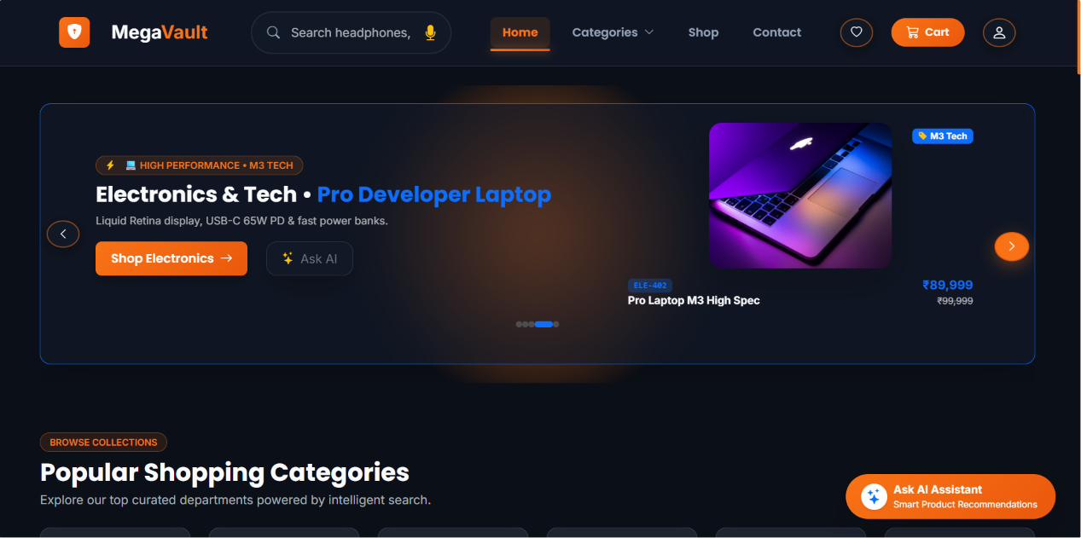
03 / CUSTOMER EXPERIENCE
The home experience is designed to guide customers from browsing to product evaluation.
KEY ELEMENTS
• Featured products and categories
• Search-first navigation
• Product cards with price and ratings
• Responsive layout
• Clear path to product details and cart
04

Slide 5
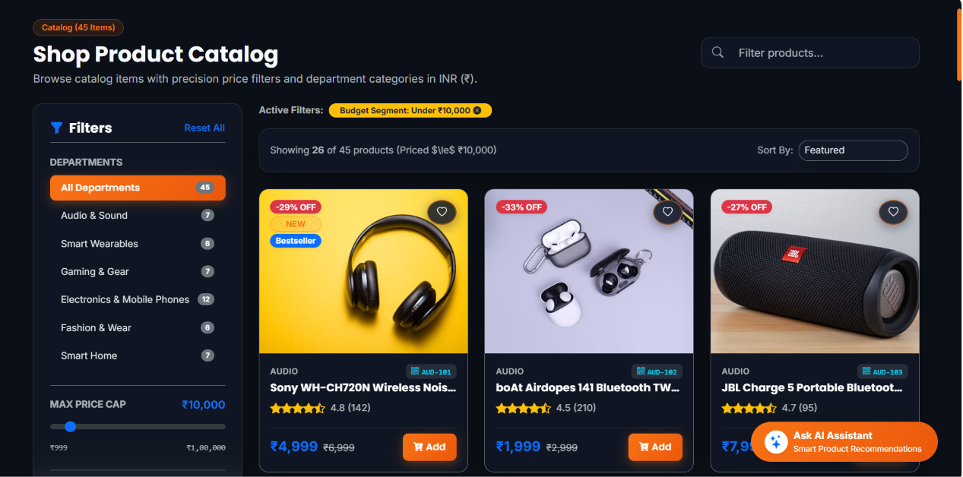
04 / PRODUCT SEARCH
Customers can narrow the catalog using keywords, categories and precise price constraints.
EXAMPLE QUERY
Products under ₹10,000
• Multi-token product search
• Category keyword detection
• Price ceiling extraction
• Relevant search results
• Faster product discovery
05

Slide 6
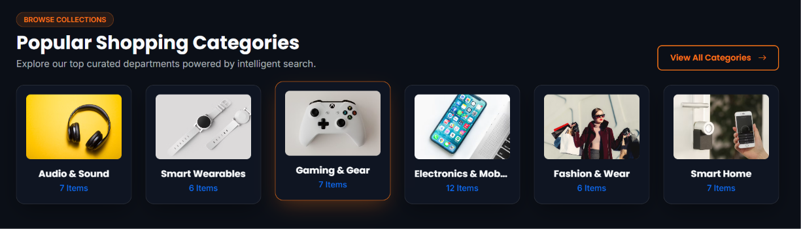
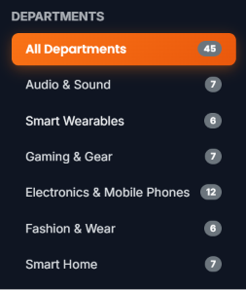
05 / CATEGORY MANAGEMENT
Categories organize the product catalog and support structured browsing and administration.
DEPARTMENTS
• Audio
• Wearables
• Gaming
• Electronics
• Fashion
• Smart Home
06

Slide 7
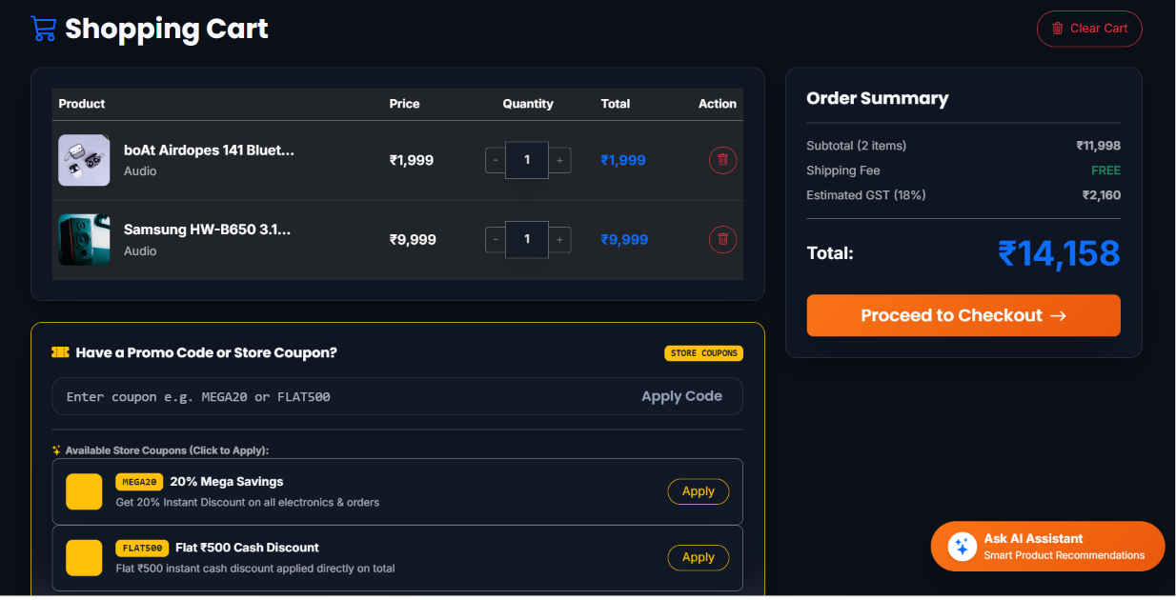
06 / SHOPPING CART & WISHLIST
Customers can save products for later and manage selected items before checkout.
CUSTOMER FLOW
Add product to cart
Save products to wishlist
Update quantity
Review total amount
Continue to checkout
07

Slide 8
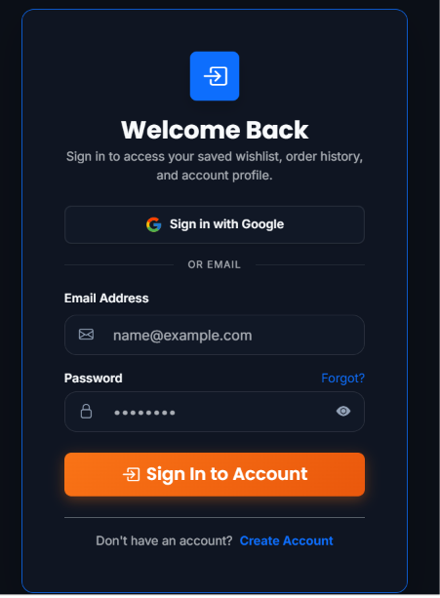
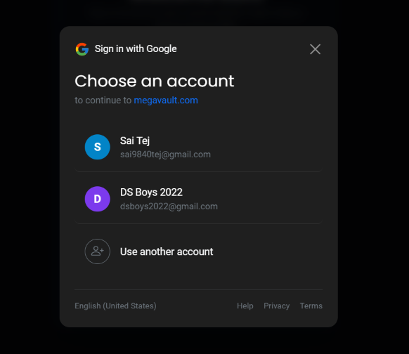
07 / GOOGLE AUTHENTICATION
Google-based authentication provides a familiar sign-in experience while maintaining application role boundaries.
AUTHENTICATION FLOW
• User chooses Google sign-in
• Google account identity is verified
• Application establishes authenticated session
• Customer access is separated from administrative roles
• Protected resources remain authorization-controlled
08

Slide 9
08 / BACKEND REST API & Database
REST services connect the React frontend with business logic and persistent MySQL data.
CORE REST ENDPOINTS
DATABASE STRUCTURE
GET
/api/products
Full catalog
• USERS — accounts, roles and verification state
• PRODUCTS — SKU, title, price, rating, category
• CATEGORIES — six product departments
• ORDERS — customer, total, status and timestamps
GET
/api/products/category/{cat}
Category filter
GET
/api/products/search?q={query}
Search
POST
/api/products
Create product
DELETE
/api/products/{id}
Delete + audit
09

Slide 10
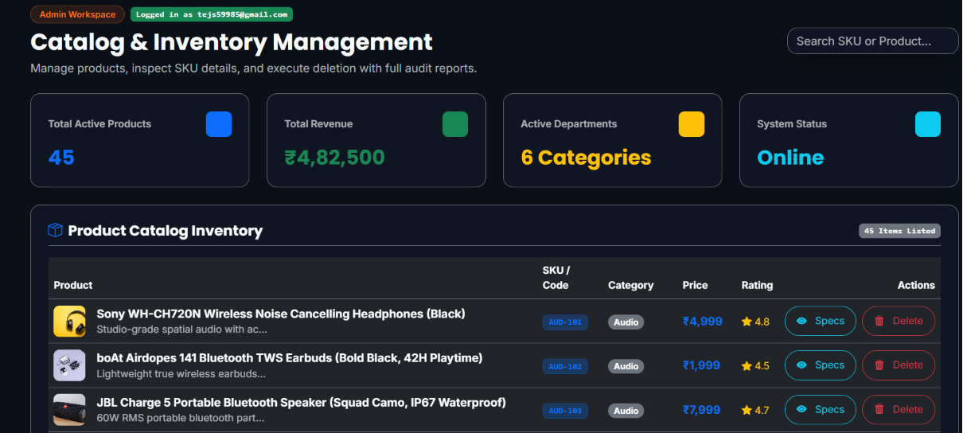
09 / ADMIN DASHBOARD
Administrative tools provide controlled product management and system-wide visibility.
ADMIN CAPABILITIES
• Manage products and categories
• Review catalog information
• Control access according to role
• Perform administrative operations
• Track important catalog changes
• Support category-level management
10

Slide 11
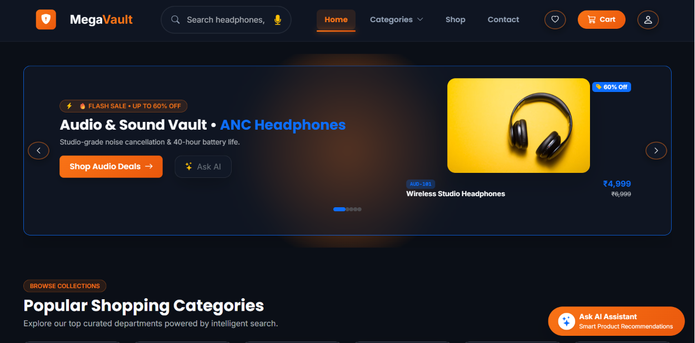
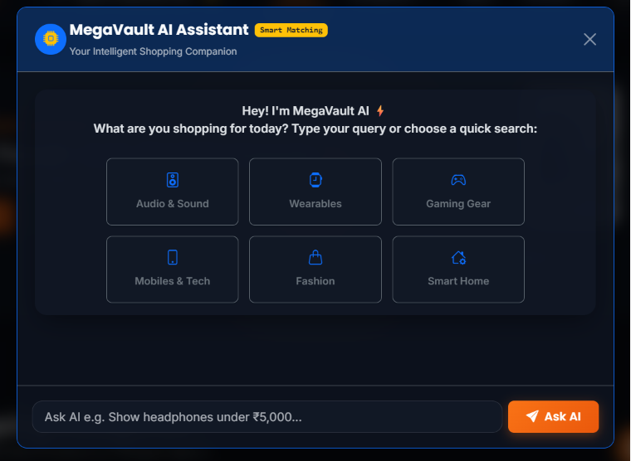
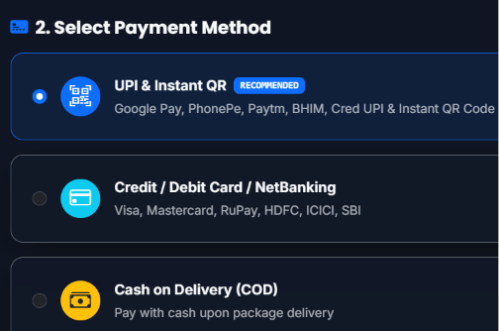
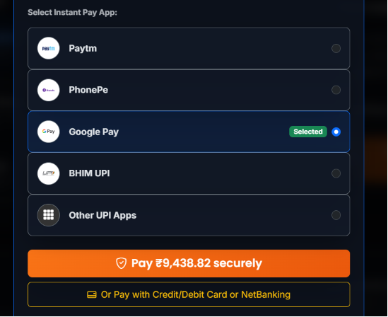
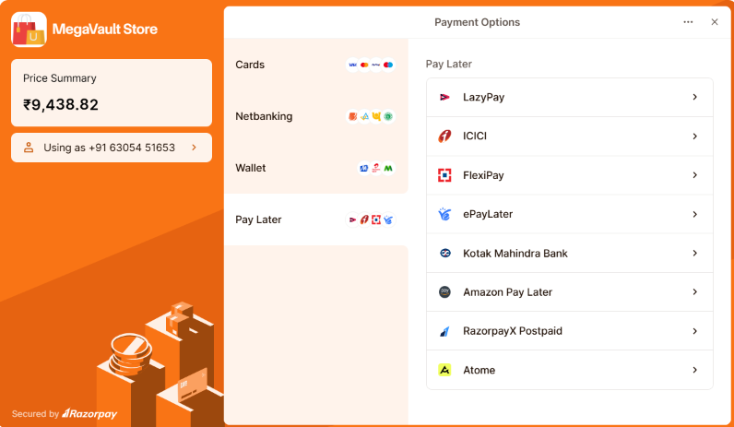
10 / PROJECT SCREENSHOTS
11

Slide 12
11 / OUTCOMES
The current implementation establishes a strong foundation for a scalable e-commerce solution.
KEY ACHIEVEMENTS
FUTURE SCOPE
• Responsive React shopping experience
• Spring Boot REST backend
• Product search and precision filtering
• Google authentication integration
• Role-based access control
• Product deletion audit response
• Payment gateway integration
• Order tracking and notifications
• Personalized recommendation engine
• Analytics and reporting dashboard
• Cloud deployment and auto-scaling
• Automated testing and CI/CD
12

Slide 13
Thank You (●’◡’●)
13

