Slide 1
Layer 7 of 28 — where the steering vector goes in
Activation Steering
on the Edge
A measured steering-vector POC on Qwen3-0.6B, with an NPU-ready
operator and an honest path to Snapdragon
steered = hidden + α · mask · v
Hackathon POC · July 2026

Slide 2
THE INTERVENTION
One vector, three moving parts
1
2
3
EXTRACT
INJECT
CONTROL
24 verbose/concise contrast pairs.
Mean activation difference at a decoder layer's residual-stream output, last token. 20% held out.
Forward hook adds α · v to the layer output — out-of-place, KV-cache-safe, works through prefill [B,T,D] and decode [B,1,D].
α is a live dose dial: negative = concise, positive = verbose. α = 0 is bit-exact identity (0.00e+00 measured).
Model: Qwen/Qwen3-0.6B (Apache-2.0) · 28 layers, hidden 1024 · greedy decoding · vectors saved with revision, dataset SHA-256, capture point

Slide 3
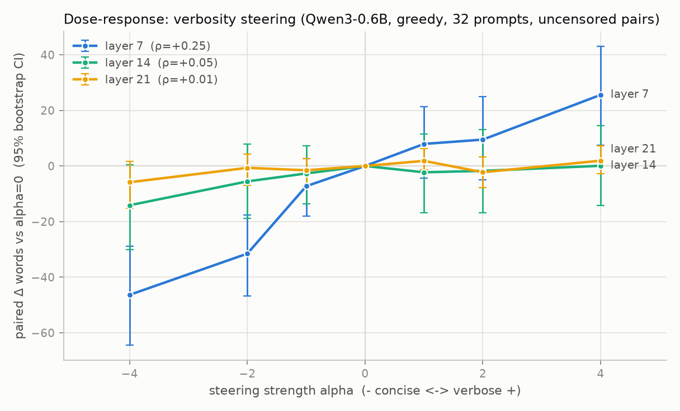
MEASURED RESULT
Behavior follows the dial
−46 words
at α = −4, CI [−64.5, −28.8]
+26 words
at α = +4, CI [+7.4, +43.1]
ρ = +0.25
Spearman(α, words), n = 214
0.00e+00
zero-dose deviation, all layers
Paired Δ words vs α = 0 · 32 prompts · 95% bootstrap CIs · censored generations excluded
Layers 14 & 21: weak/null at unit norm — shown, not hidden.

Slide 4
MEASUREMENT RIGOR
No truncated answer counts as short
CENSORING-AWARE
Every generation logs token IDs, generated_tokens, reached_eos, hit_max_new_tokens (cap 512). Truncated outputs are excluded from word stats — never reported as their "length".
PAIRED + BOOTSTRAP
Word-count change is paired per prompt against α = 0; means carry 95% percentile bootstrap CIs (10k resamples). Trend tested with Spearman rank correlation.
FLUENCY GUARD
NLL of steered text under the unsteered model stays 0.38–0.42 nats/token at every α — style changes, coherence doesn't.
38 UNIT TESTS
Zero-α identity, hook cleanup on exception, causality of last-token injection, ONNX parity, censoring accounting, split-model parity — all green, no model download needed.

Slide 5
NPU-READY OPERATOR
The whole intervention is Mul + Add
PARITY VS PYTORCH FP32
ORT CPU
bit-exact (0.0)
hidden
Add
steered
PyTorch FP16
max 2.3e-03
steering v
Mul
INT8 vector
~25x below signal
α, mask
QDQ INT8 (real)
max 3.8e-02
α = 0 identity
exact (FP32, INT8-v)
Exported at [1,16,1024] (prefill), [1,1,1024] (decode), and dynamic-T.
v, α, mask are runtime inputs — no recompile to change dose.
Opset 17, classic exporter; every graph passes onnx.checker.
Caveat: standalone-op quantization ≠ full-LLM quantization.

Slide 6
QUALCOMM INTEGRATION
The Snapdragon path, as it really is
CLOUD · VERIFIED
AI Hub Workbench, run end-to-end on a Snapdragon X Elite CRD: compile → link → on-device inference (fp16-exact vs local ORT) → profile. All 5 ops on the NPU, est. 180 µs, ~14 MB peak. qai-hub 0.52.0 pinned; opt-in via --submit.
LOCAL · SCRIPTED
QAIRT flow is discovery-driven: reads SDK version, derives flags from each tool's --help, runs contexts via qnn-net-run --retrieve_context. Without an SDK it prints templates marked UNVALIDATED.
REALITY CHECK
AI Hub's Qwen3-0.6B ships only as GGUF Q4_0 under llama.cpp (GenieX) — no editable QNN graph. Editable recipes: Llama-3.2-1B / Qwen3-1.7B+, where the residual stream crosses split boundaries as graph I/O.
Two pinned environments: model/eval (Win, py3.13, requirements.lock.txt) · Qualcomm tooling (WSL, py3.10, requirements-qualcomm.lock.txt)

Slide 7
SPLIT COMPUTE · VERIFIED 2026-07-21
One LLM, two Snapdragons
PHONE · 8 ELITE QRD
LAPTOP · X ELITE CRD
Qwen3-0.6B embed + layers 0–13
829/829 ops on NPU · 6.1 ms
peak memory 118 MB
layers 14–27 + norm + LM head
832/832 ops on NPU · 16.4 ms
peak memory 36 MB · LM head dominates
hidden state
[1,32,1024]
2 KB/token fp16
100%
fp16-exact
KL 2.1e-5
greedy token agreement with local fp32, all 32 positions
boundary crossing: 6.4e-4 relative err on 6,520-scale outliers
last-position distribution vs single-device reference
Honesty: AI Hub has no device-to-device transport — the cloud round trip stood in for the network. Functional viability on real silicon is proven; live transport latency, streaming KV-cached decode, and power are not. Fixed-shape prompt graphs (T=32).

Slide 8
HONESTY LEDGER
What we claim — and what we don't
DEMONSTRATED (ran here)
NOT YET (integration work needed)
Dose-response with CIs excluding zero (layer 7)
α = 0 → bit-exact identity, hooks exception-safe
ONNX Mul/Add graph: bit-exact ORT parity; survives FP16 / INT8 / QDQ
Steering op on X Elite via AI Hub: 100% NPU, 180 µs, fp16-exact
Qwen3-0.6B split across phone + laptop NPUs: 100% token agreement
38/38 tests, pinned deps, reproducible artifacts
Steering inside Qualcomm's deployed LLM (Genie / GenieX)
CPU split-boundary intervention — proposed, unverified (raw-QNN loop + uint16 activation encodings unproven)
Live cross-device transport & streaming decode — cloud round trip stood in for the network
Full-LLM latency / power; thermals on cloud-hosted CRDs

Slide 9
FIVE-MINUTE DEMO
See it steer, then see the graph
0:30
pytest -q — 38 green, incl. zero-α identity and split-model parity
1:30
Live: one prompt at α = −4 / 0 / +4 — concise → verbose, truncation flags shown
1:00
Dose-response plot: CIs, ρ = +0.25, weak layers included
1:00
The ONNX graph in Netron: two ops, runtime α and vector; parity + INT8 table
1:00
AI Hub job pages: steering op on X Elite (100% NPU, 180 µs) + the phone→laptop split run (100% token match)
Next experiment: patch the steering Add into qai-hub-models' Llama-3.2-1B export and recompile one split — steering inside the deployed LLM.

