Slide 1
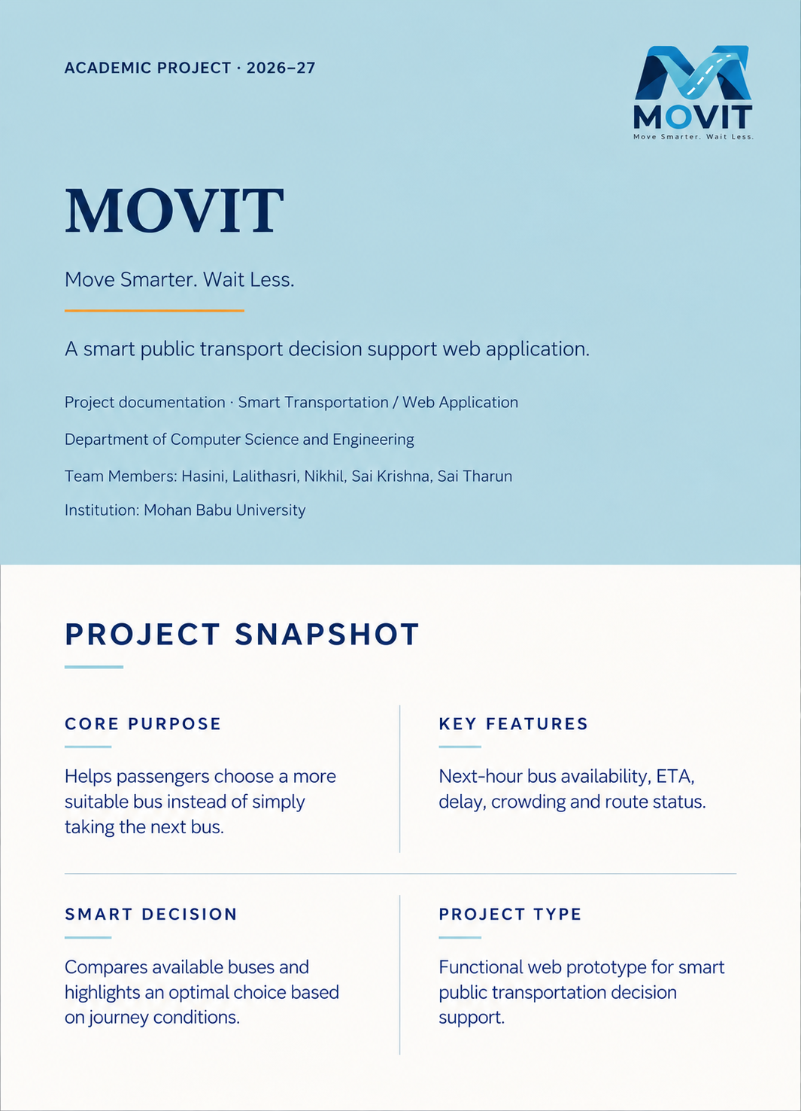

Slide 2
MOVIT
MOVIT
01 · ABSTRACT
1. Abstract
MOVIT is a smart public-transport assistance web application designed to help passengers choose a suitable bus instead of automatically taking the next arriving bus. The prototype brings arrival estimates, delay, crowding, route status, passenger-reported information, and journey requirements into one decision-support experience.
When several buses are available, passengers need more than a single arrival time. They need to understand whether waiting a little longer may produce a more reliable or comfortable journey. MOVIT presents upcoming buses within the next 60 minutes and highlights a recommended option, while remaining explicit that the current prototype is not a fully deployed live-GPS system.
CENTRAL PHILOSOPHY
“The right bus. Not just the next bus.”
Table 1. Project at a glance
ITEM | DESCRIPTION
Project Name | MOVIT
Application Type | Web Application
Domain | Smart Transportation
Primary Users | Daily Public Transport Passengers
Core Function | Bus discovery and decision support
Data Mode | Prototype / Demo Data
Primary Focus | Arrival, delay, crowding and route information
MOVIT
02

Slide 3
MOVIT
MOVIT
02 · THE USER PROBLEM
2. Problem Statement
Public-transport passengers often make a time-sensitive decision with incomplete information. They may see one bus approaching without knowing whether another service is arriving shortly, whether the first bus is delayed, or whether it is likely to be crowded. Route changes and scattered status information add to the uncertainty.
2.1 EXISTING SITUATION
DECISION GAP
Passenger reaches a stop → waits → sees a bus → decides whether to board.
A passenger may choose the first visible bus even when a slightly later service would better fit the journey.
The missing step is a consolidated view of near-term alternatives.
2.2 Project objectives
Display buses arriving within the next hour.
Present useful information for each available bus.
Show arrival estimates clearly.
Indicate delay and crowding conditions.
Highlight route-related information.
Recommend an appropriate or optimal bus.
Allow passengers to contribute transport updates.
Reduce unnecessary waiting and uncertainty.
Provide a simple and understandable interface.
Create a foundation for future real-time transport integration.
Problem → solution. Fragmented transport information → consolidated journey view → informed passenger choice.
MOVIT
03

Slide 4
MOVIT
MOVIT
03 · SYSTEM CONCEPT
3. Proposed System
MOVIT is structured around a simple passenger journey. The user selects an origin and destination, requests available buses, reviews services arriving within the next 60 minutes, compares conditions, and chooses the option that best fits the journey. The public prototype describes the same flow through journey selection, bus options, status information, and passenger reporting sections.
01
Select FROM location.
02
Select TO location.
03
Request available buses.
04
View buses arriving within the next 60 minutes.
05
Compare arrival, delay, crowding, and route information.
06
Identify the recommended option.
07
Review transport status when required.
08
Submit a passenger observation when appropriate.
Next bus versus better bus
DIMENSION | NEXT BUS | MOVIT DECISION SUPPORT
Primary focus | Earliest arrival | Overall suitability for the journey
Information used | Usually arrival time | Arrival, delay, crowding and route conditions
Passenger choice | Board the first available service | Compare alternatives before deciding
Role of the system | Listing | Decision support
MOVIT
04

Slide 5
MOVIT
MOVIT
04 · OPERATIONAL FLOW
4. System Workflow
The workflow describes how a passenger moves from an initial journey request to a bus decision. It intentionally stays at the prototype-component level; the available material does not confirm a specific backend, API, database, cloud service, or programming framework.
Passenger workflow
START
Open MOVIT
1
2
Select FROM location
Select TO location
3
4
Search
Retrieve available buses
5
6
Display buses within next 60 minutes
Analyze bus conditions
7
8
Compare arrival / delay / crowding / route information
Identify suitable bus
9
10
11
Display recommended option
12
Passenger chooses bus
13
END
High-level architecture
User Interface → Journey / Bus Search Logic → Bus Information Processing → Recommendation Logic → Status / Passenger Report Components. Each layer represents a functional prototype component rather than a claim about a deployed technical architecture. The separation helps explain what the user sees, what information is processed, and where future integrations could be added.
MOVIT
05
Figure 4.1. Prototype workflow and functional component boundary.

Slide 6
MOVIT
MOVIT
05 · DECISION SUPPORT
5. Smart Bus Selection
The “Available Buses — Next 1 Hour” feature is central to MOVIT’s purpose. Instead of presenting only the next service, the prototype is intended to show a set of upcoming options so that passengers can compare relevant conditions. The published site labels this experience “Find your best bus” and describes all arrivals in the next hour with one thoughtful recommendation for the journey.
5.1 OPTIMAL BUS
The optimal bus is not necessarily the bus arriving first. A slightly later service may be more suitable when the first option is delayed or highly crowded.
This is a decision-support indication, not a mathematically verified score unless a scoring model is implemented and documented.
Table 5.1. Illustrative bus comparison
FACTOR | BUS A | BUS B | EFFECT
Arrival | Earlier | Slightly later | Waiting time
Delay | Higher | Lower | Reliability
Crowding | High | Normal | Passenger comfort
Route | Normal | Normal | No major issue
Recommendation | — | Suitable | Overall decision
Decision principle. Compare alternatives before boarding when a short wait may improve reliability or comfort.
MOVIT
06

Slide 7



MOVIT
MOVIT
06 · SUPPORTING CAPABILITIES
6. Supporting Features
6.1 Transport status
The status view is intended to help users understand delays, crowding, route changes, transport-related alerts, and bus-specific conditions before they travel. The published prototype presents this as “Stay informed” and explicitly references delays, crowding, and route changes.
6.2 Passenger report
The passenger-reporting component allows users to contribute observations such as crowding, on-time or delayed status, breakdowns, normal or changed route conditions, and additional comments. These reports can complement system-generated information by adding situational awareness from people already travelling.
6.3 Proposed / Future Enhancement
A possible notification capability would alert a passenger when a selected bus is approximately 10 minutes away, helping them prepare to leave or reach the stop. This is a proposed enhancement and should not be presented as a currently implemented feature without further verification.
CURRENT PROTOTYPE
FUTURE BOUNDARY
Transport status, bus conditions, passenger reporting and decision support are presented as connected user-facing components.
Notifications require verified live data, event handling, and a delivery mechanism before they can be claimed as implemented.
MOVIT
07

Slide 8
MOVIT
MOVIT
07 · INTERACTION DESIGN
7. User Interface Design
The MOVIT interface follows a task-oriented structure: a journey-selection entry point, a bus-options view, a transport-status view, and a passenger-report view. The public reference uses labels such as “Where are you headed?”, “Find your best bus,” “Stay informed,” and “Your update matters,” with route examples including Tirupati → Chittoor and a “Next 60 minutes” time filter.
Interface principles
01
Simplicity for quick travel decisions.
02
Clear information hierarchy.
03
Minimal interaction.
04
Readable status indicators.
05
Consistent navigation.
06
Mobile-friendly design direction.
07
Visual focus on transport information rather than decoration.
VISUAL TREATMENT
Figure 7.1. Published MOVIT visual reference: intercity bus travel context.
Dark interface, high contrast, clear cards, strong typography, and limited visual clutter.
Additional interface screenshots should be inserted from the current prototype for a submission-ready figure set rather than replaced with generic illustrations.
MOVIT
08

Slide 9
MOVIT
MOVIT
08 · DELIVERY AND NEXT STEPS
8. Implementation and Future Development
8.1 Prototype implementation
MOVIT is currently described as a functional web prototype with interactive journey selection, bus discovery, next-hour bus listing, bus status information, an optimal-bus indication, passenger reporting, and a transport-status interface. No specific programming language, framework, database, API, or deployment infrastructure is asserted here because those details were not confirmed.
8.2 Prototype testing
TEST CASE | EXPECTED RESULT | STATUS
Select valid FROM and TO | Relevant bus options displayed | Passed
View next-hour buses | Upcoming buses displayed | Passed
Check bus condition | ETA, status and crowding visible | Passed
Open transport status | Status information displayed | Passed
Submit passenger report | Report interface available | Passed
8.3 Current limitations
8.4 Future scope
Real-time GPS integration; live vehicle tracking; real-time crowd estimation; push notifications; personalized route preferences; historical travel analytics; public transport API integration; smarter recommendation algorithms; a mobile application; authentication and user profiles; and data validation and fraud prevention.
Prototype uses demo or simulated transport information; actual real-time GPS integration is not currently demonstrated; passenger reports may require validation in a production system; recommendation quality depends on the availability and accuracy of transport data.
MOVIT
09

Slide 10
MOVIT
MOVIT
09 · CONCLUSION
9. Conclusion
Passengers do not always need the first bus. They need enough information to choose the bus that best fits their journey. MOVIT addresses this practical problem by bringing bus availability, arrival information, delay information, crowding information, route status, passenger reports, and a bus recommendation into one focused decision-support experience.
As a prototype, MOVIT demonstrates the concept without overstating the maturity of its data infrastructure. Its value lies in making the decision visible: passengers can see the available alternatives, understand the conditions attached to each one, and make a more informed choice. The same foundation can later support real-time transport integrations, stronger validation, personalization, and broader mobility services.
MOVIT aims to make everyday public transport decisions clearer, faster, and more informed.
References
MOVIT Web Prototype — published prototype reference.
Relevant public transportation and smart mobility references — to be added from the literature or institutional sources used by the project team.
APIs, frameworks, libraries, or technical resources actually used in the implementation — to be completed by the project team; no unverified technologies are listed here.
THANK YOU
MOVIT
10

