Slide 1

Blockchain Hackathon Team 7
INSURANCE CLAIMS PROCESSING
Sources : BCG , PWC , irdai , mckinsey , Forbes , IBM , E&Y , FBI , Economic Times , Deccan Chronicle.

Slide 2
Agenda
Problem Statement
Introduction to Team
Answers to the Questionnaire (Data)
Existing System
Proposed Solution
Platform Specifications
Business Applications, Post course
Demo
Q & A

Slide 3
Problem Statement
The aggregate value of processed claims : US health care market is ~3 trillion dollars . Claims : electronically and on paper. The total cost of insurance fraud (not counting health insurance) in the US is estimated to be more than $40B a year, according to the FBI.
This isn’t just a problem for the insurance companies losing money — insurance fraud costs the average US family anywhere between $400 and $700 in the form of increased premiums.
Underwriter (Poor Due Diligence)
Accidental Claims
Trust
Fake Policy
Data Privacy
Inflated billing
Claim Processing timeframe
Signature forgery
Grievances
Death Claims
Deletion of data by
Health Insurance Companies
Different Data Formats
Rework Cost

Slide 4
Answers to the Questionnaire (Data)
We chose this application because a) Domain expertise b) Interest in the area c) Growth potential

Slide 5
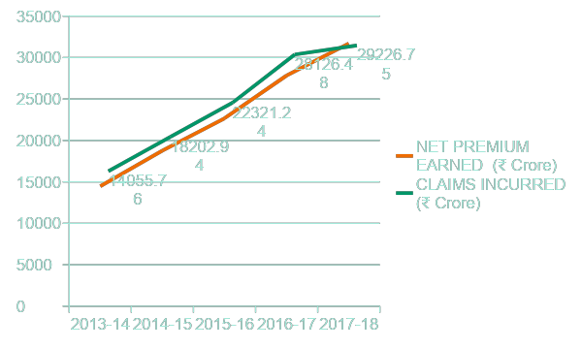
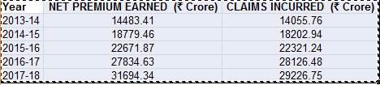
DATA
Source:
https://www.irdai.gov.in/

Slide 6
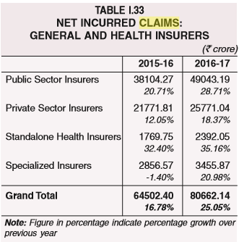
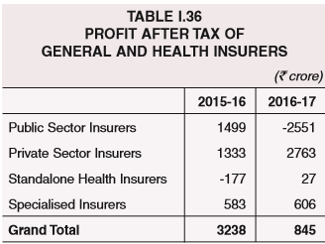
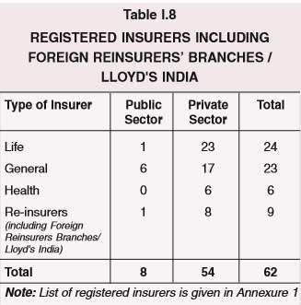
DATA
Source:
https://www.irdai.gov.in/ADMINCMS/cms/frmGeneral_NoYearList.aspx?DF=AR&mid=11.1

Slide 7
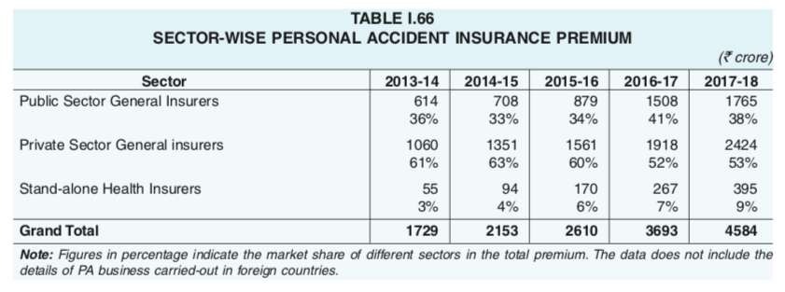
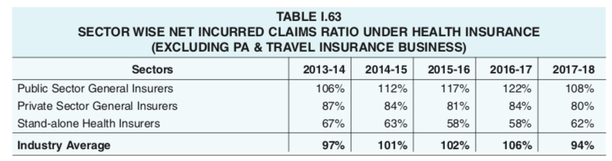
DATA

Slide 8
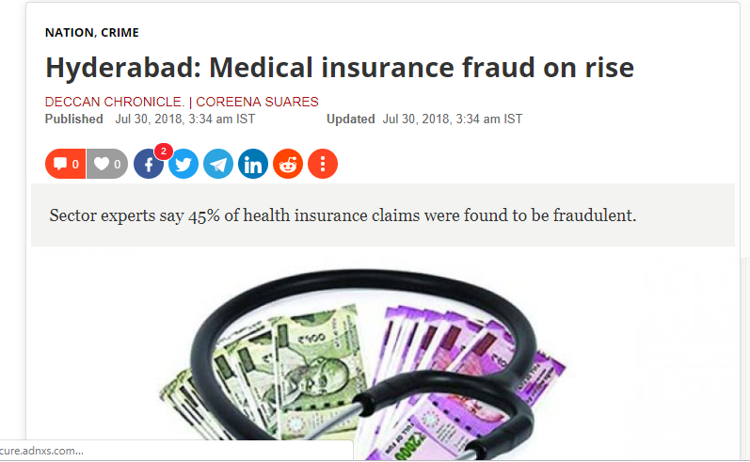
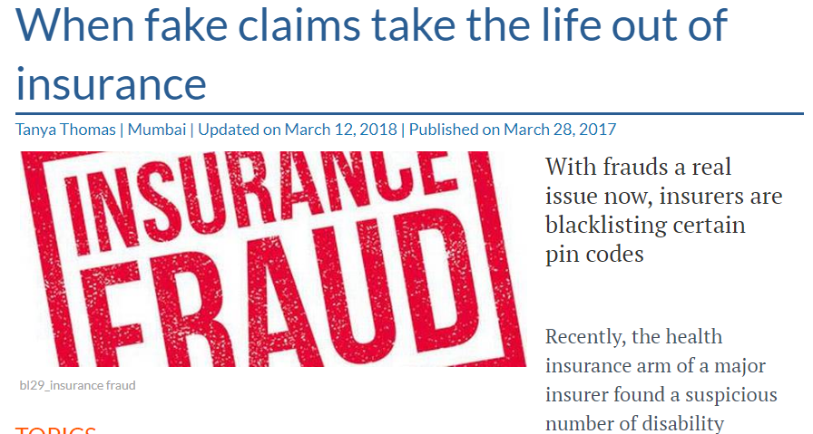
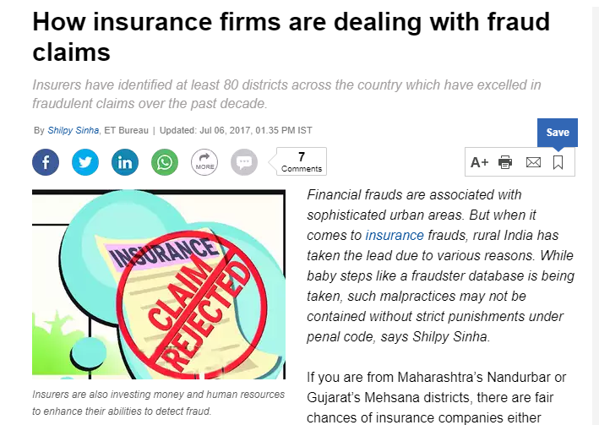
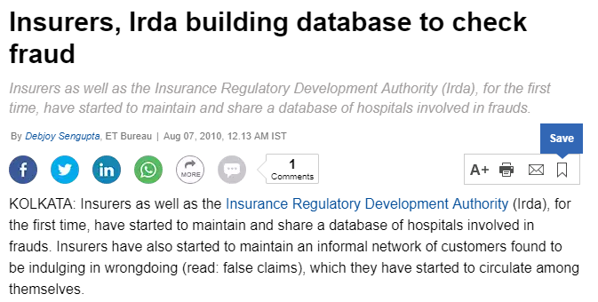

Slide 9
Group 7
Team Member 1 - Santhosh
Team Member 2 - Srinivas
Team Member 3 - Vijay
Team Member 4 - Gulrez
Team Member 5 - Sai
Team Member 6 - Abhishek

Slide 10
Answers to the Questionnaire (Data)
We chose this application because a) Domain expertise b) Interest in the area c) Growth potential
d) Trust Issues

Slide 11
Actors in the Game
Patients
Insurance Companies
Hospitals
IRDA
Ombudsman

Slide 12
Bad Actors
Patients:
Fake Claims OR credentials

Slide 13
Bad Actors
Insurance Companies:
Claims Rejections, Delete Claims

Slide 14
Bad Actors
Hospitals:
Paying Incentives to Physicians
Reporting higher than actual costs
Entering into financial relationships with Insurance providers
Performing & Billing for medically unnecessary procedures

Slide 15
Bad Actors
IRDA :
Delhi High Court Judgment
Exclusions for genetic conditions
IRDA guidelines 2013, 2016
Source:
https://www.valueresearchonline.com/story/h2_storyview.asp?str=35257&utm_medium=vro.in

Slide 16
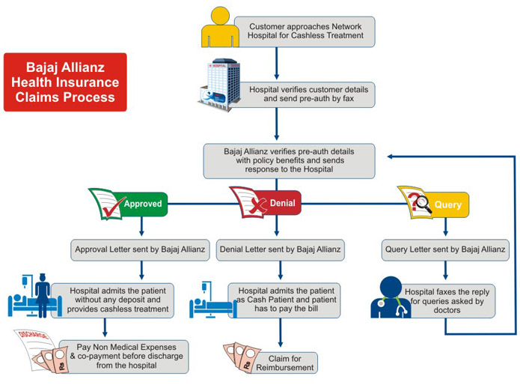
Existing Systems - Bajaj Allianz workflow

Slide 17
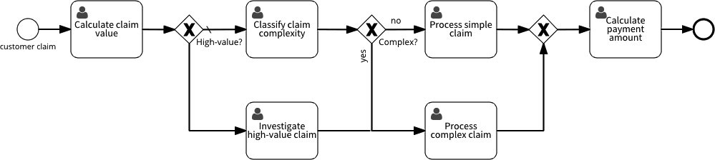
no
yes

Slide 18

no
yes

Slide 19
Platform Specifications
Fraud detection & risk prevention
Build Blockchain Consortium Trustless Platform
Design IRDA friendly platform
Apply Incentive Engineering
Apply Design Thinking
Apply Zero Knowledge Proofs

Slide 20
Fraud Detection & Risk Prevention
Claims made shortly after the Policy inception
Serious underwriting lapses observed while processing claim
Accident un-witnessed and not properly reported
Insured behind in loan repayment
Invisible injury
Insured overly aggressive in pursuit of a quick settlement

Slide 21
HBC (Health Blockchain Consortium)
Business network diagram with following Actors
IRDA (Regulator)
Insurance Companies
Hospitals (End User)
Ombudsman
Patients (End User)

Slide 22
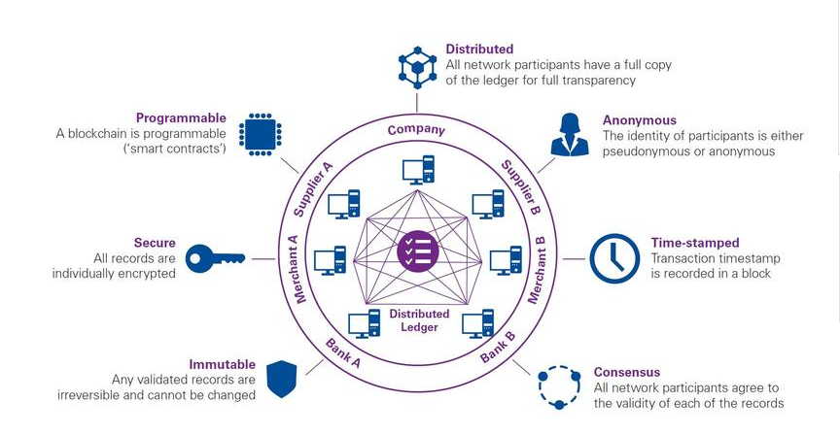
Proposed Solution
Ref : KPMG (https://home.kpmg/xx/en/home/insights/2018/09/blockchain-in-insurance-fs.html)

Slide 23
Design Thinking
Platform must be designed to assure CIA
Confidentiality, when appropriate
Integrity
Authenticity
System must be validated - for its intended use
System must have a secure, computer generated time stamped audit trail

Slide 24
Objectives of IRDA
To Promote Competition to enhance Customer Satisfaction
Increased Consumer Choice
Lower Premiums
Ensuring Financial Security of Insurance Market
Orderly Growth of Insurance Industry
Prevent Fraud OR Malpractices
To Bring Transparency

Slide 25
Incentivize Good Behaviors (in the form of discounts/Reward points)
Patient:
if he raises the claim
Adoption of Health/Wellness app OR Device
Buying Healthy compliant foods
Using a fitness trainer or gym

Slide 26
Incentivize Good Behaviors (in the form of discounts/Reward points)
Hospitals:
if they raise bills < 25% of the Sum Assured
Simplify Appointment booking OR Arrivals
Addressing behavior health visits through TeleHealth (Research says 80% of the behavior health visits can be managed by TeleHealth)
Lease reduction discount

Slide 27
Incentivize Good Behaviors (in the form of discounts/Reward points)
Insurance Companies:
Average Time to settle Claim ( ‘<‘ Industry Average OR ‘<‘ Prior year’s Average)
Renewal/Retention ( '>' Industry Average OR '>' Prior year’s Average)
Sales/New Business ( '>' Industry Average OR '>' Prior year’s Average)
Underwriting speed ( '>' Industry Average OR '>' Prior year’s Average)
Policy Sales Growth ( '<' Industry Average OR '<' Prior year’s Average)

Slide 28
Value Proposition
EMR (Electronic Medical Records), EHR (Electronic Health Records)
e-Prescriptions & Reminders
Reduce Human Intervention through Smart Contracts
Reduction in Claims OR Disputes
Create a High trust Environment

Slide 29
Future Enhancements
Full Mobile Integration
1) Available any time any place 2) Multilingual
Remote Health care
1) Reduced patients admission
2) Earlier discharges
3) Reduced need for visits
AI OR ML enabled system
e-Laboratory OR findings

Slide 30
Demo- Execution of the application

Slide 31
Q & A

Slide 32
Thank you!

