Slide 1
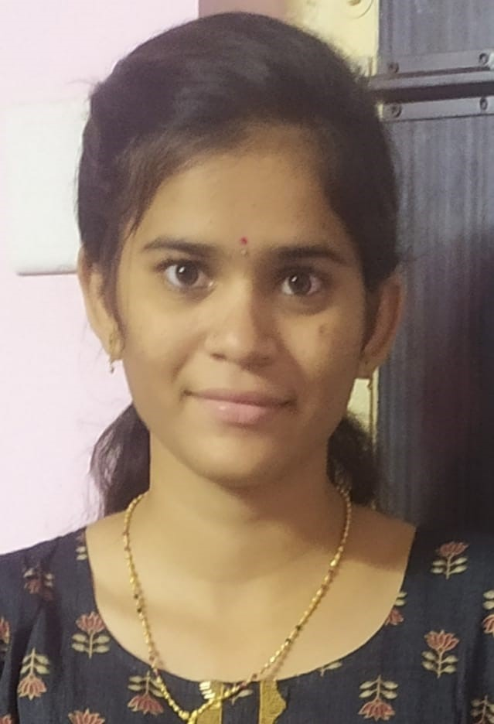
NAME : JALASUTRAM SAIVANI
EMAIL ID : jalasutramsaivani@gmail.com
COLLEGE NAME : Universal College of Engineering and Technology
ROLL NUMBER : 20NF1A0426
COLLEGE STATE : Andhra Pradesh
INTERNSHIP DOMAIN : Frontend Development
START DATE: 05-06-23 END DATE:03-07-23

Slide 2
CREATE A WEBPAGE ON
PORTFOLIO SITE
USING BOOTSTRAP

Slide 3
AGENDA
1 Introduction to Frontend Development
4 Responsive Web Design
Definition and Importance
Role in Web Development
Mobile-First Approach
Media Queries
Flexible Images and Fluid Layouts
2 HTML Fundamentals
Structure of an HTML Document
Common HTML Tags and Elements
Semantic HTML
5 JavaScript Essentials
Introduction to JavaScript
Variables, Data Types, and Operators
Control Flow and Loops
Functions and Events
3 CSS Basics
Introduction to Cascading Style Sheets
Selectors and Specificity
Box Model and Layouts
CSS Flexbox and Grid

Slide 4
AGENDA
6 Introduction to Frontend Frameworks
9 Accessibility and Usability
Overview of Popular Frameworks (e.g., React, Angular, Vue)
Benefits and Use Cases
Components and State Management
Importance of Accessibility
Web Content Accessibility Guidelines (WCAG)
Usability Principles and Best Practices
7 Performance Optimization
10 UI/UX Trends and Modern Frontend Technologies
Minification and Concatenation
Caching and CDN Usage
Image Optimization
Code Splitting and Lazy Loading
Introduction to UI/UX Design
Micro interactions and Animations
Progressive Web Apps (PWAs)
Single-Page Applications (SPAs)
8 Frontend Testing and Debugging
11 Conclusion and Q&A
Types of Testing (Unit, Integration, E2E)
Testing Frameworks (e.g., Jest, Cypress)
Debugging Techniques and Tools

Slide 5
Project Overview:
Project Name : Personal Portfolio Website
Objective :
The objective of this project is to create a personal portfolio website to showcase my skills, projects, and achievements. The website will serve as a professional platform to highlight my expertise, attract potential clients or employers, and provide a central hub for my online presence.
Key Features:
1 Home Page:
2 Portfolio :
Introduction and welcome message
Brief overview of skills and expertise
Call-to-action buttons for contacting or exploring further
Showcasing a selection of my best projects
Description, images, and links to each project
Categorization of projects for easy navigation

Slide 6
Project Overview:
3 About Me:
Detailed information about my background, education, and experience
Summary of key skills and accomplishments
Personal interests and hobbies
4 Services:
Listing the services I offer (e.g., web design, front-end development)
Description of each service and its benefits
Pricing information or a call-to-action for inquiries
5 Contact:
Contact form or information for potential clients or employers to reach out
Integration with email or messaging platforms for easy communication

Slide 7
Project Overview:
Timeline:
Technologies Used:
Planning and Design : 1 week
Development : 2 weeks
Content Creation : Ongoing during development
Testing and Refinement : 1 week
Deployment and Launch : Final week
Frontend : HTML5, CSS3, JavaScript
Deployment : Hosting on a web server or cloud platform
Styling : Bootstrap or custom CSS
Benefits:
Showcasing skills and expertise to attract clients or employers
Central hub for online presence and professional branding
Opportunity to demonstrate creativity and technical abilities
Platform for sharing knowledge and insights through a blog (if included)

Slide 8
WHO ARE THE END USERS ?
Potential Clients:
Characteristics: Small businesses, startups, entrepreneurs, or individuals looking for professional web design or front-end development services. They may have limited technical knowledge but seek high-quality and visually appealing websites.
Needs: They require a reliable and skilled professional who can effectively communicate their brand identity, create an engaging user experience, and deliver a visually impressive website that aligns with their goals.
Benefits: The portfolio website demonstrates my skills, expertise, and past projects, instilling confidence in potential clients. They can assess the quality of my work, view testimonials, and easily contact me, leading to increased inquiries and potential project opportunities.
Employers and Hiring Managers:
Characteristics: Recruiters, HR professionals, or hiring managers responsible for evaluating and hiring candidates for web development or related positions. They may represent companies of various sizes and industries.
Needs: They seek individuals with strong technical skills, a solid portfolio, and a professional online presence. They need to assess the candidate's capabilities, work experience, and suitability for specific projects or positions.
Benefits: The portfolio website allows employers to evaluate my skills, experience, and expertise easily. They can review my projects, assess my technical abilities, and gauge my fit within their organization. This can lead to potential job offers, freelance opportunities, or interviews for further evaluation.

Slide 9
WHO ARE THE END USERS ?
Colleagues and Peers:
Characteristics: Fellow professionals in the web development industry, including designers, developers, and individuals involved in related fields. They may have similar or complementary skills and seek networking opportunities.
Needs: They are interested in connecting, collaborating, and sharing knowledge within the industry. They may look for inspiration, potential partnership opportunities, or mentorship possibilities.
Benefits: The portfolio website allows colleagues and peers to explore my work, get inspired by my projects, and learn about my skills and expertise. They can easily contact me for collaborations, discuss industry trends, or seek guidance, fostering professional connections and opportunities for growth.
Visitors and General Audience:
Characteristics: Friends, family, acquaintances, or individuals who come across the portfolio website out of curiosity or interest in my professional endeavors. They may have varying levels of technical knowledge and diverse backgrounds.
Needs: They are looking to learn more about my work, skills, and achievements. They may be interested in understanding my background, expertise, and personal interests.
Benefits: The portfolio website provides visitors with a comprehensive view of my capabilities, past projects, and professional journey. They can gain insights into my skills, review my achievements, and understand my areas of expertise. This can lead to increased recognition, support, and potential opportunities for collaboration or referrals.

Slide 10
Solution And Its Value Proposition:
Effective Branding and Communication:
Professional Online Presence:
The website allows the portfolio owner to effectively communicate their brand identity, values, and unique selling points.
Through carefully crafted content and design elements, the portfolio owner can create a lasting impression and differentiate themselves in a competitive market.
The personal portfolio website establishes a professional online presence, showcasing skills, expertise, and past projects in a visually appealing and easily accessible manner.
It provides a centralized platform for potential clients, employers, colleagues, and visitors to learn about the portfolio owner's work and achievements.
Networking and Collaboration Opportunities:
Building Trust and Credibility:
The portfolio website allows colleagues, peers, and professionals within the industry to discover and connect with the portfolio owner.
It creates opportunities for networking, collaboration, and knowledge-sharing, leading to potential partnerships, mentorship possibilities, or industry recognition.
The inclusion of testimonials, client reviews, and case studies on the website helps build trust and credibility with potential clients and employers.
The portfolio owner's professionalism, reliability, and successful track record are effectively communicated, instilling confidence in prospective partners or employers.

Slide 11
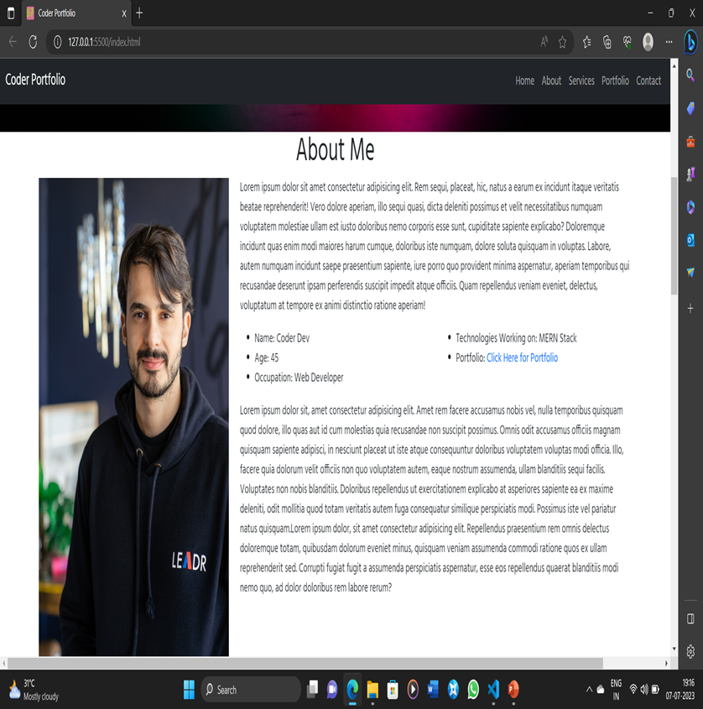
Customized the Reference Project & made my own:

Slide 12
Modelling Technologies:
Multimedia Integration:
Grid Layout:
Incorporating various multimedia elements, such as images, videos, audio clips, or interactive features, can enhance the impact and engagement of your portfolio. You can showcase your projects through image galleries, video presentations, or interactive prototypes, depending on the type of work you want to display.
Utilizing a grid-based layout helps organize your content in a structured and balanced manner. It allows for consistent spacing, alignment, and placement of elements, making it easier for visitors to navigate and explore your portfolio.
Visual Hierarchy:
Responsive Design:
Establishing a clear visual hierarchy ensures that the most important elements of your portfolio stand out. You can achieve this by using different font sizes, contrasting colors, and strategic placement of content. This technique guides visitors' attention and helps them focus on key aspects of your work.
With the increasing use of mobile devices, it's essential to create a portfolio site that is responsive and adapts to different screen sizes. Responsive design ensures that your site looks and functions well on various devices, providing an optimal user experience for all visitors.

Slide 13
Modelling Technologies
Navigation and User Experience:
Designing intuitive navigation and ensuring a seamless user experience are crucial for portfolio sites. Implement clear and easy-to-use navigation menus, provide descriptive labels for sections or categories, and offer smooth transitions between pages to enhance usability and help visitors find the information they are looking for.
Colour Palette and Branding:
Minimalism and Simplicity:
Establishing a consistent color palette that aligns with your personal or brand identity can help create a cohesive and memorable portfolio. Choose colors that complement your work and evoke the desired emotions or associations.
Employing a minimalist design approach can highlight the content of your portfolio and create a clean and elegant aesthetic. Avoid cluttering your pages with excessive elements and focus on creating a visually pleasing and uncluttered experience.

Slide 14
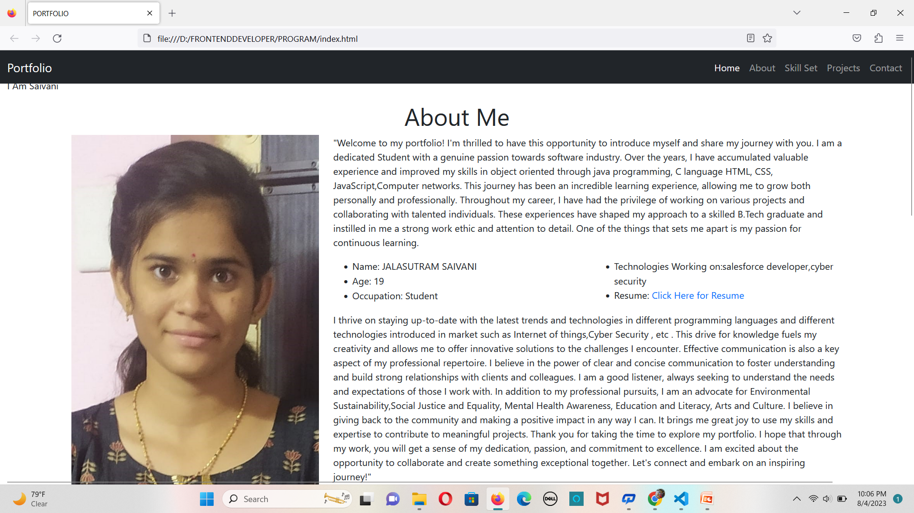
Result:
Photos:

Slide 15
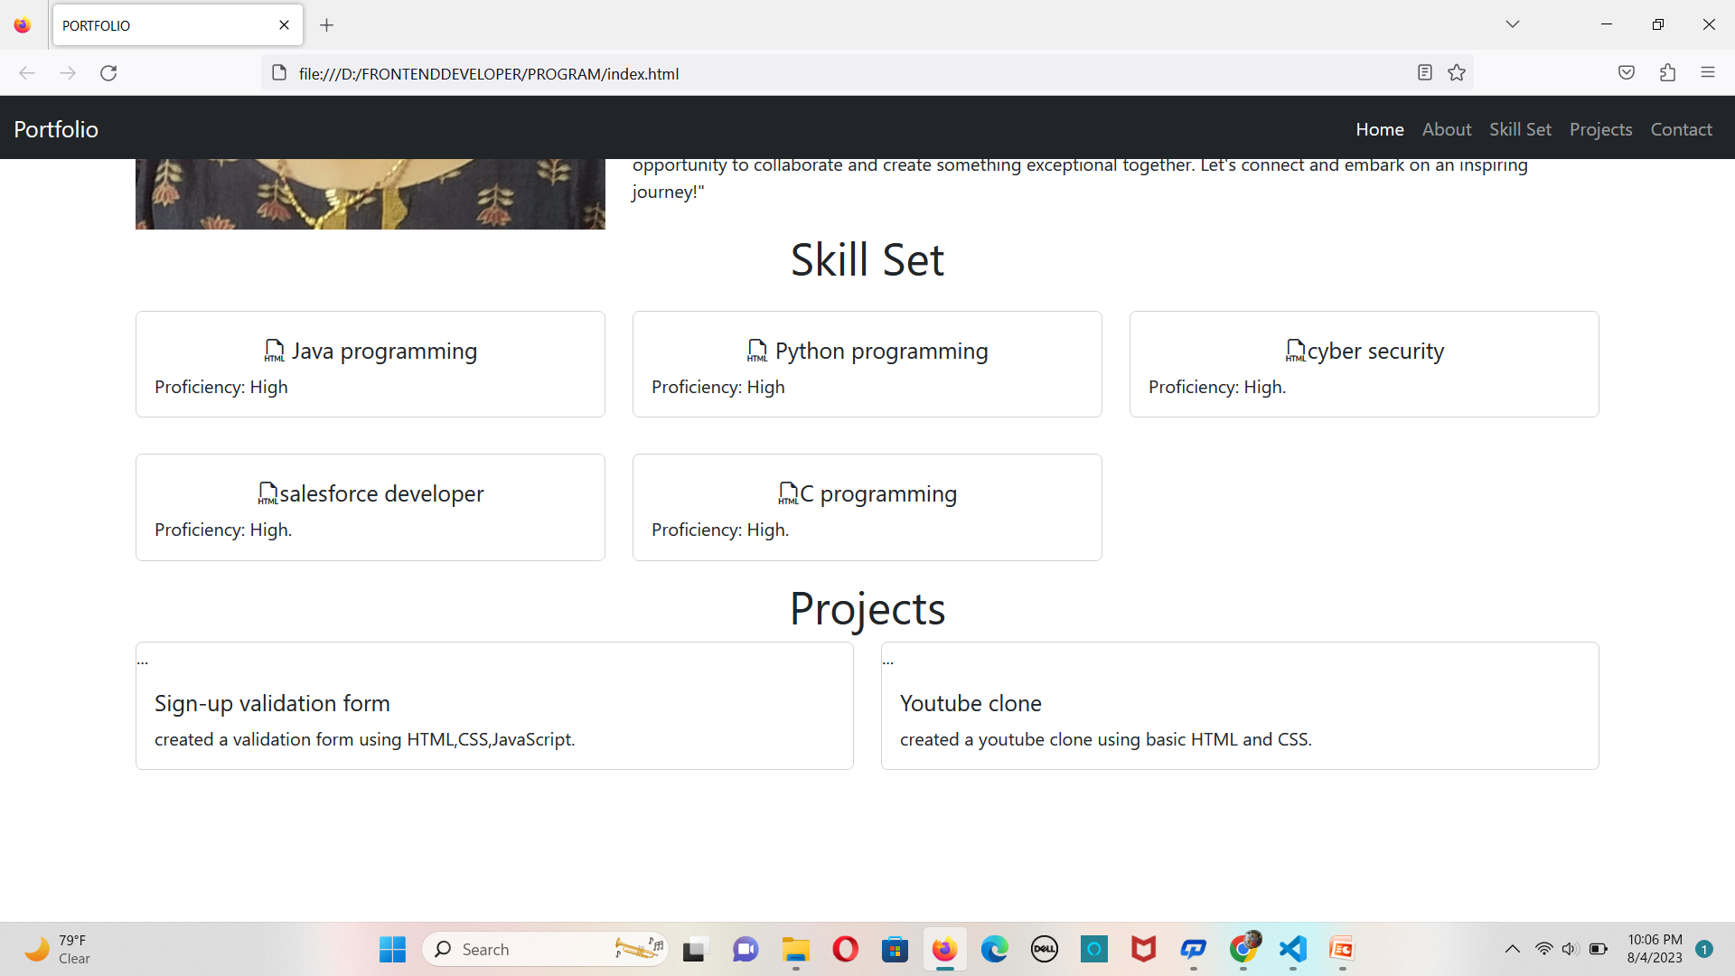

Slide 16
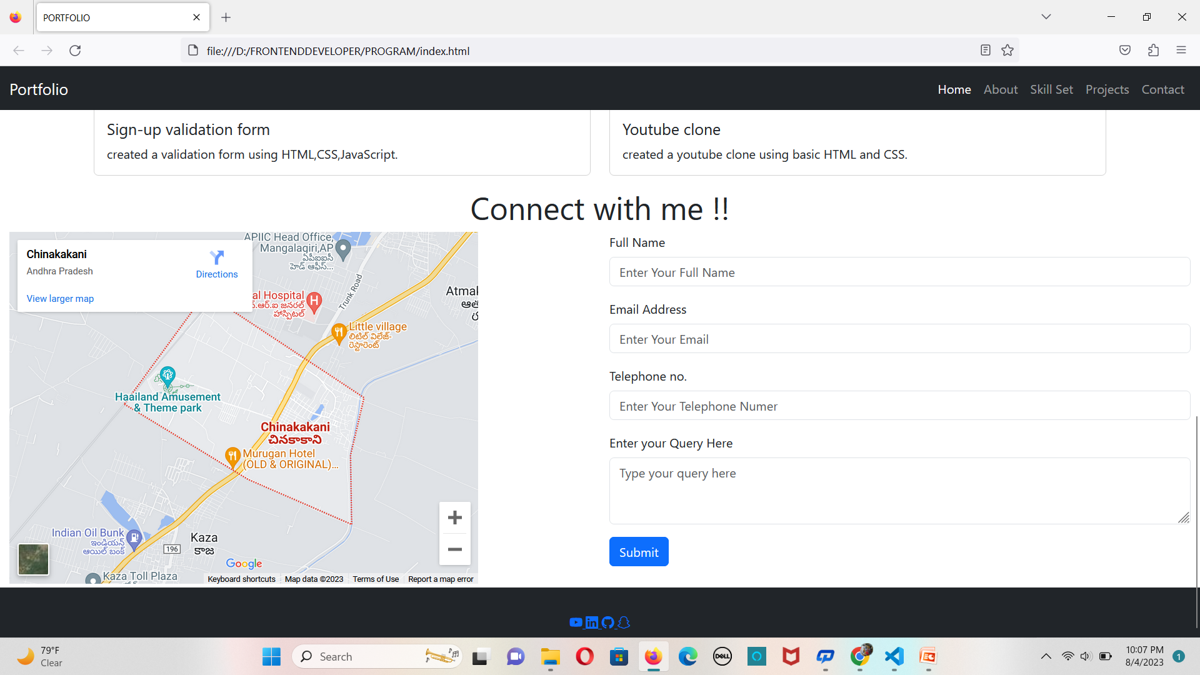

Slide 17
GitHub link of My Project on Portfolio:-
Git Hub Url: https://github.com/saivani04
Project Url:

Slide 18
Thank you

