Slide 1

College Student Attendance Portal
V .Sai Vardhan 160122737201
R .Siddhartha 160122737194
Under Guidance : - Dr. A. Sirisha mam

Slide 2

Abstract:
Our project focuses on developing a comprehensive Student Portal using the MERN stack to revolutionize the educational experience. This centralized platform offers students features such as schedule management, course material access, discussion forums, and virtual classrooms. Administrative staff benefit from streamlined processes for managing student data, attendance tracking, and generating reports. With a user-centric design and robust security, the portal ensures accessibility and data integrity, empowering students and educators to foster a more dynamic and efficient learning environment, ultimately contributing to improved academic outcomes and institutional effectiveness.

Slide 3

Introduction:
Traditional methods of attendance tracking in educational institutions are manual and prone to errors.
Challenges include inaccuracies, time-consuming processes, and limited transparency.
To overcome these challenges, we propose the College Student Attendance Portal.
The portal offers a user-friendly interface and features like absentee logs and note-writing capabilities.
Our presentation will outline the benefits, methodology, and results of implementing the portal.
By streamlining attendance tracking and promoting transparency, the portal aims to enhance academic administration.
Join us as we explore the transformative potential of the College Student Attendance Portal in revolutionizing attendance management for educational institutions.

Slide 4
Existing System(Problem statement):
Manual methods of attendance tracking in educational institutions are prone to errors and inefficiencies.
Challenges include inaccuracies, time-consuming processes, and limited transparency.
There is a need for an automated solution to streamline attendance management and improve data accuracy.

Slide 5

Methodology/Proposed System:
For our mini project, we'll focus on creating a simplified version of the College Student Attendance Portal.
We'll start by designing a basic interface with login functionality for students and faculty.
Next, we'll implement a simple database to store student information and attendance records.
The system will allow students to mark their attendance and faculty to view and update attendance records.
We'll include a feature for students to indicate their absences and reasons, if necessary.
Our priority will be to ensure the system is user-friendly and accessible for all users.
We'll follow an iterative development approach, continuously improving and refining the system based on feedback.
Testing will be conducted to ensure the reliability and functionality of the system within the scope of our mini project.

Slide 6
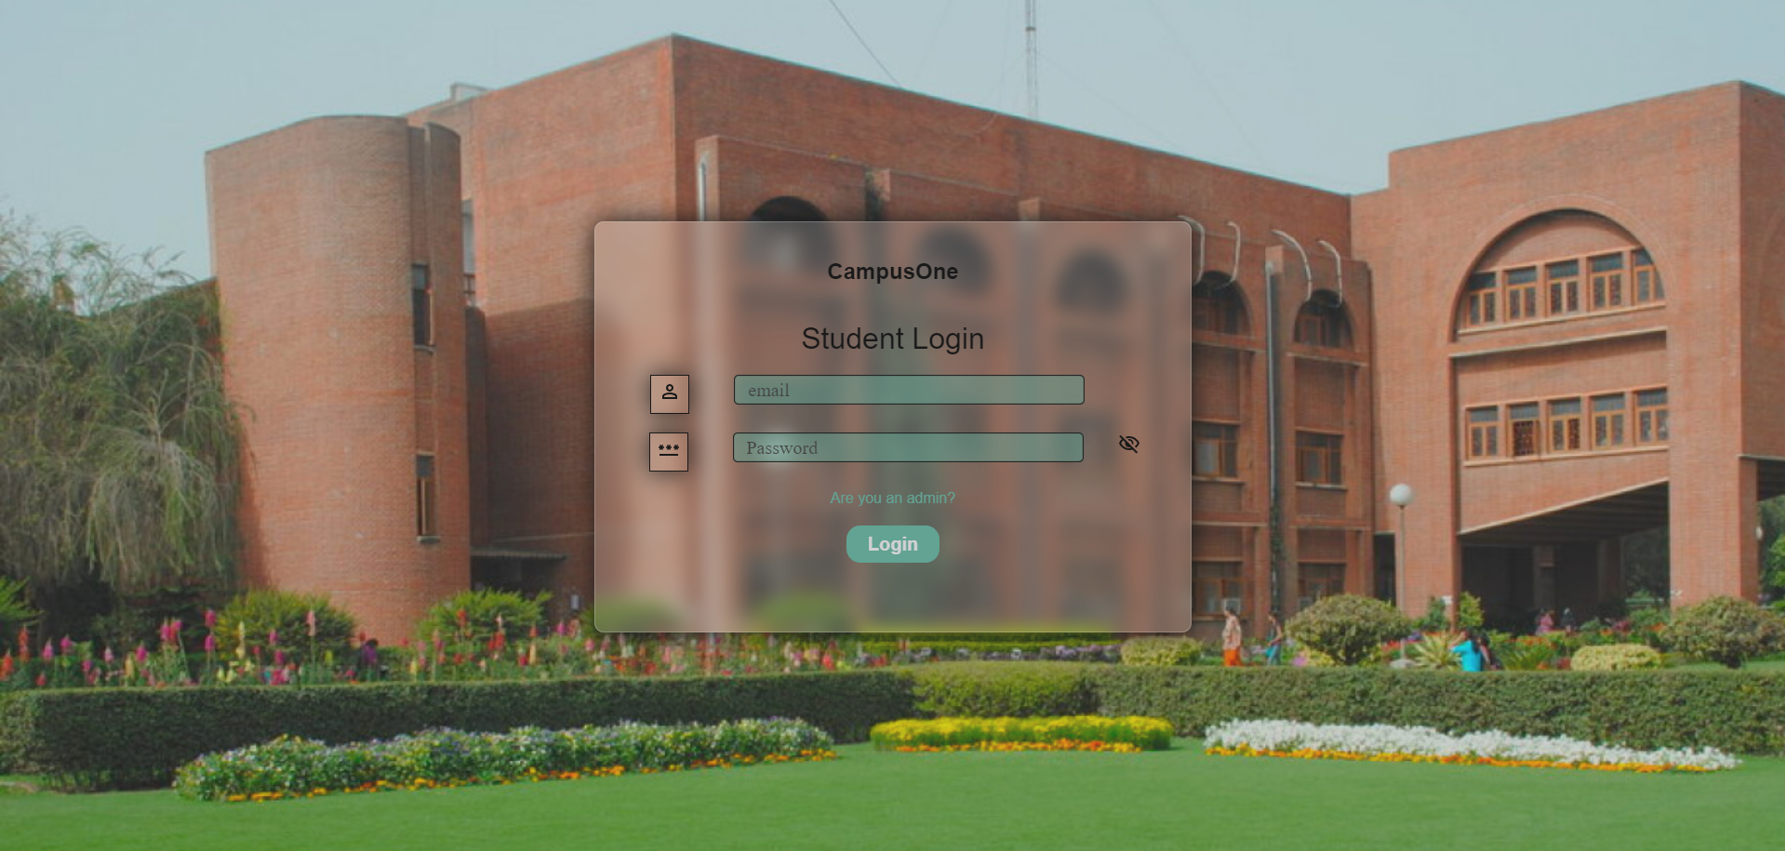
LoginPage:

Slide 7
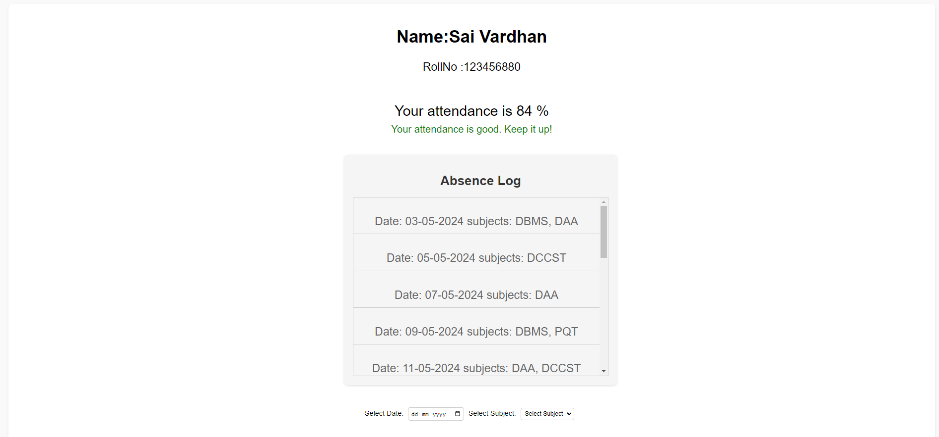
StudentPage:

Slide 8
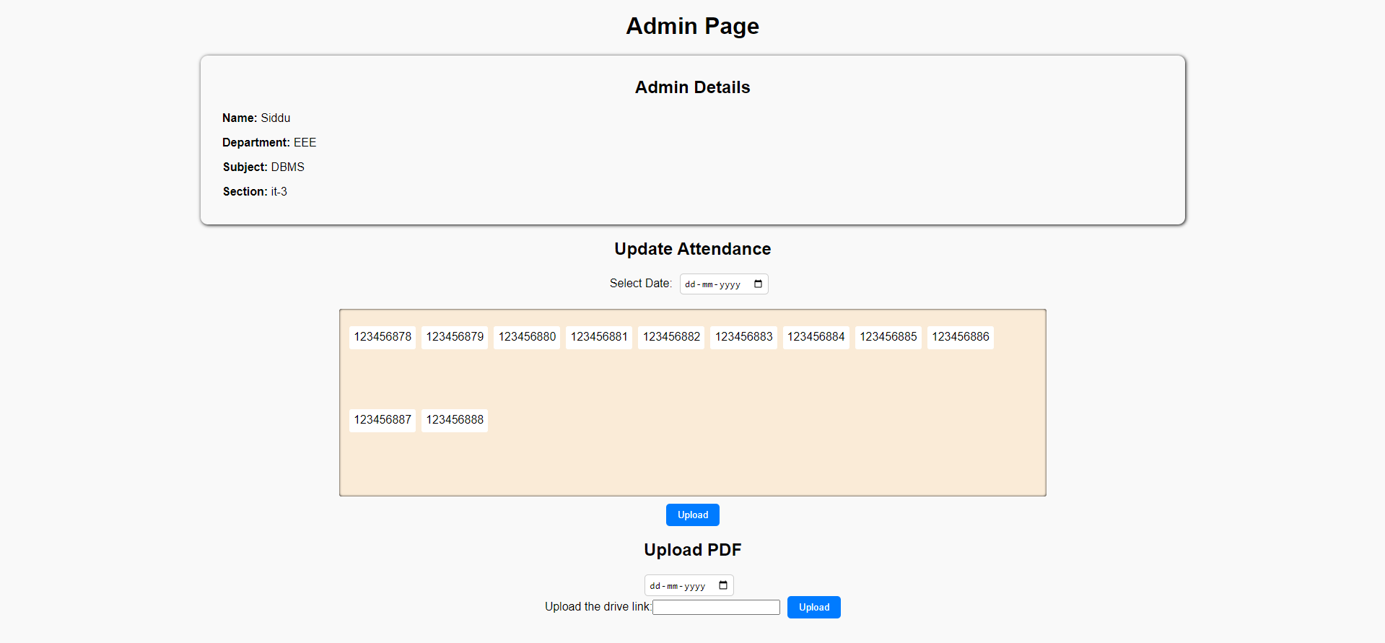
AdminPage:

Slide 9
Results:
We successfully developed a College Student Attendance Portal using the MERN stack to address the needs of educational institutions. Key features include login functionality for both students and faculty, allowing efficient access to attendance records. Students can mark their attendance, and faculty can view and update records in real-time. The system also allows students to indicate absences and provide reasons, enhancing transparency. User feedback has been positive, highlighting the system's simplicity and ease of use. Rigorous testing has ensured reliability, achieving our project objectives and providing an effective solution for managing student attendance.

Slide 10

Conclusion:
Successful development of the College Student Attendance Portal, addressing the need for an efficient attendance management system in educational institutions.
Implementation of key features such as login functionality, real-time attendance tracking, and a student absence reporting mechanism.
Positive user feedback highlighting the portal's intuitive design and practical utility.
Rigorous testing procedures ensuring the reliability and effectiveness of the portal.
Potential to enhance transparency, communication, and administrative efficiency within academic institutions.
The project's successful completion demonstrates its value as a contribution to the realm of educational technology.
Overall, the College Student Attendance Portal represents a significant step forward in optimizing attendance management processes in educational settings.

Slide 11

References
College web site
Chatgpt
Greeks for geeks
Youtube
Etc..

