Slide 1
A DATA ANALYTICS PROJECT REPORT
Marketing Campaign
Performance Analytics
Exploratory Data Analysis, KPI Evaluation, and Dashboard-Based Insight Generation from a 200,000-Campaign Marketing Dataset
Prepared by: Sai Varshini R
Course: Data Analytics
Tools Used: Python (Pandas, NumPy), Power BI
Date: September 12, 2026
Notes:
Opening line: thank the room, introduce yourself, and frame the project in one sentence — 'a full analytics workflow on 200,000 marketing campaign records, from Python cleaning through to an interactive Power BI dashboard.' Don't give away the headline finding yet — that's the next slide's job.

Slide 2
WHAT WE'LL COVER
Agenda
1
Executive Summary
5
Category Comparison
The headline result in brief
Do channels or segments really differ?
2
Objectives & Workflow
6
Power BI Dashboard
Why this project, and how it was run
A 3-page interactive companion
3
Dataset Overview
7
Findings & Recommendations
200,000 campaigns, 17 fields
What the data does — and doesn't — support
4
Exploratory Analysis
8
Limitations & Conclusion
Distributions, KPIs & relationships
Reading the results honestly
Marketing Campaign Performance Analytics
2
Notes:
Quick roadmap: we'll go from the headline result, into why we did this project and how, through the dataset and the exploratory analysis, then the category comparison and dashboard, and close with findings, recommendations, and limitations. About a dozen slides total.

Slide 3
SECTION 1
Executive Summary
A full-year, 200,000-record marketing dataset was cleaned in Python, then built into a three-page Power BI dashboard. The headline finding is nuanced: performance barely differs across campaign types, channels, segments, or companies — the one relationship that consistently holds is the mechanical link between Clicks, Impressions, and CTR.
200,000
campaign records analyzed
< 1%
This matters for how the results should be used: bar-chart differences that look meaningful (‘Influencer has the highest ROI’) do not hold up once compared against the full spread of the data — and reporting that distinction honestly is itself a core analytics skill.
spread between best & worst category averages
3-page
interactive Power BI dashboard
Marketing Campaign Performance Analytics
3
Notes:
Here's the headline up front, in case that's all anyone remembers: 200,000 campaigns, and virtually no category — channel, type, segment, company — outperforms another by a meaningful margin. The spreads are all under 1%. The one real signal is the mechanical relationship between clicks, impressions, and CTR, which we'll get to. Emphasize the italic line — this is the analytical maturity point of the whole project: don't mistake a bar chart difference for a real finding.

Slide 4
SECTION 2
Objectives & Workflow
PROJECT OBJECTIVES
Clean & validate a 200,000-row marketing dataset
TOOLS & WORKFLOW
1
Clean & Prepare
Explore 7 core KPIs: Conversion Rate, ROI, Cost, Clicks, Impressions, CTR, Engagement
Python (Pandas, NumPy) in Google Colab — validation, duplicate checks, CTR column derived
Compare performance across type, channel, segment, company & geography
2
Analyze
Descriptive stats + category-by-category KPI comparison
Build an interactive Power BI dashboard for stakeholders
3
Visualize
Translate findings into actionable recommendations
Export to CSV → build a 3-page Power BI dashboard
4
Report
Combine workflow, EDA, and dashboard review into one deliverable
Marketing Campaign Performance Analytics
4
Notes:
Left side is why we did this — standard EDA-to-dashboard objectives. Right side is the actual pipeline: clean in Python/Colab first — that's also where the CTR column got derived, since it wasn't in the raw data — then the KPI comparison analysis, then Power BI for the interactive layer, then this report ties it together. Keep this brief, it's mostly scene-setting.

Slide 5
SECTION 3
Dataset Overview
200,000
17
5
5
Campaign records
Fields (16 original + CTR derived)
Companies
Campaign types
6
5
5
0
Marketing channels
Customer segments
U.S. locations
Missing values
Dataset spans Jan 1 – Dec 31, 2021 (~16,000–17,000 campaigns/month). All categorical dimensions are evenly balanced (~20% each), and CTR was verified as a deterministic function of Clicks ÷ Impressions × 100 across every row — consistent with a clean, likely synthetically generated dataset.
Marketing Campaign Performance Analytics
5
Notes:
Scale of the dataset: 200K rows, 17 fields once CTR is added, zero missing values anywhere. Worth calling out the italic note at the bottom explicitly — every category is almost exactly evenly split (~20%), and CTR is a perfect deterministic function of clicks/impressions. That evenness is actually a clue we lean on later: it's a strong signal the data is synthetic rather than a live production export.

Slide 6
SECTION 5.1
Summary Statistics
Metric | Mean | Median | Std Dev | Min | Max
Conversion Rate | 0.080 | 0.080 | 0.041 | 0.01 | 0.15
Acquisition Cost ($) | 12,504 | 12,497 | 4,338 | 5,000 | 20,000
ROI (x) | 5.00 | 5.01 | 1.73 | 2.00 | 8.00
Clicks | 550 | 550 | 260 | 100 | 1,000
Impressions | 5,507 | 5,518 | 2,598 | 1,000 | 10,000
Engagement Score | 5.49 | 5.00 | 2.87 | 1 | 10
CTR (%) | 14.04 | 9.98 | 13.09 | 1.01 | 99.20
READING THE NUMBERS
Conversion Rate, Acquisition Cost, and ROI sit close to their midpoints with wide, even spread — typical of uniformly generated values.
CTR is the exception: right-skewed, because it's mechanically derived from Clicks ÷ Impressions.
n = 200,000 campaigns
Marketing Campaign Performance Analytics
6
Notes:
Standard descriptive stats across the seven numeric KPIs. Don't read every cell aloud — just point to the pattern: mean and median are nearly identical for most metrics, which is a tell for a uniform, evenly-spread distribution rather than a real-world skewed one. CTR is the outlier — mean well above median (14.04 vs 9.98) — because it's right-skewed. That sets up the next slide.

Slide 7
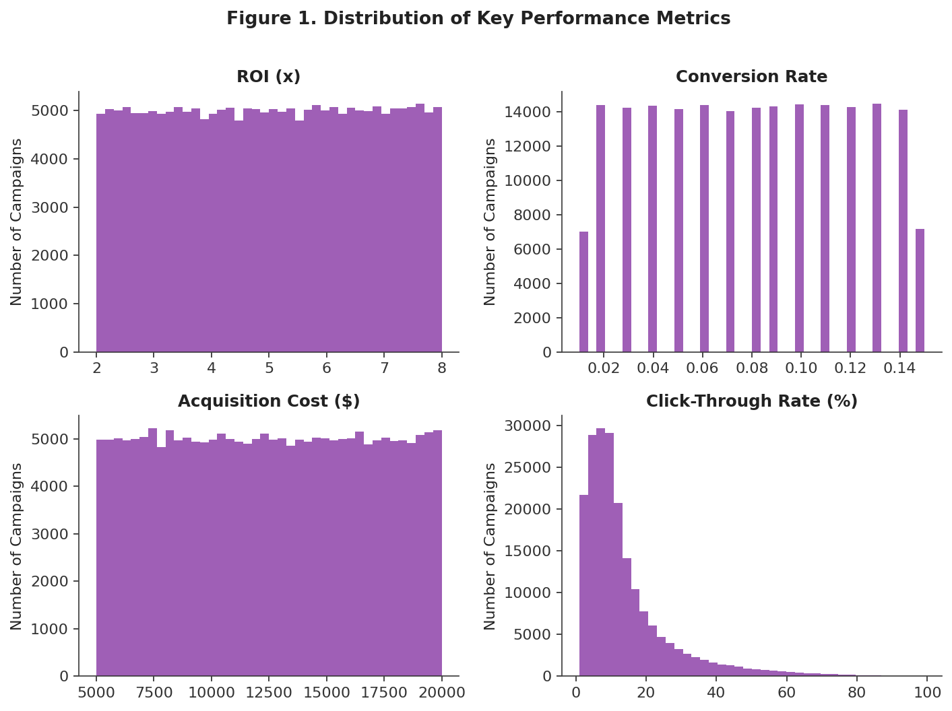
SECTION 5.2
Distribution of Key Metrics
Conversion Rate, Acquisition Cost, and ROI are all close to uniformly distributed across their ranges — every value between min and max is roughly equally likely, a strong signature of randomly generated rather than organically observed data.
CTR, by contrast, is right-skewed: most campaigns cluster at lower CTR values (5–15%), with a long tail where a small number of impressions produced a disproportionate share of clicks.
Marketing Campaign Performance Analytics
7
Notes:
Visual confirmation of what the stats table implied. Point at the top three histograms first — ROI, conversion rate, acquisition cost — and note how flat/even they look across their full range, that's the uniform-distribution signature. Then point at CTR bottom-right — clearly skewed right, long tail. Explain briefly why: CTR is calculated, not observed, so when impressions happen to be low relative to clicks, CTR spikes.

Slide 8
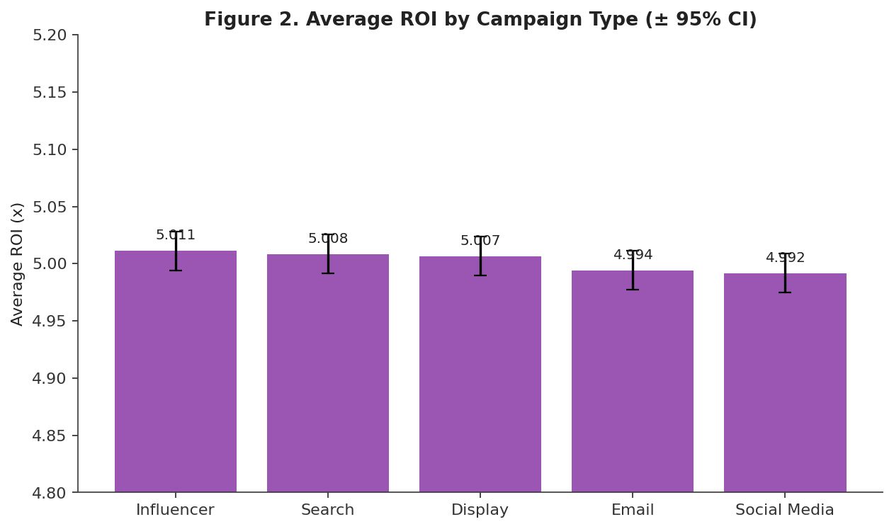
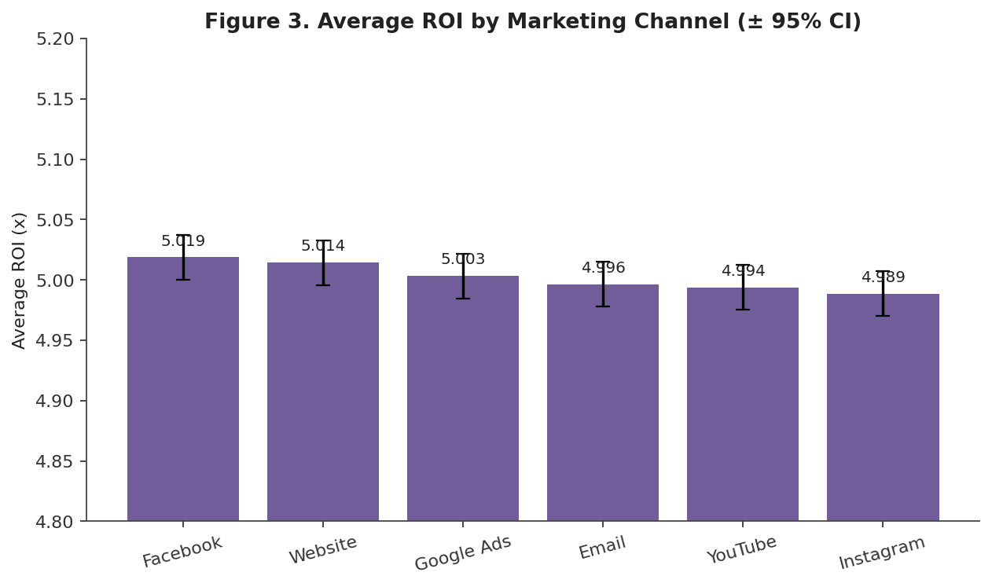
SECTIONS 5.3 – 5.4
Performance by Type & Channel
Influencer campaigns rank numerically highest (5.011x ROI) and Email lowest (4.992x) — a gap under 0.4%. Facebook edges out other channels (5.019x) while YouTube/Instagram trail slightly (~4.99x) — a spread under 0.7%. Both gaps are too small to reflect a real performance difference.
Marketing Campaign Performance Analytics
8
Notes:
These look like real differences at first glance — Influencer and Facebook both sit on top. But look at the y-axis: it only spans 4.80 to 5.20. Zoom out mentally and the bars are essentially the same height. Say this explicitly, out loud, before someone in the audience jumps to 'so we should invest in Influencer' — that's the trap this slide exists to prevent.

Slide 9
SECTION 6
Category Comparison Summary
Grouping Variable | Outcome | Range of Group Averages | Spread
Campaign Type | Average ROI | 4.992x – 5.011x | < 0.4%
Channel Used | Average ROI | 4.989x – 5.019x | < 0.7%
Customer Segment | Average Conversion Rate | 0.0798 – 0.0803 | ~ 0.6%
Company | Campaign Volume Share | 19.9% – 20.1% | < 1%
In every comparison, the spread between the highest and lowest group average is well under 1% — far smaller than the natural spread of the underlying data (Conversion Rate: 0.01–0.15; ROI: 2.0x–8.0x). It would be a mistake to read the Section 5 bar charts as actionable business insight: these differences most likely reflect normal variation, not a real performance gap. The clearer, evidence-backed pattern is the direct mathematical relationship between Clicks, Impressions, and CTR.
Marketing Campaign Performance Analytics
9
Notes:
This table is the quantitative backbone of the whole 'no real differences' claim — worth slowing down here. Walk each row: campaign type spread under 0.4%, channel under 0.7%, segment about 0.6%, company under 1%. Then compare that to the natural range of the data itself — conversion rate spans 0.01 to 0.15, a huge range — so a 0.6% difference between segments is noise, not signal. This is the slide to pause on if you only have time to defend one number.

Slide 10
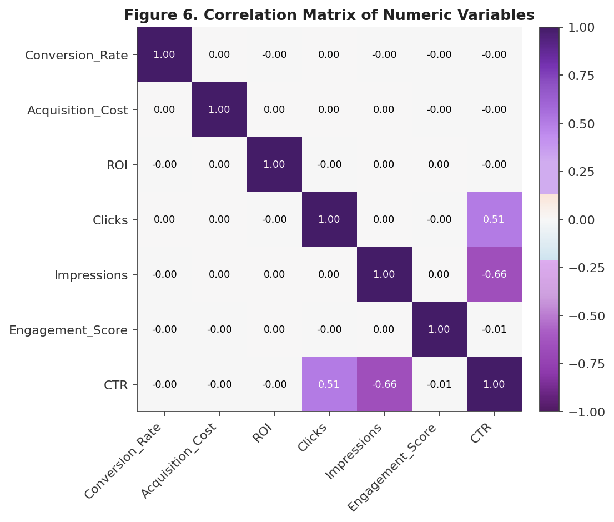
SECTION 5.7
The One Real Relationship: CTR
Across the seven numeric KPIs, only one clear relationship emerges: CTR rises with Clicks and falls with Impressions — which follows directly from its formula, CTR = Clicks ÷ Impressions × 100.
None of the other KPI pairs — including ROI with Acquisition Cost, or Conversion Rate with ROI — show a noticeable relationship, suggesting these variables move independently of one another in this dataset.
Marketing Campaign Performance Analytics
10
Notes:
Point to the two darker cells off-diagonal: Clicks-CTR at 0.51 and Impressions-CTR at -0.66. Everything else in the matrix is close to zero. Explain this isn't a business insight so much as a math fact — CTR is defined as clicks divided by impressions, so of course it correlates with both. The real takeaway: none of the other seven KPIs move together, which reinforces the 'no meaningful relationships' theme from the category comparison slide.

Slide 11
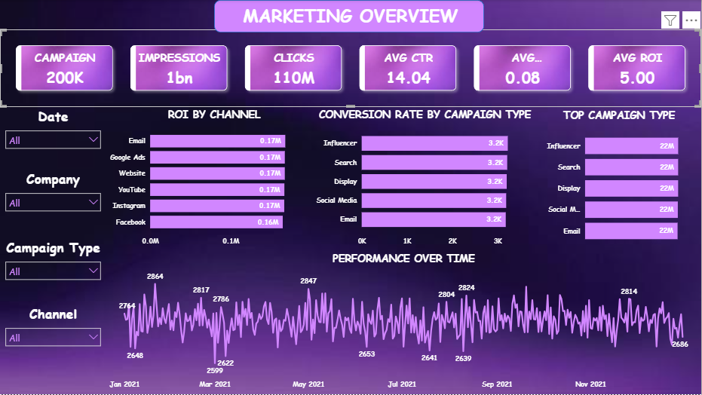
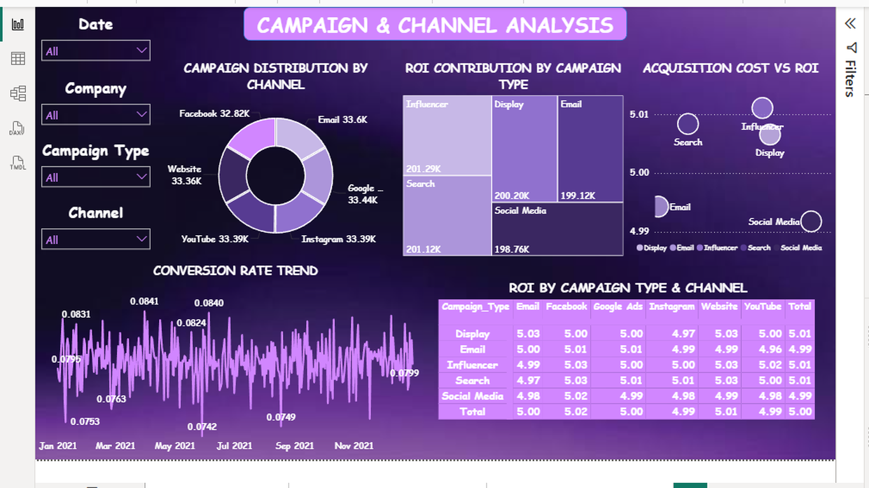
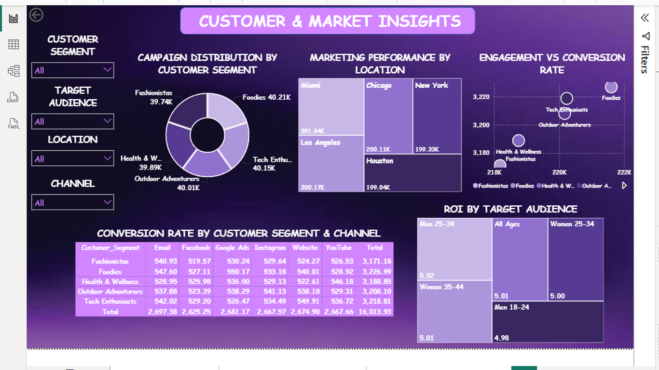
SECTION 7
Power BI Dashboard Overview
Page 1 — Marketing Overview
Page 2 — Campaign & Channel
Page 3 — Customer & Market
Headline KPI cards, ROI by channel, conversion by type, full-year ROI trend
Distribution by channel, Acquisition Cost vs. ROI, ROI matrix by type × channel
Segment/audience/location slicers, engagement vs. conversion, ROI by audience
Every cell in the ROI-by-Campaign-Type-and-Channel matrix (Page 2) falls between 4.96x and 5.03x — a direct, interactive confirmation that no combination stands out as meaningfully stronger or weaker.
Marketing Campaign Performance Analytics
11
Notes:
These are screenshots for reference — if presenting live and you have the .pbix file, switch over to the real interactive dashboard here instead, it reads much better on a projector than these thumbnails. The one number worth saying out loud: the ROI matrix on Page 2 never leaves a 4.96x-5.03x band across every type/channel combination — that's the most concrete confirmation of the whole 'no real winner' argument.

Slide 12
SECTION 8
Key Findings
1
Average ROI is ~5.00x and average conversion rate is ~0.08 across the board
2
No campaign type, channel, segment, or company shows a meaningfully different level of performance
3
CTR is a deterministic function of Clicks and Impressions — the one relationship that consistently holds
4
Category comparisons remain useful for monitoring, just not for singling out a ‘winner’
5
Uniform distributions and perfectly balanced categories point to a likely synthetic dataset
Marketing Campaign Performance Analytics
12
Notes:
Recap slide — nothing new here, so move through it at a moderate pace rather than re-explaining each point from scratch. Landing point for #5: because the data looks synthetic, treat every finding here as a demonstration of method rather than a real business conclusion. That framing matters for how you answer questions afterward.

Slide 13
SECTION 9
Recommendations
ANALYTICAL
DASHBOARD & PROCESS
Don't base channel, type, or segment budget decisions on this dataset — no category reliably outperforms another
Add a spread indicator (highest vs. lowest group average) to the dashboard's category visuals, so small differences aren't mistaken for real gaps
Prioritize collecting variables plausibly linked to outcomes: creative quality, bid strategy, fine-grained seasonality, competitor activity
If live campaign data becomes available, re-run the same KPI comparisons periodically — this pipeline (Python → KPI comparison → Power BI) is reusable for monthly or quarterly reporting
Evaluate CTR, Clicks, and Impressions together — the only variables meaningfully related here
Validate the data source with its owner before drawing business conclusions
Marketing Campaign Performance Analytics
13
Notes:
Left column is what NOT to do with this data — don't let anyone walk away thinking 'invest more in Influencer.' The more constructive point is the second bullet: if you actually want to find real performance drivers, you need different variables entirely — creative quality, bid strategy, competitor activity — none of which exist in this dataset. Right column is more practical/process-oriented: a reusable pipeline and a dashboard tweak so future viewers don't fall into the same trap this whole deck warns about.

Slide 14
SECTIONS 10 – 11
Limitations & Conclusion
LIMITATIONS
Uniform distributions & balanced categories suggest an artificially generated dataset
CONCLUSION
This project delivered a complete analytics workflow on 200,000 campaign records: Python cleaning, exploratory & KPI-comparison analysis, and an interactive Power BI dashboard.
Rather than finding that one channel, type, or segment drives superior ROI, the comparisons show none of the categorical attributes are associated with a meaningfully different level of performance. The relationship that does hold is the mechanical link between Clicks, Impressions, and CTR.
The result underscores a core analytics skill: differences that look meaningful in a bar chart don't always survive a closer look at the numbers.
No data on spend by channel, creative content, competitors, or macro conditions
Engagement Score is a pre-computed integer with no documented calculation
Cross-sectional design — no causal claims can be made
Marketing Campaign Performance Analytics
14
Notes:
Limitations first, briefly — the synthetic-data point ties back to slide 5's balanced categories, so you can reference that instead of re-explaining. Conclusion: read the middle paragraph close to verbatim if you want a strong closing line — 'none of the categorical attributes are associated with a meaningfully different level of performance' is the one sentence that summarizes the entire project. Then transition to questions.

Slide 15
Thank You
Questions & Discussion
Sai Varshini R | Data Analytics Internship Project
Notes:
Likely questions to be ready for: (1) 'Why do you think the data is synthetic?' — point to the uniform distributions and perfectly even category splits from slide 5. (2) 'So what SHOULD we do?' — point to slide 13, especially collecting better variables and validating the source. (3) 'What was the hardest part?' — reasonable answer is distinguishing a real pattern from noise at 200K rows, where even trivial differences look precise.

