Slide 1

Convergence-Aware and Hash-Ring-Based Checkpointing
for Fault-Tolerant Distributed Deep Learning
Guide:
S. Ananthakrishnan
By
127018044 – Potta Sai Varshith
B. Tech Computer Science
Business Systems (CSBS)

Slide 2
How Review I Feedback Was Addressed
Feedback | Current Status
Minimize cost | Checkpoint overhead measured across all four modes; epoch is current lowest-cost baseline
scheduling | Implemented convergence-aware checkpoint scheduling
Making title more specific | Title revised to reflect adaptive and hash-ring checkpointing
Review logs of server | Server logs unavailable; controlled runtime fault injection used instead
Intelligent checkpoint | Convergence-aware checkpointing implemented and evaluated

Slide 3
Project Overview
- Convergence-aware scheduler: adapts checkpoint timing from observed loss trend instead of using only fixed epochs.
- Hash ring storage: distributes checkpoint ownership and caching across nodes to avoid centralized recovery bottlenecks.
- Combined strategy: tries to use adaptive checkpoint timing with distributed local-cache recovery.
- Intended outcome: reduce lost work after failures while keeping checkpoint cost manageable.

Slide 4
Experimental Setup
- Dataset: FaceForensics
- Model: EfficientNet-B0
- Training configuration: 20 epochs, batch size 2, world size 4
- Modes compared: epoch, convergence, hash-ring-epoch, convergence-hash-ring
- Metrics: total training time, checkpoint count, checkpoint overhead, validation accuracy, recovery success, resumed epoch, and time to resume
- Fault model: runtime checkpoint fault injection followed by restart and resume

Slide 5
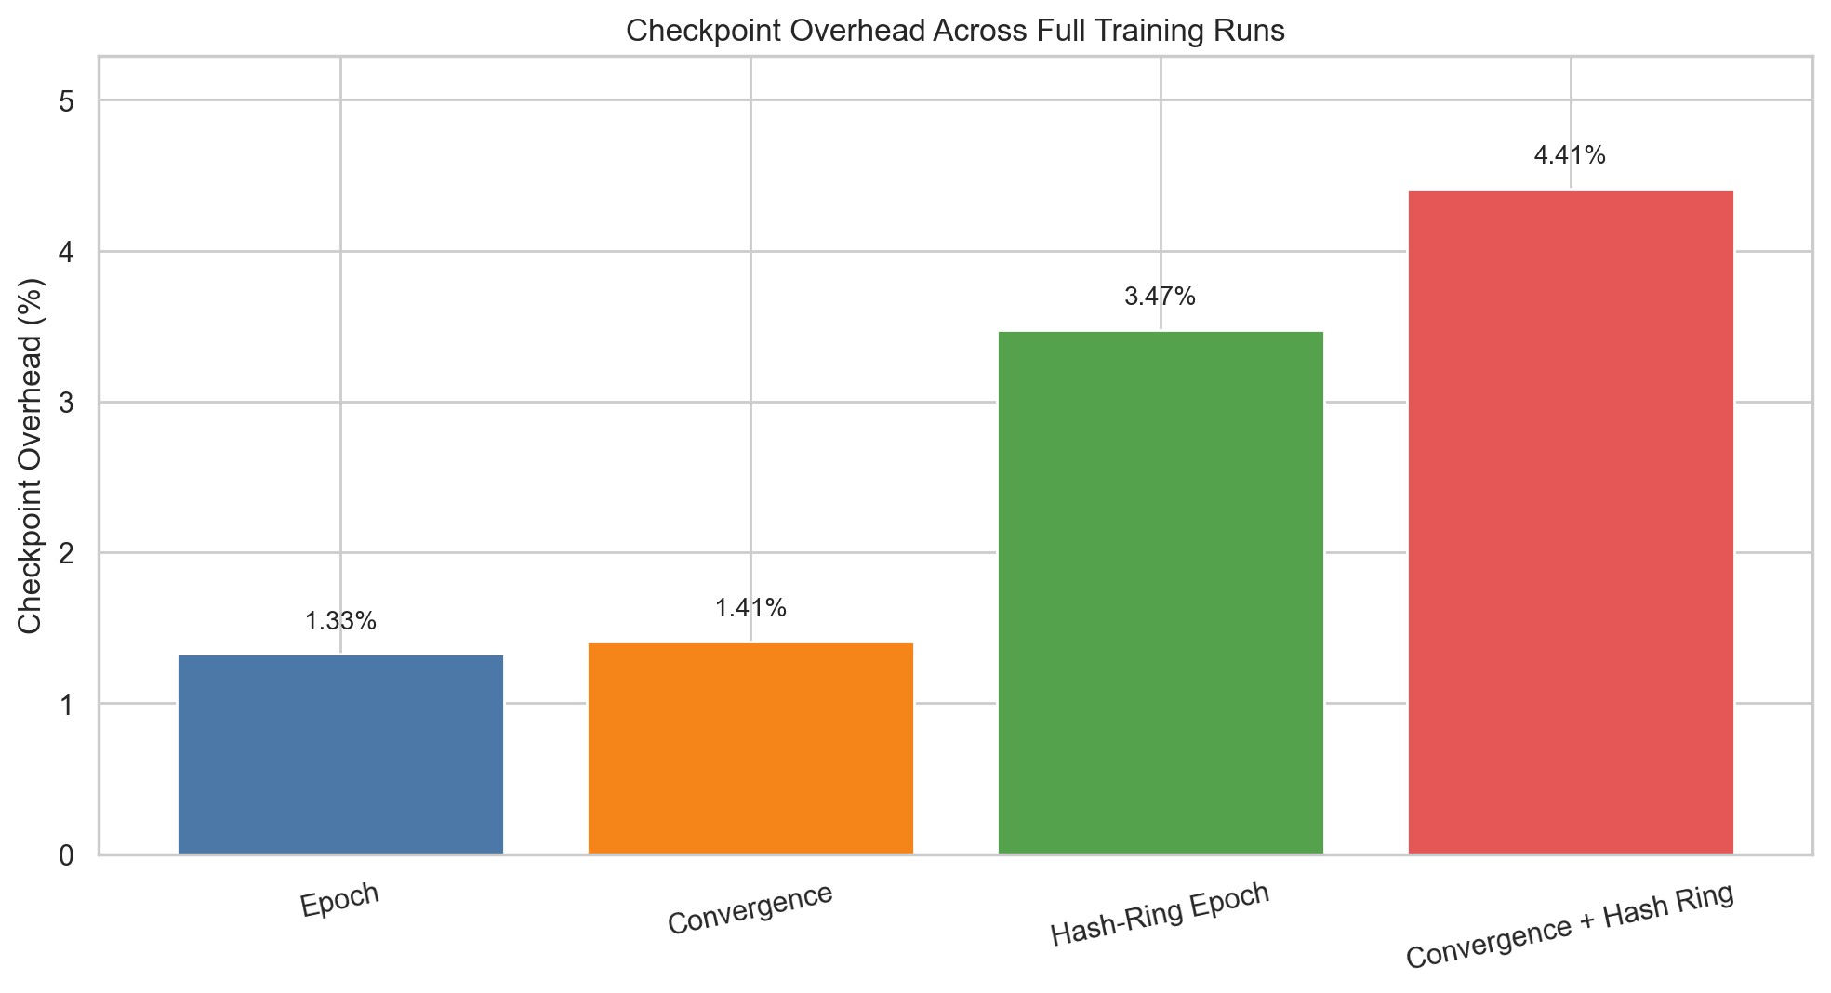
Results
Lower is better

Slide 6
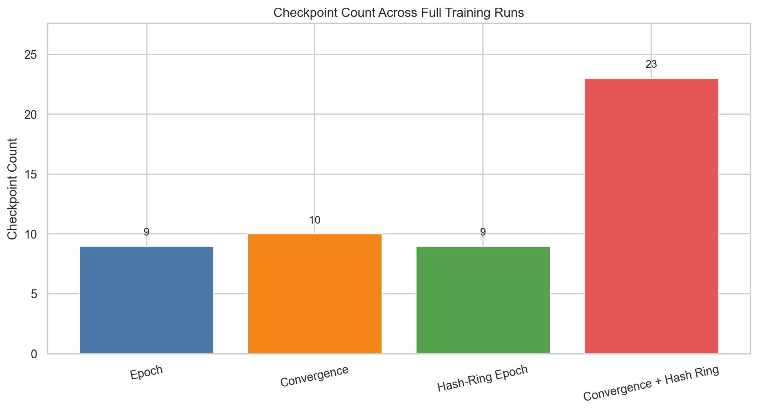
Lower is better until quality degrades

Slide 7
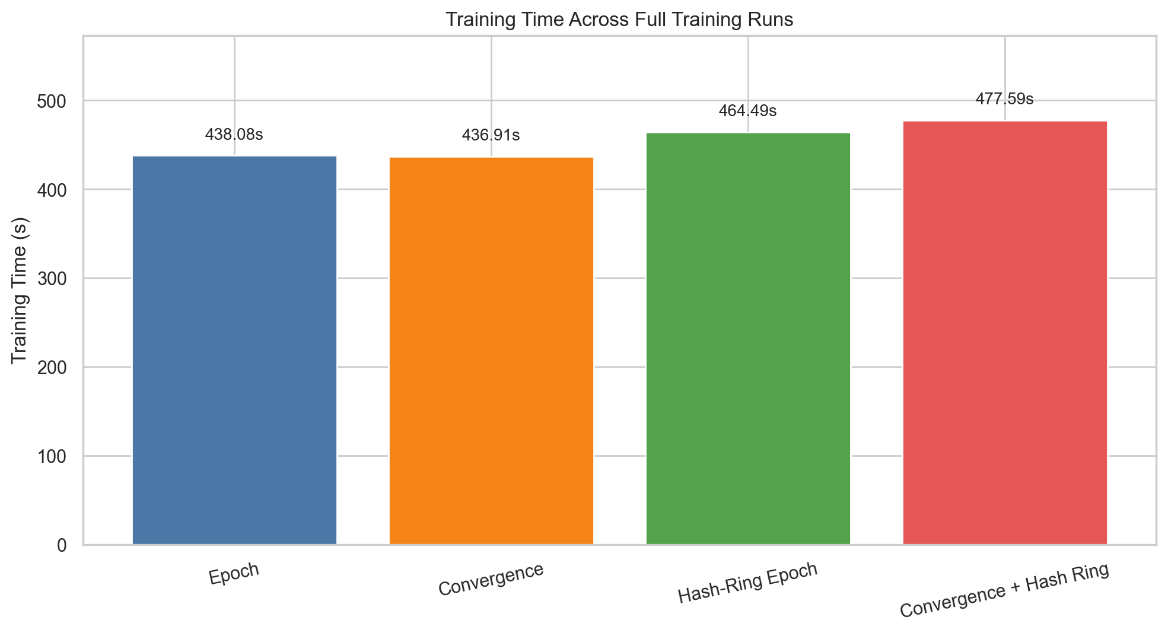
Lower is better

Slide 8
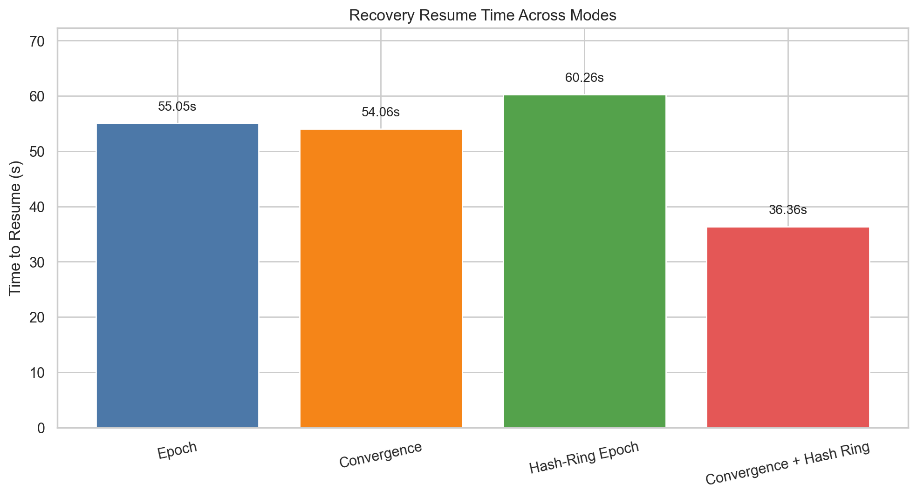
Lower is better

Slide 9
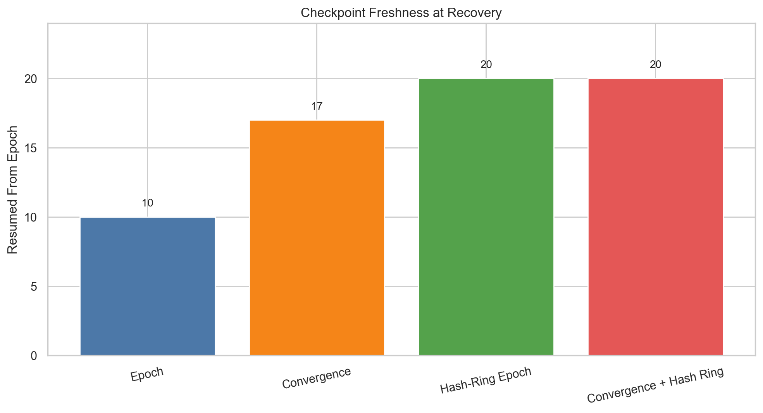
Higher is better

Slide 10
Mode | Training Time (s) | Checkpoint Count | Checkpoint Overhead (%) | Best Val Acc | Final Val Acc
Epoch | 438.08 | 9 | 1.33 | 73.75 | 71.25
Convergence | 436.91 | 10 | 1.41 | 73.75 | 71.25
Hash-Ring Epoch | 464.49 | 9 | 3.47 | 73.75 | 71.25
Convergence + Hash Ring | 477.59 | 23 | 4.41 | 73.75 | 71.25

Slide 11
Mode | Recovery Success | Resume Source | Resumed From Epoch | Resume Time (s)
Epoch | 1 | central-storage | 10 | 55.05
Convergence | 1 | central-storage | 17 | 54.06
Hash-Ring Epoch | 1 | local-cache | 20 | 60.26
Convergence + Hash Ring | 1 | local-cache | 20 | 36.36

Slide 12
Interpretation, Analysis, and Discussion
- Validation accuracy is nearly identical across all four modes, so the main differences are systems-level rather than model-level.
- Epoch checkpointing is the cheapest during normal training.
- Convergence-aware checkpointing adds intelligent scheduling, but in current runs it does not reduce checkpoint count.
- Hash ring increases checkpointing overhead during training, but it enables recovery from local cache instead of central storage.
- The most promising result is convergence + hash ring for recovery time.
- Current evidence suggests a tradeoff: higher checkpoint overhead in exchange for potentially better fault recovery behavior.
- Therefore, the contribution is best presented as an implemented comparative study of checkpointing tradeoffs with a promising recovery-oriented direction.

Slide 13
Key Result Summary
Metric | Value
Best validation accuracy | 73.75 across all matched full runs
Lowest checkpoint overhead | Epoch mode: 1.33%
Convergence scheduling effect | Adaptive timing implemented, but no accuracy gain yet
Hash ring effect | Higher overhead, but distributed cache created
Best observed recovery | Convergence-hash-ring: 36.36s from local cache
Overall takeaway | Same model quality, different cost-recovery tradeoff

Slide 14
Conclusion and Next Steps
Item | Details
Current contribution | Implemented and compared four checkpointing mechanisms for distributed deep learning
Strongest result | Fastest observed recovery came from convergence-hash-ring local-cache resume
Current limitation | Evidence is still preliminary and based on one workload
Immediate next step | Run more repeated fault campaigns and verify rollback metrics
Longer-term goal | Optimize checkpoint timing and distributed cache policy to reduce overhead

