Slide 1
Title: Fake News Detection using SVM
UMBC Data Science :DATA 606
Dr. Chaojie (Jay) Wang
Author Name: Saivarun Kotha
fw61697

Slide 2
Introduction
What is Fake News? Fake news refers to misinformation that are deliberately spread to deceive people. It often mimics legitimate news but contains misleading or fabricated information.
The Problem and Impact With the rise of social media and digital platforms, fake news has become a significant issue, influencing public opinion, spreading misinformation, and causing real-world consequences. Detecting fake news effectively can help reduce its impact and prevent misinformation from spreading further.

Slide 3
Project Objectives
Classify News Articles: Develop a machine learning model to classify news articles as "Real" or "Fake".
Feature Extraction: Use TfidfVectorizer to convert text into numerical features for modeling.
Model Selection: Train and evaluate an effective classifier using Support Vector Machine (SVM).
Interactive Application: Deploy a Streamlit app to allow real-time prediction of news authenticity.

Slide 4
Dataset Overview
The dataset features two key columns: text (the article content) and label (either "Real" or "Fake"). The dataset is used to train a machine learning model to identify patterns in news articles that indicate authenticity.
The text column provides rich content for feature extraction using TfidfVectorizer, while the label column enables supervised learning. Challenges such as class imbalance are addressed through appropriate preprocessing, making this dataset an ideal basis for training a Support Vector Machine (SVM) model for fake news detection.

Slide 5
About the data
Dataset: fake_and_real_news.csv
Number of Articles: Approximately 20,000
Features:
Text: Contains the content of news articles.
Label: Indicates whether the article is "Real" or "Fake".
Purpose: To train and evaluate a machine learning model for detecting fake news based on textual data.

Slide 6
Data Dictionary
Text: The full content of each news article. This is the primary feature used for classification.
Label: Indicates whether the article is "Real" or "Fake". This is the target variable for supervised learning.
Target Variable:
Label: Used to train the model to classify news articles.
Features for Modeling:
TF-IDF Features: Extracted from the text column to convert raw text into numerical vectors that the model can process.

Slide 7
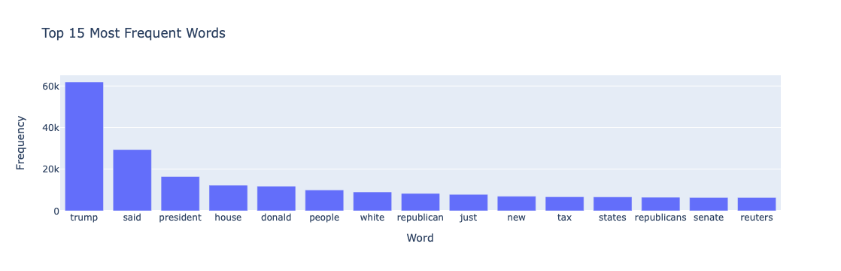
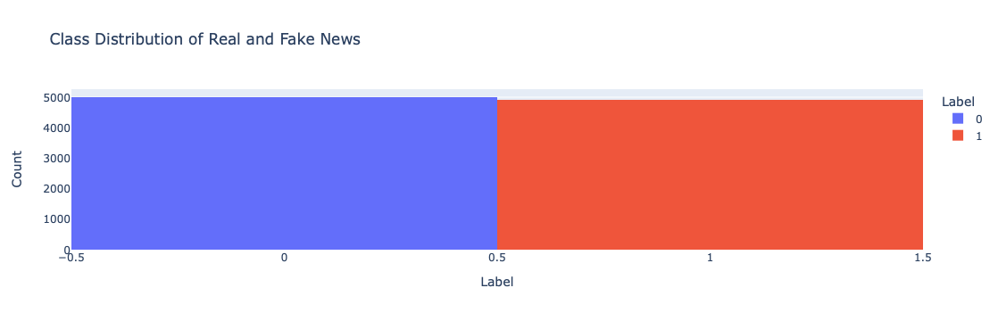
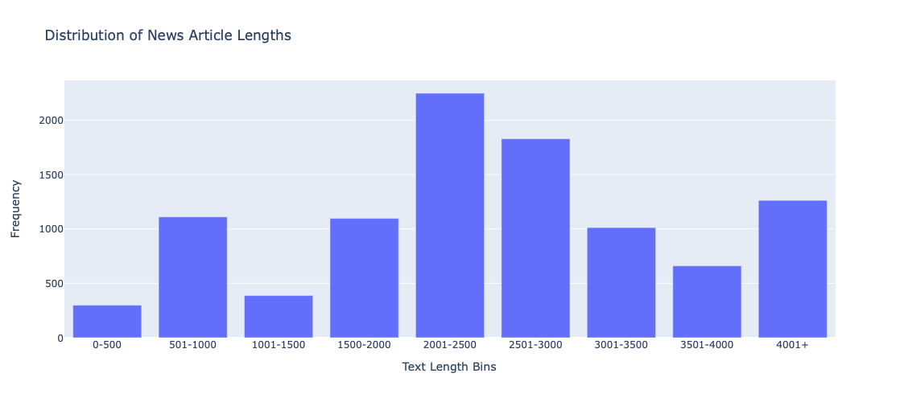
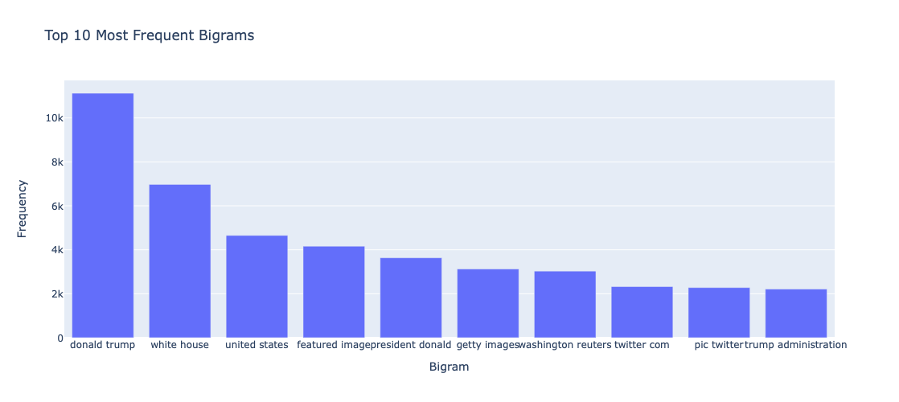
Exploratory Data Analysis

Slide 8
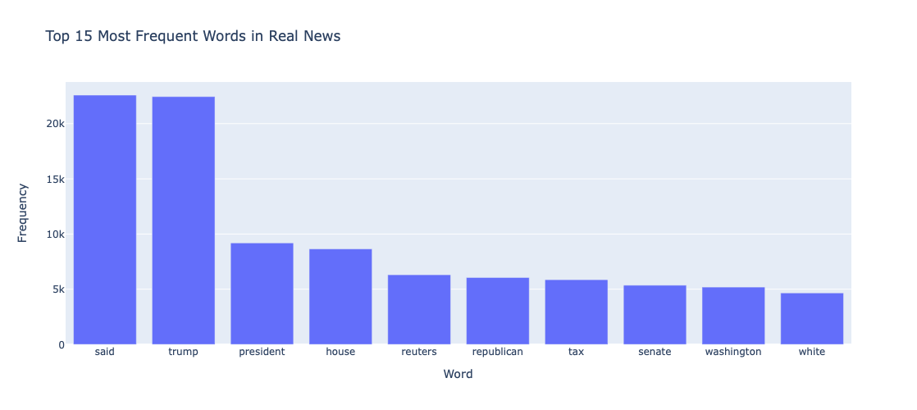
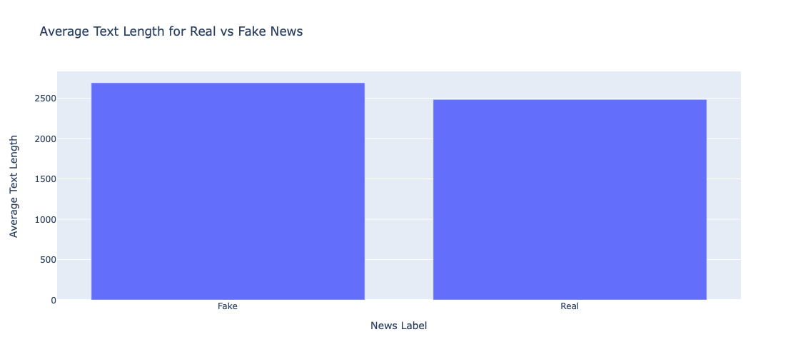
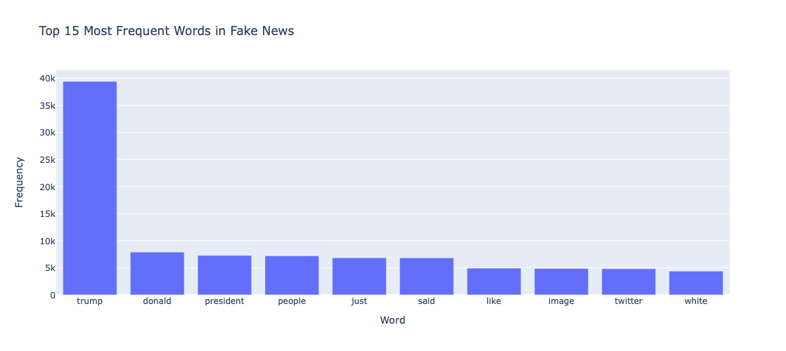

Slide 9
Data Preprocessing
Text Cleaning:
Removed non-word characters, punctuation, and converted all text to lowercase for consistency.
Handling Missing Values:
Verified that no rows had missing values in the text or label columns.
Feature Extraction:
Used TfidfVectorizer to convert textual content into numerical features.
Limited to 35,910 features to effectively represent the articles while reducing dimensionality.
Class Imbalance:
Addressed potential class imbalance by adjusting dataset sampling to ensure fair representation of "Real" and "Fake" articles.

Slide 10
Model Training
Data Split:
Split the dataset into 80% training and 20% testing sets to ensure effective training and unbiased evaluation.
Handling Class Imbalance:
Applied SMOTE (Synthetic Minority Over-sampling Technique) to balance the dataset by generating synthetic samples of the minority class ("Fake" articles).
This ensured fair representation of both "Real" and "Fake" articles during model training.
Model Used:
Support Vector Machine (SVM) classifier was chosen due to its effectiveness in high-dimensional feature spaces, making it suitable for text classification tasks.

Slide 11
Training Process:
Trained the SVM model using TF-IDF feature vectors generated from the text of the news articles.
The model learned to distinguish between real and fake news based on linguistic and content patterns captured in the TF-IDF features.
Saving the Model:
Saved the trained SVM model and TF-IDF vectorizer as .pkl files (svm_model.pkl and tfidf_vectorizer.pkl) for use in deployment and real-time prediction.

Slide 12
Streamlit Application Overview
Interactive Interface:
Allows users to input custom text to check if it is "Real" or "Fake" news.
Real-Time Prediction:
Uses the trained SVM model and TF-IDF vectorizer to classify articles in real time.
User-Friendly Design:
Easy-to-use interface built with Streamlit, providing immediate feedback on the authenticity of news.
Purpose:
Demonstrates practical use of the fake news detection model for broader accessibility and real-world application.
Notes:
##

Slide 13
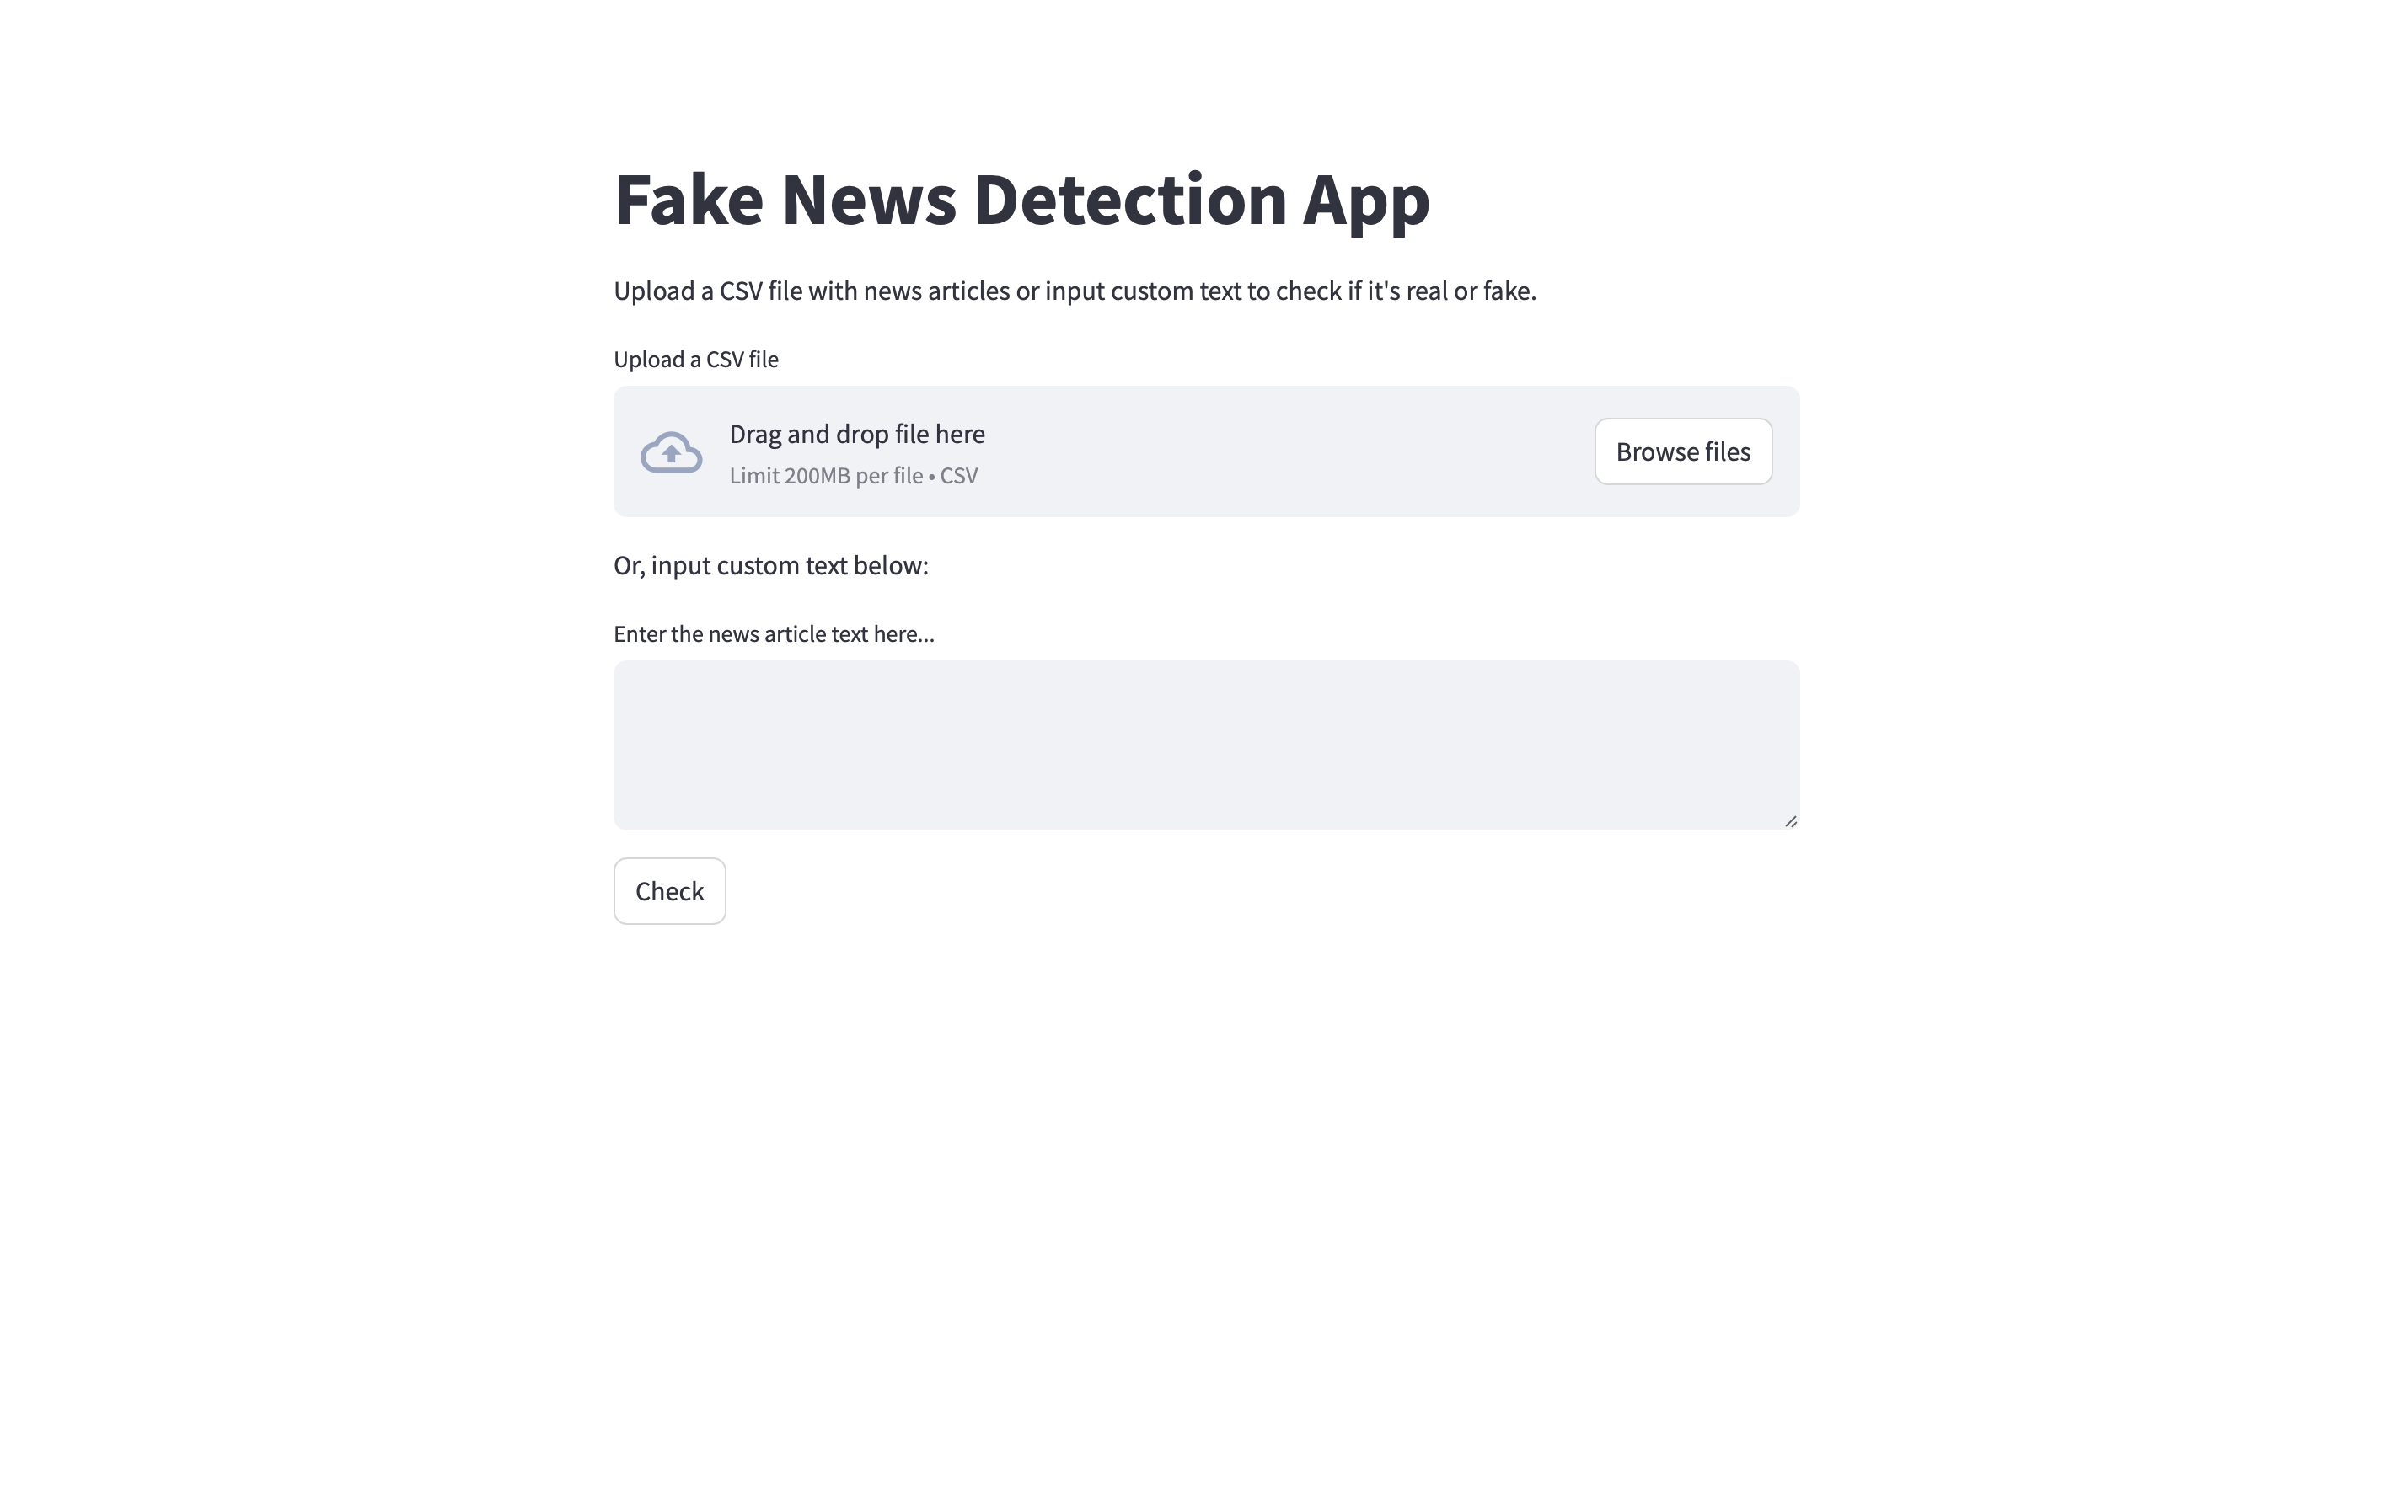
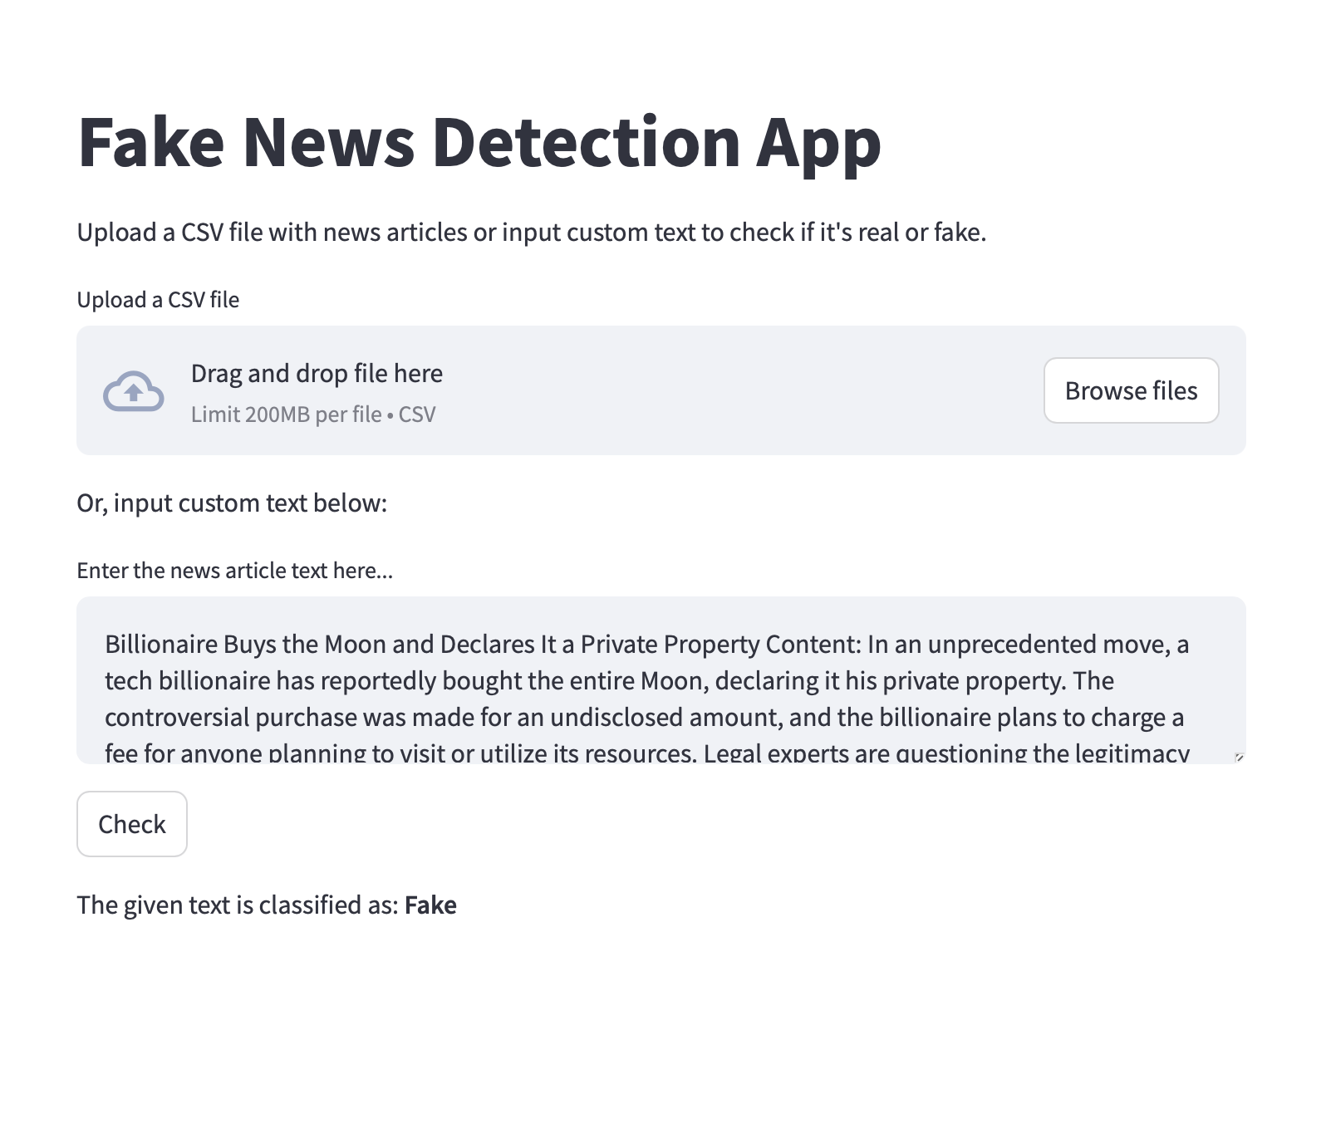
Streamlit Demo

Slide 14
Conclusion
Successful Fake News Detection:
Developed an effective model to classify news articles as "Real" or "Fake" using TF-IDF features and an SVM classifier.
Balanced Model:
Addressed class imbalance using SMOTE, resulting in high precision and recall for both classes.
Practical Implementation:
Deployed a user-friendly Streamlit app for real-time fake news detection, making the solution accessible to non-technical users.

Slide 15
Limitations
Data Imbalance: Despite using SMOTE, real-world data might still have class imbalance issues, affecting model generalization.
Limited Dataset: The model was trained on a relatively small dataset, which may limit its ability to detect diverse types of fake news.
Feature Representation: TF-IDF might not capture deeper contextual relationships, leading to missed nuances in language.

Slide 16
Future Scope
Advanced Models: Experiment with neural networks and transformers to capture deeper patterns and improve classification accuracy.
Larger Datasets: Use larger and more diverse datasets to enhance the robustness and generalizability of the model.
Real-World Deployment: Integrate the model into web applications or browser extensions for broader use in real-time news validation.

Slide 17

References
Bird, S., Klein, E., & Loper, E. (2009). Natural language processing with Python: Analyzing text with the Natural Language Toolkit. O'Reilly Media. https://www.oreilly.com/library/view/natural-language-processing/9780596803346/
Chawla, N. V., Bowyer, K. W., Hall, L. O., & Kegelmeyer, W. P. (2002). SMOTE: Synthetic minority over-sampling technique. Journal of Artificial Intelligence Research, 16, 321-357. https://jair.org/index.php/jair/article/view/10302
Streamlit Documentation. (2023). Streamlit: Turn data scripts into sharable web apps. Streamlit. https://docs.streamlit.io/
Cortes, C., & Vapnik, V. (1995). Support-vector networks. Machine Learning, 20(3), 273-297. https://doi.org/10.1023/A:1022627411411

