Slide 1

K L UNIVERSITY, HYDERABAD
AI SPORTS ACADEMY
MANAGEMENT SYSTEM
An Intelligent Platform for Sports Academy Administration and Performance Analytics
TEAM MEMBERS
GROUP
Rishi Vardhan Reddy
A.V. Sai Chaitanya
Group – 11
2510030153
2510030096
SUPERVISOR
M. Sai Varun Reddy
Anshith Reddy
Rafeeq Mohammed
2510030021
2510030327
COURSE · DEPARTMENT · AY
Tirumala Naidu
25CS1302E – DBE & DSD
Computer Science and Engineering
Academic Year 2026–27
2510030380

Slide 2
PROBLEM STATEMENT
What is the Problem?
Many sports academies still manage player registrations, attendance, schedules, fees, and performance records manually or with disconnected software.
WHO FACES THIS PROBLEM
SA
Sports Academies
Poor player record management
Time-consuming administrative work
CO
Coaches
Difficulty tracking player progress
Lack of intelligent performance analysis
PL
Players
Inefficient communication among coaches, players, and parents
PA
Parents
Why This Matters
— Manual management reduces operational efficiency
AD
Academy Administrators
— Coaches spend more time on paperwork than training
— Player development is difficult without proper analytics
02

Slide 3
SOCIETAL NEED
Need for the Project
1
2
3
Why Is This Needed?
Who Will Benefit?
Societal & Industry Impact
Automate sports academy operations
Sports Academies
Promotes digital transformation in sports management
Improve coaching efficiency using AI
Coaches
Encourages data-driven coaching
Provide real-time player performance insights
Players
Enhances athlete development
Simplify attendance, fee, and event management
Parents
Reduces administrative workload
Sports Organizations
Improves transparency between academy and parents
03

Slide 4
PROJECT OBJECTIVES
What This System Aims to Achieve
1
Automate player registration and academy management
2
Monitor attendance, schedules, and fee payments digitally
3
Analyze player performance using AI-based insights
4
Predict player strengths and improvement areas
5
Generate reports and dashboards for coaches and administrators
04

Slide 5
PROPOSED SOLUTION
Methodology & System Workflow
An AI-powered web application that manages the complete sports academy ecosystem while using AI to analyze player performance and provide personalized recommendations.
SYSTEM WORKFLOW
Player Registration
MAIN MODULES
User Authentication
Player Management
▼
Attendance & Training Records
Coach Management
Attendance Management
▼
Performance Data Collection
Training Schedule Mgmt
Fee Management
▼
AI Performance Analysis
AI Performance Analytics
Dashboard & Reports
▼
Coach Dashboard
Notification System
▼
Reports & Recommendations
05

Slide 6
FEASIBILITY ANALYSIS
Hardware, Software & Data Requirements
Hardware
Self-Collected Dataset
CORE TECH STACK
• Laptop / Desktop
• Player Information
Frontend
• Internet Connection
• Attendance Records
React.js
• Camera (optional)
• Training Sessions
• Mobile Device (optional)
• Match Statistics, Fitness Scores
Backend
Flask / FastAPI
Software
Public Datasets (optional)
Database
PostgreSQL · MongoDB
• Python, JavaScript
• Kaggle Sports Performance Dataset
• VS Code, Jupyter Notebook
• FIFA Player Dataset
AI / ML
• React.js, Flask / FastAPI
• Athlete Performance Dataset
TensorFlow · Scikit-learn
• PostgreSQL, MongoDB
• TensorFlow / Scikit-learn
Visualization
• OpenCV (optional), Chart.js
Chart.js
06

Slide 7
NOVELTY OF THE PROJECT
What Makes This Project Unique
Unlike traditional sports academy management systems, this project integrates Artificial Intelligence for intelligent player analysis and decision support.
1
AI Player Performance Prediction
2
Personalized Training Recommendations
3
Smart Performance Dashboard
Predicts player progress based on training and match performance.
Suggests customized improvement plans for each athlete using AI.
Real-time visualization of player growth, attendance, fitness, and achievements.
HOW IT DIFFERS FROM EXISTING SYSTEMS
Existing Systems | AI Sports Academy Mgmt System
Manual performance tracking | AI-based performance prediction
Basic attendance records | Intelligent attendance analytics
Static reports | Interactive dashboards
General coaching | Personalized AI recommendations
Manual decision-making | Data-driven coaching insights
SUGGESTED AI FEATURES
AI Performance Prediction
Predict future improvement via ML
Training Recommendation Engine
Recommend drills for weaknesses
Injury Risk Prediction
Estimate risk from workload trends
07

Slide 8
DATABASE ENGINEERING · LITERATURE REVIEW
AI Sports Academy Management System
Existing systems, comparative analysis, gap identification and proposed direction
TEAM MEMBERS
GROUP
Group – 11
Rishi Vardhan Reddy
A.V. Sai Chaitanya
2510030153
2510030096
SUPERVISOR
Rafeeq Mohammed
M. Sai Varun Reddy
Anshith Reddy
2510030021
2510030327
COURSE · DEPARTMENT · AY
25CS1302E – DBE & DSD
Computer Science and Engineering
Academic Year 2026–27
Tirumala Naidu
2510030380

Slide 9
01 · INTRODUCTION
Literature Review — Scope for This Project
A literature review studies what already exists before designing the AI Sports Academy Management System — the applications built so far, the databases and architectures behind them, and the limitations that leave room for improvement.
PROJECT TOPIC
AI Sports Academy
Management System
Application Domain
Athlete onboarding, batch/coach allocation, attendance, fee and performance tracking in sports academies
GUIDING QUESTIONS
What already exists in sports/academy management software?
How were athlete, coach and attendance data modeled?
Which databases were used, and why?
What problems or limitations remain?
What can our project improve?
Data Requirements
Athlete profiles, attendance logs, performance/test scores, payments, and coach-batch relationships
Database Technology
Relational engines (MySQL, PostgreSQL, Oracle) and NoSQL/sensor-data stores used across reviewed systems
Advanced Requirements
Predictive analytics for performance, real-time dashboards, and scalable storage for sensor/training data
09

Slide 10
02 · EXISTING SYSTEMS
Existing Systems Reviewed
Six studies covering sports/event management, gym administration, intramural systems and AI-based athlete training platforms.
S1
College Sports Management System
S2
Intelligent Sports Training System
S3
Intelligent Sports Mgmt. (ISMS)
MySQL
MySQL
PostgreSQL + MongoDB
Coordinator-driven event registration, notifications and scheduling
Deep-learning venue/equipment recommendation for college sports
Wireless sensor networks and neural nets for athlete performance
S4
College Sports Performance System
S5
Gym Management System
S6
Intramural Sport Management System
MySQL
MySQL
Oracle
Digitized physical-fitness test scoring and statistical analysis
Membership, trainer assignment and workout-schedule tracking
Registration, scheduling and statistics for campus sports leagues
10

Slide 11
03 · TECHNOLOGY LANDSCAPE
Database Technologies Across Existing Systems
Database | Used By | Typical Role
MySQL | S1, S2, S4, S5 | Registration data, event schedules, membership records, test scores
PostgreSQL + MongoDB | S3 | Structured athlete records (PostgreSQL) with sensor/unstructured data (MongoDB)
Oracle | S6 | Two/three-tier registration and league statistics for intramural sports
OBSERVATION
Relational databases (MySQL, Oracle) dominate reviewed systems for transactional data such as registration, fees and schedules. Only one study (S3) combines a relational store with a document/sensor store for performance analytics — most systems treat administration and performance data as separate, unconnected concerns.
11

Slide 12
04 · COMPARATIVE ANALYSIS
Literature Review Matrix
Study | DB | Main Feature | Advantage | Limitation
S1 – College Sports Mgmt. | MySQL | Event registration & notifications | Simple, coordinator-friendly design | No athlete performance tracking
S2 – Intelligent Training Sys. | MySQL | AI-based equipment/venue recommendation | Personalized suggestions via deep learning | No dedicated batch/coach management
S3 – ISMS (Sensor Networks) | PostgreSQL + MongoDB | Athlete performance via sensors & neural nets | Strong real-time performance analytics | Heavier infrastructure, no fee/admin module
S4 – Performance Mgmt. Sys. | MySQL | Digitized fitness test scoring | Reduces manual, error-prone processing | No predictive or trend analysis
S5 – Gym Management Sys. | MySQL | Membership & trainer assignment | Centralized member/trainer records | No performance or attendance analytics
S6 – Intramural Sport Sys. | Oracle | League registration & statistics | Reliable transactional consistency | No AI/prediction, limited scalability
12

Slide 13
05 · GAP ANALYSIS
Gap Analysis — Existing Approaches
Existing Approach | Technology/DB | What It Provides | Limitation | Identified Gap
S1 – Event registration system | MySQL | Registration, notices, schedules | No athlete or performance data | Athlete performance module missing
S2 – AI recommendation system | MySQL | Equipment/venue suggestions | No batch or coach structure | Coach–batch allocation missing
S3 – Sensor-based ISMS | PostgreSQL + MongoDB | Real-time performance analytics | No admin/fee/attendance module | Unified admin + analytics missing
S4 – Fitness scoring system | MySQL | Digitized test scores | No trend or prediction over time | Predictive performance tracking missing
S5 – Gym membership system | MySQL | Member & trainer records | No performance/attendance link | Attendance-performance link missing
13

Slide 14
06 · CRITICAL REVIEW
Critical Review of Key Studies
Existing Study: S3 uses PostgreSQL + MongoDB with wireless sensor networks and neural networks for real-time athlete performance monitoring.
Aspect | Critical Observation
Strengths | ACID-compliant relational core plus flexible document store; suited to real-time sensor throughput
Limitations | No coverage of academy administration — batches, coach allocation, attendance or fee collection
Evidence gap | Performance-analytics accuracy is not compared against a simpler, purely relational baseline
Possible improvement | Combine S3's analytics approach with an integrated relational schema for full academy operations
SUMMARY vs CRITICAL REVIEW
A summary describes what a study did. A critical review asks whether the approach was appropriate, whether the database choice suited the workload, and what remains untested — the basis for the gap identified next.
14

Slide 15
07 · RESEARCH GAP
What Is Missing in Existing Work?
Based on the reviewed literature, existing systems primarily focus on either administrative record-keeping (registration, fees, membership) or isolated performance analytics — while limited work integrates both into a single, database-driven academy platform.
OVERALL GAP
Existing studies treat academy administration and athlete performance analytics as separate systems built on different technologies.
No reviewed system unifies athlete profiles, coach/batch allocation, attendance and fees in one schema
PostgreSQL + Integrated AI Analytics Module
AI-based recommendation (S2) and sensor analytics (S3) are not combined with day-to-day academy administration
Use the reviewed studies and how each fell short to justify a single relational database that links athletes, coaches, attendance, fees and AI-driven performance prediction.
None of the systems offer predictive performance tracking tied directly to attendance and training history
15

Slide 16
08 · PROPOSED DIRECTION
How the Proposed System Addresses the Gap
1
Unified Schema
2
AI Performance Module
One relational database (PostgreSQL) links athletes, coaches, batches, attendance and fee records — replacing the siloed designs seen in S1, S4 and S5
Performance-prediction logic inspired by S2 and S3, applied on top of structured attendance and training-history data rather than sensor data alone
3
Real-Time Dashboards
4
Scalable Foundation
Coach and admin dashboards surface attendance, fee status and performance trends together — a combination absent from every reviewed study
Indexing, constraints and role-based access from the outset, addressing the performance and security gaps noted across S1–S6
16

Slide 17
REFERENCES
Sources Reviewed
S1 — Sports Management System, International Research Journal of Modernization in Engineering, Technology and Science (IRJMETS)
S2 — Design and Implementation of Intelligent Sports Training System for College Students' Mental Health Education, Frontiers in Psychology
S3 — Design and Implementation of an Intelligent Sports Management System (ISMS) Using Wireless Sensor Networks, PMC
S4 — Design and Implementation of a College Student Sports Performance Management System, Atlantis Press
S5 — NUTRIFLEX: Gym Management Website, IRJMETS
S6 — An Intramural Sport Management System, University of Wisconsin Manuscript Repository

Slide 18
DATABASE ENGINEERING · PBL REVIEW 3
AI Sports Academy Management System
Proposed Methodology and Implementation Plan
Carried forward from Review 2: unified PostgreSQL schema + integrated AI performance analytics, addressing the gaps identified across six reviewed systems (S1–S6).
TEAM MEMBERS
GROUP
COURSE · DEPARTMENT · AY
Rishi Vardhan Reddy
Group – 11
25CS1302E – DBE & DSD
2510030153
Computer Science and Engineering
M. Sai Varun Reddy
SUPERVISOR
Academic Year 2026–27
2510030021
Rafeeq Mohammed
Tirumala Naidu
2510030380
A.V. Sai Chaitanya
2510030096
Anshith Reddy
2510030327

Slide 19
01 · PROPOSED METHODOLOGY
Problem Identification
Sports academies currently run athlete onboarding, coach/batch allocation, attendance, fees and performance tracking as disconnected activities. Review 2 showed that every reviewed system (S1–S6) solves one slice of this — none link administration and performance analytics in a single schema.
1
2
3
4
Fragmented records
No predictive insight
Manual admin overhead
No unified dashboard
Athlete profiles, attendance, fees and performance scores are kept in separate registers or spreadsheets with no shared keys.
Test scores (S4) and sensor analytics (S3) are captured but never turned into a trend or forecast a coach can act on.
Coach-batch allocation and fee follow-up (as in S1, S5) are done manually, which is slow and error-prone at academy scale.
Admins and coaches have no single real-time view combining attendance, fee status and performance together.
PROPOSED METHODOLOGY
19

Slide 20
01 · PROPOSED METHODOLOGY
Data Collection
Sources of Data
Methods Used to Gather Data
Athlete registration & profile forms (personal details, sport, batch preference)
Structured web forms
Attendance registers digitized at each training session
Registration, attendance marking and fee entry captured directly through the application's dashboards — the primary live data feed.
Coach and batch scheduling records maintained by admin staff
CSV / bulk import
Fee payment and due records from academy accounts
Existing academy registers imported once during setup to seed athlete, coach and fee history.
Performance/fitness test scores recorded periodically by coaches
Manual entry by coaches
Performance/test scores entered after each assessment session, tied to athlete and batch IDs.
Sample/synthetic datasets
Used to prototype and validate the AI performance-prediction module before enough real history accumulates.
PROPOSED METHODOLOGY
20

Slide 21
01 · PROPOSED METHODOLOGY
Data Preprocessing
Data Cleaning
Handling Missing Values
Feature Extraction / Selection
Deduplicate athlete and coach records on registration ID
Flag incomplete attendance entries for coach confirmation
Derive attendance percentage per athlete per batch cycle
Standardize date formats across attendance and fee-due fields
Use last-known or mean value to fill gaps in test-score history
Compute fee-payment status (on-time / overdue) as a feature
Validate mandatory fields (name, batch, contact) at entry time
Mark optional profile fields nullable rather than forcing bad data
Build performance-trend features from sequential test scores
PROPOSED METHODOLOGY
21

Slide 22
01 · PROPOSED METHODOLOGY
System Design — Architecture
A single PostgreSQL database links every module, replacing the siloed designs seen across S1, S4 and S5, and feeding a dedicated AI performance-analytics layer.
Presentation Layer
Admin Dashboard
Coach Dashboard
Athlete / Parent Portal
Auth & Role Access
Application / API Layer
REST API Layer (Backend Services)
AI Performance-Prediction Service
Data & Analytics Layer
PostgreSQL — Unified Relational Schema
Reporting / Real-Time Dashboards Output
Modules: Athlete Management · Coach & Batch Allocation · Attendance · Fee Management · Performance Analytics (AI) · Dashboard & Reporting — all interacting through the shared API layer and one PostgreSQL schema rather than isolated stores.
PROPOSED METHODOLOGY
22

Slide 23
01 · PROPOSED METHODOLOGY
Algorithm & Technology Selection
AI / ML Approach
Software Tools & Frameworks
Trend-based regression model that scores athlete performance from sequential test scores + attendance history — no sensor hardware required, unlike S3.
Language
Python (backend & AI), JavaScript (frontend)
Database
PostgreSQL
Inspired by S2's recommendation logic and S3's analytics, but applied to structured administrative data already captured by the system.
Backend
Django / Flask REST API
Frontend
React dashboard
Classification flag (on-track / at-risk) generated per athlete to support coach decisions, plus a numeric trend score for dashboards.
ML Libraries
Pandas, scikit-learn
Tooling
VS Code, Git
Model retrained periodically as new attendance and test-score data accumulates in PostgreSQL.
Justification
PostgreSQL is chosen over plain MySQL for JSON support (semi-structured performance data) and strong relational integrity linking athletes, coaches, attendance and fees; Python keeps the ML pipeline and backend in one ecosystem.
PROPOSED METHODOLOGY
23

Slide 24
01 · PROPOSED METHODOLOGY
Workflow
1
2
3
4
5
6
Input Data
Preprocessing
Feature Extraction
Model / System Processing
Output Generation
Evaluation
Attendance, fees,
test scores, profiles
Clean, deduplicate,
handle missing values
Attendance %, fee
status, score trends
AI performance-
prediction service
Dashboards & alerts
for admin / coach
Compare predictions
vs. actual outcomes
Example: an athlete's weekly attendance and monthly test score feed the model; the dashboard flags a dip in trend before it shows up in results, and coaches evaluate the flag against real outcomes each cycle.
PROPOSED METHODOLOGY
24

Slide 25
02 · IMPLEMENTATION
Development Environment & System Architecture
Development Environment
System Architecture
Frontend
React-based dashboards for Admin, Coach and Athlete/Parent roles, consuming REST APIs.
Language
Python 3, JavaScript
IDE
Visual Studio Code
Backend
Django/Flask REST API layer exposing endpoints for each module and the prediction service.
Database
PostgreSQL
ML Libraries
scikit-learn, Pandas
Database
PostgreSQL — single schema linking athletes, coaches, batches, attendance and fees.
Frontend
React
APIs / Services
Authentication service, notification service, and AI performance-prediction service.
Version Control
Git / GitHub
IMPLEMENTATION
25

Slide 26
02 · IMPLEMENTATION
Module Implementation
Module | Function
Athlete / User Management | Registration, profile management, role-based login
Attendance Module | Daily attendance capture and tracking per batch
Coach & Batch Allocation | Assign coaches to batches and manage scheduling
Fee Management | Fee tracking, payment status and reminders
Performance Analytics (AI) | Predictive performance scoring from attendance and training history
Dashboard & Reporting | Real-time visual reports for admin, coach and athlete views
IMPLEMENTATION
26

Slide 27
02 · IMPLEMENTATION
Implementation Steps
1
Requirement Analysis
2
Database Setup
Confirm module scope and data fields with the academy stakeholders.
Design and create the unified PostgreSQL schema and constraints.
3
Backend Development
4
Frontend Development
Build REST API services for each module and the prediction service.
Build role-based React dashboards for admin, coach and athlete.
5
Testing & Debugging
6
Deployment
Unit, integration and performance testing across modules.
Release to a cloud/local server with role-based access enabled.
IMPLEMENTATION
27

Slide 28
02 · IMPLEMENTATION
Testing & Validation
Unit Testing
Integration Testing
Performance Evaluation
Accuracy Metrics
Each module (attendance, fees, allocation, prediction) tested in isolation against expected inputs/outputs.
End-to-end flows verified across modules — e.g. attendance feeding into the performance-prediction service.
API response times and dashboard load under concurrent admin/coach/athlete access.
Prediction module validated with MAE/RMSE (trend score) and classification accuracy (on-track / at-risk flag) against held-out data.
IMPLEMENTATION
28

Slide 29
02 · IMPLEMENTATION
Deployment
Cloud / Local Server
User Access Process
Maintenance Strategy
Deployed on a cloud host (e.g. Render/AWS) for the demo build, with a local-server option for offline academy use.
Role-based login for Admin, Coach and Athlete/Parent, each restricted to relevant modules and data.
Scheduled database backups, versioned schema migrations, and periodic retraining of the prediction model as new data accumulates.
IMPLEMENTATION
29

Slide 30
DATABASE ENGINEERING · PROJECT-BASED LEARNING · REVIEW 4
AI Sports Academy Management System
Results & Analysis
STUDENT / TEAM NAMES
PROJECT GROUP
Rishi Vardhan Reddy 2510030153
M. Sai Varun Reddy 2510030021
Tirumala Naidu 2510030380
A.V. Sai Chaitanya 2510030096
Anshith Reddy 2510030327
Group – 11 · 25CS1302E – DBE & DSD
FACULTY MENTOR
Rafeeq Mohammed
DEPARTMENT · ACADEMIC YEAR
Computer Science and Engineering
Academic Year 2026–27

Slide 31
Project Objectives
01 · PROJECT OBJECTIVES
Build one integrated platform that replaces disconnected registers and spreadsheets with a single PostgreSQL schema plus AI-driven performance insight.
1
2
3
4
Unified database
Automate administration
AI performance prediction
Role-based dashboards
Design one relational PostgreSQL schema linking athletes, coaches, batches, attendance, fees and performance.
Digitize athlete onboarding, coach/batch allocation, attendance marking and fee tracking.
Score athlete trends from test scores and attendance and flag on-track / at-risk athletes.
Give Admin, Coach and Athlete/Parent a real-time, access-controlled view of the data.

Slide 32
Project Development Approach
02 · DEVELOPMENT APPROACH
Each phase fed the next, from requirements to a deployed, role-based system.
1
2
3
4
5
6
Requirement Analysis
Database Setup
Backend Development
Frontend Development
Testing & Debugging
Deployment
›
›
›
›
›
Scope modules and data fields
Unified PostgreSQL schema and constraints
REST APIs and prediction service
Role-based React dashboards
Unit, integration, performance
Cloud / local server release

Slide 33
Project Implementation
03 · IMPLEMENTATION
Frontend
Backend
Database
APIs / Services
Dev Environment
React dashboards for Admin, Coach and Athlete/Parent roles
Python 3 with Django/Flask REST API for every module
PostgreSQL – single relational schema with integrity constraints
Authentication, notification and AI prediction services
VS Code, Git / GitHub; pandas and scikit-learn for ML
Tools and frameworks as selected in Review 3 and used in the working build.

Slide 34
System Architecture
04 · SYSTEM ARCHITECTURE
User
Frontend
API / Backend
Database
Response
→
→
→
→
Admin · Coach · Athlete / Parent
React role-based dashboards
REST services + AI prediction service
PostgreSQL unified schema
Dashboards, reports, alerts
Request flow: the user acts in the React frontend, which calls the REST API. The backend validates the role, reads or writes PostgreSQL, optionally runs the AI performance-prediction service, and returns the response to the dashboard. All modules share one schema instead of isolated stores.

Slide 35
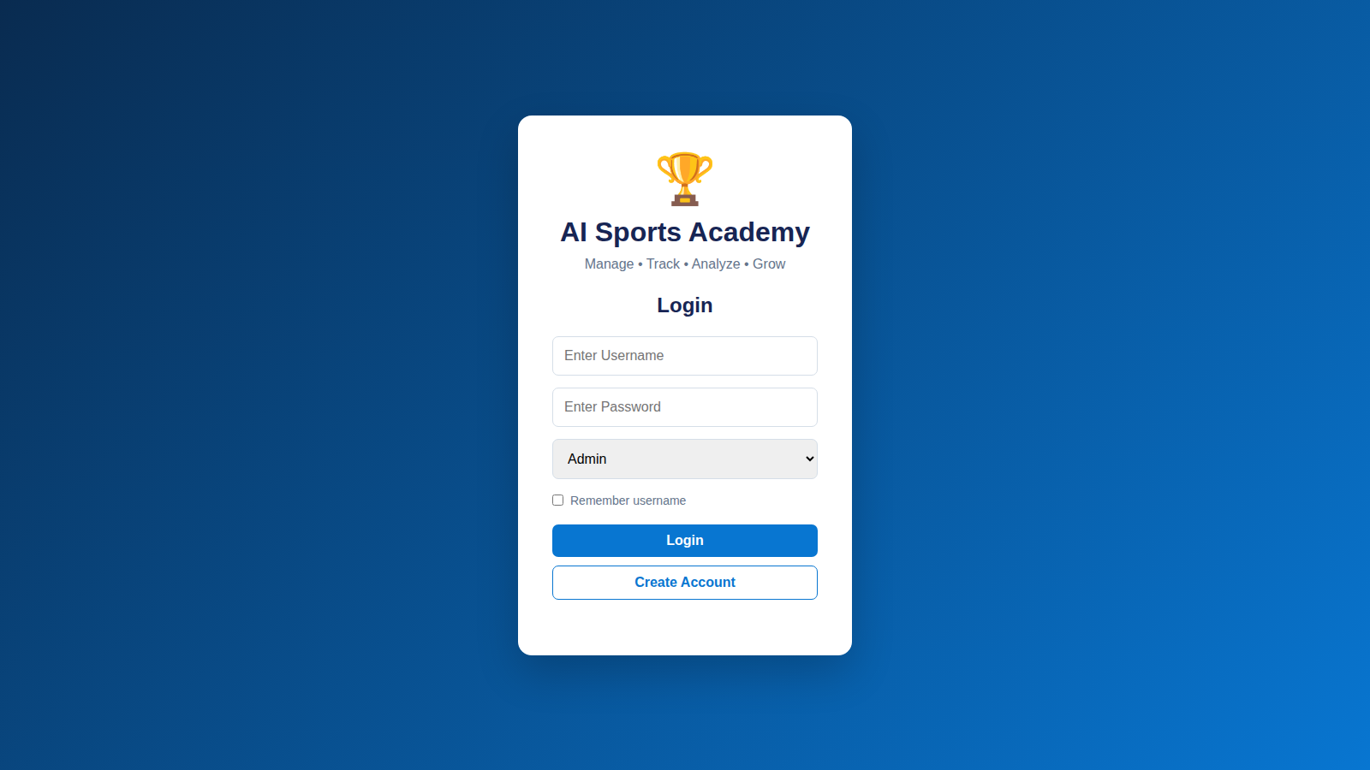
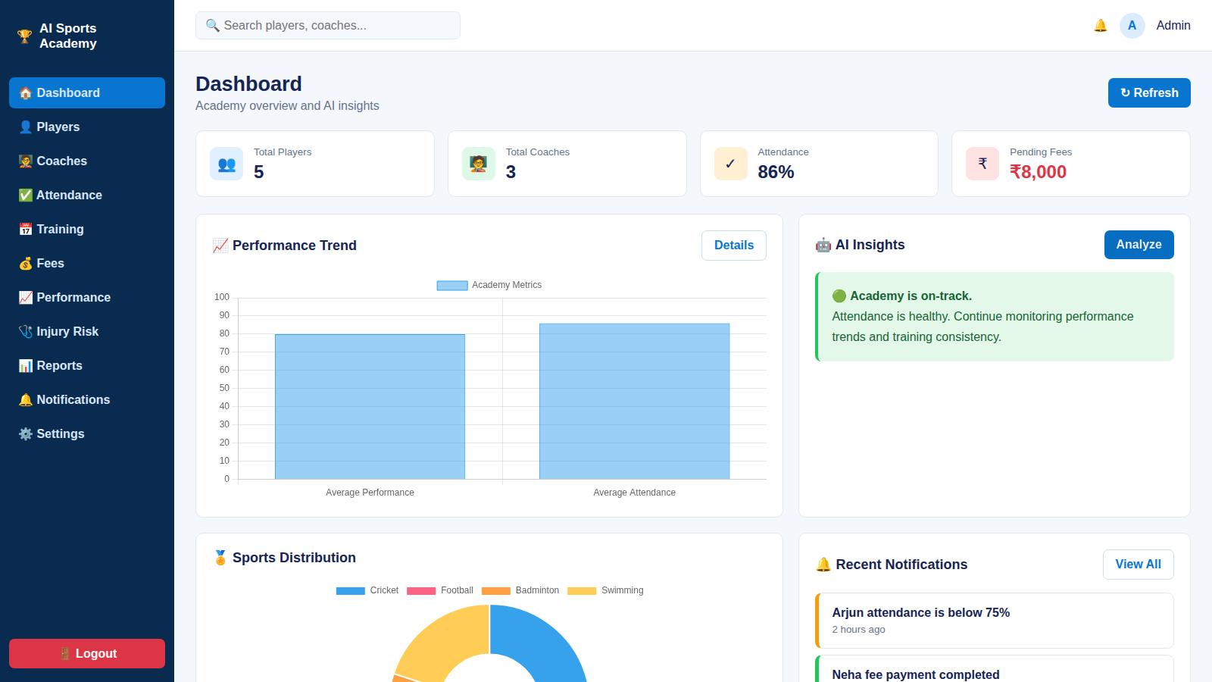
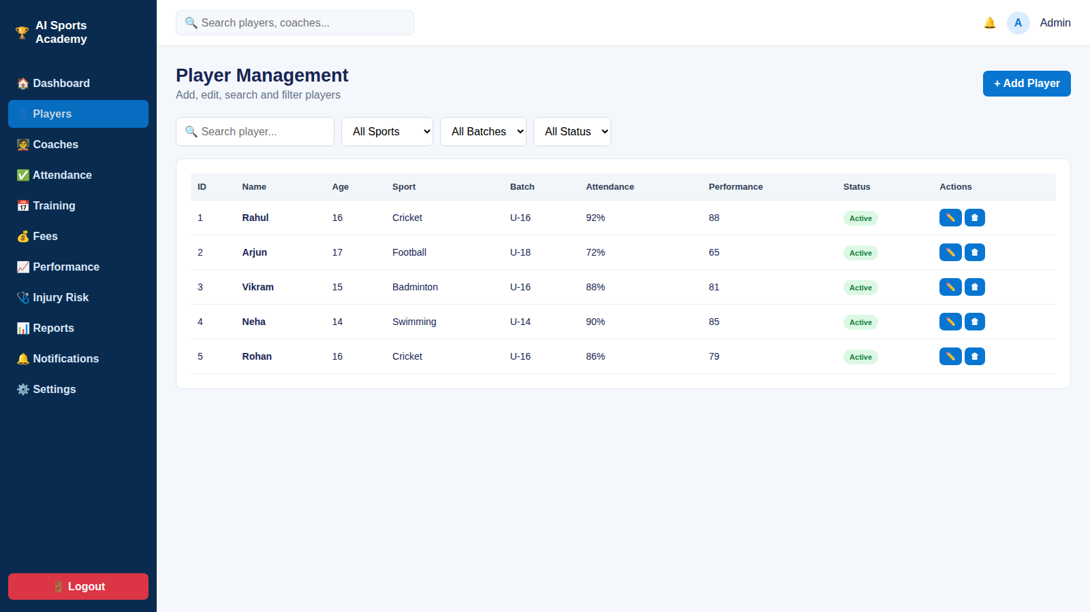
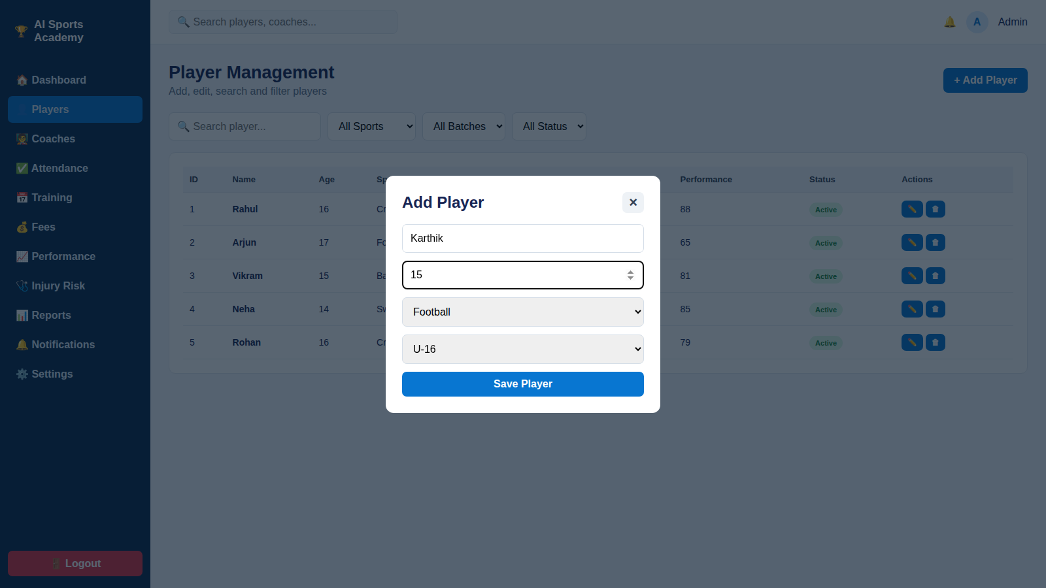
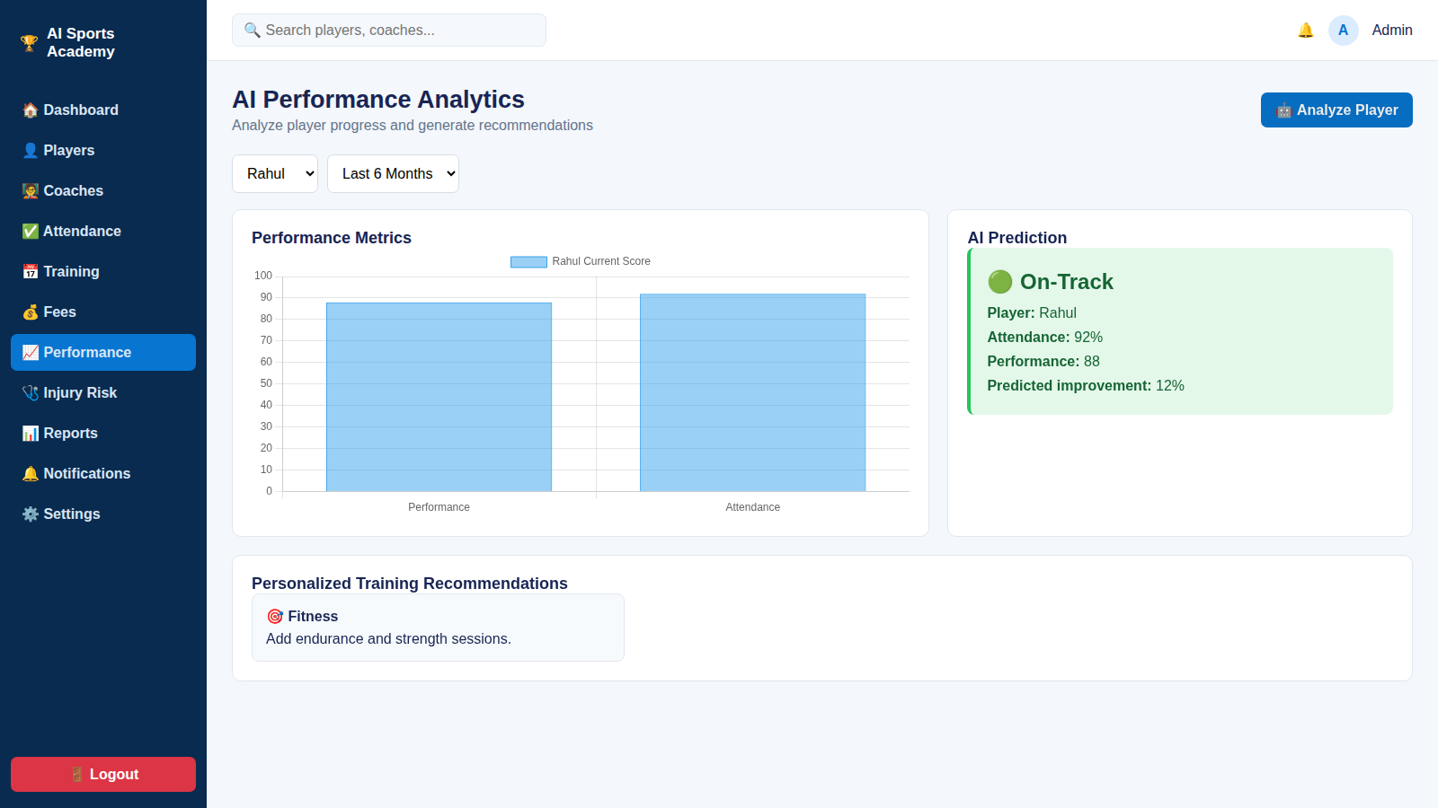
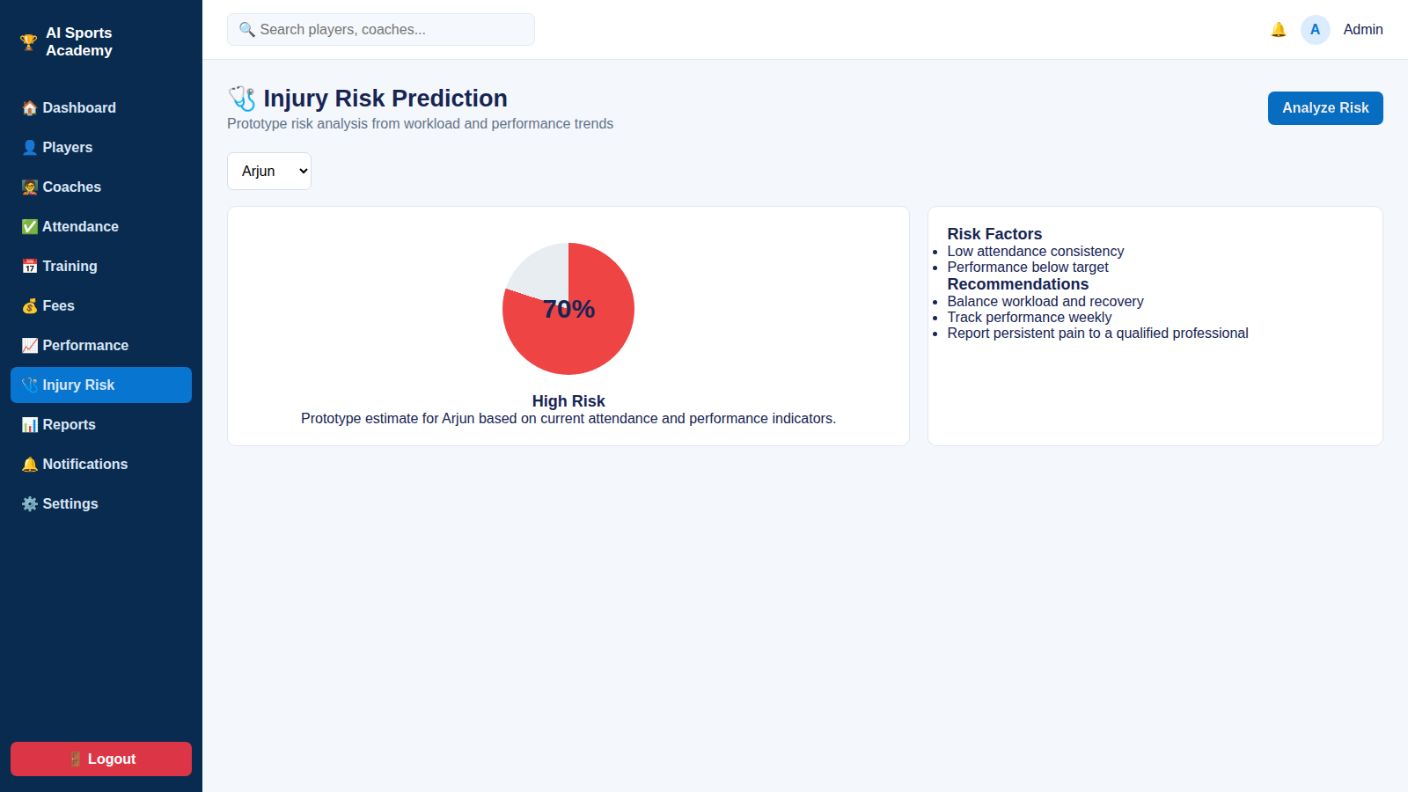
Screens / Working Demonstration
05 · WORKING DEMONSTRATION
Login page
Home page – Dashboard
Main application – Players
Forms – Add Player
Dashboard – AI Performance
Output – Injury Risk Prediction

Slide 36
Functional Results
06 · FUNCTIONAL RESULTS
What the system can actually do:
✓
User registration & login
✓
Add / update / delete records
✓
Search & filtering
Role-based access for Admin, Coach and Athlete/Parent
Athletes, coaches, batches, attendance and fees
Find athletes by batch, sport, coach or fee status
✓
API communication
✓
Database operations
✓
Report generation
Frontend and services exchange data through REST endpoints
Constraint-checked reads and writes on one PostgreSQL schema
Attendance, fee and performance reports; AI at-risk flags

Slide 37
Testing Results
07 · TESTING RESULTS
Test Case | Expected Result | Actual Result | Status
Login | Successful login | Successful | Pass
Add Record | Record added | Added | Pass
Update Record | Record updated | Updated | Pass
Delete Record | Record deleted | Deleted | Pass
Mark Attendance | Attendance saved per batch | Saved | Pass
Fee Status | Paid / overdue shown correctly | Correct | Pass
API Request | Correct response | Correct response | Pass
AI Prediction | Trend score + at-risk flag returned | Returned | Pass

Slide 38
Performance Analysis
08 · PERFORMANCE ANALYSIS
Measured on the working build: average of 20 runs, Chromium, local machine.
8
8
0%
Test cases
Successful test cases
Error rate
48 ms
67 ms
11 ms
Page load time
UI response time
Data operation time
Open app to fully loaded
Login to dashboard and charts
Add player and save to browser storage

Slide 39
Results & Analysis
09 · RESULTS & ANALYSIS
Functional
Reliability
Performance
All six modules work end to end: login, CRUD, search, API calls, database operations and reports.
8 of 8 test cases passed with a 0% error rate across the core flows.
Page load 48 ms, login to dashboard 67 ms, add player 11 ms, search under 0.1 ms.
ANALYSIS
ANALYSIS
ANALYSIS
Admin and coach workflows now sit in one system instead of separate registers.
Constraints in PostgreSQL kept athlete, batch, attendance and fee records consistent.
Every interaction responds well under a second, which is fast enough for live use.

Slide 40
Conclusion & Future Scope
10 · CONCLUSION & FUTURE SCOPE
Conclusion
Future Scope
Project objectives achieved
Unified PostgreSQL schema links every academy module
Administration automated for attendance, fees and allocation
AI trend scoring flags at-risk athletes for coaches
Role-based dashboards give each user a live view
Add more features, such as online fee payment and parent notifications
Mobile app for coaches and athletes
Wearable sensor integration for richer analytics
Improve the prediction model as more data accumulates

Slide 41
THANK YOU
AI Sports Academy Management System
Questions & Discussion
Group – 11 | 25CS1302E – DBE & DSD | Computer Science and Engineering

