Slide 1

Persona of Mortgage Applications

Slide 2
Agenda
Review Marketing request
Select & Prepare the Data
Data General Observations
Correlation Analysis
Predictive Analysis

Slide 3
Project Description
Purpose: To map the persona of mortgage applicants
Data : All mortgage applications
Fields : City, Zip, Age, P$ycle, Income, FICO, Length of membership, Loan Purpose, and Loan Amount
Research Methodology : Building a correlation between each of the above fields to approval and funding
Benefits : Digital agency will be able to target for prospects matching the derived persona.

Slide 4
Steps Involved
Data Extraction and cleaning
Distribution analysis
Correlation analysis
Classification & Regression analysis of the dataset

Slide 5
Data Cleaning
Extracted dataset from ‘application_final’ and ‘member_final’ Mortgage Cadence ADU data tables.
Excluded applications older than 3 years
Excluded incomplete/cancelled/withdrawn applications

Slide 6
Excluded applicants with no DoB and no P$ycle classification
Excluded applicants with Income <500$ and Income >200000$
Excluded applicants of Age < 20 and Age > 100
Excluded applicants who requested Loan Amount > 750000$
Excluded Construction purpose applications

Slide 7
Summary of the Dataset

Slide 8
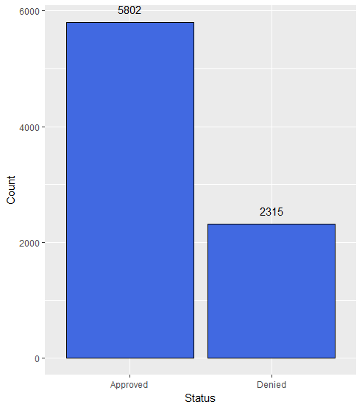
Approved vs. Denied

Slide 9
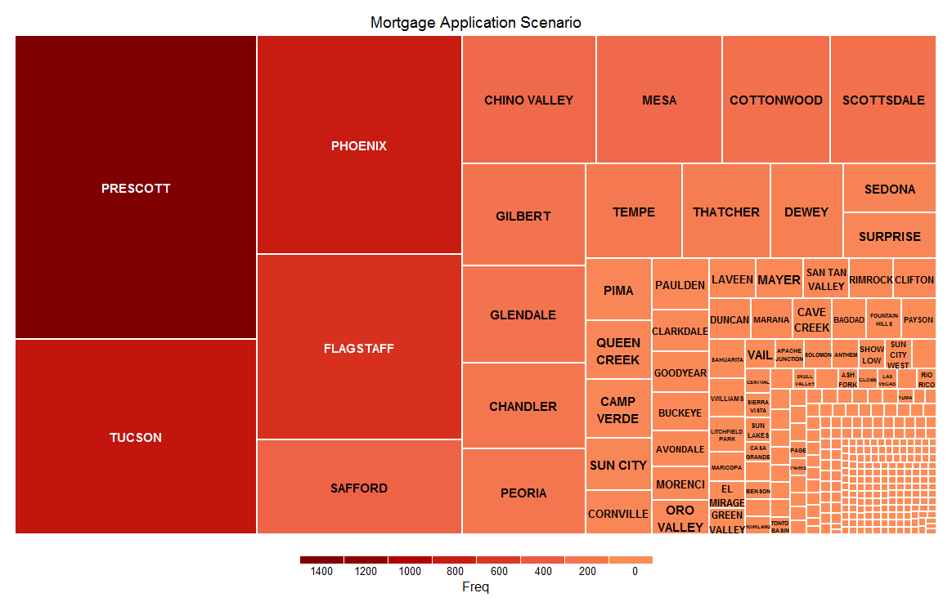
Distribution of Applicant City

Slide 10
Approval Rate Scenario in Top 30 cities with highest number of Mortgage Applications

Slide 11
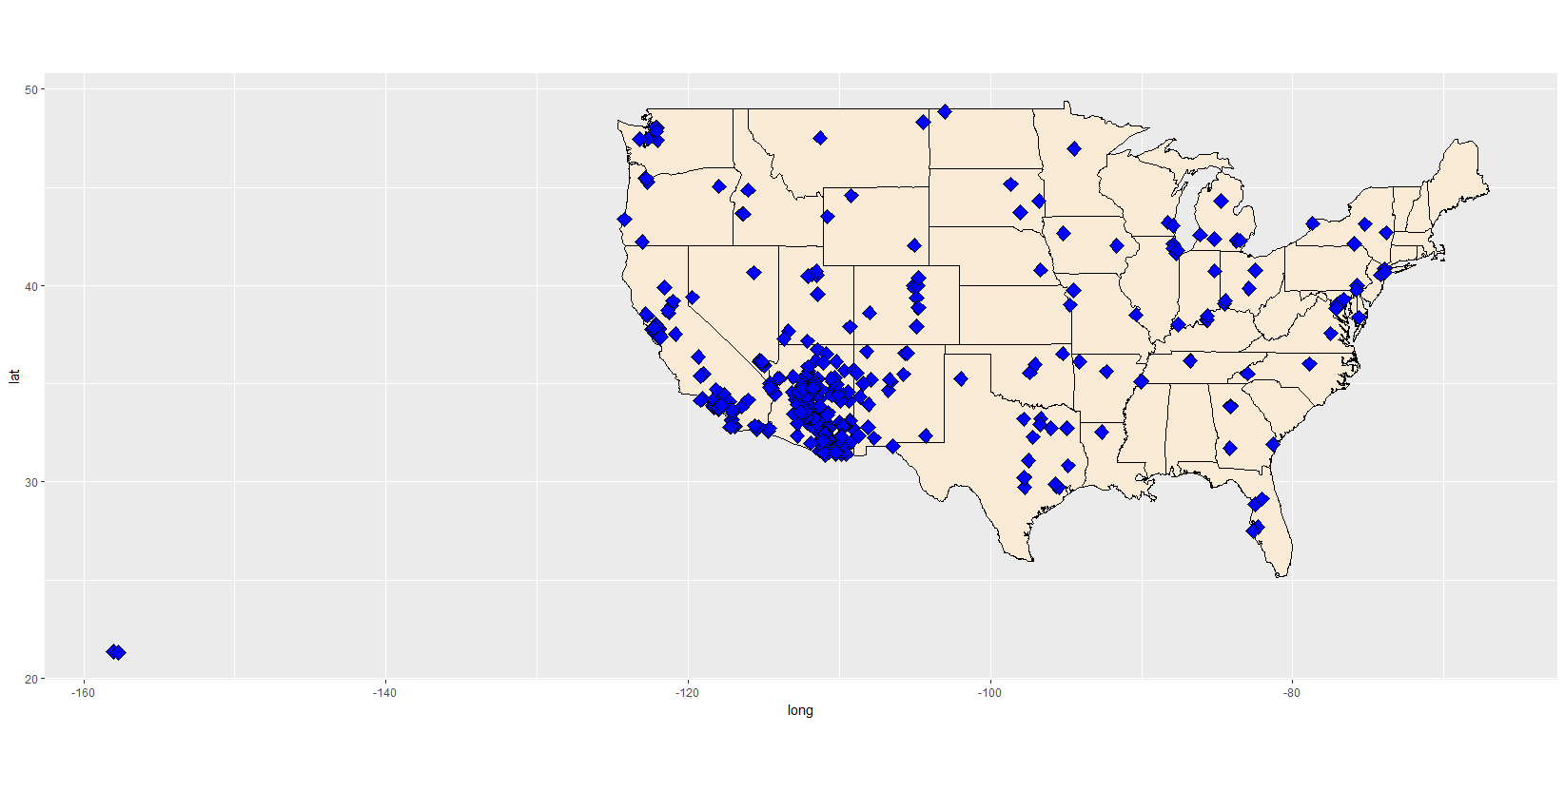
Distribution of Applications by Zip code/City

Slide 12
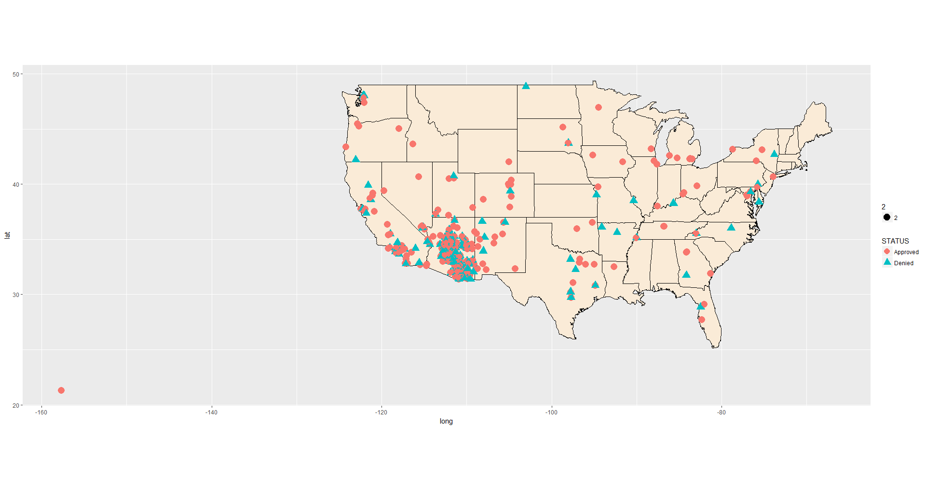
Approve/Denied Applications by Zip code/City

Slide 13
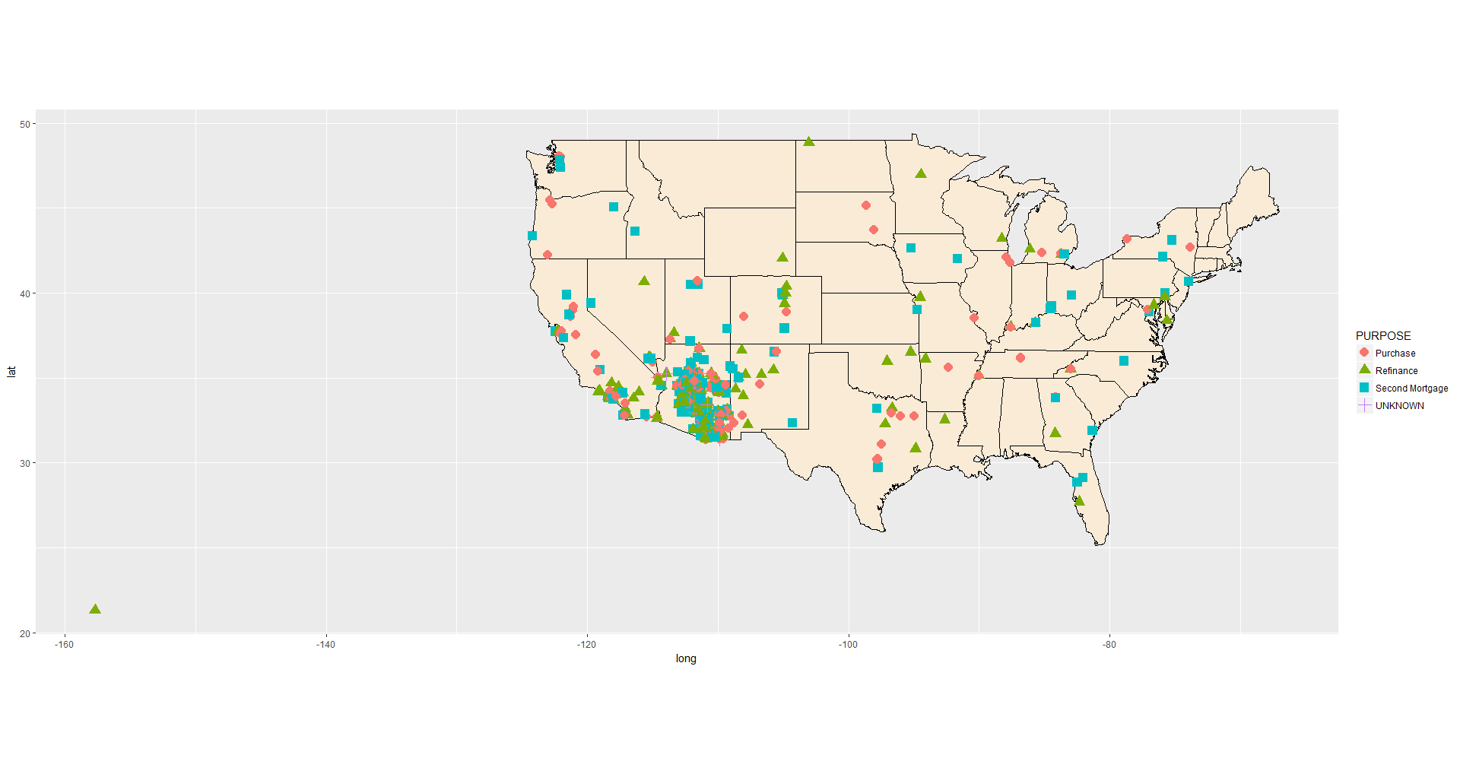
Purpose of Applications by Zip code/City

Slide 14
Purpose of Applications by City
Significantly higher number of Purchase applicants than the Refinance applicants
Interesting find – Sedona, Dewey, Camp Verde have lesser Purchase applicants

Slide 15
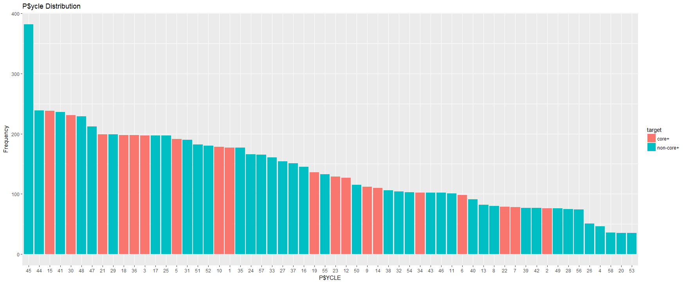
Distribution of All Applications by P$ycle

Slide 16
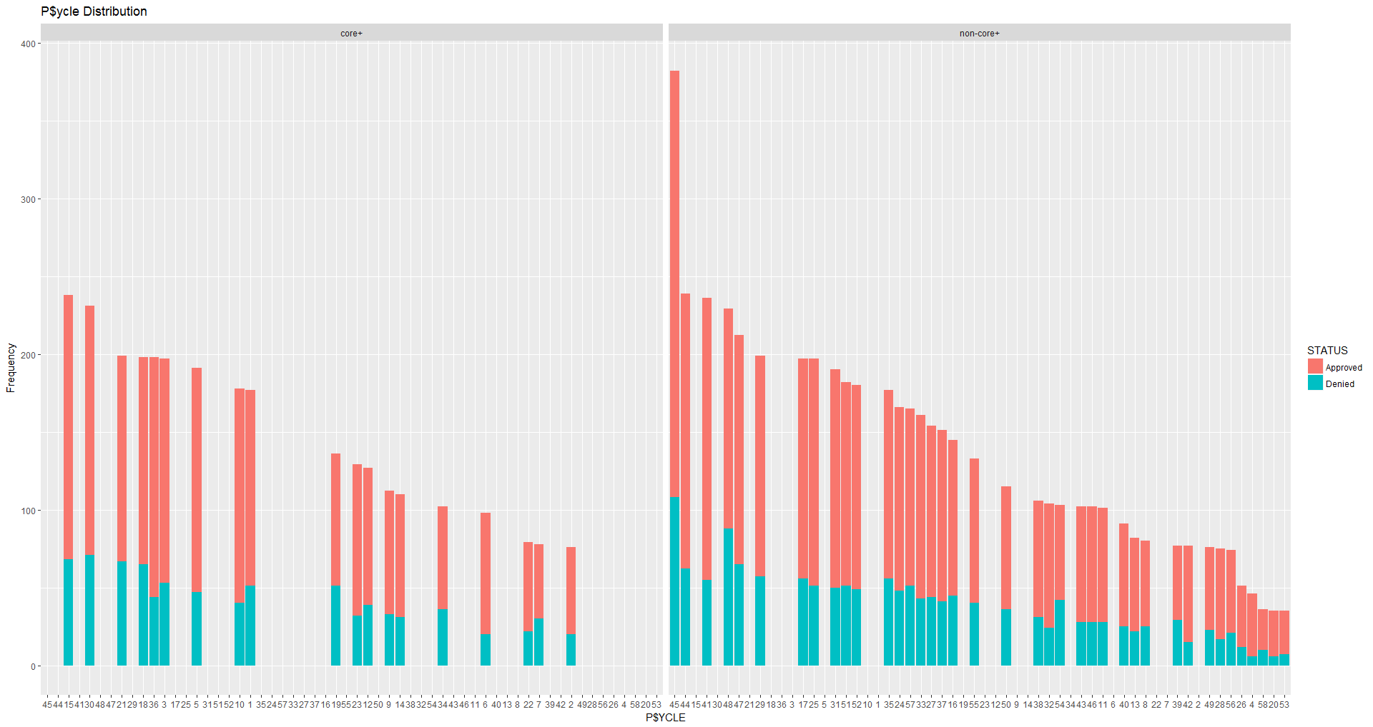
Approve/denied vs. Purpose
Core +
Core

Slide 17
Greenback Acres(Working Class-USA) have highest number of applications and also highest denial rate.
Retirement Ready (Midscale Matures) also have higher applicants and also higher denial rate.
Mass Middle Class and Working Class account to highest number of mortgage loans

Slide 18
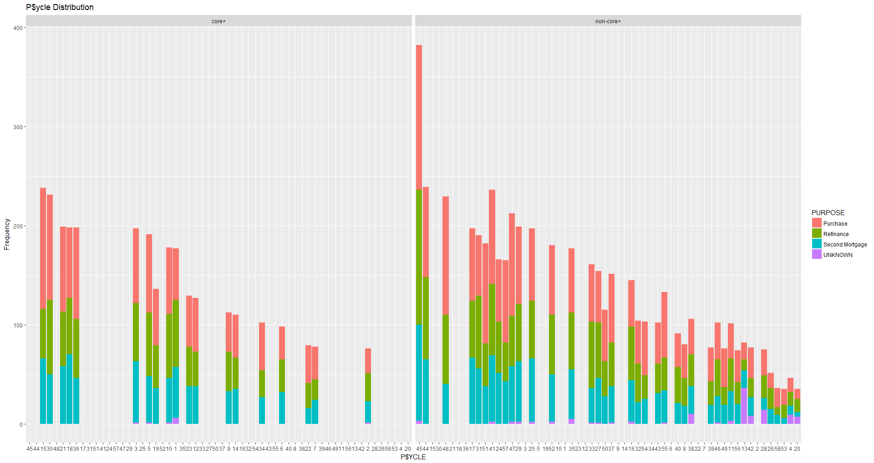
P$ycle vs. Purpose
Core +
Core

Slide 19
The top 5 P$ycles belong to Mature Years Life Cycle
The bottom 5 P$ycles belong mostly to Younger Years followed by Family Life

Slide 20
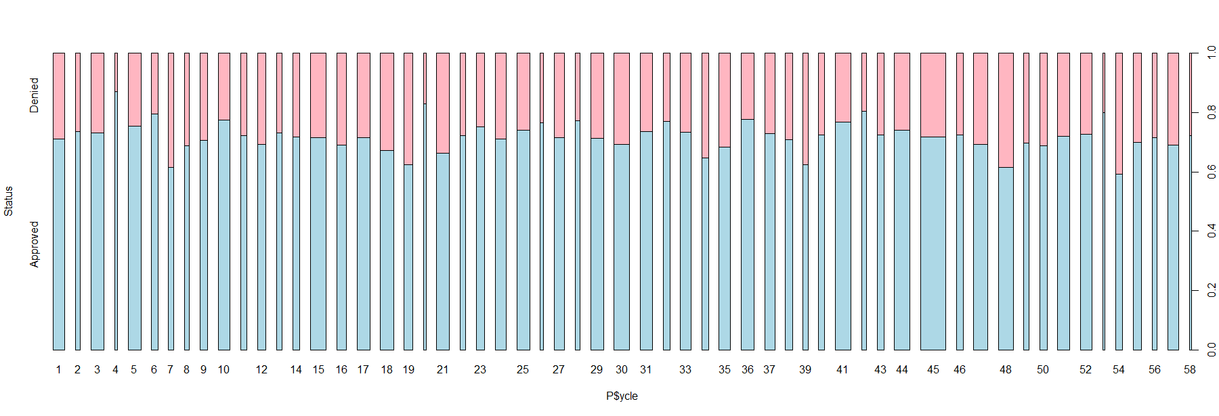
P$ycle Distribution
11
13
20
22
24
26
28
32
34
38
40
42
47
49
51
53
55
57
Homespun Families & Greenback Acres have highest number of applicants (Core)

Slide 21
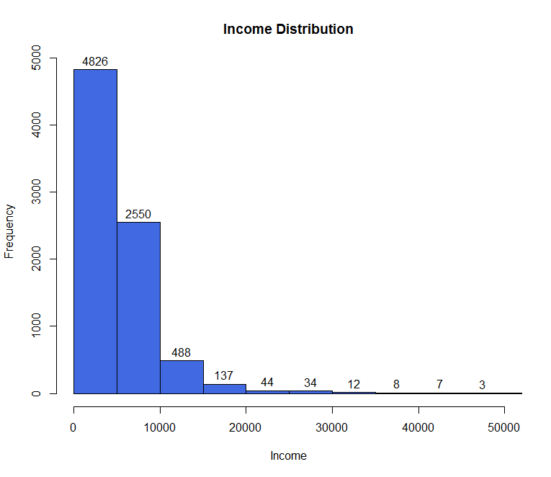
Distribution of Income

Slide 22
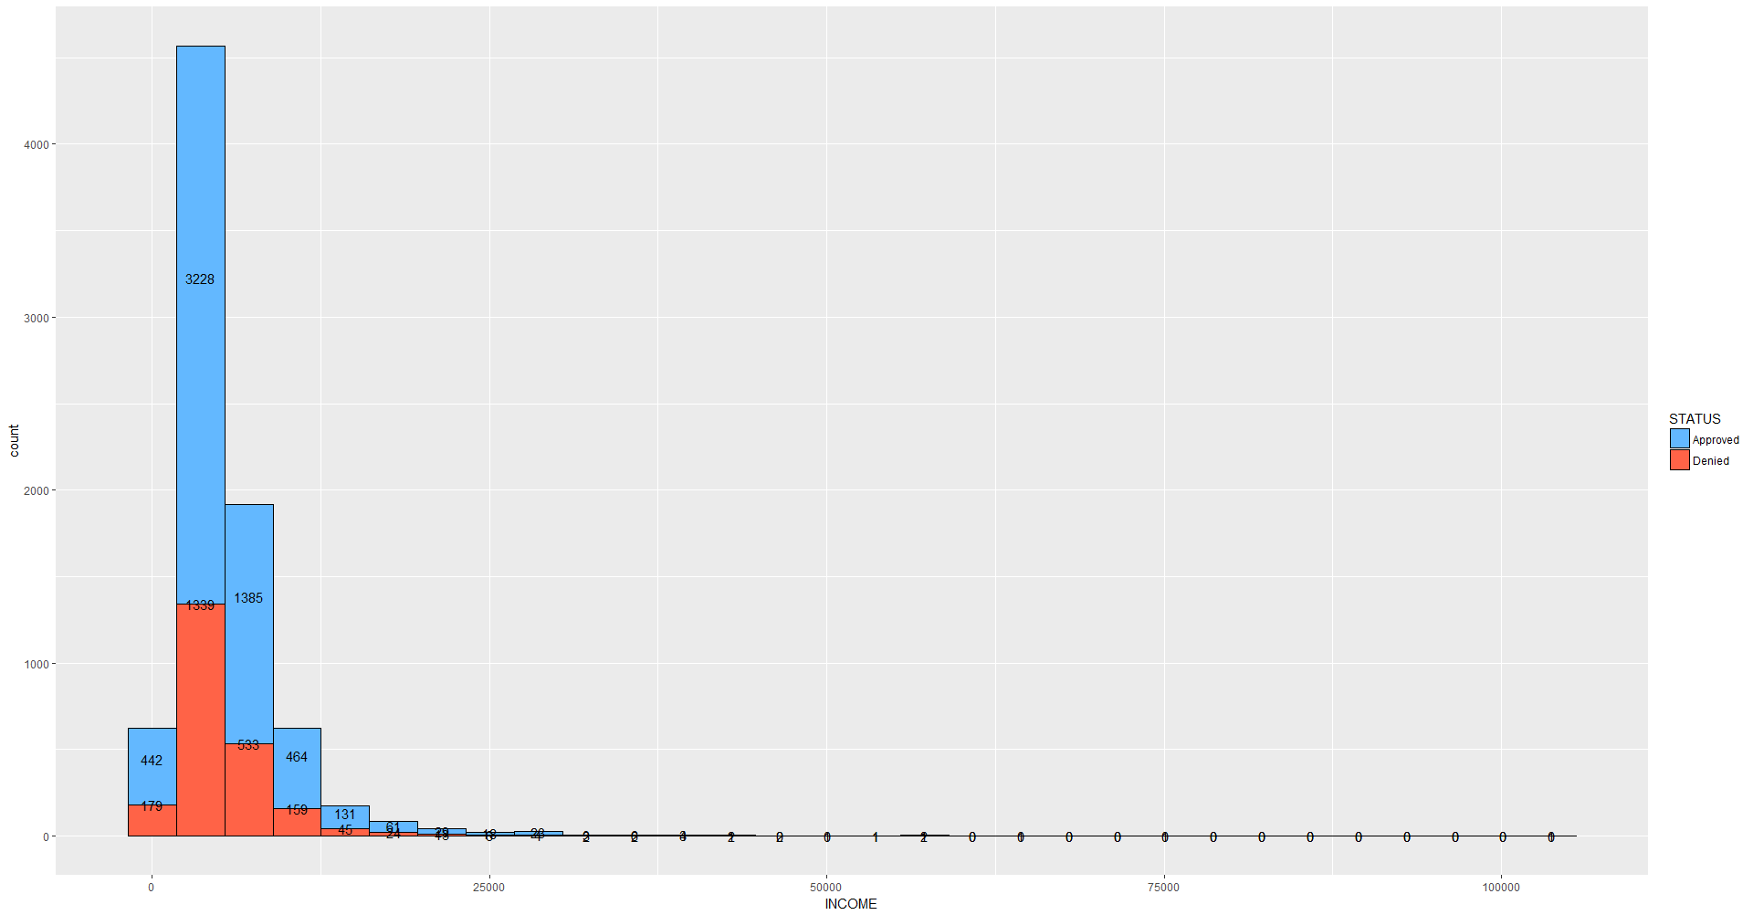
Income Distribution

Slide 23
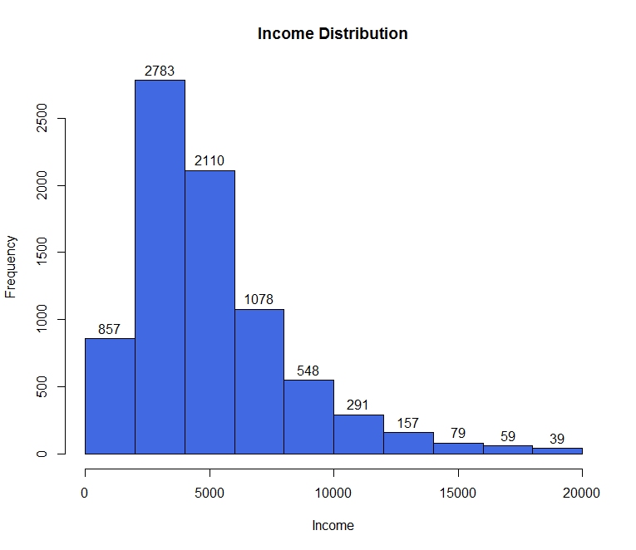
Most number of applicants lie in the range of 500$ and 20,000$

Slide 24
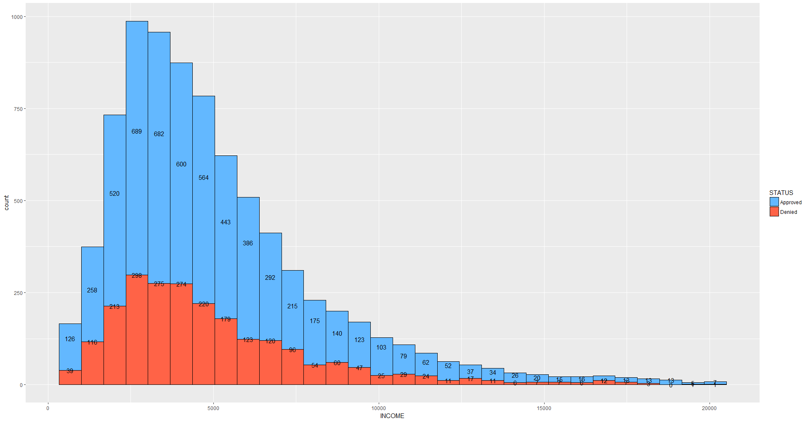
Income Distribution
Highest number of applicants between 1500$ to 5500$

Slide 25
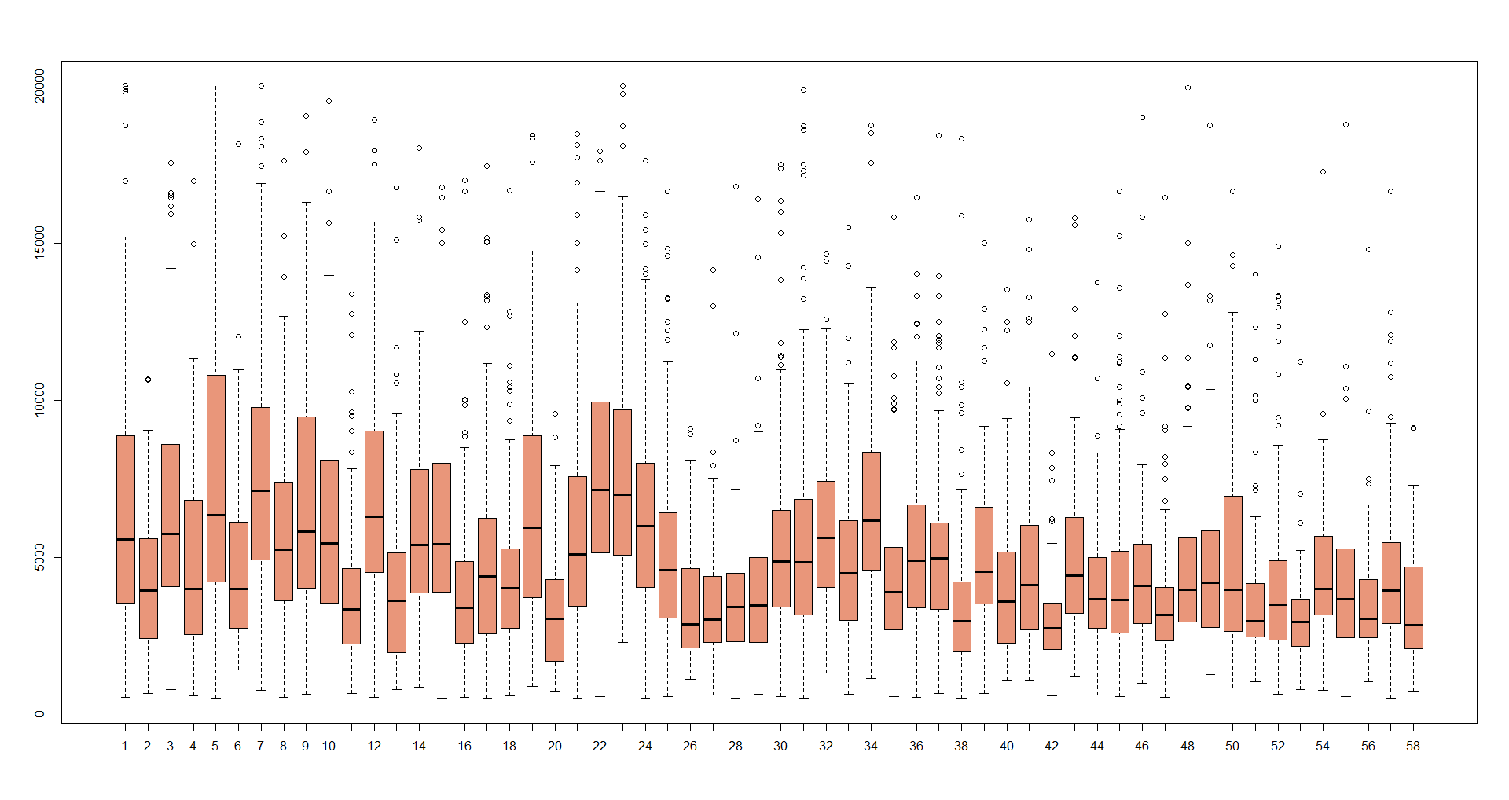
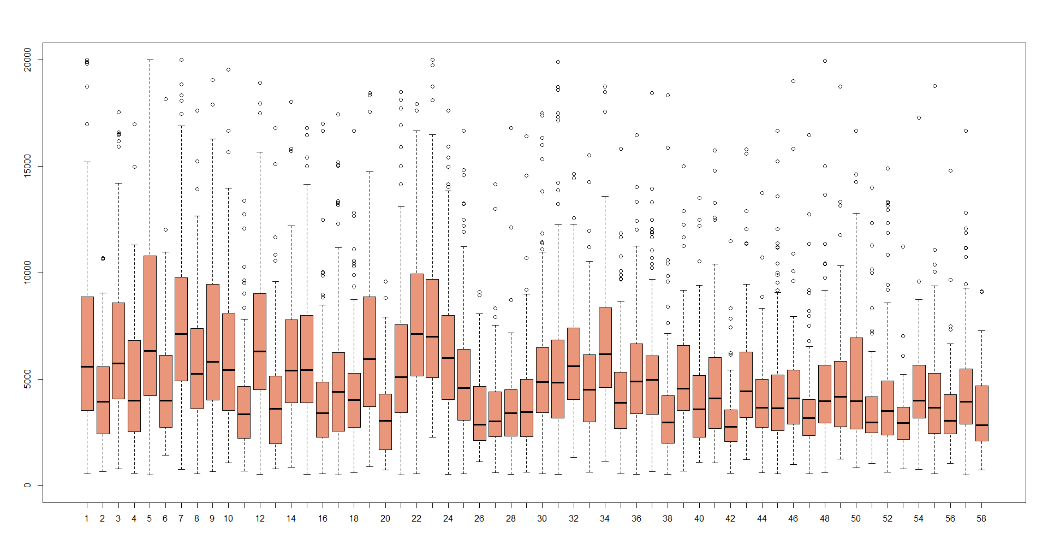
Income vs. P$ycle Distribution
23

Slide 26
P$ycle 22 and 23 have highest mean income values but their approval rate is significantly lower (~75%)
P$ycle 4 has lower mean income but higher approval rate (~87%)

Slide 27
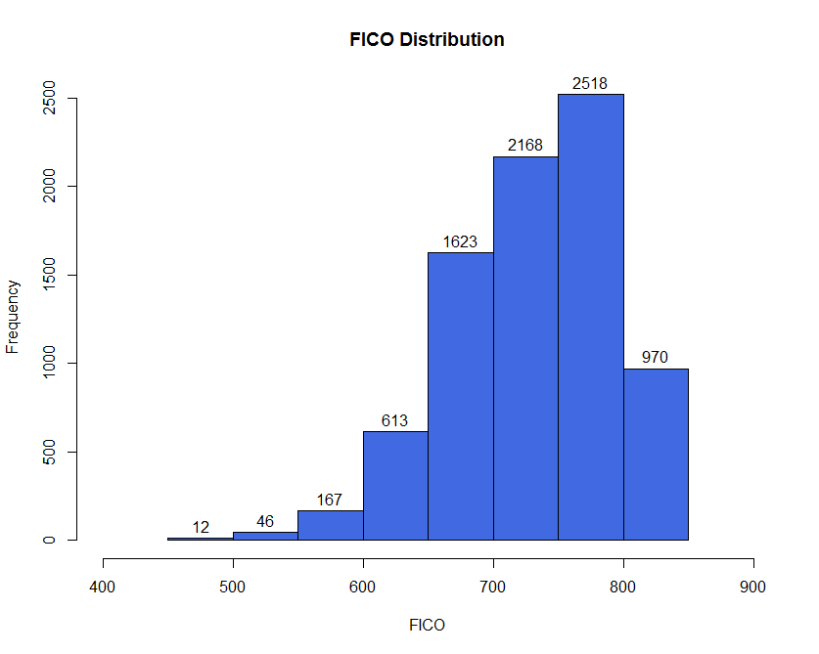
Distribution of FICO

Slide 28
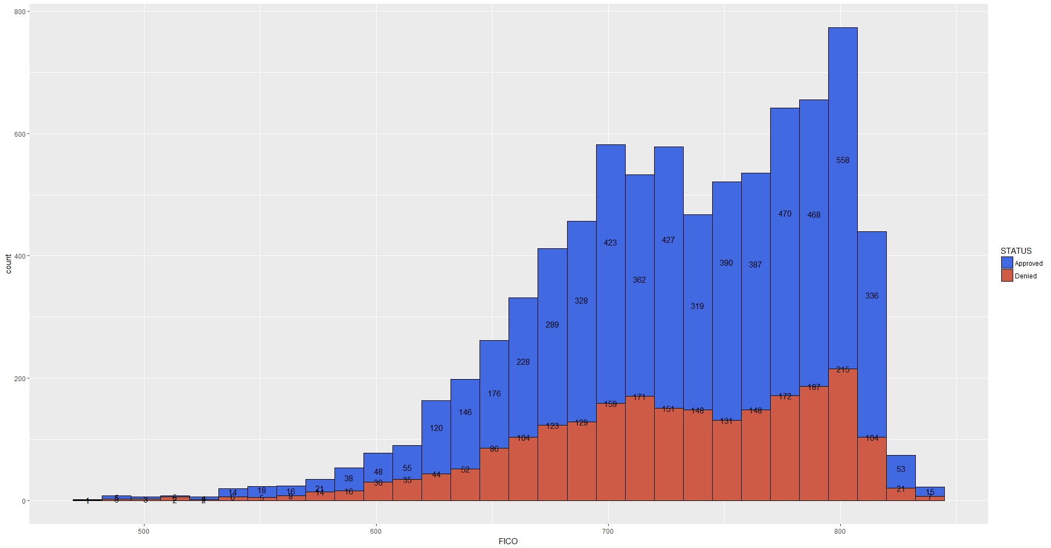
FICO Distribution

Slide 29
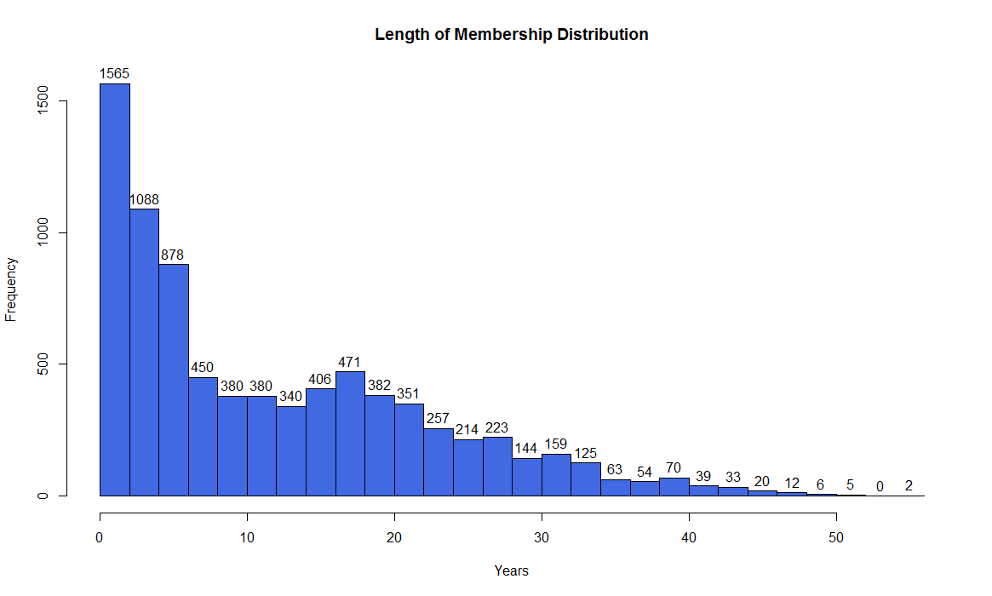
Distribution of Length of Membership

Slide 30
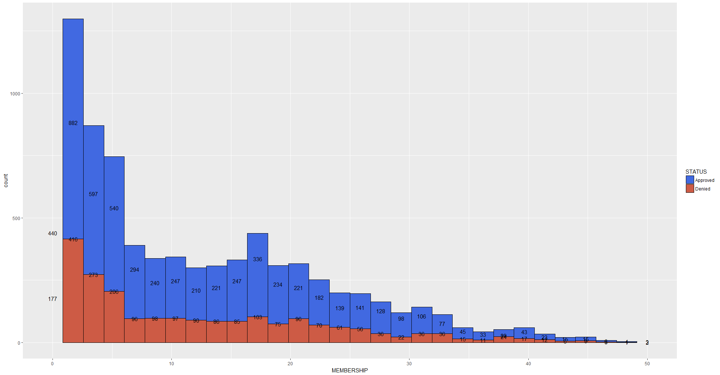
Length of Membership Distribution

Slide 31
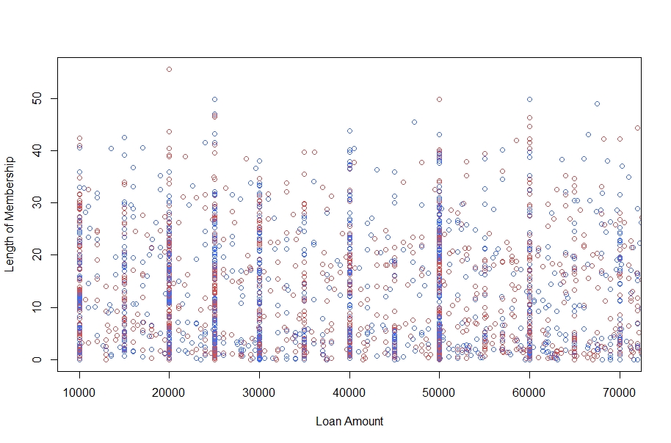
Pattern of Loan Request Amount vs. Length of Membership
Highest number of applicants applying for loan amount = 50K

Slide 32
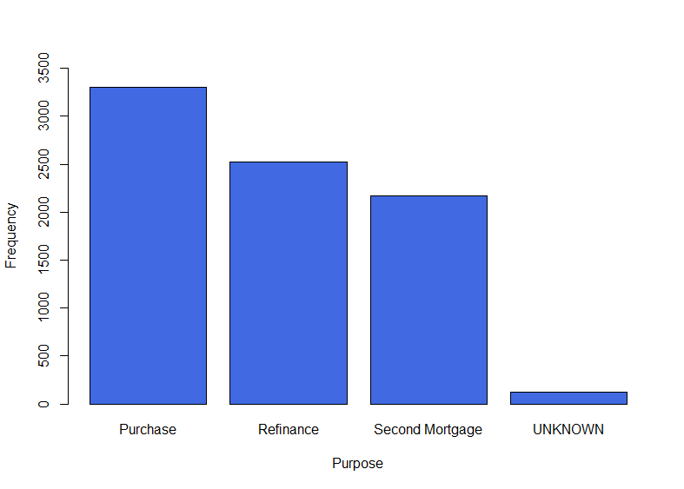
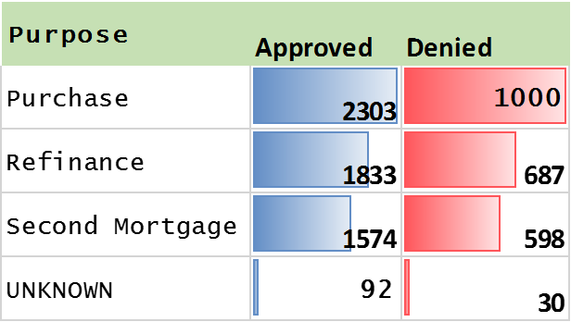
Distribution of Loan Purpose

Slide 33
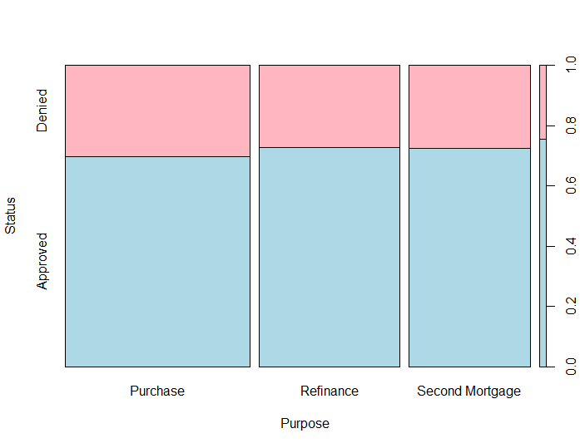

Slide 34
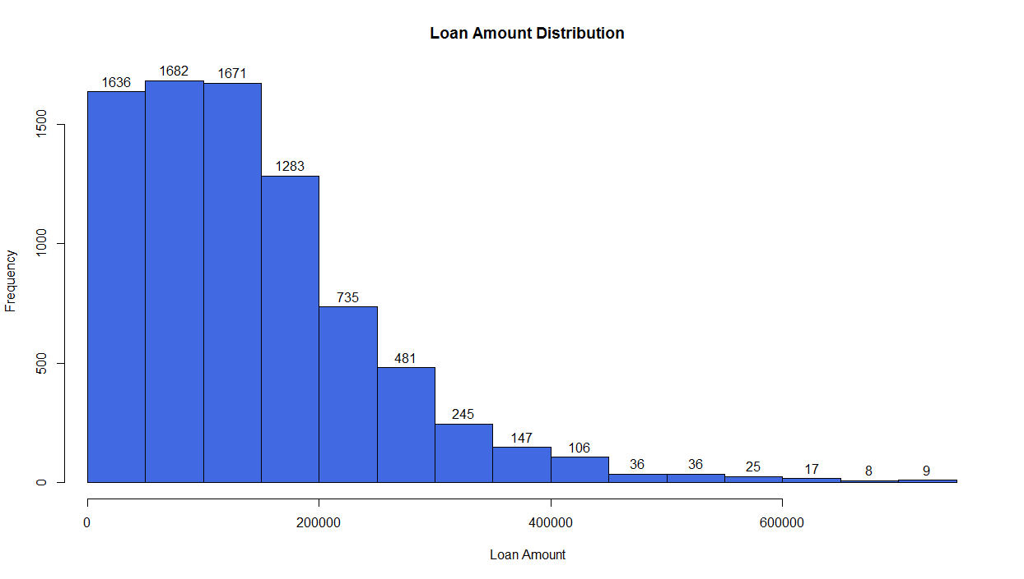
Distribution of Loan Amount

Slide 35
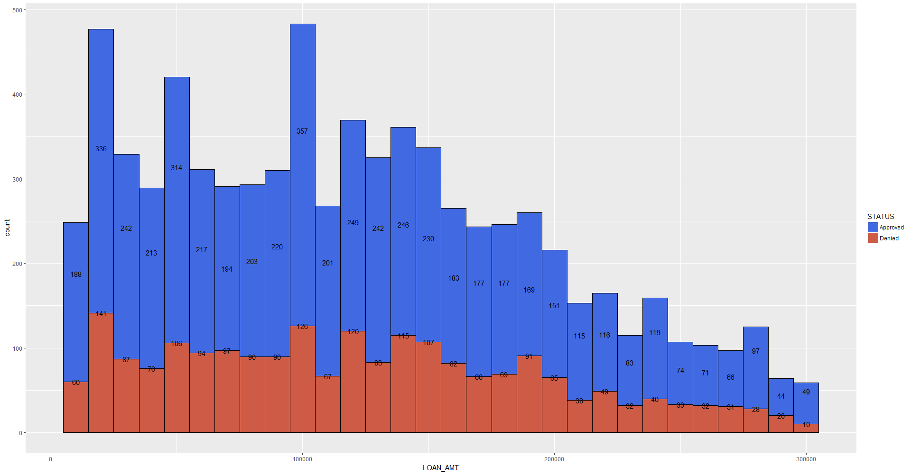

Applications > $300k Excluded

Slide 36
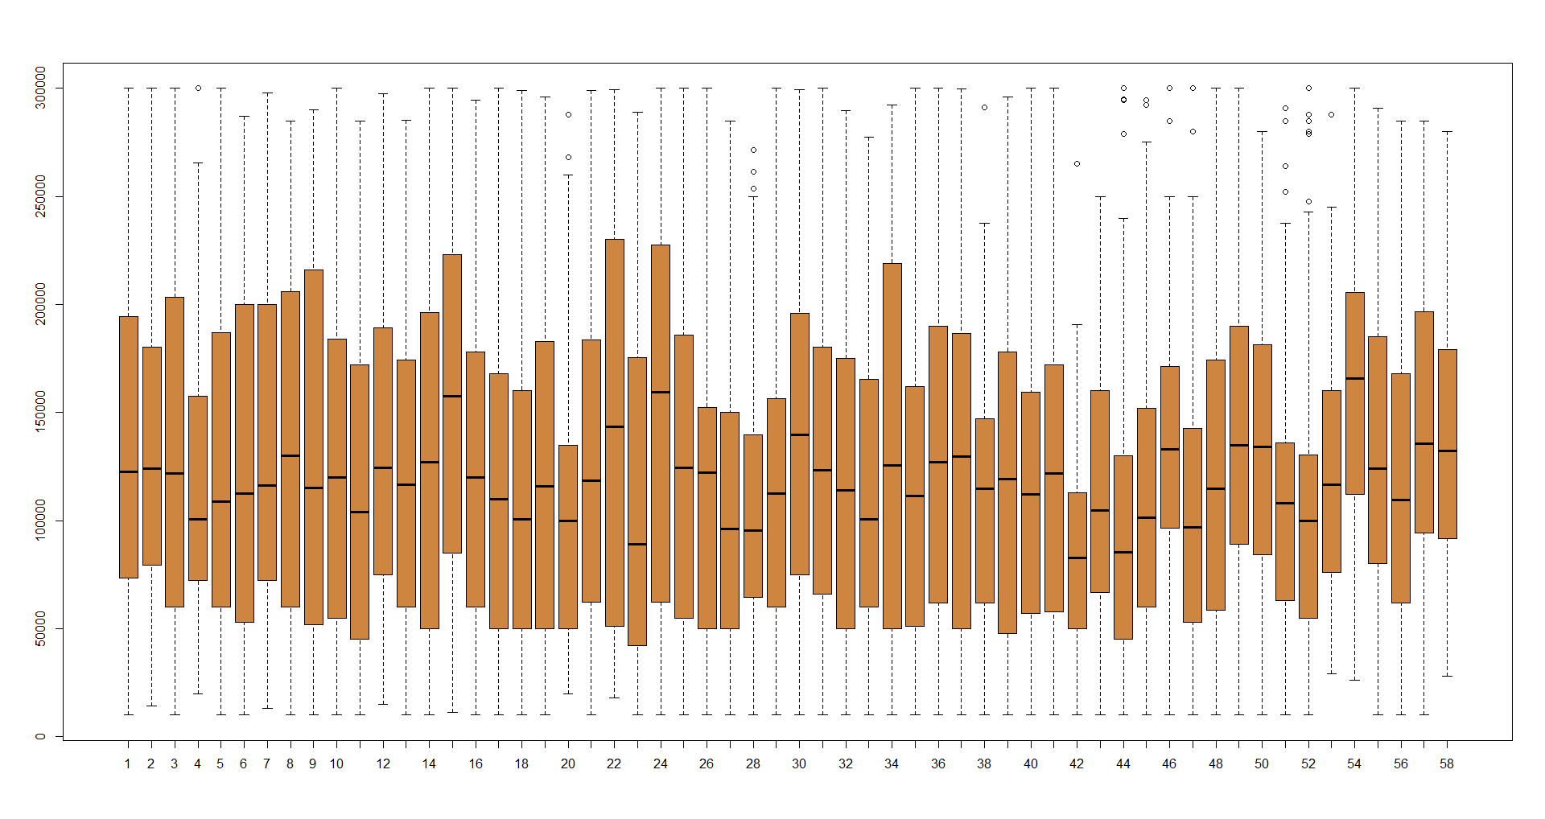
Loan Amount vs. P$ycle

Slide 37
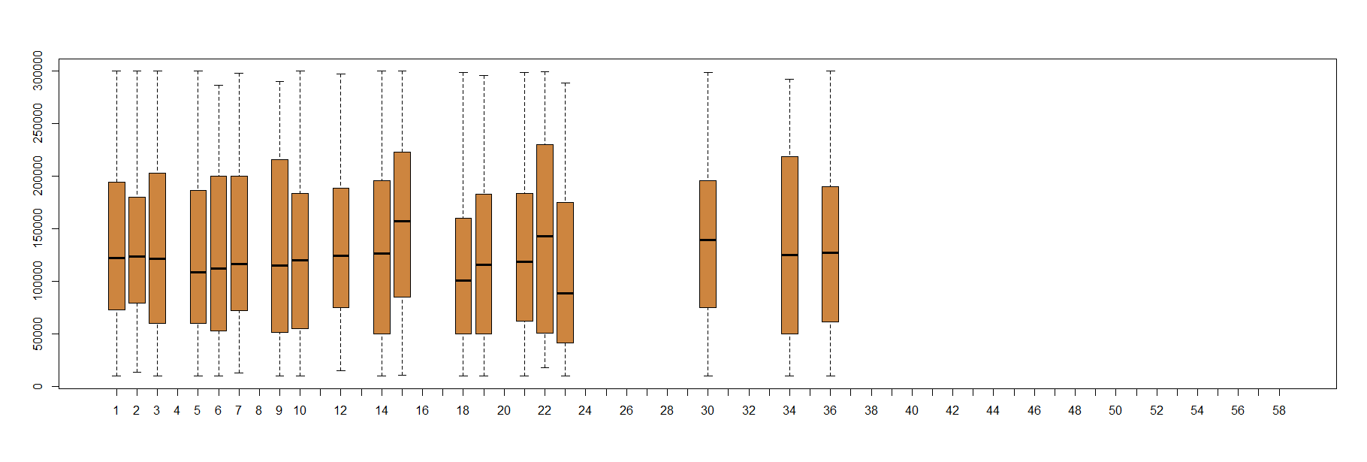
Core+ P$ycle

Slide 38
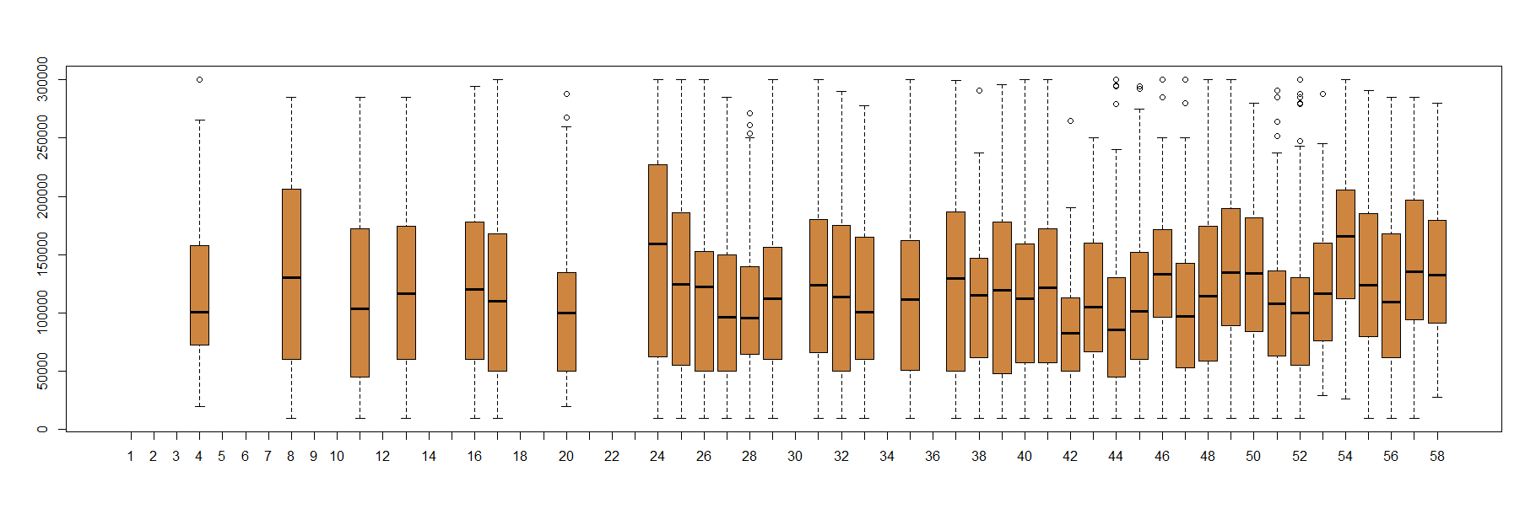
Core P$ycle

Slide 39
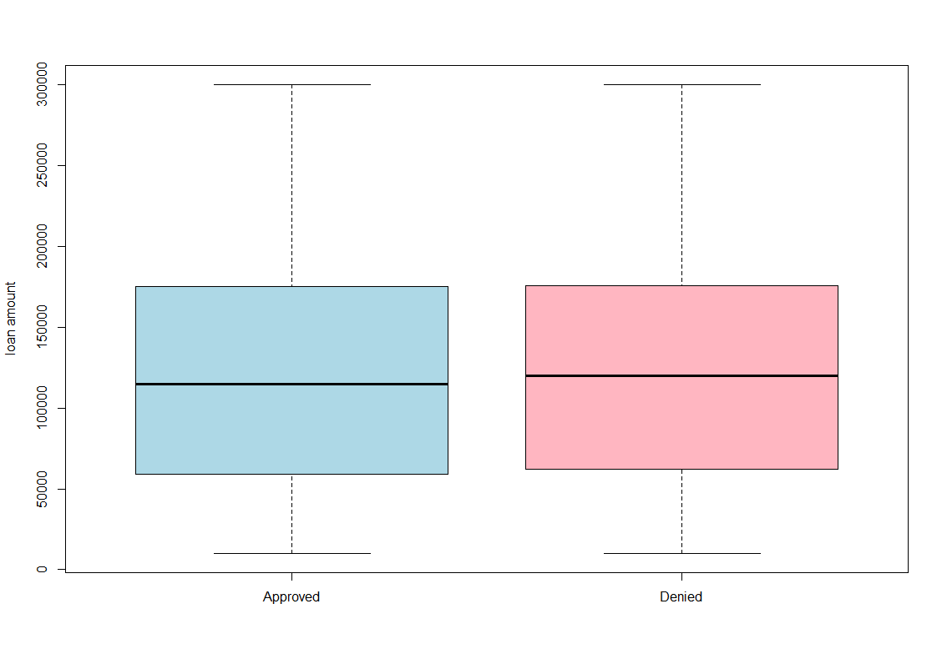
Loan amount vs. Approval Status

Slide 40
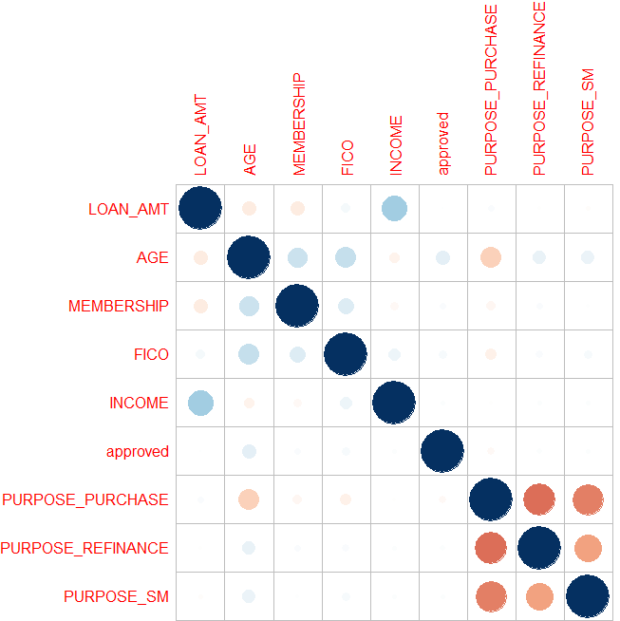
Correlation Analysis
Income and Loan Amount are highly correlated positively
Purchase Purpose and Age are negatively correlated

Slide 41
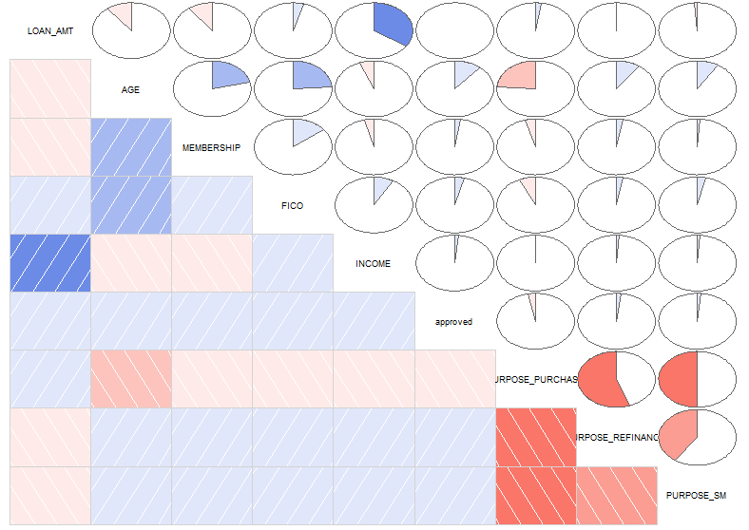
Correlation Analysis

Slide 42
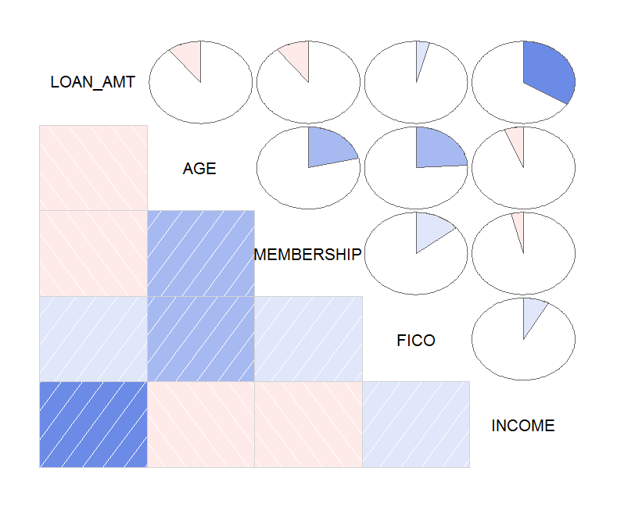
Higher income ~ Higher Loan Amount
Younger people requesting for higher loan amounts
Applicants associated for shorter length requesting for higher loan amounts
- Younger age ~ higher income ~ higher loan amount ~ lesser approval rate

Slide 43
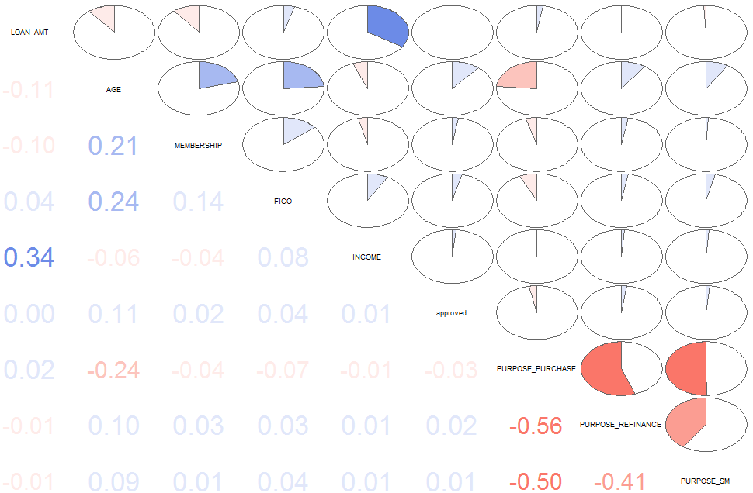
Correlation Analysis

Slide 44
Predictive Analysis
My approaches to predict mortgage application outcomes included:
Decision Tree (Conditional inference Trees)
K- Nearest Neighbors
Logistic regression model
All the three analysis achieved an accuracy ~ 72%

Slide 45
Decision Tree
Constructed a tree to see probability of approval of an applicant
0’s represent denial
1’s represent approval

Slide 46
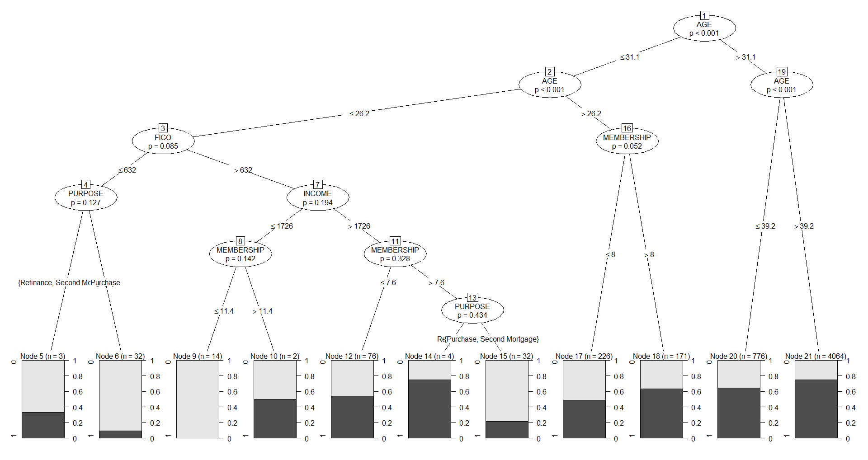
Decision Tree

Slide 48
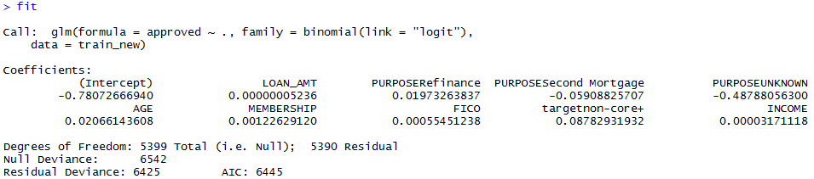
Logistic Regression Model

Slide 49

K-Nearest Neighbors

Slide 50
From the analysis, I can see that, there is a scope to extend data mining and predictive analysis to understand the persona of applications.
The models presented have given an average accuracy of 72% and they could be trained well to give better accuracy based on consistent data.
I started analysis with 12500 applicants and with all exclusions it narrowed down to 8100 for three years of data.

Slide 51
Conclusion
Core comprises of higher number of Mortgage applications than Core+
Better marketing strategies to cater to Core applicants
Better judgement of future loan outcomes and identifying exceptions
This predictive analysis can also be used in analyzing delinquent loans, credit approval analysis and recommendation systems for new members

Slide 52
Thank You.

