Slide 1

Note: The data and information in this document is reflective of a hypothetical situation and client. This document is to be used for KPMG Virtual Internship purposes only.
Sprocket Central Pty Ltd
Data analytics approach

Slide 2
Note: The data and information in this document is reflective of a hypothetical situation and client. This document is to be used for KPMG Virtual Internship purposes only.
Agenda
Introduction
Data Exploration
Model Development
Interpretation

Slide 3
Note: The data and information in this document is reflective of a hypothetical situation and client. This document is to be used for KPMG Virtual Internship purposes only.
Introduction
The approach will be implemented in three stages :
Data Exploration
Model Development
Interpretation

Slide 4
Introduction
Introduction
Approach for New Customer Data analysis :
Age distribution
Bike purchase
Job industry
Number of cars owned

Slide 5
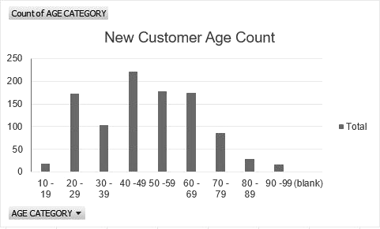
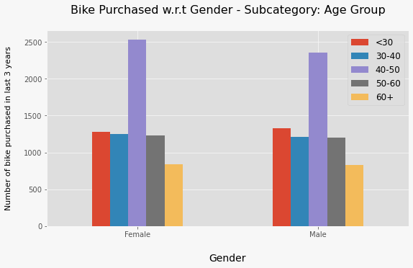
Note: The data and information in this document is reflective of a hypothetical situation and client. This document is to be used for KPMG Virtual Internship purposes only.
Data Exploration : Age Distribution & Bike Purchases
New customers are more from the age group of 40-49 , followed by 50-59 & 60-69.
Fewer customer are from 10-19 & 90-99 for obvious reasons.
Data shows age group 40-50 has high count in terms of bike purchased in last 3 years with a slightly greater female ratio.
The target audience for our marketing and advertising should be inclined to provide focus on females than males.

Slide 6
Note: The data and information in this document is reflective of a hypothetical situation and client. This document is to be used for KPMG Virtual Internship purposes only.
Model Development
CUSTOMER CLASSIFICATION – Targeting High Value Customers
The following are the high-value clients to target from the new list :
Aged between 40 – 50.
Most of the high value customers are female compared to male
Working in Financial Service, Manufacturing and Health.
Who are currently living in New South Wales and Victoria.

Slide 7
Note: The data and information in this document is reflective of a hypothetical situation and client. This document is to be used for KPMG Virtual Internship purposes only.
Interpretation
HIGH-VALUE CUSTOMER SUMMARY TABLE
Customer ID | Bike Related Purchases for the last 3 years | Age | Job Industry | Wealth Segment | Owns Cars | State
1842 | 445 | 44 | Financial Services | Mass Customer | No | New South Wales
2001 | 168 | 44 | Manufacturing | Mass Customer | Yes | New South Wales
650 | 486 | 44 | Health | Mass Customer | No | New South Wales
3297 | 234 | 46 | Manufacturing | Mass Customer | No | Victoria
50 | 266 | 41 | Manufacturing | Mass Customer | Yes | New South Wales

Slide 8
Note: The data and information in this document is reflective of a hypothetical situation and client. This document is to be used for KPMG Virtual Internship purposes only.
THANK YOU

