Slide 1


HOSPITAL DATABASE
MANAGEMENT
SYSTEM

Slide 2



METHODS OF STORING DATA IN HOSPITAL RECEPTION
USING RECORD
USING DATABASE
RECEPTION
HOSPITAL USING DATABASE
IN RECEPTION
HOSPITAL USING RECORDS
IN RECEPTION

Slide 3
Content
Problem Statement
01
Entity Relation Diagram
02
Relational Schema
03
Normal Forms
04

Slide 4

PROBLEM STATEMENT
Now –a-days the demand for newly established hospitals is growing rapidly it is difficult to manage all the data of a hospital in records (i.e, tests, medicines and room if necessary ,treatment costs ,employee records and their work). The main objective our model is to store and access the data in fingertips. This database helps ensure that all the records of both patients and employees are neatly organized and easily accessible.

Slide 5

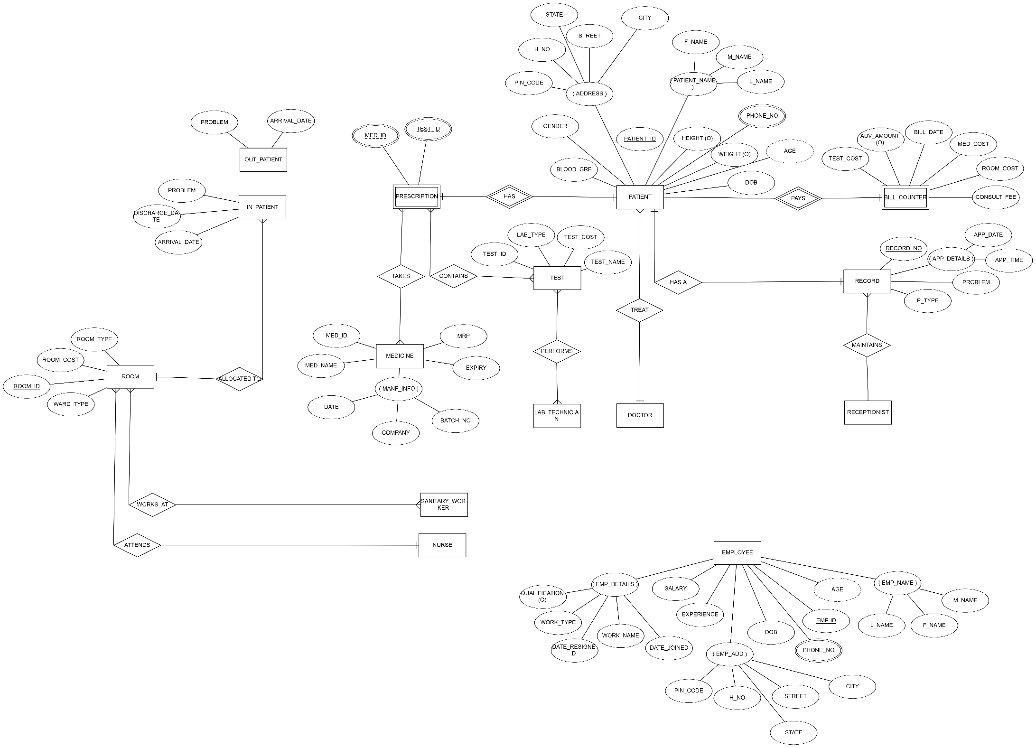


https://erdplus.com/

Slide 6
SL.NO | ENTITY-1 | ENTITY-2 | RELATIONSHIP NAME | RELATIONSHIP TYPE | EXPLANATION
1. | PATIENT | BILL-COUNTER | PAYS | ONE TO ONE | A patient has only one bill to pay and a bill is addressed to a single patient.
2. | PATIENT | RECORD | HAS A | ONE TO ONE | A patient has only one row in record and one row in record is associated to a single patient.
3. | PATIENT | DOCTOR | TREAT | MANY TO ONE | A doctor can treat many patients but a patient gets treated by only one doctor.
4. | PATIENT | PRESCRIPTION | HAS | ONE TO ONE | A patient is prescribed a single prescription and a prescription is addressed to a single patient.
5. | RECORD | RECEPTIONIST | MAINTAINS | MANY TO ONE | One receptionist can handle many rows in a record but a single row in a record can’t be handled by many receptionists.
6. | PRESCRIPTION | MEDICINE | TAKES | MANY TO MANY | One prescription can contain many medicines and one medicine can be in many prescriptions.
7. | PRESCRIPTION | TEST | CONTAINS | MANY TO MANY | One prescription can contain many tests and one test can be in many prescriptions.
8. | TEST | LAB_TECHNICIAN | PERFORMS | MANY TO MANY | One test can be performed by many lab-technicians and one lab-technician can perform many tests.
9. | IN_PATIENT | ROOM | ALLOCATED TO | MANY TO ONE | One room can be allotted to many patients but one patient can’t be allotted to many rooms.
10. | ROOM | SANITARY_WORKER | WORKS_AT | MANY TO MANY | A sanitary worker can work at many rooms and a room can have many sanitary workers working.
11. | ROOM | NURSE | ATTEND | MANY TO ONE | A nurse can attend to many rooms but room can only be attended by one nurse

Slide 7
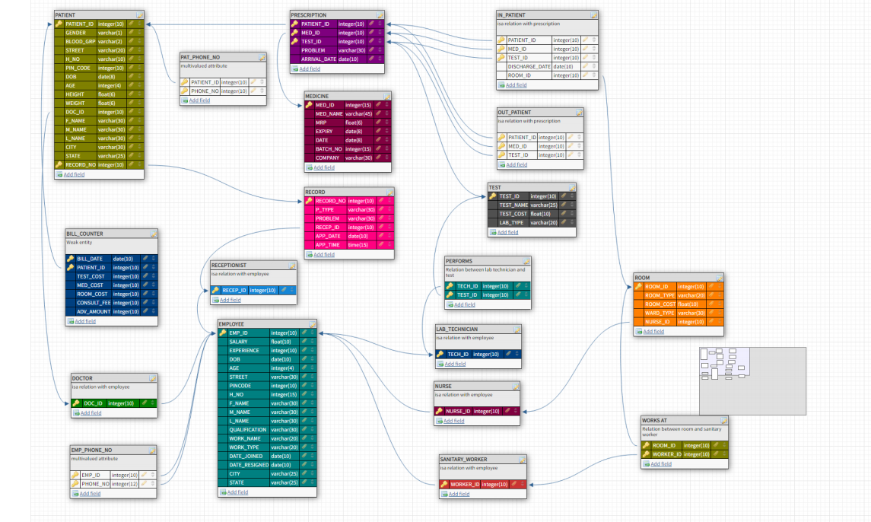

https://app.dbdesigner.net/

Slide 8
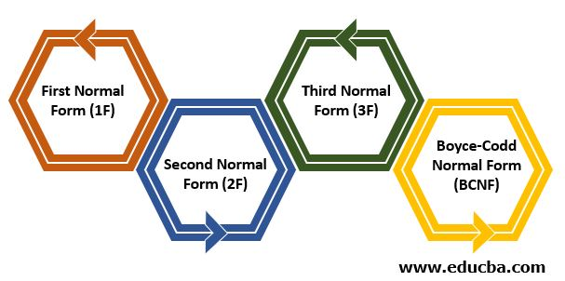
NORMAL
FORMS

Slide 9
1st NF:
Atomic attributes: To ensure that all attributes are atomic,
→ for composite attributes, all it’s components are included in the table. (address attribute in Patient and Employee tables).
→ for multivalued attributes, we maintained a separate table referencing to the main table(pat_phone_no with patient_id referencing to patient and emp_phone_no with emp_id referencing to employee)
Uniqueness: We made sure that every attribute in a table has a unique name and there are no repeated tuples
Thus, 1st NF is achieved.
Ex:
INSERT INTO PATIENT VALUES( 21001 , 'M' ,'O+' , 'SPRUSE STREET ' , '79B' , 523001, '06-FEB-1998' , 23 , 5.8 , 60 , 101 , ‘KUMAR ' , 401, 9889898999 );
INSERT INTO PATIENT VALUES( 21001 , 'M' ,'O+' , 'SPRUSE STREET ' , '79B' , 523001, '06-FEB-1998' , 23 , 5.8 , 60 , 101 , 'KUMAR’ , 401 , 9889342342 );
INSERT INTO PATIENT VALUES( 21001 , 'M' ,'O+' , 'SPRUSE STREET ' , '79B' , 523001, '06-FEB-1998' , 23 , 5.8 , 60 , 101 , 'KUMAR’ , 401 , 9239342342 );
REDUNDANCY
BEFORE 1st NF:

Slide 10
AFTER 1st NF:
Ex:
PATIENT:
INSERT INTO PATIENT VALUES( 21001 , 'M' ,'O+' , 'SPRUSE STREET ' , '79B' , 523001, '06-FEB-1998' , 23 , 5.8 , 60 , 101 , 'SHARMA' , 401);
PAT_PHONE_NO:
INSERT INTO PAT_PHONE_NO VALUES(21001 , 9889898999);
INSERT INTO PAT_PHONE_NO VALUES(21001 , 9889342342 );
INSERT INTO PAT_PHONE_NO VALUES(21001 , 9239342342 );
Now the database in 1st NF

Slide 11
2nd NF:
Partial dependency: There is no relation with one of the proper subsets of the candidate keys functionally dependent on the non-prime attributes. Hence, there is no partial dependency in any of the relations.
As all relations are in 1st NF and there is no partial dependency, we can say that the relational schema is already in 2nd NF.

Slide 12
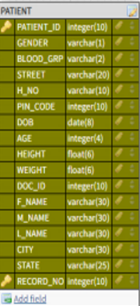
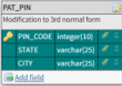
3rd NF:
• Transitive dependency: Except for employee and patient relations, there is no relation where there is a functional dependency between two non-prime attributes. I.e. only employee and patient relations are transitively dependent.
So, all relations except employee and patient are in 3rd NF. In employee and patient relations, we have a FD pin_code->(state, city). Since pin_code is not a primary key in those relations but it determines state , city due which it is not in 3rd NF. To convert it into 3rd normal form, we are creating a relation with pin_code as primary key and state and city as the other two attributes. In the main table we referenced pin_code attribute to the pin_ code from this table. Hence, the relational schema is in now 3rd NF.
After 3rd NF
pin code determines state and city => transitive dependency

Slide 13
BCNF:
Here, after converting the schema into 3rd NF there are no relations with functional dependencies without their left hand side being a super key(i.e., after all 3 NFs all the functional dependencies only have super keys as determinants). So, the relational schema is in BCNF.

Slide 14
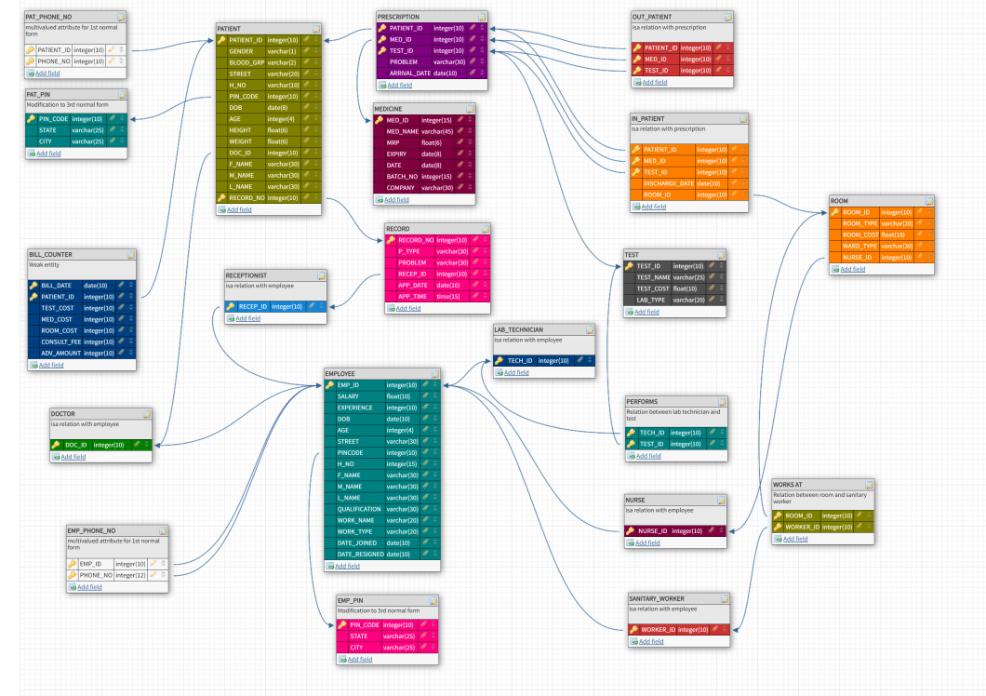
AFTER ALL NFs
https://app.dbdesigner.net/

Slide 15

FUNCTIONAL DEPENDENCIES
Patient:
patient_id → (gender, blood_grp, street, h_no, pincode, dob, age, height, weight, doc_id, f_name, m_name, l_name)
record_id → ( gender, blood_grp, street, h_no, pincode, dob, age, height, weight, doc_id, f_name, m_name, l_name)
pincode → (state, city)
Prescription:
(patient_id, med_id, test_id) → (problem, arrival_date)
Medicine:
med_id → (med_name, mrp, expiry, mfg_date, batch_no, company)
Record:
record_no → (p_type, problem, recep_id, app_date, app_time)
Test:
test_id → (test_name, test_cost, lab_type)
Bill_counter:
(bill_date, patient_id) → (test_cost, med_cost, room_cost, consult_fee, adv_amount)
Employee:
emp_id → (salary, experience, dob, age, street, pincode, h_no, f_name, m_name, l_naem, qualification, work_name, work_type, date_joined, date_resigned)
pincode → (state, city)

Slide 16
Room:
room_id → (room_type, room_cost, ward_type, nurse_id)
Works at:
PK=(room_id, worker_id)
Performs:
PK=(tech_id, test_id)
Doctor:
PK=doc_id
Receptionist:
PK=recep_id
Nurse:
PK=nurse_id
Sanitary_worker:
PK=worker_id
In_patient:
(patient_id, med_id, test_id)->(discharge_date, room_id)
Out_patient:
PK=(patient_id, med_id, test_id)
**NOTE: rest all tables in the schema diagram are multivalued attributes represented as tables (1st NF)*****

Slide 17



Team Members :
1. Maddisetty Venkatasai
2. Kandukuri Sree Hari Reddy
3. Kota Shanth Kumar
Team Members :
1. Maddisetty Venkatasai
2. Kandukuri Sree Hari Reddy
3. Kota Shanth Kumar

