Slide 1

Simple Mathematics Calculator

Slide 2
Agenda
Objective
Tools Used
Pre-processing
Data Visualization
Dataset
Flowchart
Our Model
Model in Action
Challenges faced
Conclusion
References

Slide 3
Objectives
To implement a Simple Mathematics Calculator using Deep Learning techniques.
To detect handwritten mathematical expressions and evaluating them.
Static images to be used for training, testing and demonstration.
The trained model shall be able to perform accurately.
Projection of this model could be an assistance.

Slide 4





Tools Used

Slide 5
Pre-Processing
ImageDataGenerator.
Converting raw image data to 64x64 greyscaled image.
Data visualization.
Imbalance in data.

Slide 6
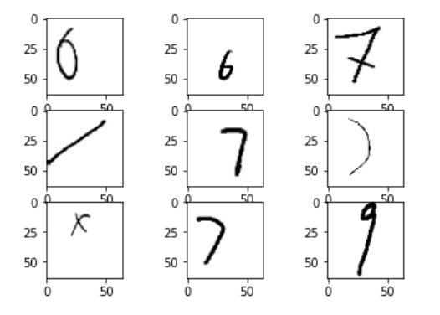
Data Visualization
Visualizing some of the raw inputted images

Slide 7
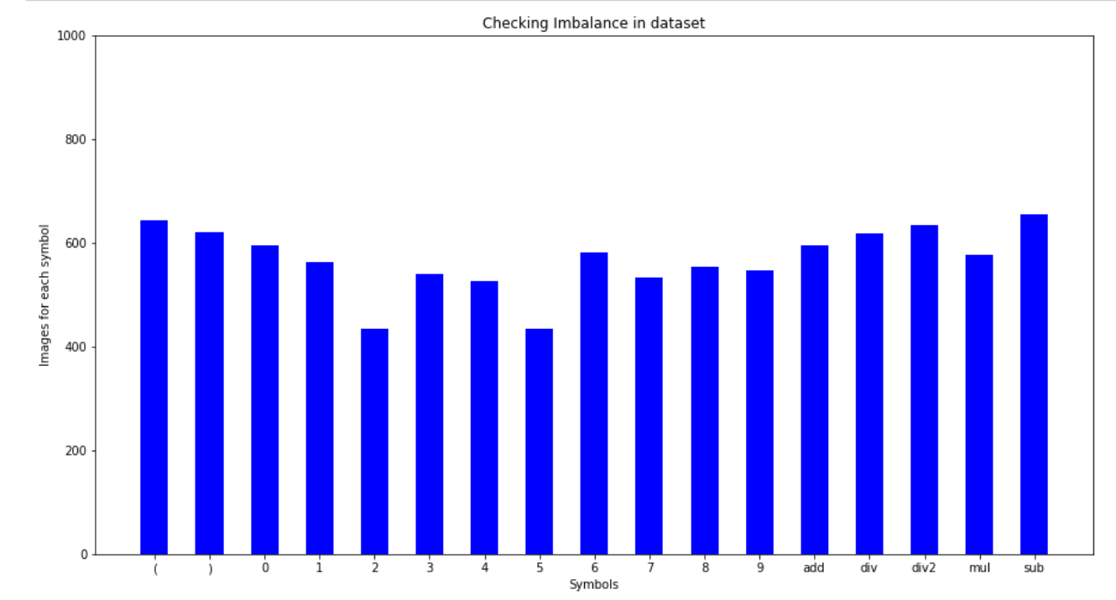
Dataset
Numbers
Operators
Parentheses

Slide 8

Flowchart
Raw Data
Data Visualization
Pre-processing
Data Feed
Contour Detection
Evaluation
Prediction
Model
Result

Slide 9
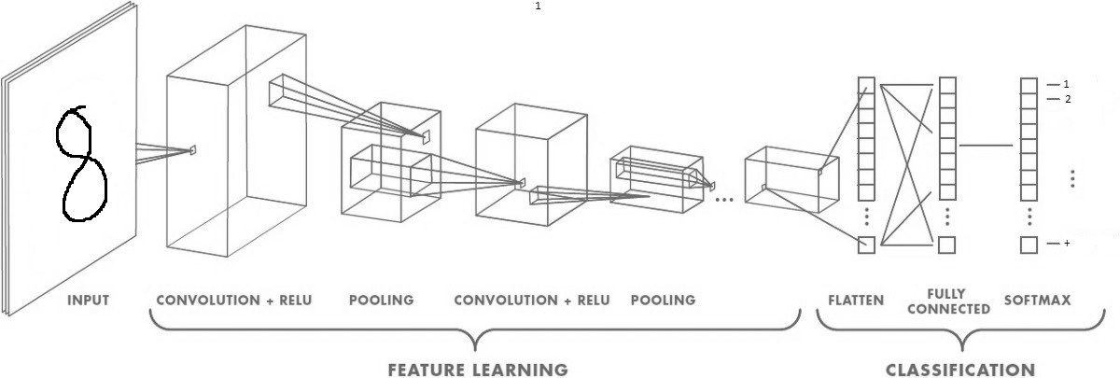
Our Model

Slide 10
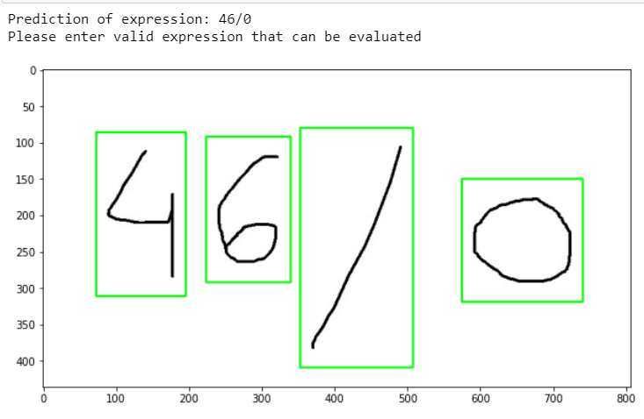
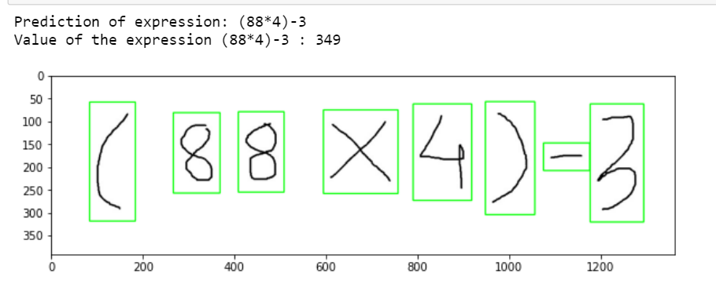
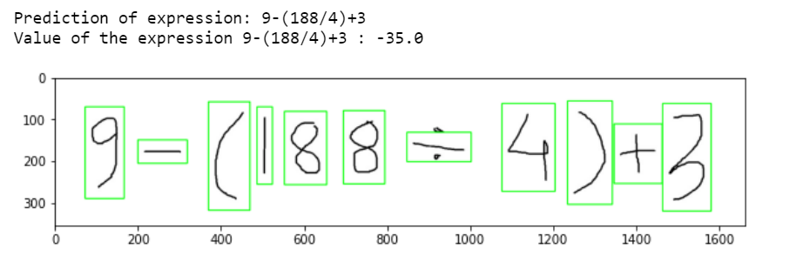
Model in Action

Slide 11
Challenges faced
No Optimal Dataset.
Missing division signs.
Non-uniform intensity in dataset(thickness)
Created dataset from foundation.
Contours boxes were not able to pickup the formal division symbol.
Increased the height of contour box.

Slide 12
Conclusion
The workings of the Complex Neural-networks has been acknowledged and gained practical knowledge
This simple mathematical expression calculator would be projected to include higher degree of evaluation
Deep-Learning has the potential to achieve this future projection.

Slide 13
References
A. Géron, Hands-On Machine Learning with Scikit-Learn, Keras, and TensorFlow: Concepts, Tools, and Techniques to Build Intelligent Systems. O’Reilly Media, Inc., 2019.
‘ML Practicum: Image Classification | Machine Learning Practica’, 2020. https://developers.google.com/machine-learning/practica/image-classification
Introduction to CNN Keras — 0.997 (top 6%)’. https://kaggle.com/yassineghouzam/introduction-to-cnn-keras-0-997-top-6
M. D. Learning, ‘MIT Deep Learning 6.S191’, MIT Deep Learning 6.S191.
www.introtodeeplearning.com

Slide 14
Thank you

