Slide 1
Courseera Capstone
Battle of Neighborhood

Slide 2
Business Problem
Location of the shopping mall is one of the most important decisions that will
determine whether the mall will be a success or a failure
Objective: To analyse and select the best locations in the city of Chennai,
Tamilnadu to open a new shopping mall
This project is timely as the city is currently suffering from oversupply of shopping
malls
Business question
In the city of Chennai if a property developer is looking to open a new shopping mall, where would you recommend that they open it?

Slide 3
Data
Data required
List of neighbourhoods in Chennai
Latitude and longitude coordinates of the neighbourhoods
Venue data, particularly data related to shopping malls
Sources of data
Wikipedia page for neighbourhoods
(https://en.wikipedia.org/wiki/Category:Suburbs_of_Chennai)
Geocoder package for latitude and longitude coordinates
Foursquare API for venue data

Slide 4
Methadology
Web scraping Wikipedia page for neighbourhoods list
Get latitude and longitude coordinates using Geocoder
Use Foursquare API to get venue data
Group data by neighbourhood and taking the mean of the frequency of occurrence of each venue category
Filter venue category by Shopping Mall
Perform clustering on the data by using k-means clustering
Visualize the clusters in a map using Folium

Slide 5
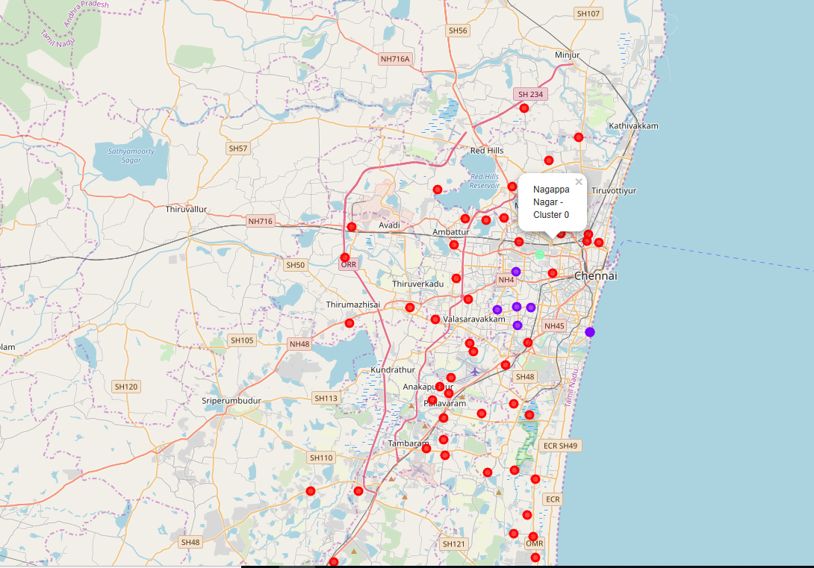
Results
Categorized the neighbourhoods
into 3 clusters :
➢Cluster 0: Neighbourhoods with
moderate number of shopping
malls
➢Cluster 1: Neighbourhoods with high
number
➢Cluster 2: Neighbourhoods with
low concentration of shopping
malls

Slide 6
Discussion
Most of the shopping malls are concentrated in the central area of the city
• Highest number in cluster 1 and moderate number in cluster 0
• Cluster 2 has very low number to no shopping mall in the neighbourhoods
• Oversupply of shopping malls mostly happened in the central area of the city, with the suburb area still have very few shopping malls

Slide 7
Recommendations
Open new shopping malls in neighbourhoods in cluster 2 with little to no
competition
• Can also open in neighbourhoods in cluster 0 with moderate competition if have
unique selling propositions to stand out from the competition
• Avoid neighbourhoods in cluster 1, already high concentration of shopping malls
and intense competition

Slide 8
Conclusions
Answer to business question:
The neighbourhoods in cluster 1 are the most preferred locations to open a new shopping mall
• Findings of this project will help the relevant stakeholders to capitalize on the
opportunities on high potential locations while avoiding overcrowded areas in
their decisions to open a new shopping mall

