Slide 1
CAPITA SELECTA
T.Mishra
S.V.Sridhar Eswari
K.K.B.N.V.V. Tummalapalli
V.P. Narayanaswamy Selvakumar Amudha
S. Anita Shanmugalingham
P.V. Narayanan

Slide 2
Course Introduction to 2IMP05
Essence of MBSE.
Practical: Arduino Setup
Testing
Project Management: AGILE/SCRUM
Introduction to GIT
C++, IBM Rhapsody

Slide 3
Arduino Setup
Expected deliverable.
Arduino essentials :
Hardware setup
Arduino language semantics
Types of Sensors.
Sample codes.
Final code generation

Slide 4
CVS GIT
Git essentials
GIT GUI and GIT Bash
Basics of Version Control
GitHUB Desktop (Baby version)
Repository link(Public repository) – Captiaselecta_alpha1
https://github.com/saivignesh-s-e/Captiaselecta_alpha1

Slide 5
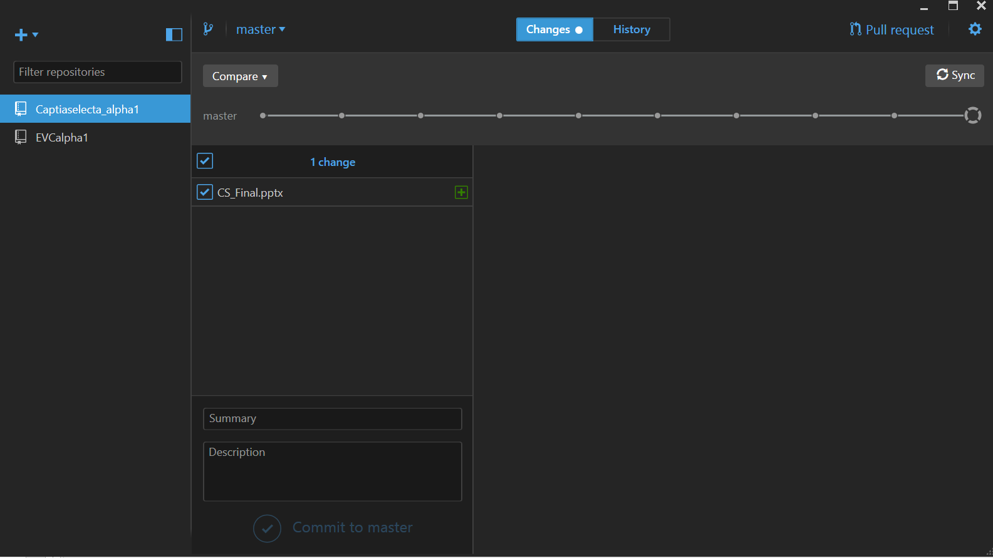
Git Desktop (Baby software View)
A small sample to view changes, summary, description, sync and pull request

Slide 6
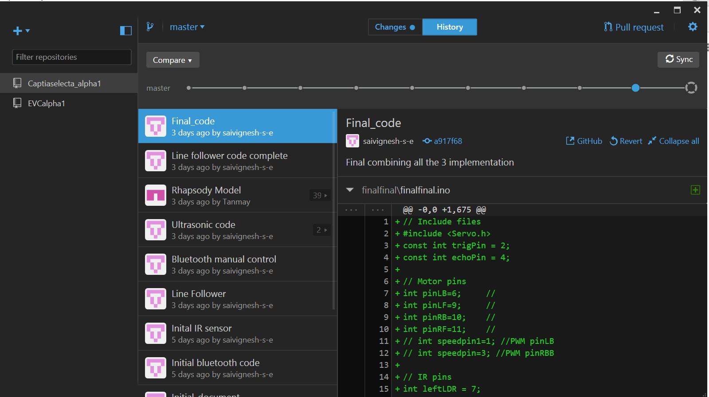
Git History
History of changes including the changes and description.

Slide 7
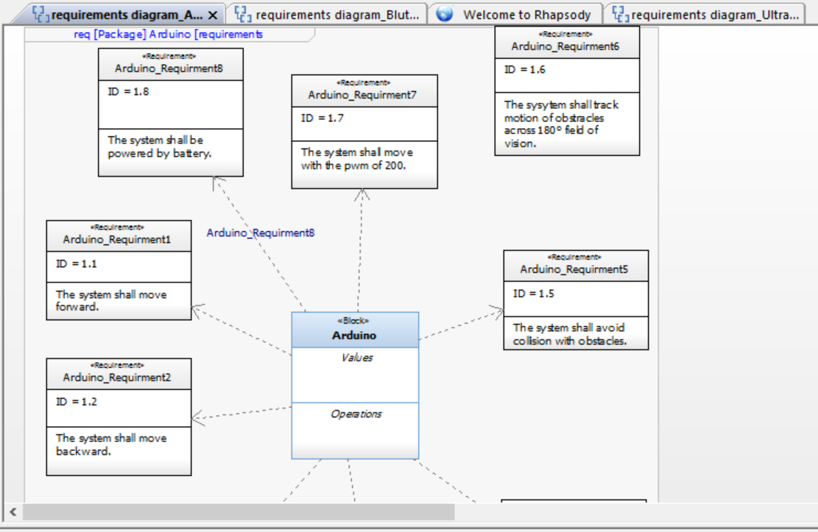
Requirement diagram
A Simple view is shown
Requirement diagram

Slide 8
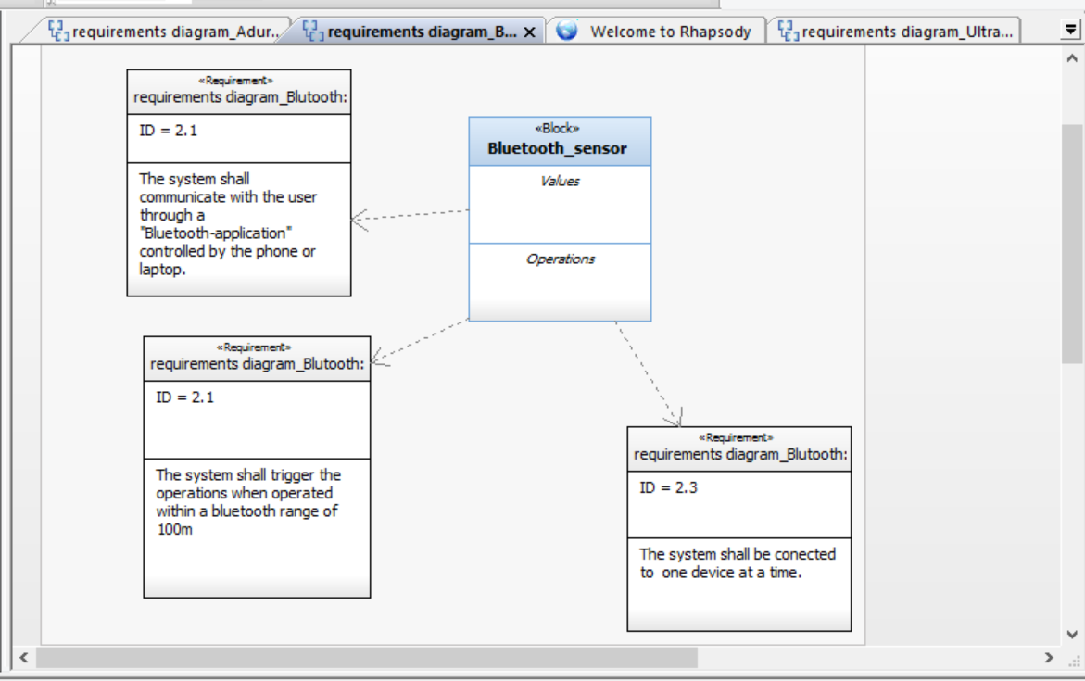
Requirement diagram

Slide 9
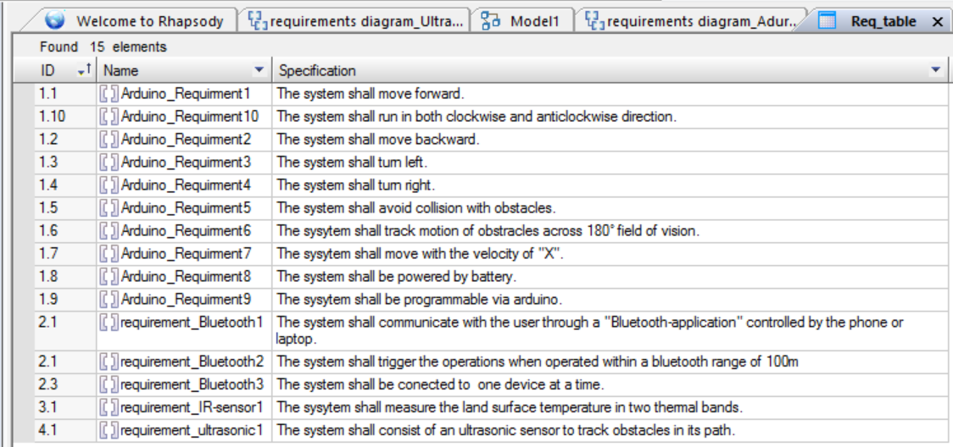
Requirement Table

Slide 10
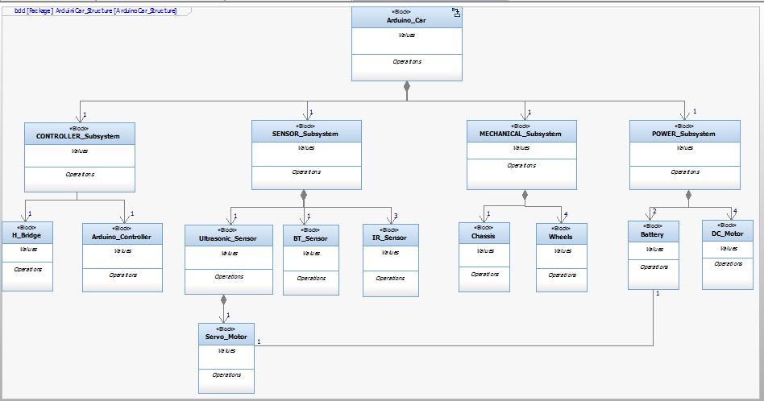
SysML

Slide 11
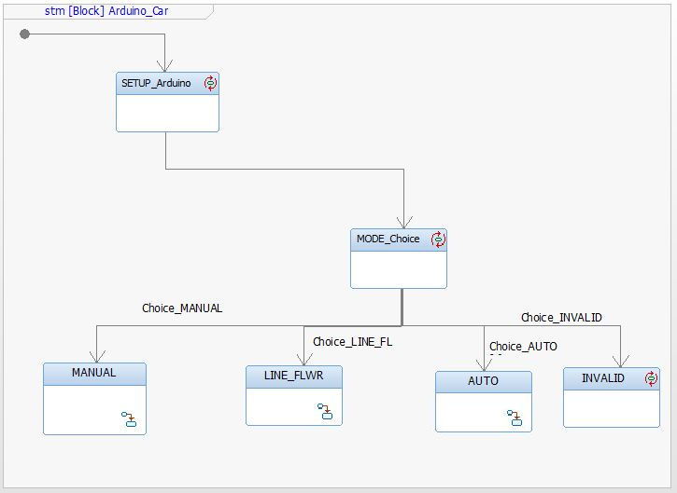

Slide 12
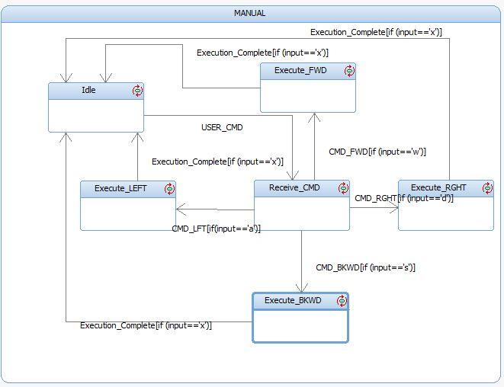

Slide 13
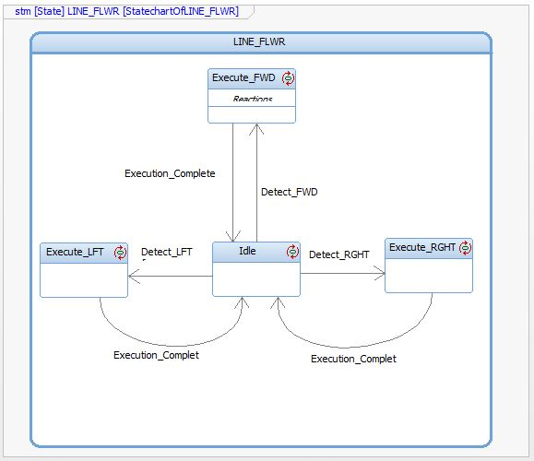

Slide 14
Challenges
Purpose of the BOT
Working Around Sensors
SYSML-Arduino Integration (!!)

Slide 15
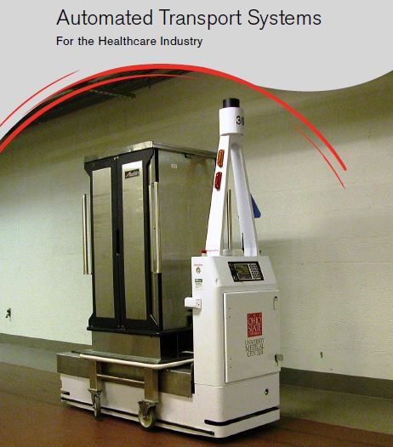
FUTURE PROSPECTS

Slide 16
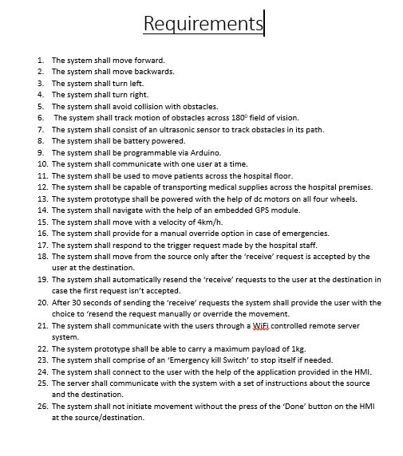

Slide 17
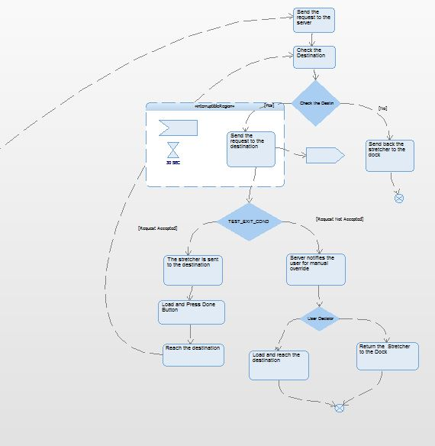
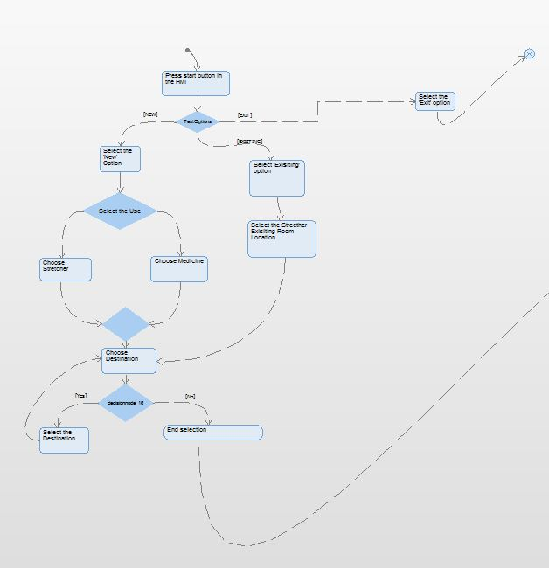

Slide 18
THANK YOU

