Slide 1

Northeastern University
Team Members
Saivignesh Sridhar – NU ID 001547227
Vignesh Haribalakrishnan – NU ID 001569768
Gowtham Raghuraman – NU ID 001529954

Slide 2
Northeastern University
Introduction :
It is very important for universities to be aware of the quality of education provided by them. A performance measurement solution is created using software engineering techniques that enables universities to measure the quality of the education they deliver to their students. The feedback from the alumni and students are taken into account to determine the factors like faculty and courses in the educational system that contributed to their growth over a 5-year span.

Slide 3
Northeastern University
Digital Ideas for K-12 Systems in Developing Countries
Intuitiveness of technology in Students and Faculty
Sufficient time span to learn to “drive the vehicle” – avoids hurdles and improves learning curve
“Fresh Perspective” – exploring newer trends and on the latest topics – Informational topics on student’s desire to learn
Gamify the learning experience – rewards – instills and improves passion for technology in students
Major Factors to be addressed:
Technology self efficacy
Teaching self efficacy
Pedagogical Practices
Professional Development
A software should not become a focus of learning or a hurdle that it impedes the original learning goals.

Slide 4
Northeastern University
Additional Suggestions
Professional Development
Adding Uniqueness to the individual
Coursework from student’s point of view
Bottom-up approach instead of top-down hierarchy in education
Addition of subjective elements in the education system which are tangible.
Technology Efficacy
Input from Employers – Correlations in their top employees’ GPA and relevant coursework.
Keeping courses fresh and aligned to the industry standards
Teaching Efficacy
Reviewing Faculty Rating
Research output/publications relevant to the courses taught
Reviewing the h-index of the faculty and their overall contribution in that field.
h-index – academic influence in the faculty’s respective field of research and at large.

Slide 5
Northeastern University
academia
credibility
Education System as a “broker” between Students and Employers
Student
University
Employers
knowledge
reputation
Excellent broker by providing “Secure Exchange”.
Employers INVEST in University for Employees – investing based on reputation.
Research value identified in students and scholars.
Reliable resources – temporary and permanent at the time of need.
Credibility of state-of-the-art education and career growth.
Credibility in identifying value in the alumni
Credibility from previous workforce and from hiring experiences
Credibility in the trust bonding developed between Employers and University
Credibility is currency!

Slide 6
Northeastern University
Suggestions in framing a Ranking System
Encouraging International Students Mobility directly increases the consumer demand for Information – highly valuable to stakeholders
Direct Impacts
Increase in Average GPA in various departments of University
Increase in reliable employers having a bond with University
Increase in research output (h-index) and paper publications
Indirect Impacts
Increase in number of students from abroad
Increase in number of grants, funding by the Government

Slide 7
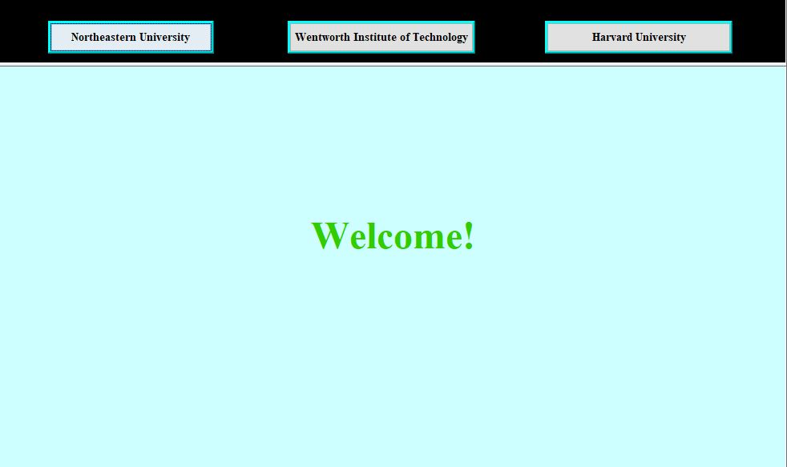
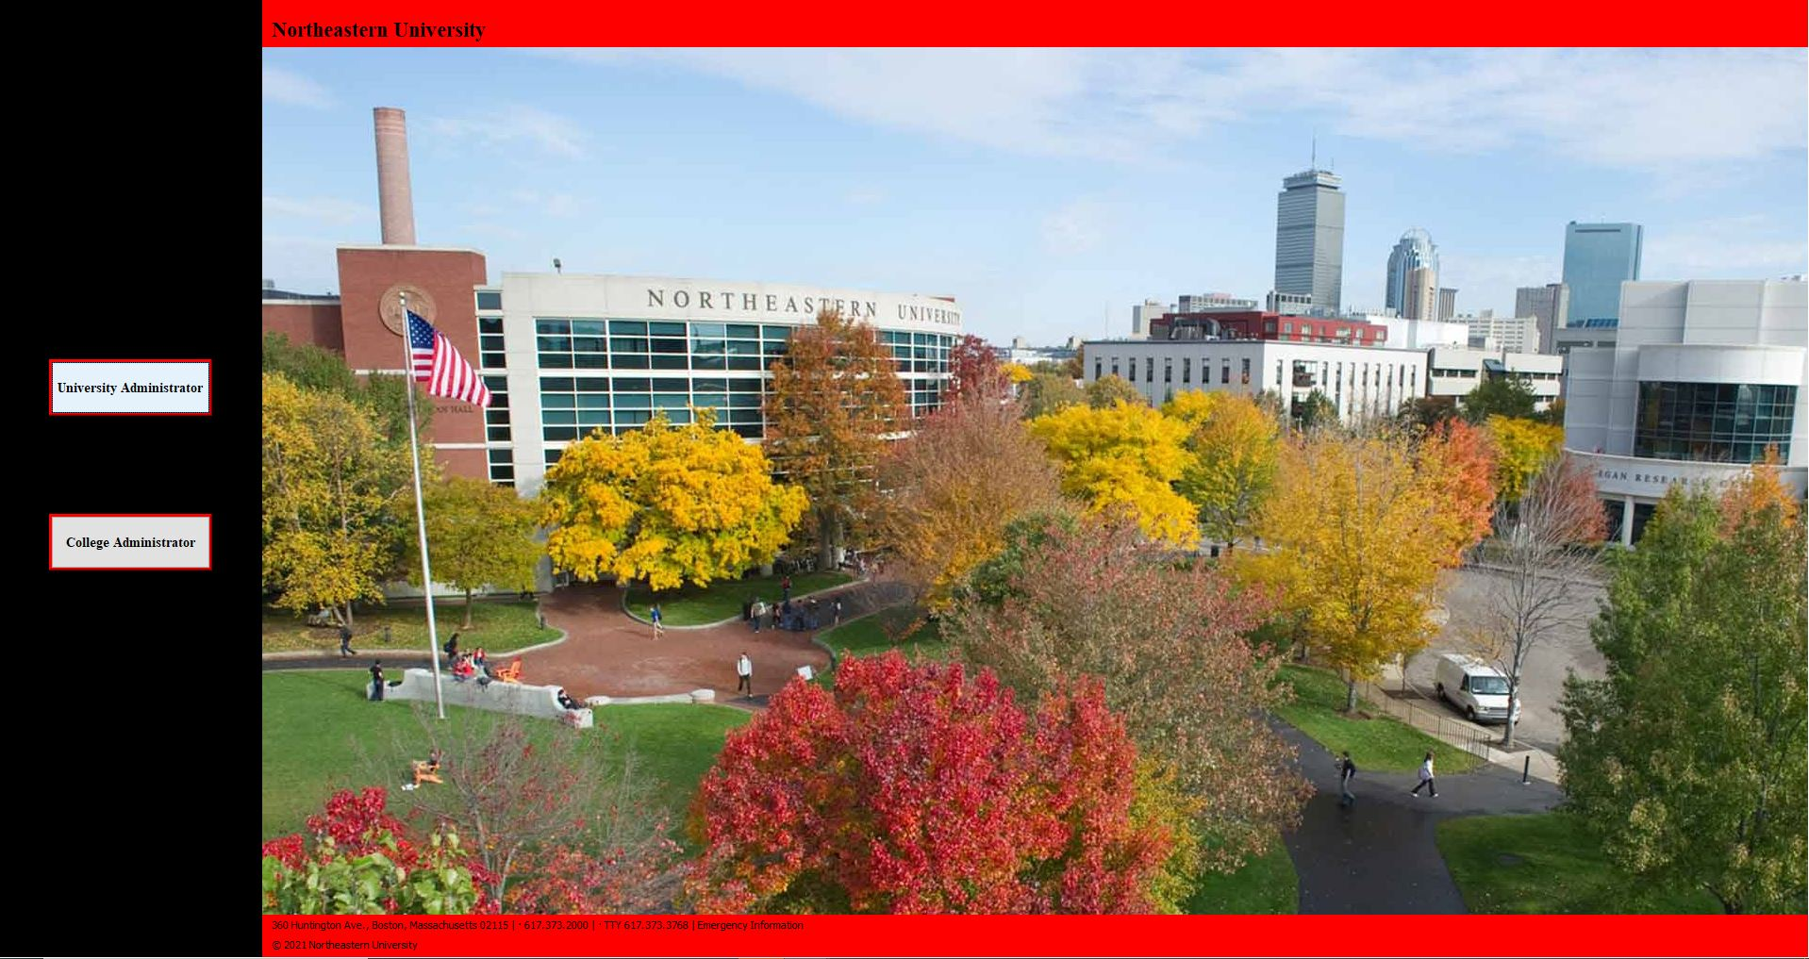
Northeastern University
Login Page :

Slide 8
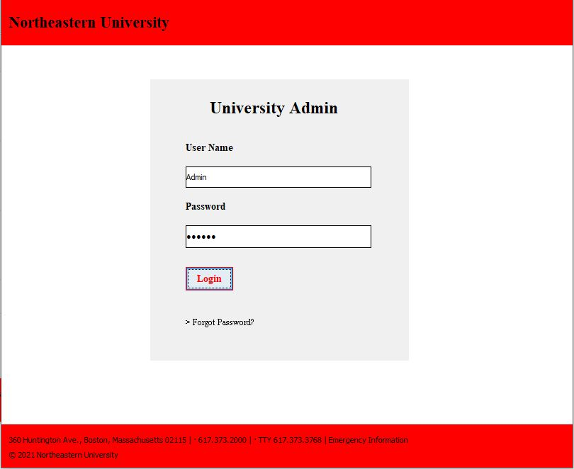
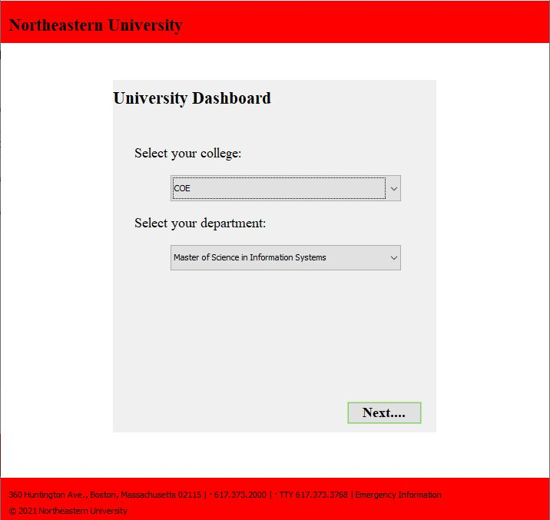
Northeastern University
Login Page :

Slide 9
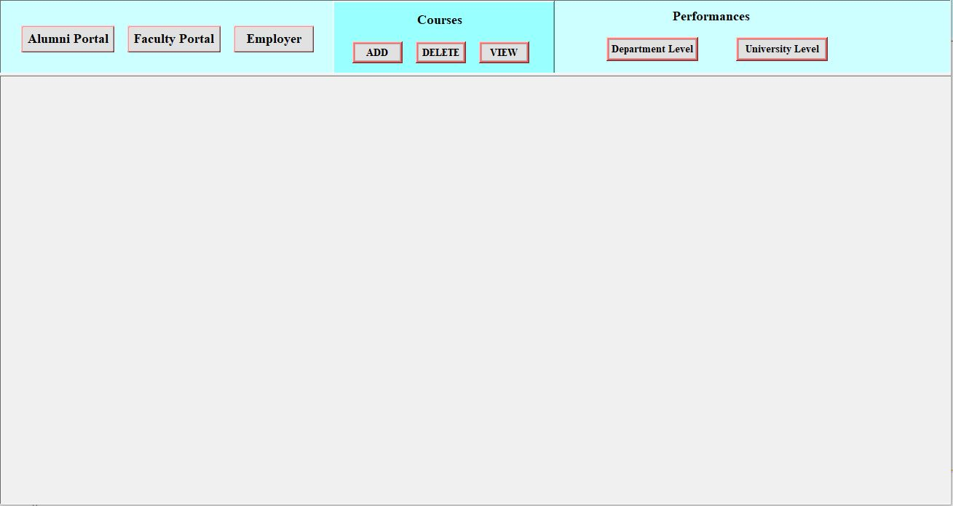
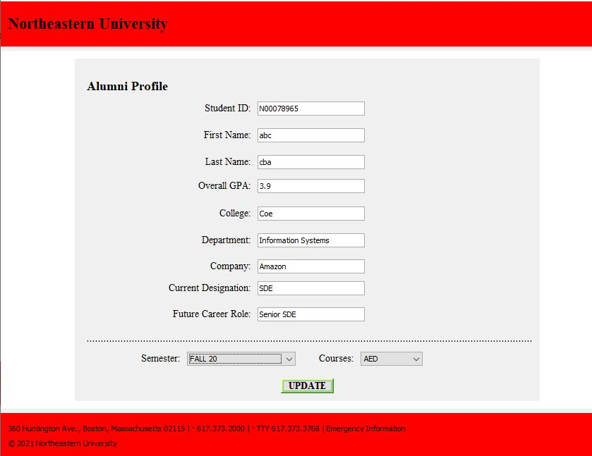
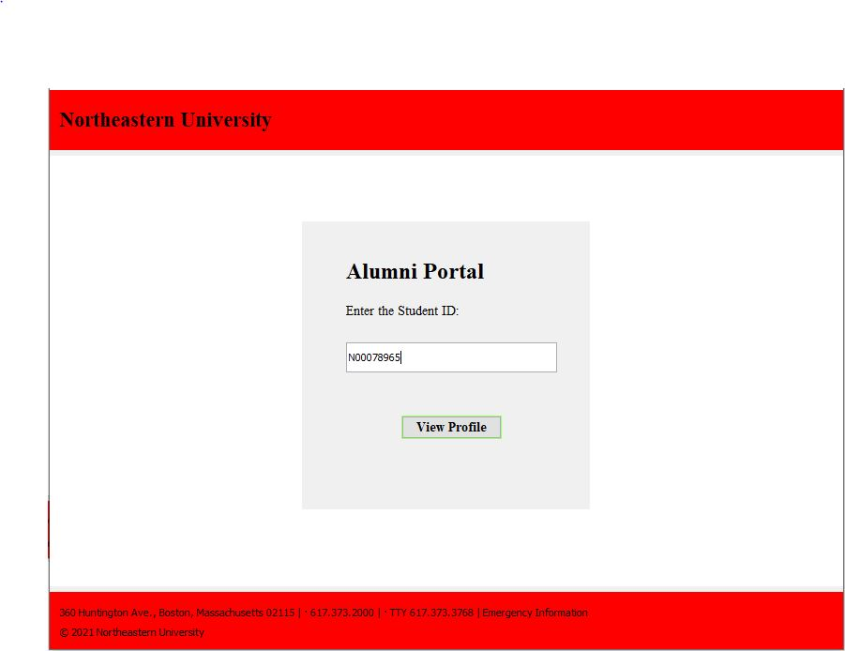
Northeastern University

Slide 10
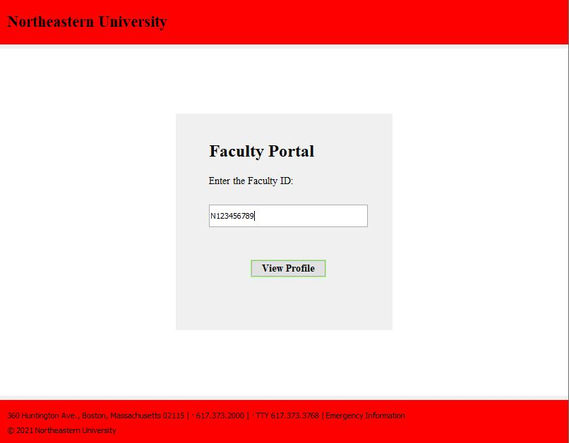
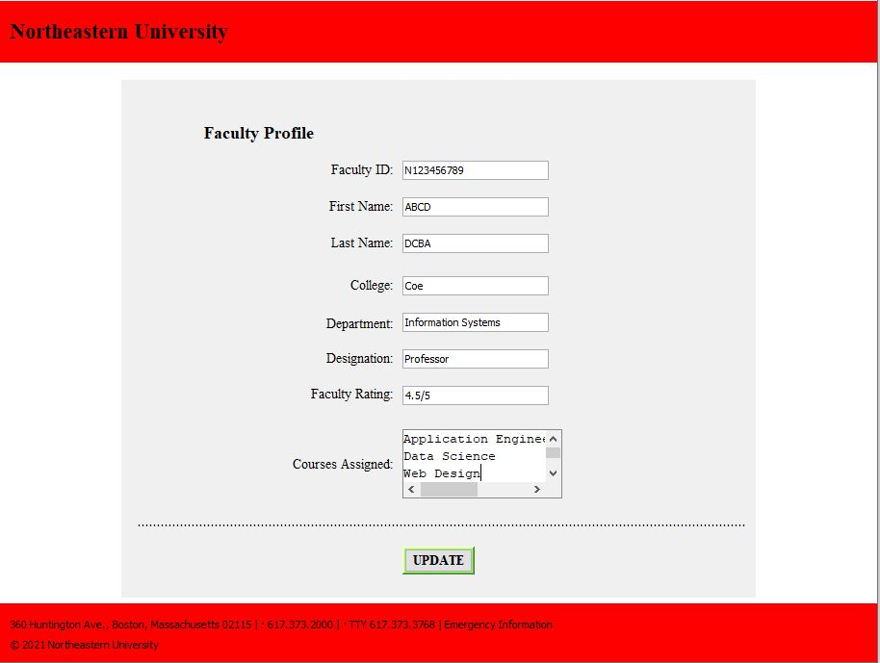
Northeastern University
Faculty Directory :

Slide 11
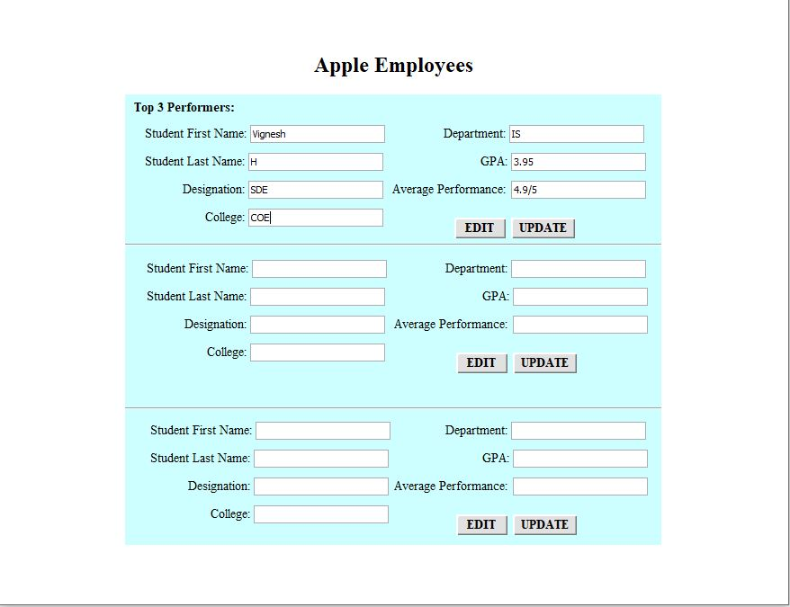
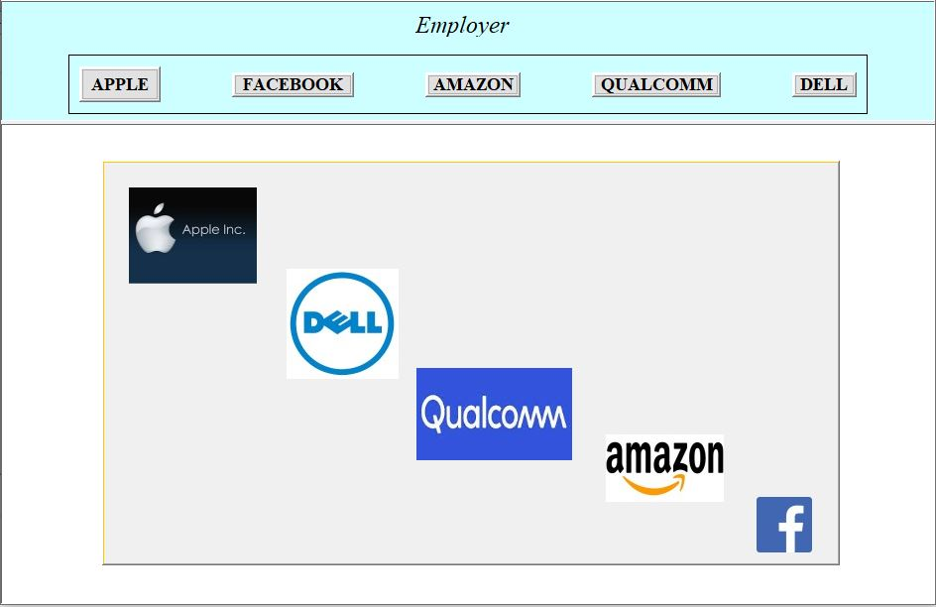
Northeastern University
Employer Directory:

Slide 12
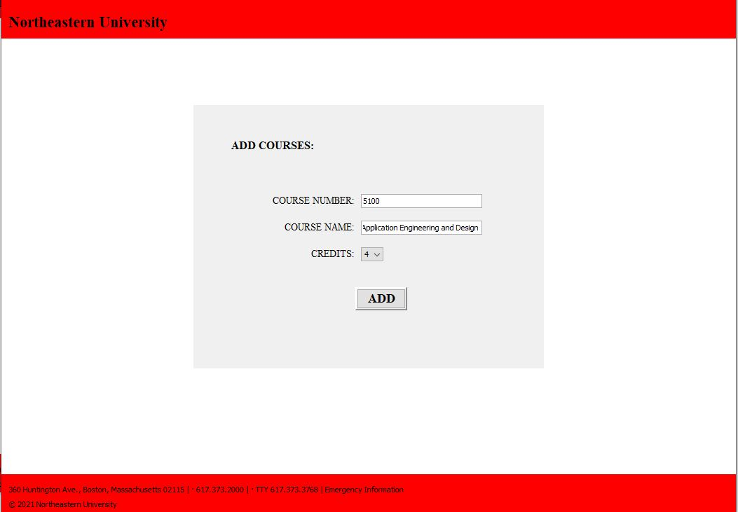
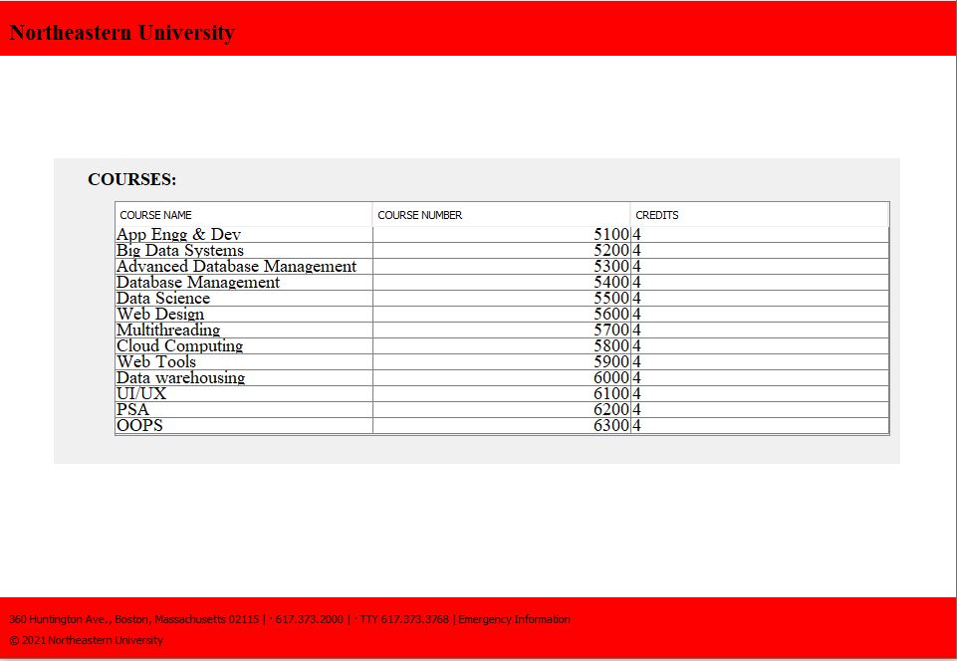
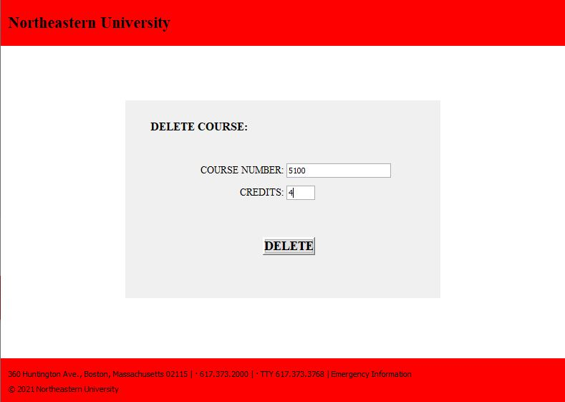
Northeastern University
Department Course Catalog:

Slide 13
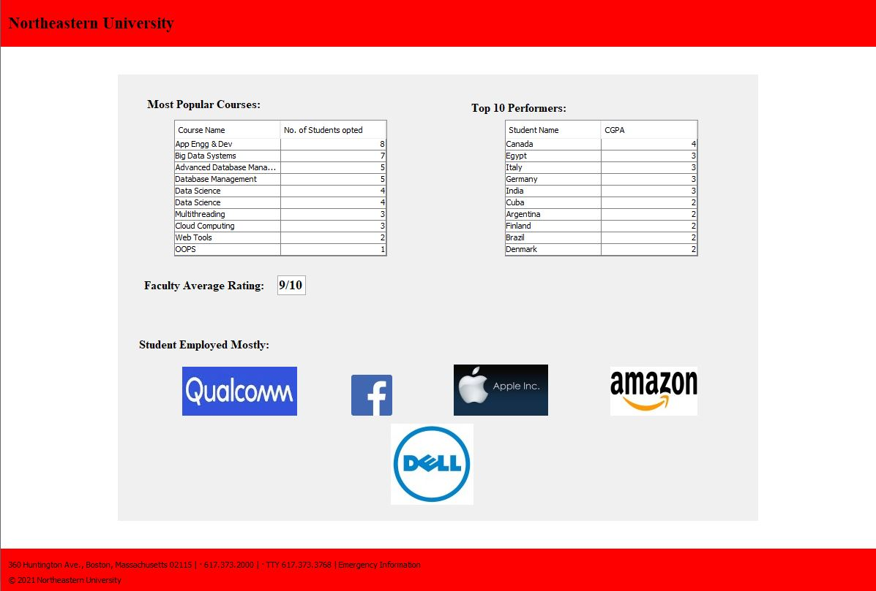
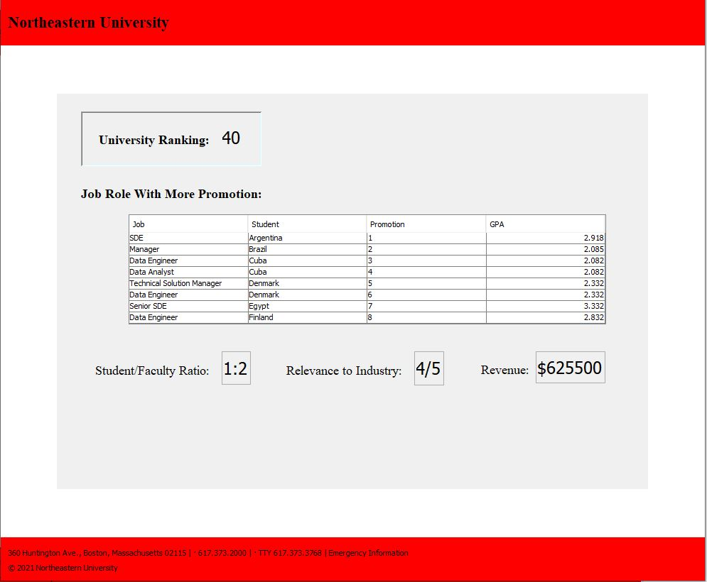
Northeastern University
Employer Directory:

Slide 14
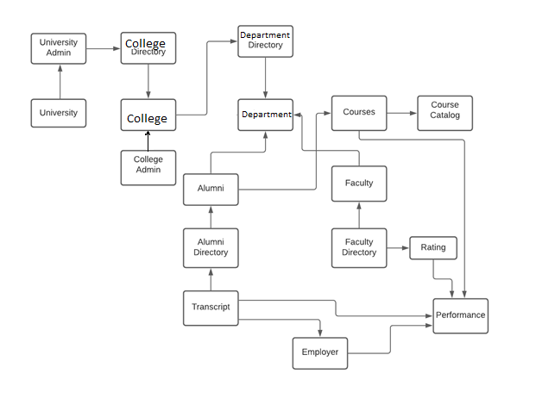
Northeastern University
Object Model

Slide 15
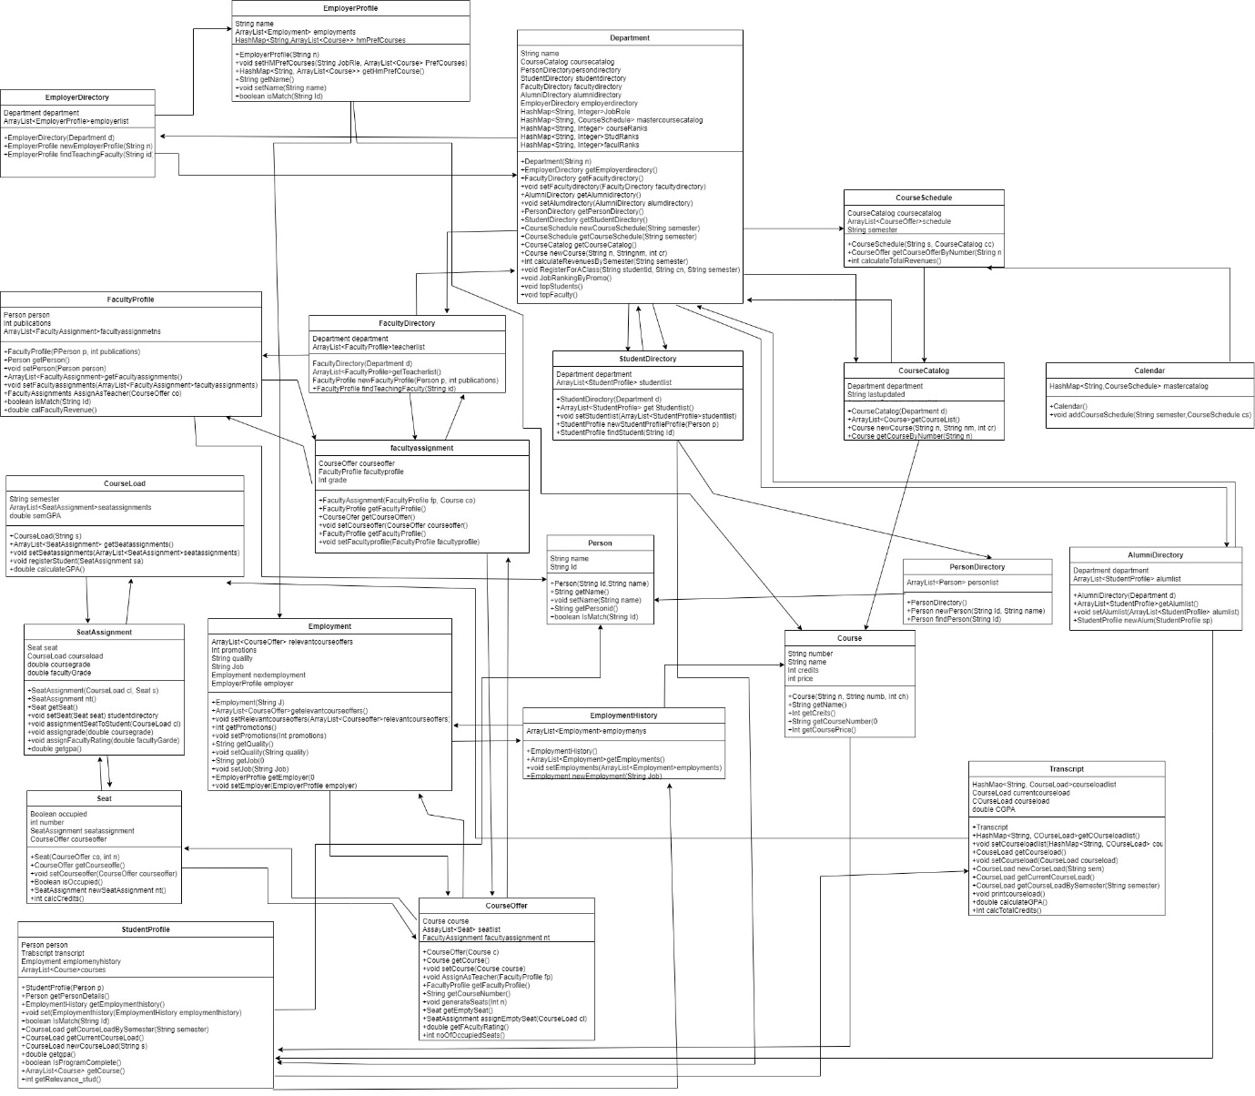
Northeastern University
Class Diagram

Slide 16
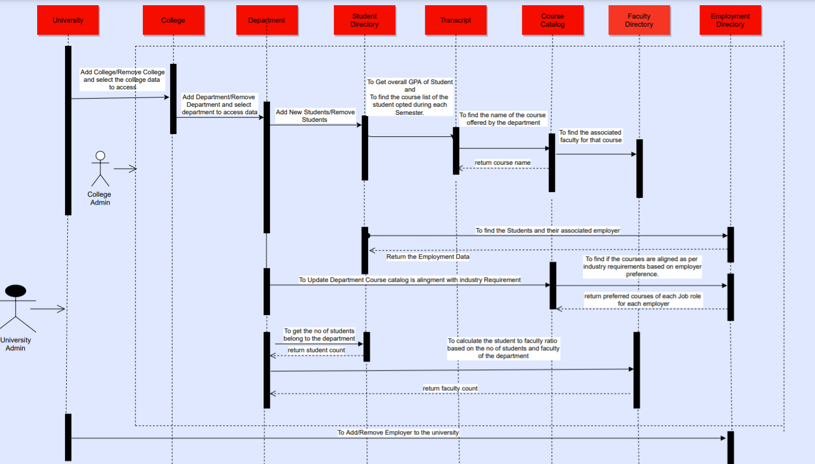
Northeastern University

Slide 17
Northeastern University
Performance Metrices :
This Metrics will evaluate the student to faculty ratio to add additional faculty.

Slide 18
Northeastern University
SDE (5)
Web Developer (3)
Data Engineer (2)
Performance Metrics: This Metrics will analyze the students who got Hired soon after graduation to
Figure the job roles that the Alumni exists.
Job roles Students got Hired from Information System Department

Slide 19
Northeastern University
Performance Metrics:
Metrics created to analyze the revenue of each department for each semester for the same Course Period.

Slide 20
Northeastern University
Department Metrices: To Figure out the course catalog of the department is aligned with the Industry expectation to Add/Remove any courses to its catalog.
By doing this we’re evaluating the department course relevance %
With Market Trends.

Slide 21
Northeastern University
Performance Metrics:
This metrics are created to evaluate the faculty based on each course offering to figure the top faculty to open more number of seat assignments during upcoming semester.

Slide 22
Northeastern University
Performance Metrics:
This Metrics are created to analyze the popular courses that the students selected based on the seat assignment of each course offering.

