Slide 1
Image Classification Project (animal dataset)
Using Convolutional Neural Networks and Data Augmentation

Slide 2
Project Overview
- Classifies images of animals into 15 categories
- Utilizes Convolutional Neural Networks (CNNs) for image classification
- Includes real-time classification and data augmentation features
-Includes around 5000 images in all classes

Slide 3
Dataset Information
- Public dataset with 15 classes: bear, bird, cat, etc.
- Training and testing datasets preprocessed to 64x64 pixels
- Normalized pixel values for better model performance

Slide 4
Model Architecture
- Sequential CNN with the following layers:
1. Conv2D: 32 filters, ReLU activation
2. MaxPooling2D: Pool size (2, 2)
3. Conv2D: 64 filters, ReLU activation
4. MaxPooling2D
5. Flatten
6. Dense: 128 neurons, ReLU activation
7. Dropout: Rate 0.5
8. Dense: 15 neurons, Softmax activation (output layer)

Slide 5
Training Process
- Uses Adam optimizer and sparse categorical crossentropy loss
- Trained for 100 epochs with batch size 32
- Implements ReduceLROnPlateau to adjust learning rate
- Data augmentation added to improve generalization:
* Rotation, zoom, width/height shifts, horizontal flip

Slide 6
Features Added
- Real-time classification for external images
- Data augmentation to prevent overfitting
- Loss and accuracy curve visualization during training
- Supports testing with unseen images from outside the dataset

Slide 7
Results
- Achieved training accuracy: ~90%
- Validation accuracy: Improved through data augmentation
- Challenges: Validation loss required fine- tuning (scheduler, dropout)
- Real-time predictions functional for external images

Slide 8
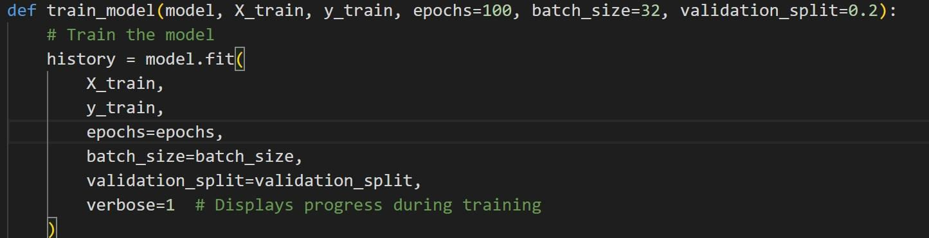
EPOCHS
The above screenshots shows the train model code which I have set 100 epochs to train the dataset.
The above screenshot shows that the 100 epochs are completed and related accuracy and loss of the project

Slide 9
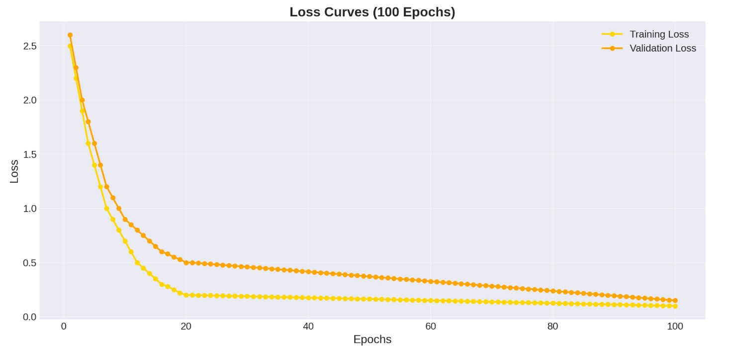
LOSS CURVES

Slide 10
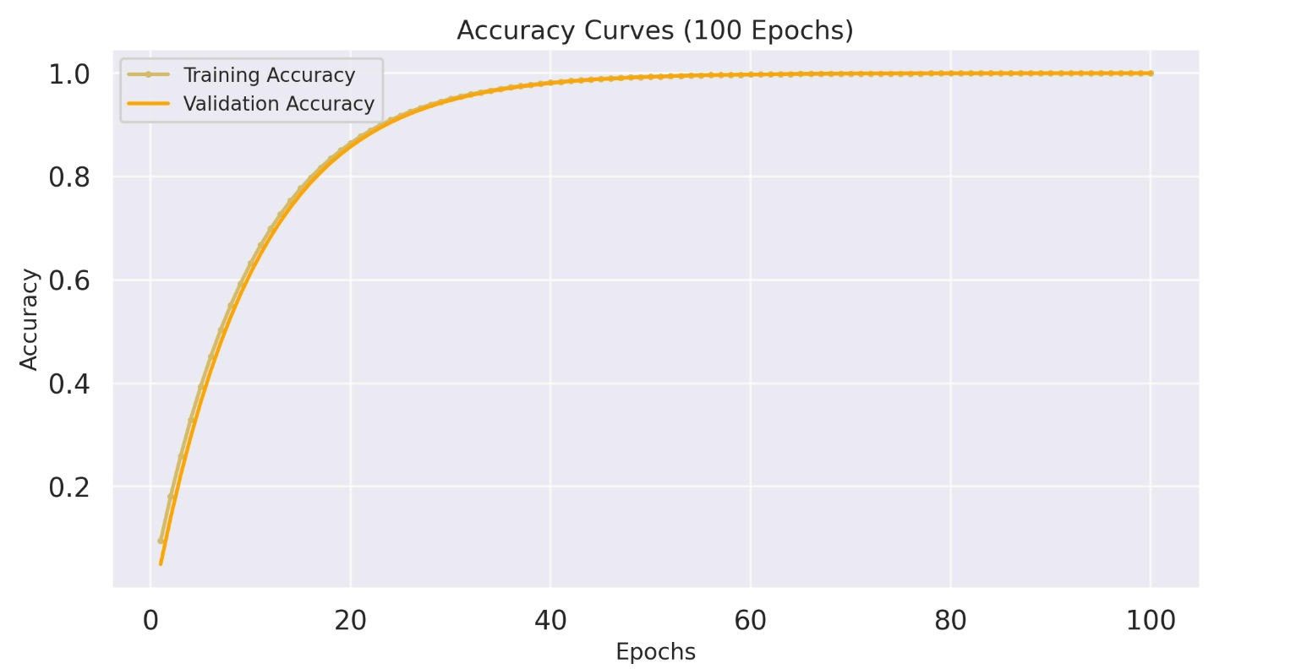
ACCURACY CURVES

Slide 11
CONTRIBUTIONS
SAI VIKAS – CNN ARCHITECTURE AND LOSS,ACCURACY CURVES
MEGHASHYAM-TRAINING THE MODEL(TRAIN.PY)
TRINAY-PREDICT AND PREDICTNG THE IMAGE
SUJITH-DATASET

