Slide 1
Predicting Student Dropout and Academic Success
Fall 2025 - ECIS-690-U Capstone Project
Christian Brothers University
ML-powered Django Web Application
Professor,
Dr. Hari Nair
Student,
Sai Vineeth Reddy Suravi

Slide 2
Problem Statement & Objective
Develop a machine-learning powered web application that flags students likely to drop out, remain enrolled, or graduate (three-class classification). Early detection will enable universities to deploy targeted support and improve retention rates.
Objective: Predict Dropout / Enrolled / Graduate.
Build an ML model + Django app for real-time predictions.

Slide 3

Dataset Description
UCI dataset: 4,424 records, 36 features.
Contains demographic, socio-economic, academic, economic data.
Target: Dropout, Enrolled, Graduate.
Source of the dataset: https://archive.ics.uci.edu/dataset/697/predict+students+dropout+and+academic+success

Slide 4
Technology Stack & Commands
Stack: Python, Scikit-learn, Django, SQLite, Bootstrap.
Django Commands:
startproject,
startapp,
makemigrations, migrate,
runserver,
createsuperuser.

Slide 5
ML Pipeline & Model Selection
Preprocessing, train-test split.
Models: LR, Random Forest, Gradient Boosting, SVC.
Best model: Gradient Boosting (saved as .pkl).

Slide 6
Evaluation Metrics
Accuracy: overall correctness.
Precision (macro): correctness of positives across classes.
Recall (macro): ability to find true instances.
F1 (macro): harmonic mean of precision & recall.

Slide 7
Django Web Application
Pages: Registration, Login, Prediction, Result, History, field information, customized admin
Custom registration with DOB validation.
Two-column prediction form using Bootstrap.
History Page with ML model result

Slide 8
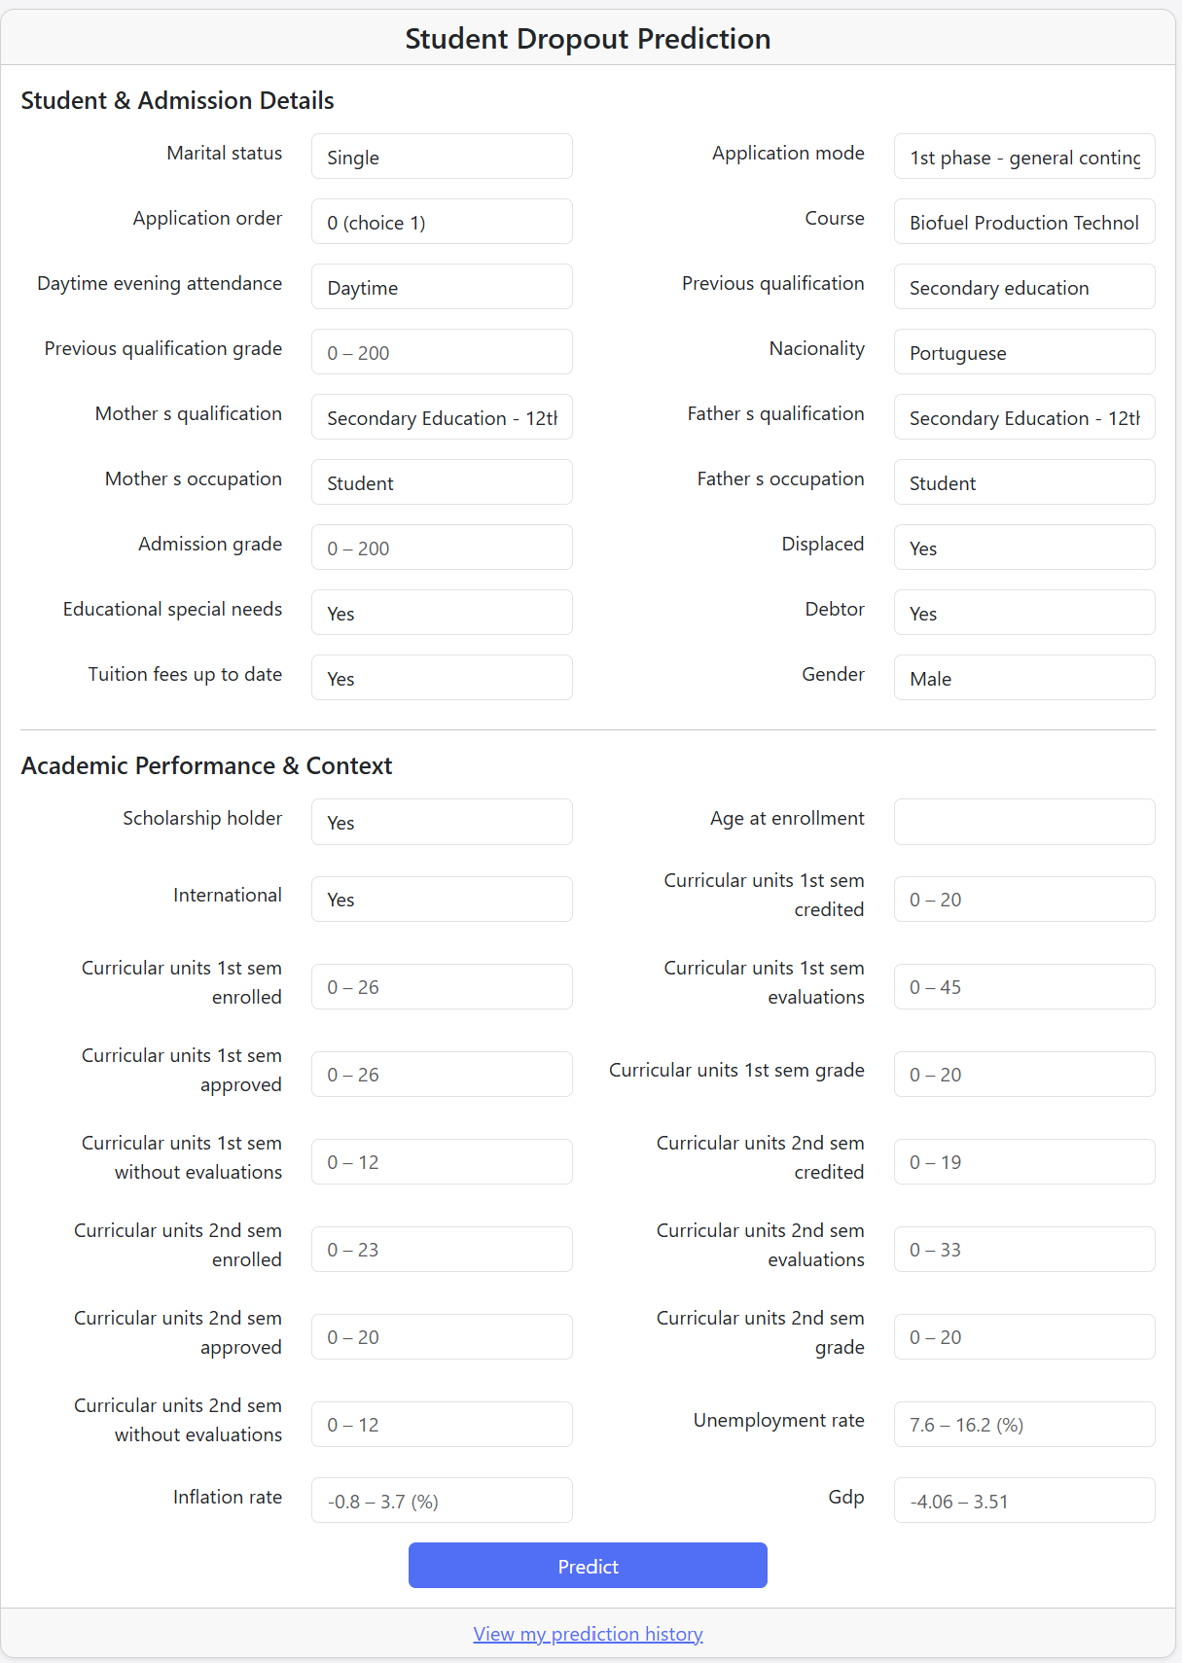
Prediction Form Details
Categorical fields via dropdowns (TypedChoiceField).
Numeric fields with min/max & placeholders.
Aligned two-column layout with Bootstrap.

Slide 9
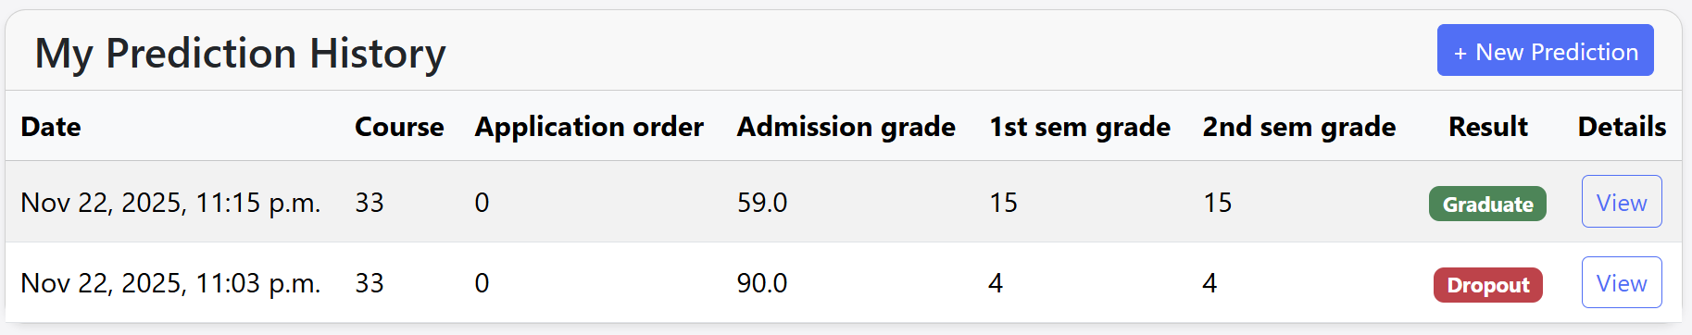
History & Field Info Pages
History table: date, course, grades, result badge.
View details for each prediction.
Static Field Info page describes all dataset fields.

Slide 10
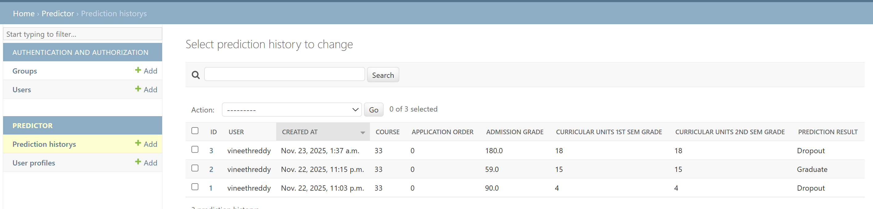
Admin & Backend Management
Custom admin for PredictionHistory.
List filters, search, grouped fieldsets.
Readonly fields: created_at, prediction_result.

Slide 11
Thank You!!

