Slide 1
Decrypting Cipher text using the DFA extracted by RNN and Lstar Algorithm
Group Number 26:
Amruta Katke
Anirudha Nilegoankar
Austin Mathew
Jiangfeng Pian
Piyusha Jaisinghani
Rohit Nikam
Sai Vinherkar

Slide 2
Objective
Decrypting cypher English text which was encrypted by cypher keys using DFA.
Extracting DFA for English alphabet subset.
To extract the DFA we are using L* Algorithm and RNN which is based on the paper “Extracting Automata from Recurrent Neural Networks using Queries and Counterexamples”.

Slide 3
State of the Art
The Cipher are attacked in the present using frequency analysis.
Extracting DFA from RNN by defining a finite partitioning of the real-valued RNN state space. Exploring the network transitions in the partitioned space to done by using techniques such as BFS exploration and other transition-sampling approaches.
State space partitioning is done to extract DFA, it divide each dimension into q equal intervals with q being the quantization level.
4. Using unsupervised classifier such as k-mean to a large sample set of reachable network states.

Slide 4
Limitation of current Practice
Frequency analysis relies on the fact that in any language, one letter in a language is more frequently used than the other. Example Z is less frequent than A.
To attack a ciphered text with frequency analysis a long message is required so that we can get accurate frequencies of letter. And hence would not work for short cipher texts.
In Frequency analysis subject to matter of the text is not considered, for e.g. if some article is related to vowels then the letter W is more frequent in comparison to other letters.
The state space partitioning approach to extract the DFA suffers from inherent state space explosion.
Previous approaches face the challenge of choosing the best parameter value for extraction because the partitioning is set before the extraction begins .

Slide 5
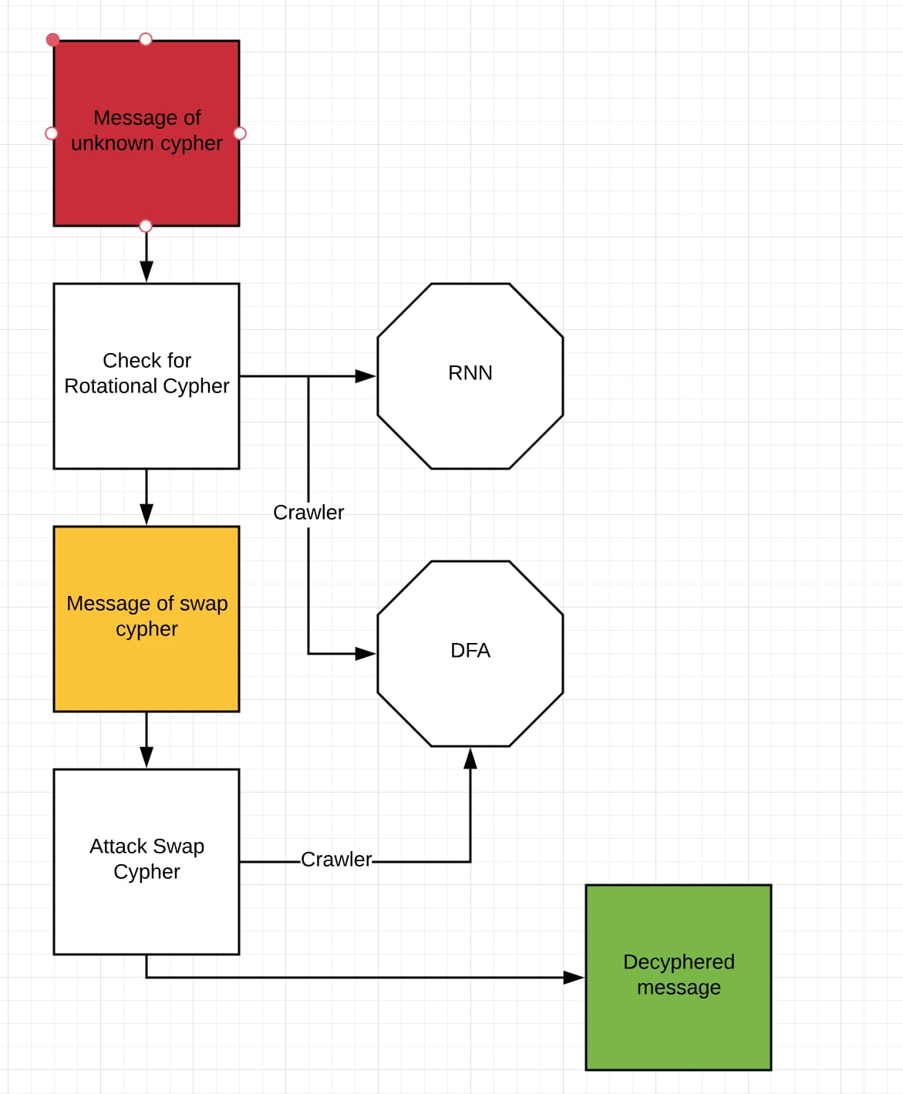
Our Approach
We are using DFA to deciphered the cyphered text.

Slide 6
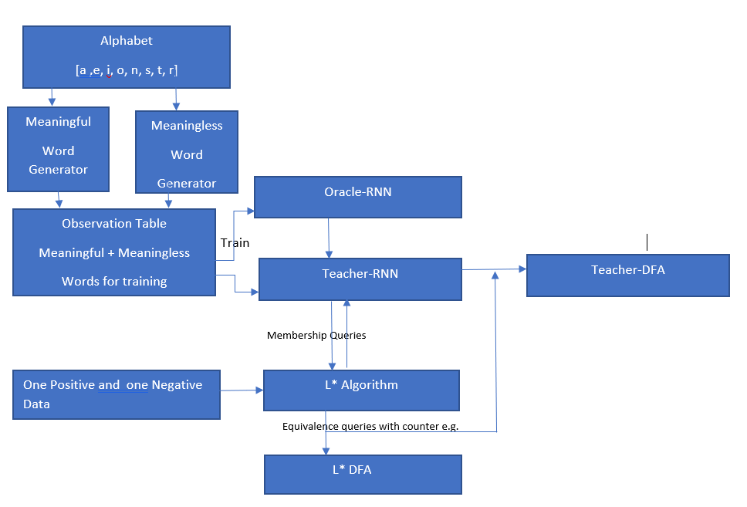
Our Approach
The DFA used to decipher the texts is extracted using L* Algorithm and RNN which is based on the paper “Extracting. Automata from Recurrent Neural Networks using Queries and Counterexamples”.

Slide 7
Applications
Many variants of cyphers are used by military of multiple countries to communicate among each other.
Cyphers are used to encode the messages sent over http protocols.
Application software's using Apache, Tomcat or Microsoft iis as web servers always need a technique to discover week ciphers.

Slide 8
Risks
RNN trained over English alphabet subset sometimes accepts non English words. To make it a more robust teacher for L* we tuned the parameter of RNN to num layers = 3 and hidden layers =15.
Due to the polynomial complexity of L* Algorithm extracting DFA for a complex network like words of English Alphabet set more than 8 takes longer and large DFAs are extracted. We are timing the extraction to 60 seconds and hence the DFAs extracted for an alphabet set greater than 8 have missing edges.
The RNN is trained over a word set of 1032 which is not enough data for the RNN to generalize over the language and our method tries to find adversarial inputs and in result builds a DFA that is large and tries to refine it.

Slide 9
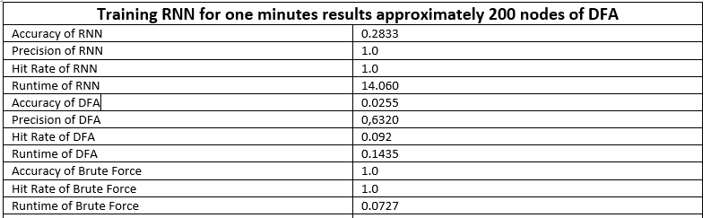
Mid term outcome results
We trained RNN over eights letter alphabet.

Slide 10
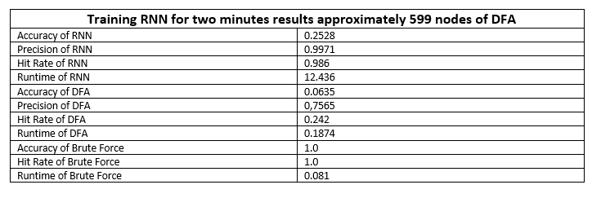
Contd.

Slide 11
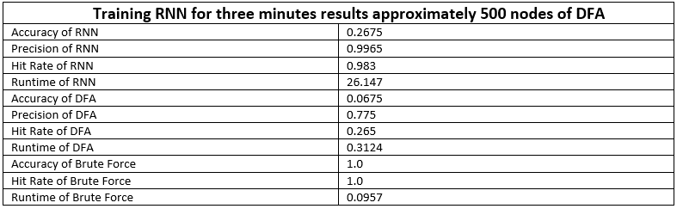
Contd.

Slide 12
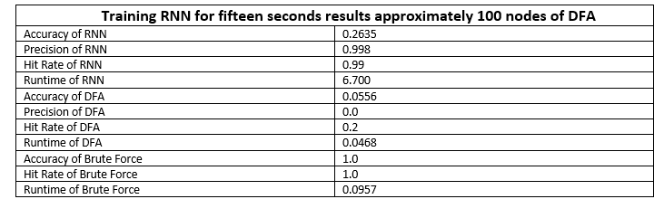
Contd.

Slide 13
Final outcomes

Slide 14
Final outcomes

Slide 15
Final outcomes

Slide 16
Final outcomes

