Slide 1
Fast and efficient Binary Generative Models
Anirudha Nilegaonkar, Sai Vinherkar, Shashanka Venkataramanan
University of Central Florida

Slide 2

[Source: PhD Comics: https://phdcomics.com ]

Slide 3

[Source: PhD Comics: https://phdcomics.com ]

Slide 4

[Source: PhD Comics: https://phdcomics.com ]

Slide 5

[Source: PhD Comics: https://phdcomics.com ]

Slide 6
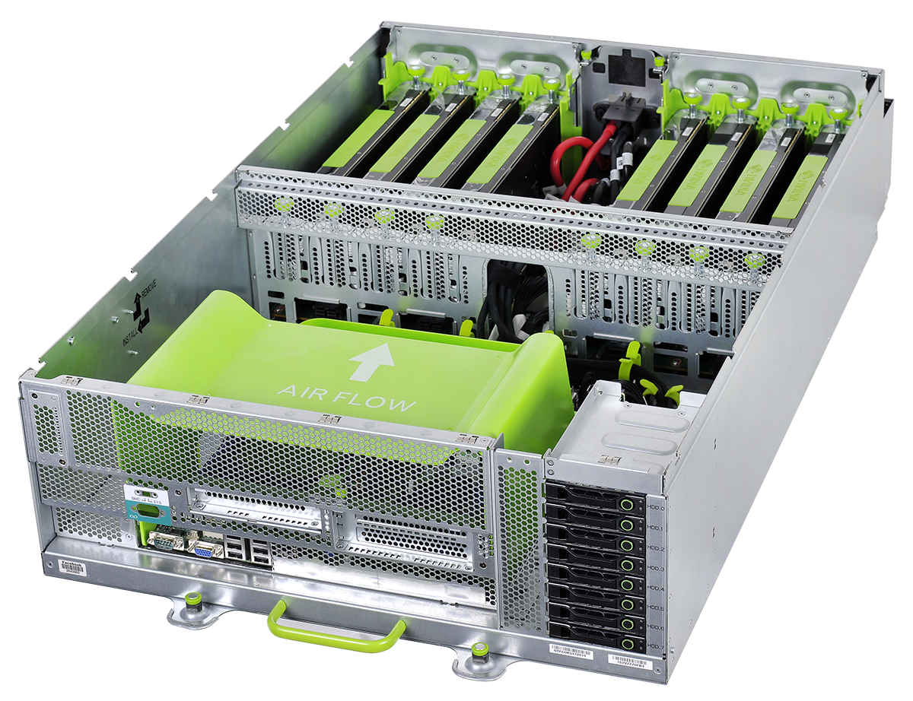
State of the Art Generative Models
[Source: Google Images]

Slide 7
State of the Art Generative Models
These GPU servers are expensive in terms of:
Memory
Computation
Power
[Source: Google Images]

Slide 8
State of the Art Generative Models
These GPU servers are expensive in terms of:
Memory
Computation
Power
Number of Operations:
DCGANs = 1.5B FLOPs
CycleGAN = 19.6B FLOPs
[Source: Google Images]

Slide 9
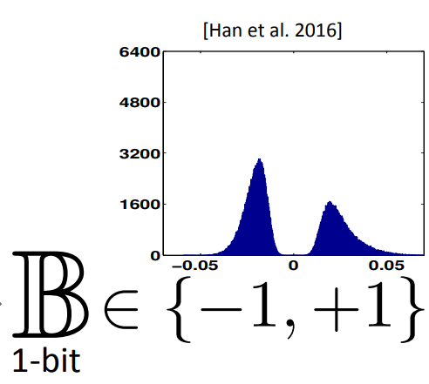
Lower Precision
Reducing Precision has the following advantages:-
Reduces Computation
Reduces Memory

Slide 10
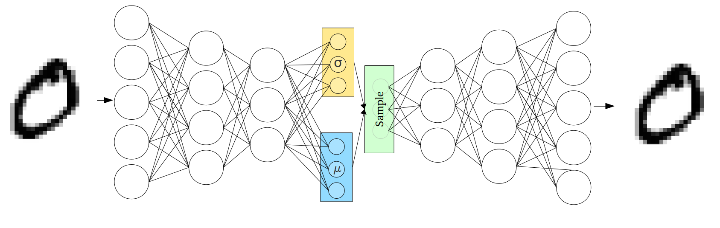
Variational Autoencoders

Slide 11
Binarizing Variational Autoencoders
{-1, 1}
{-1, 1}

Slide 12
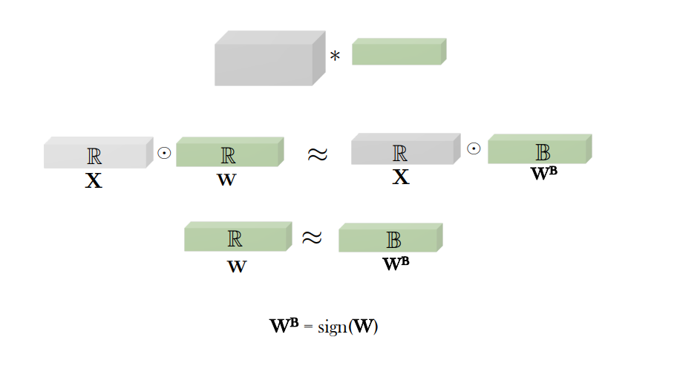
How are weights binarized?

Slide 13
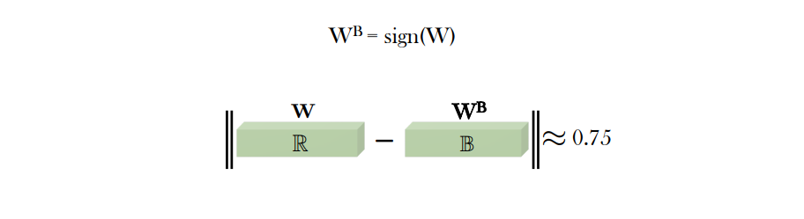
Quantization Error

Slide 14
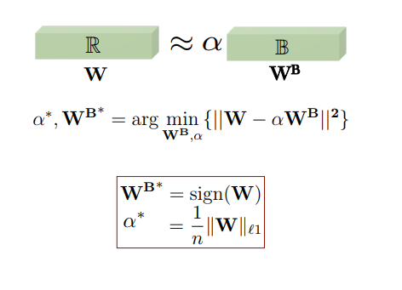
Use of Scaling Factor
[Source: Rastegari et al., ECCV 2016]

Slide 15

Results (Binary weight Network)
Epoch 1

Slide 16
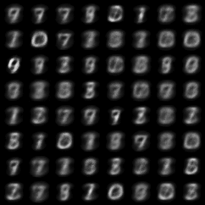
Results (Binary weight Network)
Epoch 1
Epoch 5

Slide 17
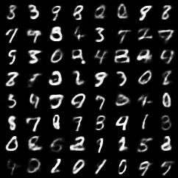
Results (Binary weight Network)
Epoch 1
Epoch 5
Epoch 50

Slide 18
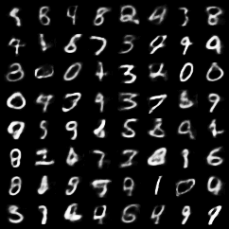
Results (Binary weight Network)
Epoch 1
Epoch 5
Epoch 50
Epoch 100

Slide 19
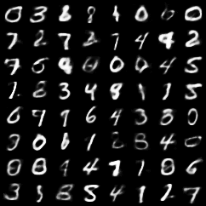
Binarized VAE
Std. VAE

Slide 20
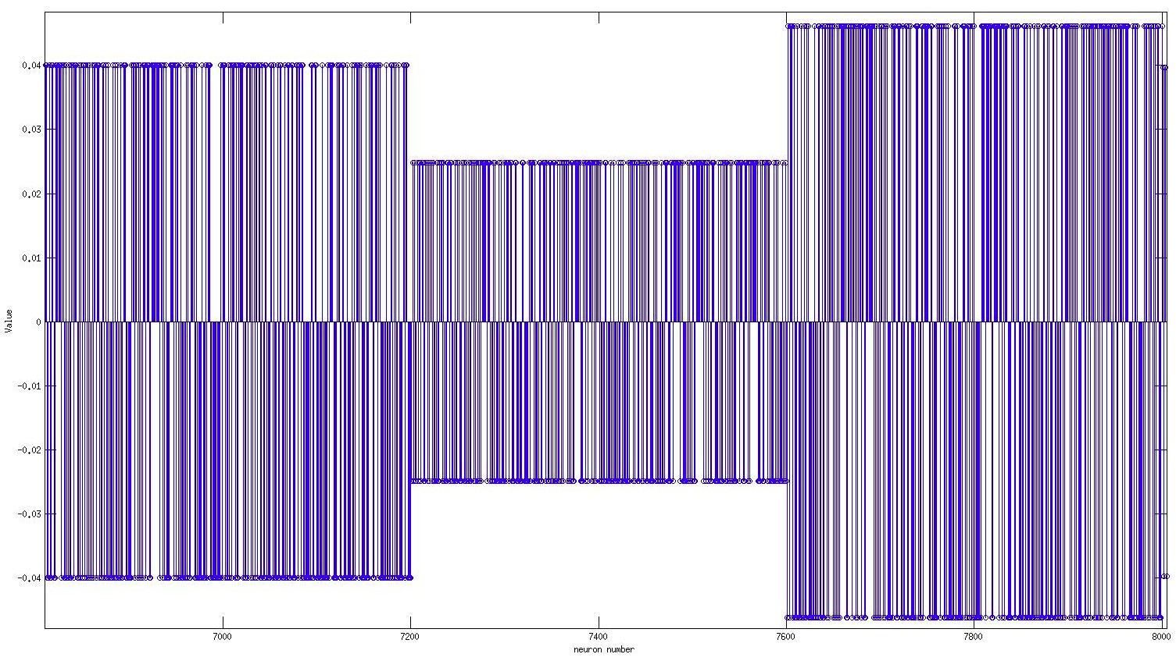
Representation of Weights

Slide 21
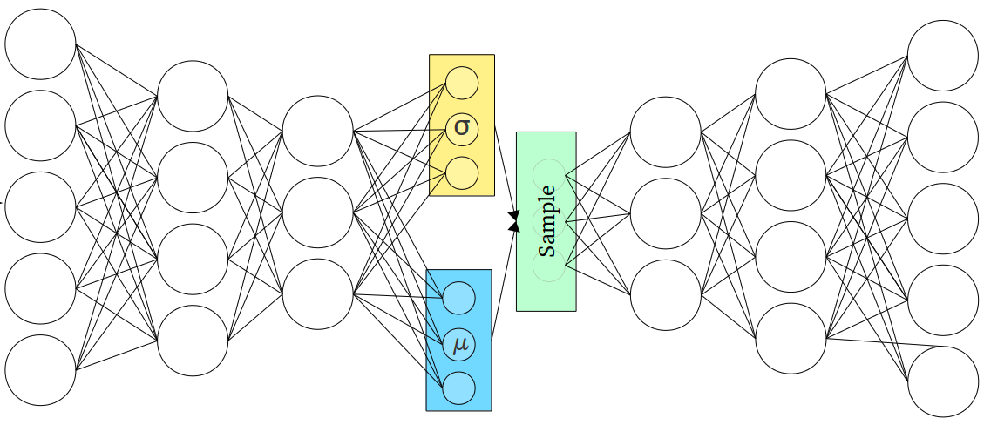
Performance on Unseen Data
{-1, 1}
{-1, 1}

Slide 22

Performance on Unseen Data
{-1, 1}
{-1, 1}

Slide 23
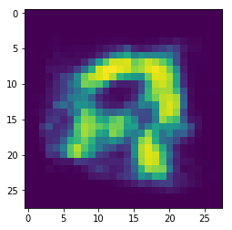
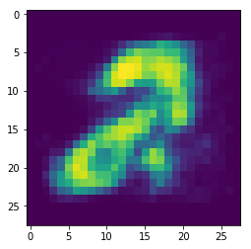
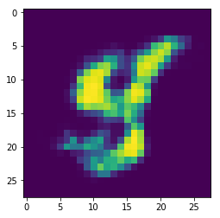
Input
Output

Slide 24


Slide 25


