Slide 1
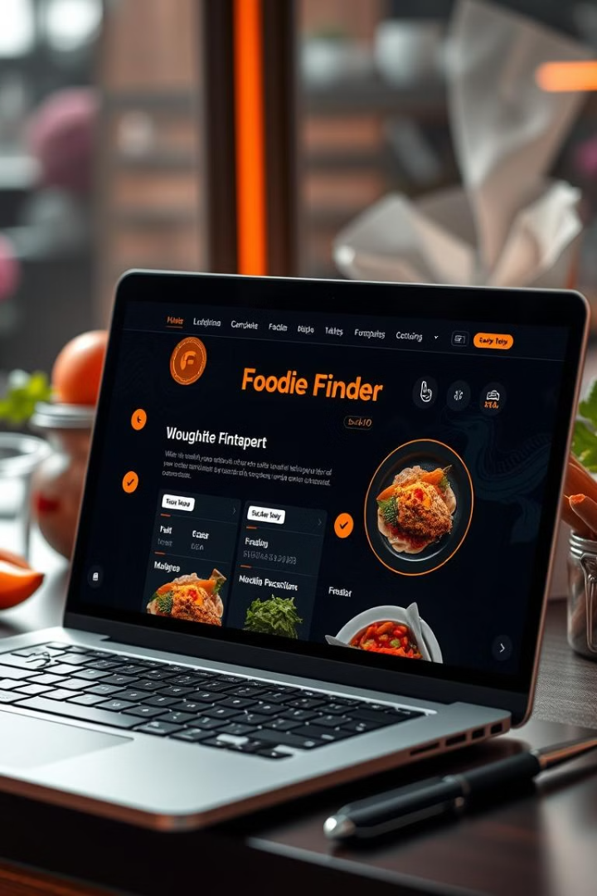

Foodie Finder: Overview and Purpose
Foodie Finder is a Flask-based web application that helps users discover recipes based on ingredients they already have. It uses machine learning (TF-IDF and cosine similarity) to match ingredients with suitable recipes, reducing food waste and inspiring culinary creativity.
by Jindam Sreenath

Slide 2
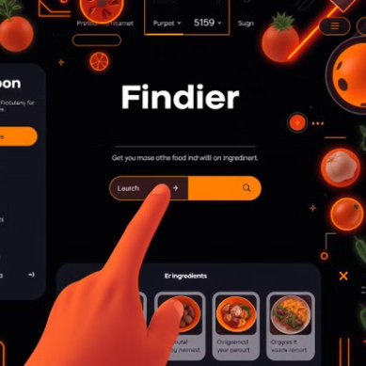
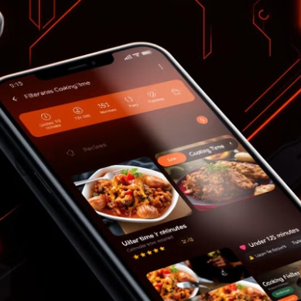
• Smart Ingredient Matching: Uses TF-IDF and cosine similarity to find recipes based on available ingredients
• Cooking Time Filters: Quick (0-30 min), Medium (30-60 min), or Long (60+ min) options
• User Authentication: Secure login/signup system with password hashing and session management
• Favorites System: Save and manage your favorite recipes
• User Profiles: Personalized user experience
• Responsive Design: Modern UI that works on all devices
• Recipe Details: View comprehensive recipe information including ingredients, instructions, and cooking time
Foodie Finder: Powerful Features

Slide 3
CI/CD and Testing: Roadblocks Faced
Infrastructure Limitations: Running CI/CD on a single laptop has limitations.
Test Environment Consistency: Mimicking production on a laptop is difficult.
Database Management: Setting up test databases on a laptop is a challenge.
ML Model Integration: Testing TF-IDF within CI/CD reliably is difficult.
NLTK Dependency Management: Ensuring NLTK data is consistent for test runs.

Slide 4


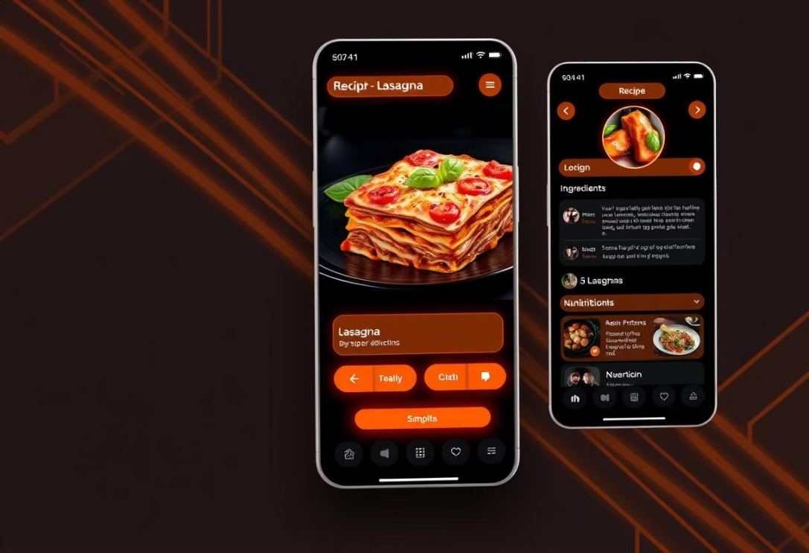
Future of Foodie Finder: Next Steps
Cloud Deployment: Migrate to AWS, Google Cloud, or Azure for better scalability
Machine Learning Enhancements: Improve recommendation algorithm with user feedback
Mobile App Development: Create native mobile apps for iOS and Android
Social Features: Allow users to share recipes and cooking experiences
Dietary Preferences: Add filtering by dietary restrictions (vegan, gluten-free, etc.)
Ingredient Substitution: Suggest alternatives for missing ingredients
Integration with Grocery Services: Connect with online grocery delivery
Enhanced UI/UX: Improve the user interface and overall experience of using the application.

