Slide 1
Desktop UI Changes

Slide 2
Normal user welcome

Slide 3
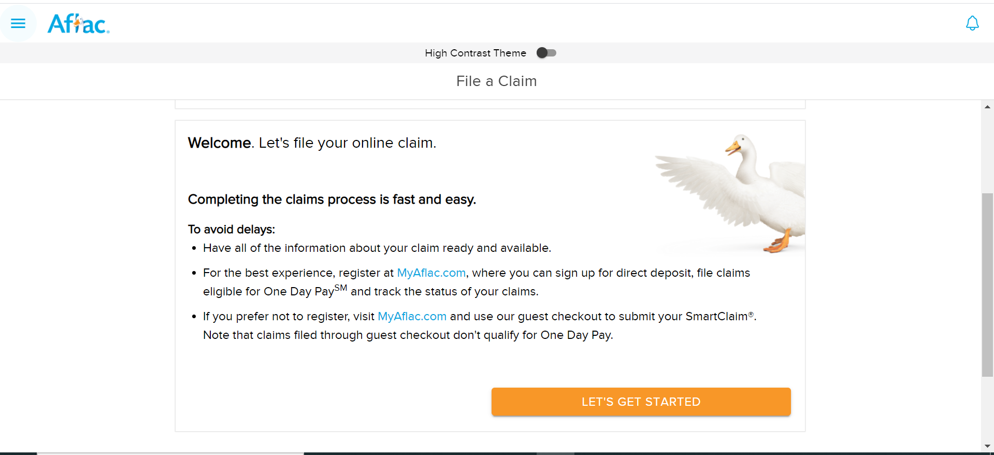
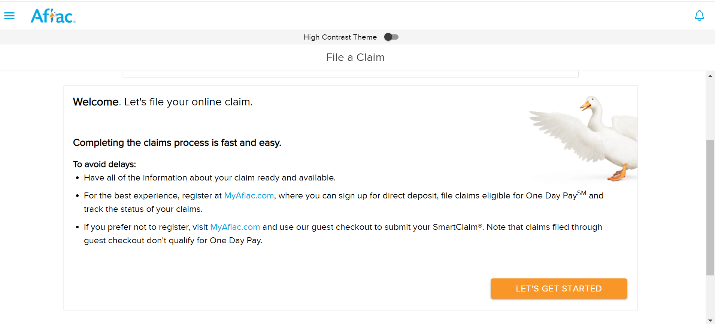
Guest user welcome

