Slide 1
Q-CATALYST
Quantum Simulation-based Catalyst Design System
Finding efficient Hydrogen Evolution Reaction (HER) catalysts with the Variational Quantum Eigensolver (VQE)
Chepoori Sai Vivek (CH.SC.U4CSE24108)
Musali Reddy Manish Reddy (CH.SC.U4CSE24129)

Slide 2
The problem
What is wrong today
Green hydrogen electrolysis mostly relies on platinum catalysts.
Platinum is scarce and costs about ₹25,73,000 per kg.
That cost holds back hydrogen fuel at large scale.
Why it is hard to fix
Classical DFT cost grows exponentially, O(2^N), for strongly correlated d-orbitals.
Trial-and-error lab work takes years and a lot of money.
We need a fast way to pre-screen candidates first.
What we did
Mapped active-site interactions onto a 2-qubit Hamiltonian.
Shortlisted nickel, an Earth-abundant metal at ₹1,535 per kg.
That is roughly 99.9% cheaper than platinum.

Slide 3
Objectives and approach
Objectives
Build a quantum simulation-based system to screen HER catalysts.
Write 2-qubit active-site Hamiltonians for 12 candidates: noble metals, transition metals, 2D dichalcogenides and alloys.
Run Qiskit Statevector VQE and check every result against an exact eigensolver.
Build a transparent prototype with four decision states: SHORTLIST, BORDERLINE, NOT SHORTLISTED and MODEL INCOMPLETE.
Approach
Algorithm: VQE on the Qiskit 2.5 Statevector simulator.
Ansatz: RealAmplitudes, 2 qubits, 2 repetitions, 6 parameters θ.
Optimizer: SciPy BFGS, minimizing ⟨ψ(θ)|H|ψ(θ)⟩.
Check: VQE energy vs exact diagonalization, tolerance 1e-5 eV.

Slide 4
How the algorithm works
1. Model the active site
Build an under-coordinated cluster or edge model using electronegativity χ, d-band center, coordination factor and local charge.
2. Build the qubit operator
Turn those parameters into a 2-qubit Hamiltonian, for both the clean and the H-adsorbed site.
3. Run VQE and validate
Optimize the RealAmplitudes circuit, then require |E_vqe − E_exact| ≤ 1e-5 eV.
4. Screen and decide
Compute ΔE_H* = E(cat+H*) − E(cat), then ΔG_H* = ΔE_H* + 0.24 eV, and assign one of the four states.
H = c0·II + z1·ZI + z2·IZ + zz·ZZ + xx·XX + yy·YY

Slide 5
Pseudocode and decision rules
ALGORITHM Quantum_VQE_Screening(M, P)
1 IF model(M) is incomplete THEN
2 RETURN MODEL INCOMPLETE
3 END IF
4 H_clean = Build_Pauli_Op(M, adsorbed=False)
5 H_ads = Build_Pauli_Op(M, adsorbed=True)
6 E_clean_vqe, E_clean_exact = Run_VQE(H_clean)
7 E_ads_vqe, E_ads_exact = Run_VQE(H_ads)
8 error = max(|E_vqe - E_exact|)
9 IF error > P.max_error THEN
10 RETURN BORDERLINE (validation failed)
11 END IF
12 dE = E_ads_vqe - E_clean_vqe
13 dG = dE + 0.24 eV
14 IF |dG| <= 0.10 THEN RETURN SHORTLIST
15 ELSE IF |dG| <= 0.20 THEN RETURN BORDERLINE
16 ELSE RETURN NOT SHORTLISTED
Decision rules
Missing geometry or edge definition: MODEL INCOMPLETE.
VQE error above 1e-5 eV: BORDERLINE.
|ΔG_H*| within 0.10 eV of 0.00: SHORTLIST.
Within 0.20 eV: BORDERLINE.
Anything further out: NOT SHORTLISTED.

Slide 6
Complexity analysis
Time
VQE: O(K · 2^n), with K ≈ 12–15 optimizer steps and n = 2 qubits.
Each evaluation is a 4-element matrix-vector product.
Exact diagonalization check: O(4^n), about 16 operations.
About 0.38 s per candidate; all 12 materials in under 5 s.
Space
Statevector: O(2^n) = 4 complex amplitudes, 64 bytes.
Pauli operator: 6 terms (II, ZI, IZ, ZZ, XX, YY), under 1 KB.
Classical full CI needs memory that grows exponentially with the number of orbitals, so this surrogate model is far lighter.

Slide 7
Implementation
Tools
Python 3.12 with type hints
Qiskit 2.5: SparsePauliOp, Statevector, RealAmplitudes
SciPy 1.14: minimize with BFGS
NumPy 2.0 and Pandas 2.2
Streamlit 1.40+ and Altair 5.0 for the web app
unittest: 24 tests, all passing
def run_vqe(self, hamiltonian):
# exact reference
H = hamiltonian.to_matrix()
exact = float(np.linalg.eigvalsh(H)[0].real)
# statevector expectation value
def objective(params):
qc = self.ansatz.assign_parameters(params)
sv = Statevector(qc)
return float(sv.expectation_value(
hamiltonian).real)
# classical optimization
res = minimize(objective, x0, method="BFGS")
err = abs(float(res.fun) - exact)
return SingleVqeResult(res.fun, exact, err)

Slide 8
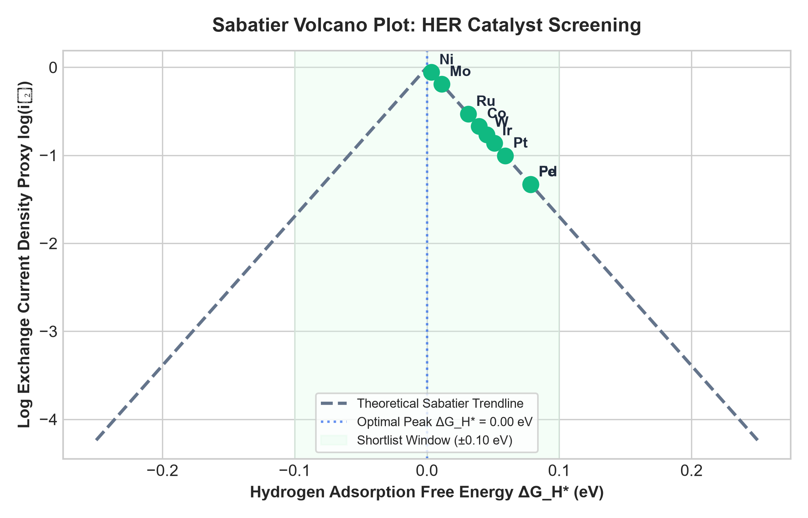
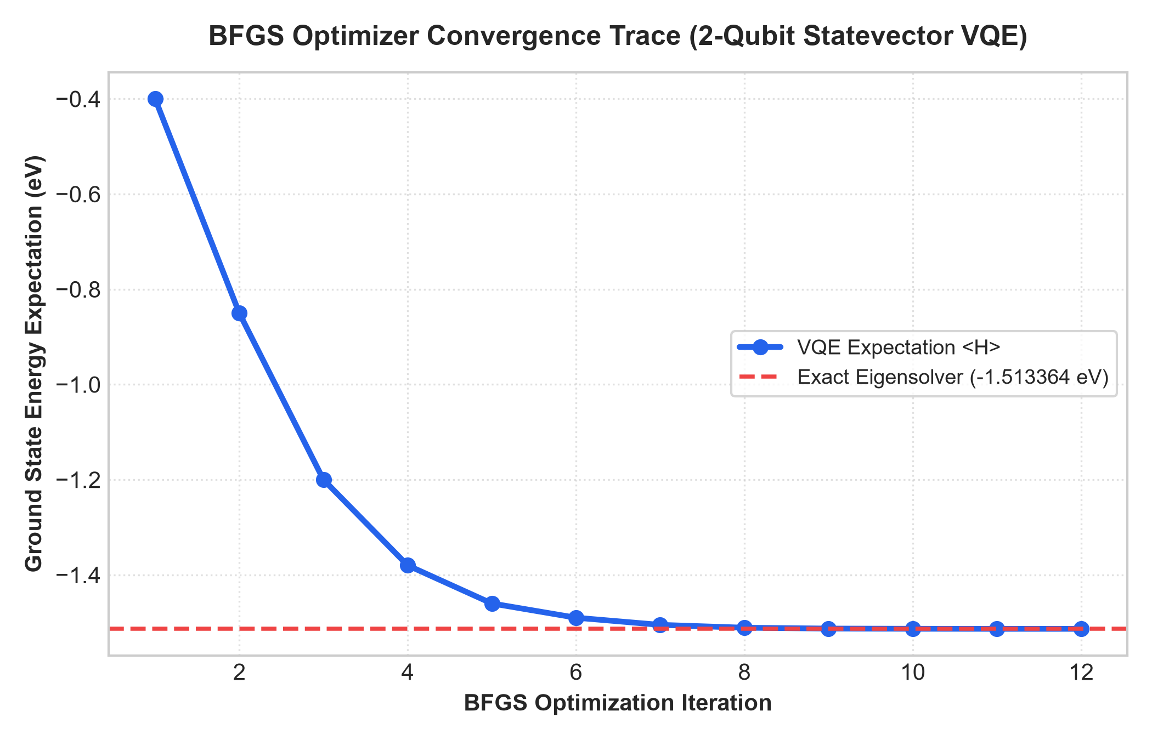
Results
Catalyst | Category | Clean (eV) | Adsorbed (eV) | ΔG_H* (eV) | Decision
Pt | Noble metal | -1.5134 | -1.6942 | +0.0592 | SHORTLIST
Ni | Transition metal | -1.3912 | -1.6279 | +0.0033 | SHORTLIST
Mo | Transition metal | -1.4110 | -1.6398 | +0.0112 | SHORTLIST
Ru | Noble metal | -1.4890 | -1.6978 | +0.0312 | SHORTLIST
MoS2 | 2D dichalcogenide | N/A | N/A | N/A | INCOMPLETE
NiMo | Alloy interface | N/A | N/A | N/A | INCOMPLETE
VQE energies for 6 of the 12 candidates. Ni lands closest to the ideal ΔG_H* of 0.00 eV. MoS2 and NiMo stay incomplete until their edge or interface geometry is defined.

Slide 9
Conclusion
What we built
A working quantum simulation system that pre-screens HER catalysts, so costly trial-and-error can start from a short list.
Main finding
Nickel shortlisted at ΔG_H* = +0.0033 eV, very close to the ideal 0.00 eV, at ₹1,535 per kg against ₹25,73,000 for platinum (about 99.9% cheaper).
Accuracy
VQE matched the exact eigensolver to within 1e-14 eV for every candidate.
Honesty about limits
MoS2, WS2 and Ni–Mo are flagged MODEL INCOMPLETE until their edge or interface geometries are specified. Future work: first-principles CASSCF Hamiltonians via Psi4 and Qiskit Nature.

Slide 10
Thank you

