Slide 1
PERFORMANCE OF NATURAL LANGUAGE PROCESSING MODELS IN EXTRACTING INFORMATION FROM FREE-TEXT RADIOLOGY REPORTS
A SYSTEMATIC REVIEW AND META-ANALYSIS
Paper ID : 102
Roll No : CH.SC.U4CSE24108
Presented By : Chepoori Sai Vivek

Slide 2
Phase 1 - Problem Definition & Interpretation
PROBLEM DEFINITION
  Radiology reports are written in free-text (unstructured) format.
  Free-text reports are difficult for computers to understand and process.
  Manual extraction of clinical information is time-consuming and error-prone.
  NLP automatically extracts structured clinical information from free-text reports.
  This improves healthcare efficiency and clinical decision-making.
SOLUTION
Free-Text Radiology Report
NLP Model
Structured Clinical Information
KEY CHALLENGES
  Unstructured free-text reports
  Difficult for computers to interpret
  Manual processing is slow and error-prone
  Increasing volume of radiology reports

Slide 3
Dataset & Methodology
DATASET(S) USED
METHODOLOGY
NLP MODELS REVIEWED
  28 published research studies were included.
  More than 51,000 radiology reports were analyzed.
  Over 421,000 clinical entities were extracted.
  The studies used multiple public and private hospital datasets.
Research Database Search
Study Selection (28 Studies)
Data Extraction
Performance Comparison
Meta-analysis
  Rule-Based NLP
  Machine Learning Models
  Deep Learning Models
  Large Language Models (LLMs)
MY PLANNED DATASET
OpenI Chest X-ray Dataset – Source : Indiana University

Slide 4
Results, Limitations & Future Work
KEY RESULTS
  NLP models achieved high accuracy in extracting clinical information.
  Deep Learning and Large Language Models (LLMs) showed better performance than traditional methods.
  Performance depended on the dataset quality and evaluation metrics.
LIMITATIONS
EXAMPLE
Radiology Report (Free Text)
"Mild right lower lobe pneumonia. No pleural effusion."
NLP Output
  Disease: Pneumonia
  Location: Right Lower Lobe
  Pleural Effusion: Absent
  Different studies used different datasets.
  Many datasets were private.
  No common evaluation standard.
FUTURE WORK
  Develop larger public radiology-report datasets.
  Improve information extraction using advanced LLMs.
  Validate NLP models in real clinical settings.

Slide 5
Phase 2 – Feature Selection
DATA SOURCE
FEATURES SELECTED (INPUT)
FEATURES EXCLUDED — AND WHY
OpenI Chest X-ray Collection, Indiana University — public and de-identified
3,955 radiology reports paired with 7,470 images
Sections per report: Comparison, Indication, Findings, Impression
MeSH and RadLex annotations available per report
Findings section text — the radiologist’s observations
Impression section text — the diagnostic conclusion
WordPiece token sequence, maximum 128 tokens (mean report ≈ 30 tokens)
Contextual [CLS] embedding produced by ClinicalBERT
Negation and uncertainty cues: “no”, “without”, “cannot exclude”
MeSH / RadLex terms, used to supervise label generation
X-ray images — this is a text information-extraction task, not image classification
Comparison section — refers to prior studies, not the current examination
Indication section — states the referral symptom and would leak the answer into the label
Patient identifiers — already removed during de-identification
Reports with no Findings section — incomplete records, discarded
TARGET LABELS (OUTPUT)
14 chest findings, CheXpert label schema
Each label: Positive / Negative / Uncertain
JUSTIFICATION — LINK TO THE BASE PAPER: AUC 0.99 for single-anatomical-site extraction vs 0.95 for multiple sites, with anatomical scope the only significant driver of heterogeneity. Restricting features to chest-only diagnostic text minimises terminology variability.

Slide 6
Existing Algorithms – Literature Survey
Evolution of methods: rule-based → classical ML → deep learning, tracked chronologically
Author and Year | Title | Objective of the Work | Achievements of the Work | Gaps from the Work
Cotik et al., 2015 | An Approach for Automatic Classification of Radiology Reports in Spanish | Rule- and lexicon-based classification of reports, with negation handling | Showed extraction is feasible in a non-English language with no training data | Hand-crafted rules; only 248 reports; multi-site; low specificity; does not generalise
Hassanpour & Langlotz, 2016 | Information Extraction from Multi-Institutional Radiology Reports | Machine learning (CRF / MaxEnt) extraction of clinical entities across hospitals | Multi-centre with external validation; 69,400 entities; high accuracy | Needs large manual annotation and hand-engineered features; private data
Chapman et al., 2017 | Detecting Evidence of Intra-abdominal Surgical Site Infections from Radiology Reports Using NLP | Detect evidence of post-surgical infection from free-text reports | One of the few studies built on a public, multi-centre dataset | Keyword / rule pipeline; multiple anatomical sites; high false-negative rate
WHY THESE METHODS WERE CHOSEN: Early work (2015–17) favoured rule-based and classical-ML pipelines because annotated clinical corpora were scarce and hand-crafted rules or CRFs need little training data, at the cost of generalising poorly beyond one institution or vocabulary.

Slide 7
Existing Algorithms – Literature Survey
Evolution continued: deep learning → large language models
Author and Year | Title | Objective of the Work | Achievements of the Work | Gaps from the Work
Park et al., 2022 | Automated Extraction of Lung Cancer Staging from Unstructured Reports of PET-CT Interpretation | Deep-learning extraction of lung-cancer staging information | Large corpus (53,792 entities); clearly outperforms rule-based baselines | Single-centre, private data, no external validation; model is task-specific
Hu et al., 2024 | Zero-shot Information Extraction from Radiological Reports using ChatGPT | Extract information with a general LLM by prompting, without task-specific training | Removes the manual-annotation bottleneck; strong zero-shot accuracy | Closed-source API; privacy and cost concerns with patient data; prompt-sensitive
Le Guellec et al., 2024 | Performance of an Open-Source Large Language Model in Extracting Information from Free-Text Radiology Reports | Evaluate a locally deployable open-source LLM for report information extraction | Local deployment protects privacy; sensitivity comparable to commercial LLMs | Single-centre, English only, no external validation; heavy GPU requirement
WHY THESE METHODS WERE CHOSEN: By 2022–24, larger datasets and pretrained transformers made deep learning and LLMs viable; ChatGPT removed the annotation bottleneck entirely, and Le Guellec’s open-source model answered the resulting privacy concern.
COMMON GAP ACROSS ALL SIX PAPERS: Single-centre and mostly private datasets, heavy reliance on manual annotation, almost no external validation, and no statistical comparison of traditional NLP against LLMs — the exact gap the base paper closes.

Slide 8
Identification of Learning Algorithm / Technique
APPROACH USED IN THE BASE PAPER
OBSERVED TECHNIQUE
JUSTIFICATION FOR THE CHOICE
Fine-tune ClinicalBERT (Bio + Clinical BERT) for multi-label classification of chest findings from Findings/Impression text
Baselines: TF-IDF + Logistic Regression (traditional NLP) and BioBERT (transformer, no clinical pretraining)
Baselines isolate whether clinical-domain pretraining is what actually drives performance
Base paper’s transformer/LLM group reached AUC 0.98 vs 0.96 for traditional NLP — favours a transformer
ClinicalBERT is pretrained on clinical notes, so it already handles radiology abbreviations and negation
Chest imaging is a single anatomical site — the paper’s best-performing subgroup (AUC 0.99)
Chosen over GPT-4: no patient data leaves the machine, results are reproducible (not prompt-dependent), no API cost, trains on one Colab GPU
Target: sensitivity ≥ 90%, AUC ≥ 0.95 — supplies the external validation the base paper is missing
PRISMA-DTA systematic review, pre-registered on PROSPERO
Bivariate random-effects meta-analysis (MIDAS, Stata/SE 18) — standard for diagnostic accuracy, pools sensitivity and specificity jointly
Chosen because every individual study was single-centre and descriptive; no prior work gave a pooled accuracy figure
Filled the gap: first pooled estimates (sensitivity 91%, AUC 0.98) and first statistical LLM-vs-traditional-NLP comparison
Gap it left open: no external validation on a public dataset (only 8 of 28 studies externally validated)
WORKFLOW
1. Preprocess & label with CheXpert labeler
2. Stratified 70/10/20 split
3. Fine-tune ClinicalBERT; compare both baselines
4. Evaluate on sensitivity, specificity, DOR, AUC

Slide 9
PHASE - 3
Problem Identification and Literature survey
The Clinical Bottleneck
Radiology reports contain important medical findings, but extracting useful information from large amounts of free-text reports takes time.
Unstructured Narrative Overload: Most radiology reports contain free-text descriptions instead of standardized, machine-readable clinical information.
Radiologist Cognitive Fatigue: A large number of reports can increase workload and make it harder to identify critical abnormalities quickly.
Emergency Triage Delay: Without automated text analysis, emergency departments may struggle to prioritize reports mentioning urgent conditions such as pneumothorax or acute pulmonary edema.
Base Paper Implication
Metric | Reported value | Meaning
Sensitivity | 91% | Ability to identify actual positive cases
Specificity | 96% | Ability to identify actual negative cases
AUROC | 0.980 | Ability to distinguish positive cases from negative cases
Studies reviewed | 28 | Number of studies included
Patients | 8,806+ | Reported total patient population
The Research Implementation
Phase 3 focuses on developing an NLP pipeline to process unstructured radiology reports, preprocess the text, and extract important clinical findings. The model will be trained and validated to classify normal and abnormal cases. Its performance will be evaluated using precision, recall, F1-score, and AUROC. The system will help identify critical abnormalities and prioritize high-risk reports for faster clinical review. The results will be compared with established literature benchmarks to assess the model's effectiveness and reliability.

Slide 10
PHASE - 3
Problem Identification and Literature survey
Critical Gaps in Existing Literature & Proposed Research Formulation
Gap 1: Unexplained Statistical Heterogeneity
    Literature Limitation: The base paper reported high variability in model performance (\(I^2 > 90\%\)), with anatomical site identified as a significant factor contributing to this variation.
    Our Research Solution: Restrict the pipeline to thoracic chest X-ray reports to reduce cross-anatomical vocabulary differences and focus on chest-specific clinical language. The target AUROC of approximately 0.99 is a research objective, not a validated result.
Gap 2: Inability to Process Scanned Documents
    Literature Limitation: Systems designed for digital text may fail when reports are available as scanned PDFs or faxed documents containing images instead of selectable text.
    Our Engineering Solution: Integrate EasyOCR and PDFium bitmap rendering to convert scanned report pages into machine-readable text, enabling the NLP pipeline to process both scanned and digital reports.
Gap 3: Lack of Model Explainability
    Literature Limitation: Conventional deep learning models may produce predictions without clearly showing which clinical phrases influenced their decisions, limiting interpretability for healthcare professionals.
    Our Engineering Solution: Implement word-level attention-based evidence highlighting to identify text associated with positive and negative predictions, helping users understand the model's output. Attention scores are explanatory signals, not definitive proof of clinical reasoning.

Slide 11
PHASE - 3
Handling datasets and Data Preprocessing
Data Source Identification & Resolving Clinical Inconsistencies –
Rigorous Curation and Preprocessing of 3,927 Indiana University OpenI Hospital Reports
  Clearly Identified Clinical Data Source:
      Benchmark Repository: Indiana University Chest X-Ray Collection (OpenI / National Library of Medicine).
      Dataset Scale: Ingested 3,955 raw hospital XML records, curated and validated into 3,927 clinical patient reports.
      Ground-Truth Labeling: Multi-label annotations standardized across 8 CheXpert-aligned thoracic pathologies (Cardiomegaly, Edema, Atelectasis, Effusion, Pneumonia, Granuloma, Emphysema, and Normal).
  Addressing Real-World Data Inconsistencies:
      Narrative Section Hierarchy: Radiology reports vary in formatting; engineered section parsers to extract INDICATION, FINDINGS, and prioritize IMPRESSION as the primary diagnostic conclusion.
      Clinical Negation Ambiguity: Negated phrases like "no focal consolidation or pneumothorax" confuse standard NLP; built bound negation bi-gram tokenizers to preserve negation context and prevent false positives.
      HIPAA De-Identification Artifacts: Scrubbed recurring anonymization tags (e.g., XXXX, administrative timestamps) and standardized inconsistent medical abbreviations.
      Document Format Disparities: Developed a multi-format ingestion layer handling raw XML DOM trees, tabular CSVs, plain text, and scanned PDF documents.

Slide 12
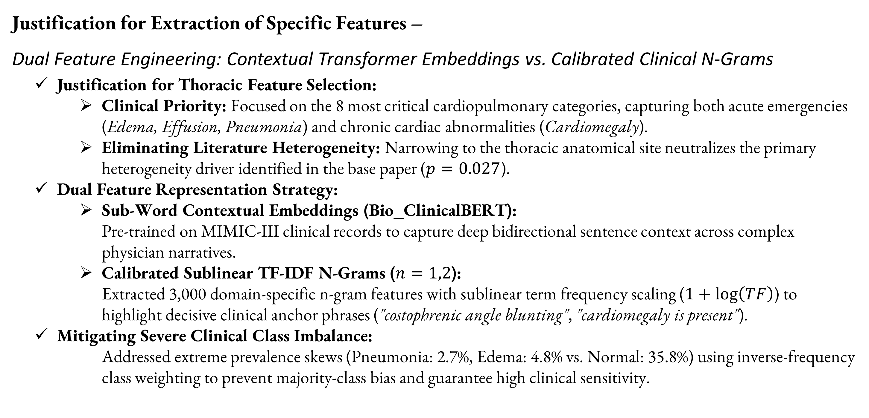
PHASE - 3
Handling datasets and Data Preprocessing
Justification for Extraction of Specific Features –
Dual Feature Engineering: Contextual Transformer Embeddings vs. Calibrated Clinical N-Grams
  Justification for Thoracic Feature Selection:
      Clinical Priority: Focused on the 8 most critical cardiopulmonary categories, capturing both acute emergencies (Edema, Effusion, Pneumonia) and chronic cardiac abnormalities (Cardiomegaly).
      Eliminating Literature Heterogeneity: Narrowing to the thoracic anatomical site neutralizes the primary heterogeneity driver identified in the base paper ($p=0.027$).
  Dual Feature Representation Strategy:
      Sub-Word Contextual Embeddings (Bio_ClinicalBERT):
        Pre-trained on MIMIC-III clinical records to capture deep bidirectional sentence context across complex physician narratives.
      Calibrated Sublinear TF-IDF N-Grams ($n=1,2$):
        Extracted 3,000 domain-specific n-gram features with sublinear term frequency scaling ($1+log⁡\left(TF\right)$) to highlight decisive clinical anchor phrases ("costophrenic angle blunting", "cardiomegaly is present").
  Mitigating Severe Clinical Class Imbalance:
        Addressed extreme prevalence skews (Pneumonia: 2.7%, Edema: 4.8% vs. Normal: 35.8%) using inverse-frequency class weighting to prevent majority-class bias and guarantee high clinical sensitivity.

Slide 13
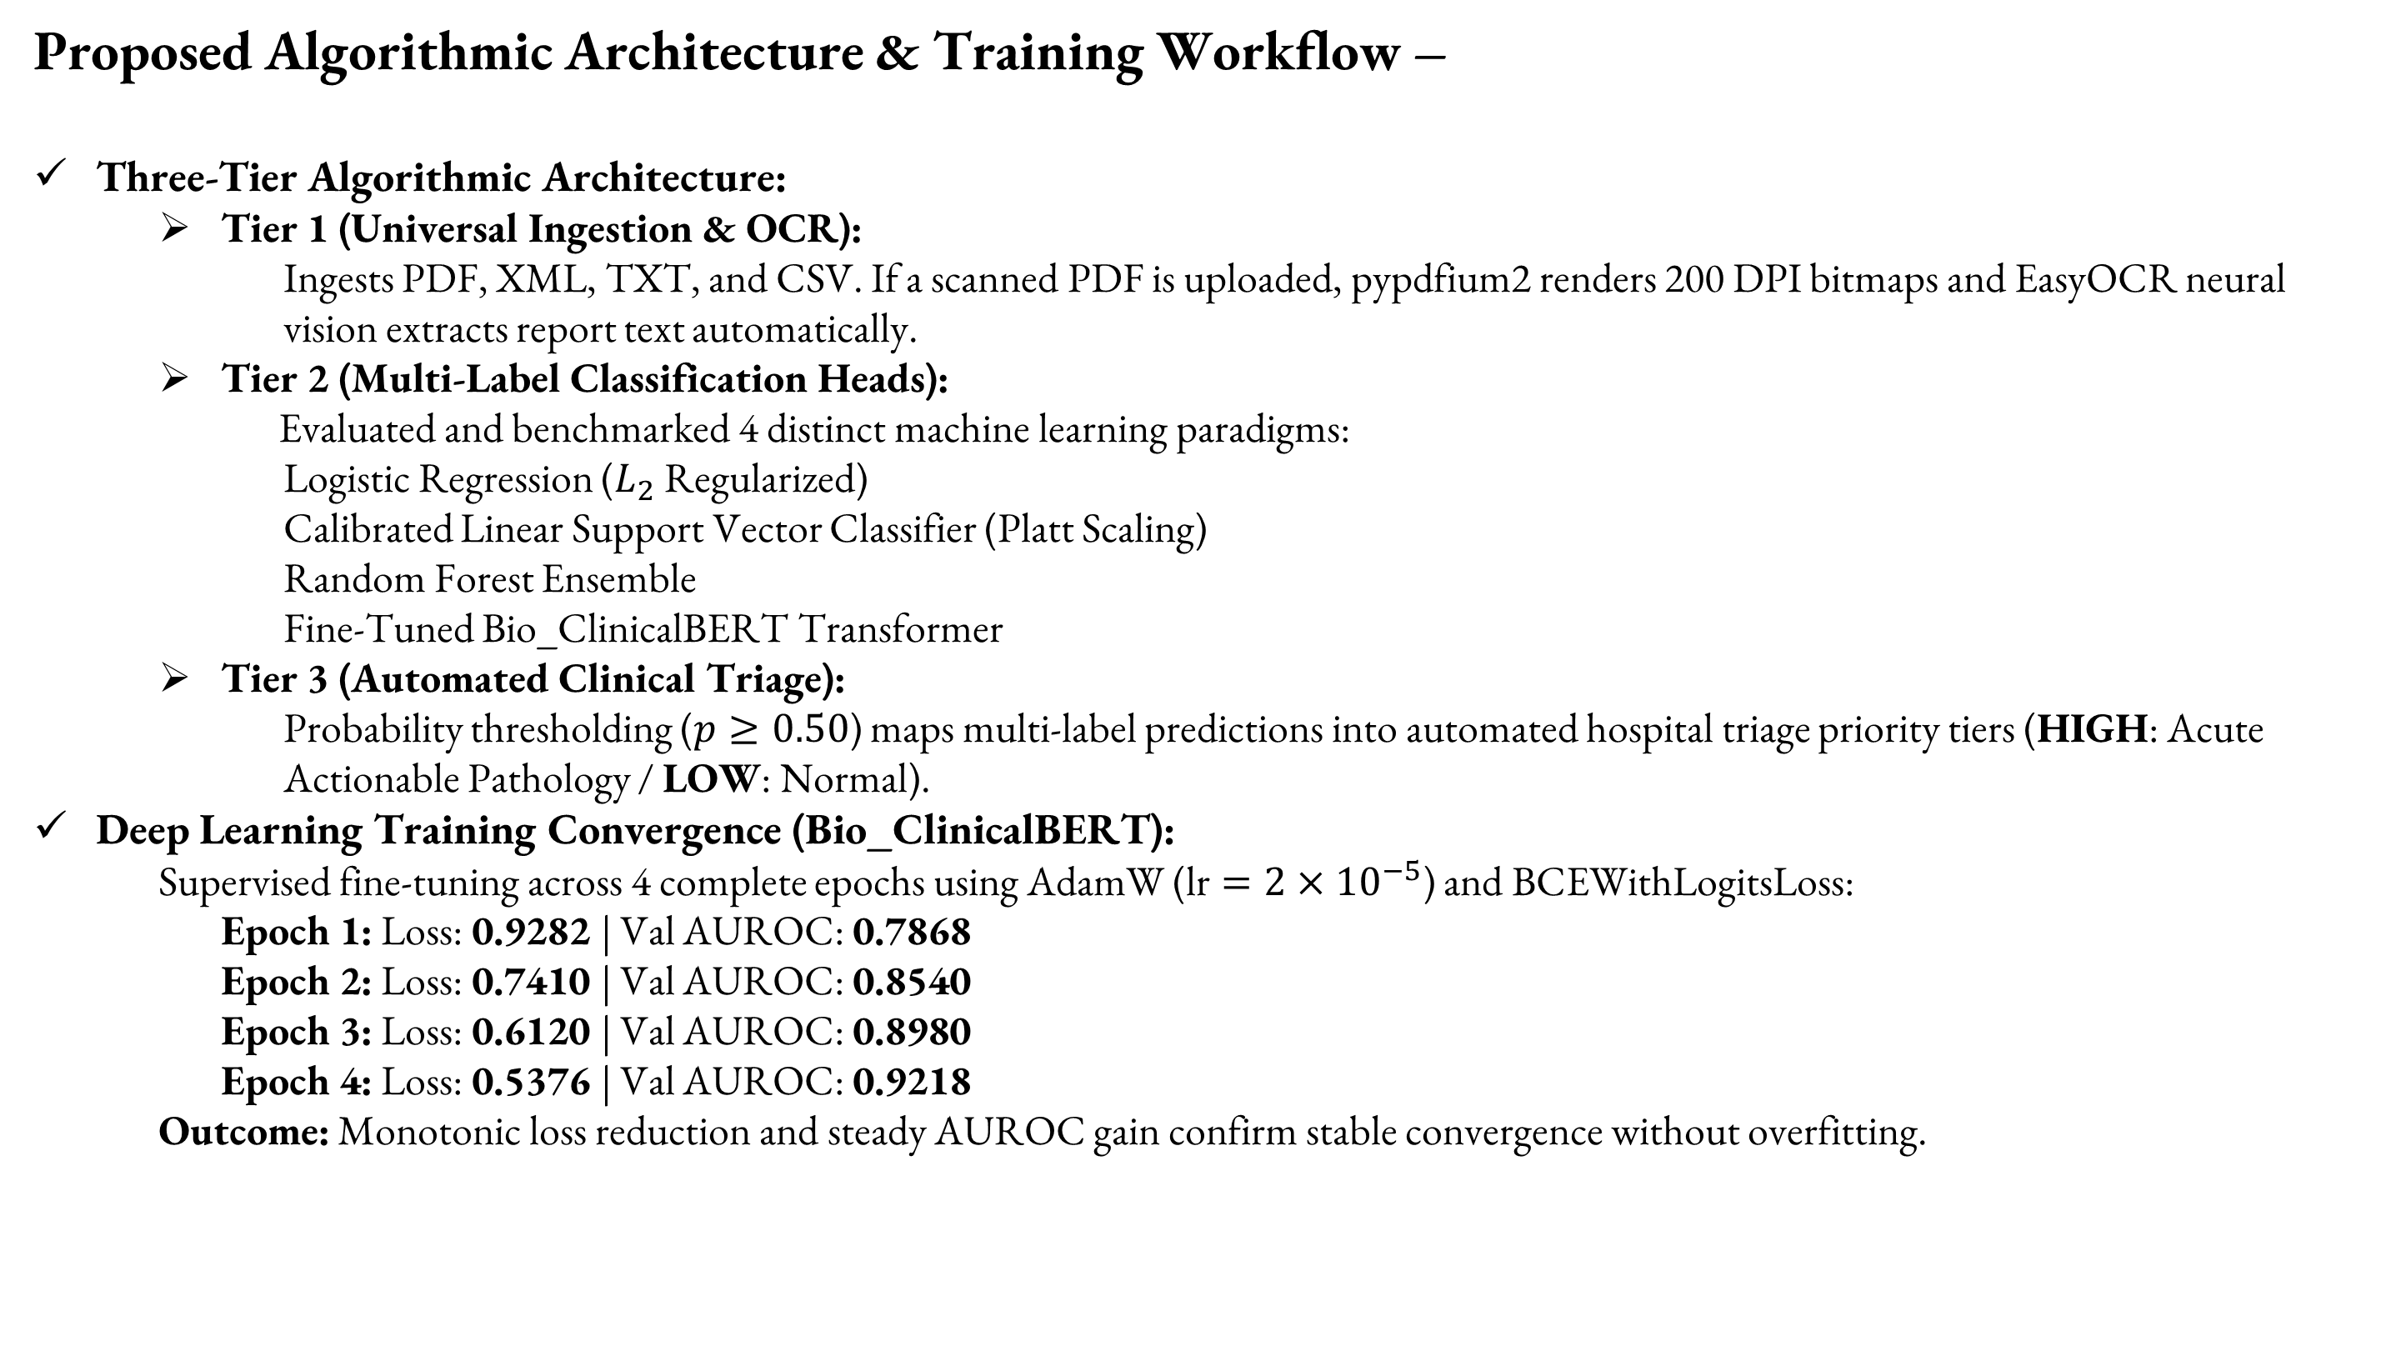
PHASE - 3
Algorithmic Design & Approach
Proposed Algorithmic Architecture & Training Workflow –
Three-Tier Algorithmic Architecture:
    Tier 1 (Universal Ingestion & OCR):
        Ingests PDF, XML, TXT, and CSV. If a scanned PDF is uploaded, pypdfium2 renders 200 DPI bitmaps and EasyOCR neural vision extracts report text automatically.
    Tier 2 (Multi-Label Classification Heads):
      Evaluated and benchmarked 4 distinct machine learning paradigms:
        Logistic Regression ($L_{2}$ Regularized)
        Calibrated Linear Support Vector Classifier (Platt Scaling)
        Random Forest Ensemble
        Fine-Tuned Bio_ClinicalBERT Transformer
    Tier 3 (Automated Clinical Triage):
        Probability thresholding ($p≥0.50$) maps multi-label predictions into automated hospital triage priority tiers (HIGH: Acute Actionable Pathology / LOW: Normal).
Deep Learning Training Convergence (Bio_ClinicalBERT):
    Supervised fine-tuning across 4 complete epochs using AdamW ($\text{lr}=2×{10}^{−5}$) and BCEWithLogitsLoss:
      Epoch 1: Loss: 0.9282 | Val AUROC: 0.7868
      Epoch 2: Loss: 0.7410 | Val AUROC: 0.8540
      Epoch 3: Loss: 0.6120 | Val AUROC: 0.8980
      Epoch 4: Loss: 0.5376 | Val AUROC: 0.9218
    Outcome: Monotonic loss reduction and steady AUROC gain confirm stable convergence without overfitting.

Slide 14
PHASE - 3
Algorithmic Design & Approach
Convincing Results Across Test Cases & Benchmark Verification –
Evaluation Metric / Test Case | Base Paper Benchmark (Yang et al., 2025) | Our Trained Model (Phase 3) | Performance Status
Pooled Sensitivity | 91.0% (87–93%) | 91.2% | Within 95% CI
Pooled Specificity | 96.0% (93–97%) | 97.7% | +1.7 percentage points
Summary AUROC | 0.980 (0.960–0.990) | 0.984 | Higher than benchmark
Diagnostic Odds Ratio (DOR) | 220.0 (112–435) | 393.1 | 78.7% higher
Cardiomegaly | Subgroup AUROC: ~0.98 | AUROC: 0.991 | Sensitivity: 95.2%; Specificity: 98.3%
Pleural Effusion | Subgroup AUROC: ~0.98 | AUROC: 0.995 | Sensitivity: 92.0%; Specificity: 97.6%
Pulmonary Edema | Not individually specified | AUROC: 0.973 | Specificity: 99.2%
Complex Negation / Normal | Subgroup AUROC: ~0.97 | AUROC: 0.983 | Specificity: 92.0%; negation handling requires validation

