Slide 1
GMP- Hands on Practice
Dr. R.Padmavathy

Slide 2
What is gmp?
Portable Library
High precision arithmetic operations
Very fast operations on big numbers

Slide 3
How to install?
Open Terminal
sudo apt-get update
sudo apt-get install libgmp3-dev
Download GMP manual
gmplib.org/gmp-man-6.0.0a.pdf

Slide 4
Basics
Header file - #include<gmp.h>
The mpz_t datatype:
First declare a variable
eg - mpz_t a,b,c;
Initialize the variable
eg - mpz_init(a); //single variable
eg - mpz_inits(a,b,c,NULL); //multiple variable
Setting the value to some unsigned integer type (ui)
eg - mpz_set_ui(a,10000);

Slide 5
Input/ Output
Taking input from users:
gmp_scanf(“%Zd”, a);
Printing on screen
gmp_printf(“Value of a is : %Zd”,a);

Slide 6
Basic arithmetic in gmp
a > b => mpz_cmp(a,b) > 0
a < b => mpz_cmp(a,b) < 0
a == b => mpz_cmp(a,b) == 0
a > 0 => mpz_cmp_ui(a,0) > 0
a < 0 => mpz_cmp_ui(a,0) < 0
swap values of a and b -> mpz_swap(a,b);

Slide 7
Basic arithmetic in gmp
c = a + b => mpz_add(c,a,b);
c = a - b => mpz_sub(c,a,b);
c = a * b => mpz_mul(c,a,b);
c = a / b => mpz_fdiv_q(c,a,b);
c = a % b => mpz_fdiv_r(c,a,b);
c = a + 5 => mpz_add_ui(c,a,5);
a++ => mpz_add_ui(a,a,1);
a-- => mpz_sub_ui(a,a,1);

Slide 8
Test Program : greater of two numbers
#include<gmp.h>
void main()
{
mpz_t a,b,c;
mpz_inits(a,b,c,NULL);
gmp_printf(“\n Enter the value of a - “);
gmp_scanf(“%Zd”,a);
gmp_printf(“\n Enter the value of b - “);
gmp_scanf(“%Zd”,b);
if(mpz_cmp(a,b) > 0) printf(“a is greater”);
else printf(“b is greater”);
}

Slide 9
Compile and Run
To complile - gcc fileName.c -lgmp
To run - ./a.out
OR
To complile - gcc progName.c -o p1 -lgmp
To run - ./p1

Slide 10
Calculator Program
#include<gmp.h>
void main()
{
mpz_t a,b,c;
mpz_inits(a,b,c,NULL);
gmp_printf(“\n Enter a - “);
gmp_scanf(“%Zd”,a);
gmp_printf(“\n Enter b - “);
gmp_scanf(“%Zd”,b);
mpz_add(c,a,b);
gmp_printf(“a + b = %Zd”,c);
mpz_sub(c,a,b);
gmp_printf(“a - b = %Zd”,c);
mpz_mul(c,a,b);
gmp_printf(“a * b = %Zd”,c);
mpz_fdiv_q(c,a,b);
gmp_printf(“a / b = %Zd”,c);
mpz_mod(c,a,b);
gmp_printf(“a % b = %Zd”,c);
}

Slide 11
Taking random inputs
gmp_randstate_t state;
gmp_randinit_mt(state);
unsigned long seed;
seed = time(NULL);
gmp_randseed_ui(state,seed);
Method 1:
mpz_set_ui(max,100000);
mpz_rrandomm(a,state,max);
Method 2:
int bits = 10;
mpz_rrandomb(a,state,bits);

Slide 12
Euclidean Algorithm
Input two numbers a and b
while(mpz_cmp_ui(b,0) != 0 )
mpz_set(t,b);
mpz_mod(b,a,b);
mpz_set(a,t);
gcd is 'a'
Eg ->
1. a = 180 b = 48
rem = 36
2. a = 48 b = 36
rem = 12
3. a = 36 b = 12
rem = 0
4. a = 12 b = 0
gcd = 12

Slide 13
Assignment 1
Write a program (in gmp) to find the gcd of two numbers using euclidean algorithm.

Slide 14
Extended Euclidean Algorithm
The extended Euclidean algorithm is an extension to the Euclidean algorithm, it computes,
the greatest common divisor of integers a and b, and
the coefficients x and y such that
ax + by = gcd(a,b)
s(i) = s(i-2) - q(i)*s(i-1)
t(i) = t(i-2) - q(i)*t(i-1)

Slide 15
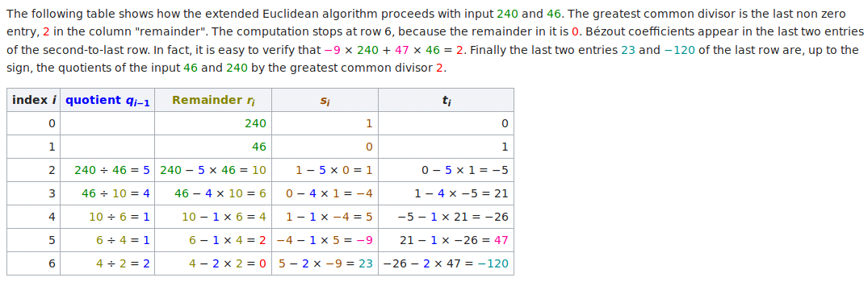

Slide 16
Multiplicative Inverse
Modulo Arithmetics:
5 % 3 = 2 13 % 5 = 3 17 % 7 = 3 24 % 12 = 0
17 % 11 = ? 29 % 6 = ? 11 % 2 = ? 100 % 70 = ?
Inverse in modulo arithmetics
If a*b(% m) = 1, then a is the inverse of b in modulo m, and vice versa.
Examples:
inv of 3 in (mod 5) = 2, [3 * 2 = 6 (%5) = 1]
inv of 9 in (mod 11) = 5, [9 * 5 = 45(%11) = 1]
inv of 2 in (mod 13) = 7, [2 * 7 = 14(%11) = 1]
GMP Function : mpz_inv (inv, num, mod);

Slide 17
Inverse using Extended Euclidean
Goal is to find the inverse of a in (mod m).
Use the equation of ex_eucliden
ax + my = d, d is the gcd of a and b
If a and b are co-primes, then gcd, d = 1 .
Taking (mod m) on both sides
(ax + my) (mod m) = 1 (mod m)
ax (mod m) = 1 (mod m)
x is the inverse of a in mod m.

Slide 18

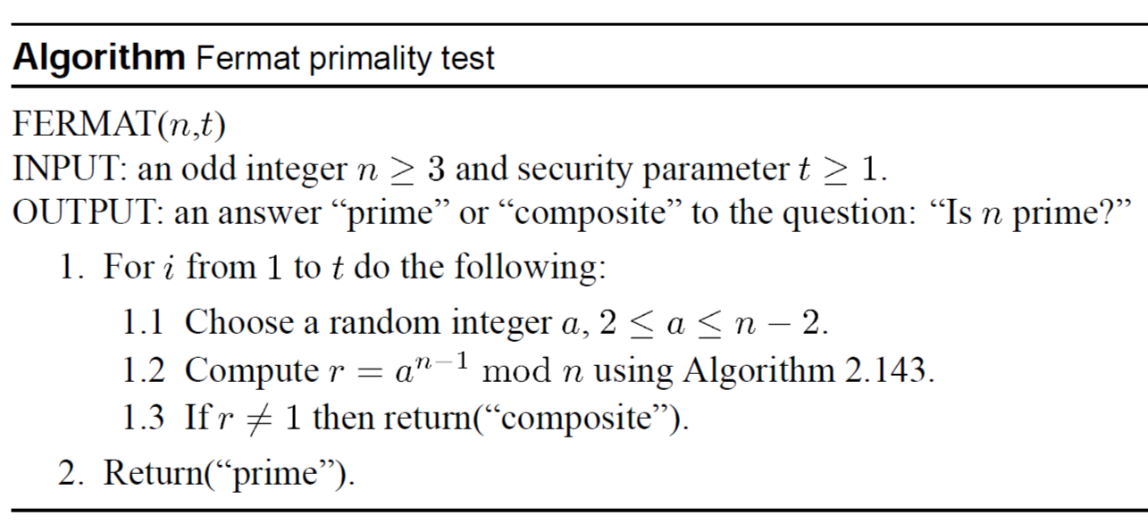
Primarility Test
Fermat's Theorem : Let p be a prime. If gcd(a,p) = 1, then

Slide 19
Assignment 2
int mpz_probab_prime_p (const mpz t n, int reps)
Determine whether n is prime. Return 2 if n is definitely prime, return 1 if n is probably prime (without being certain), or return 0 if n is definitely composite.
void mpz_nextprime (mpz t rop, const mpz t op)
Set rop to the next prime greater than op.
Write a program in GMP to generate 1024 bit prime number.

Slide 20
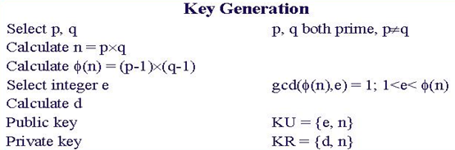



RSA Algorithm

Slide 21

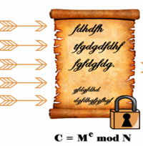

RSA Algorithm (Encryption)
Simplified model of RSA Cryptosystem

Slide 22
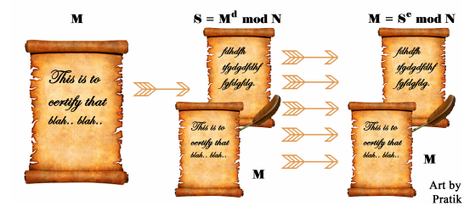
RSA Algorithm (Signature)
Simplified model of RSA Signature

Slide 23
RSA Algorithm Example
Step 1: Let p = 47 and q = 59. Thus n = 47 x 59 = 2773
Step 2: Select e = 17
Step 3: Publish (n,e) = (2773, 17)
Step 4: (p-1) x (q-1) = 46 x 58 = 2668
Use the Euclidean Algorithm to compute the modular
inverse of 17 modulo 2668. The result is d = 157
<< Check: 17 x 157 = 2669 = 1(mod 2668) >>
Public key is (2773,17)
Private key is 157

Slide 24
RSA Algorithm Example Cont.
Public key is (2773,17)
Private key is 157
Plaintext block represented as a number: M = 31
Encryption using Public Key: C = 31¹⁷ (mod 2773)
= 587
Decryption using Private Key: M = 587¹⁵⁷ (mod 2773)
= 31

Slide 25
Assignment 3
Design RSA cryptosystem for secure communication.
Design RSA for encrypting and decrypting string messages.

Slide 26
Generator of a field
A generator g of a finite field F of order p (contains p elements) is an element whose first p - 1 powers generate all the nonzero elements of F. That is, the elements of F consist of 0, g⁰, g¹ , .. .. .. , g^{p-1.}
Example : Z7 ={ 0,1,.....,6}
g¹ = 3 , g² = 2, g³ = 6 , g⁴ = 4 , g⁵ = 5 , g⁶ = 1
3 generates all the elements of Z7. Hence, it is the generator.

Slide 27
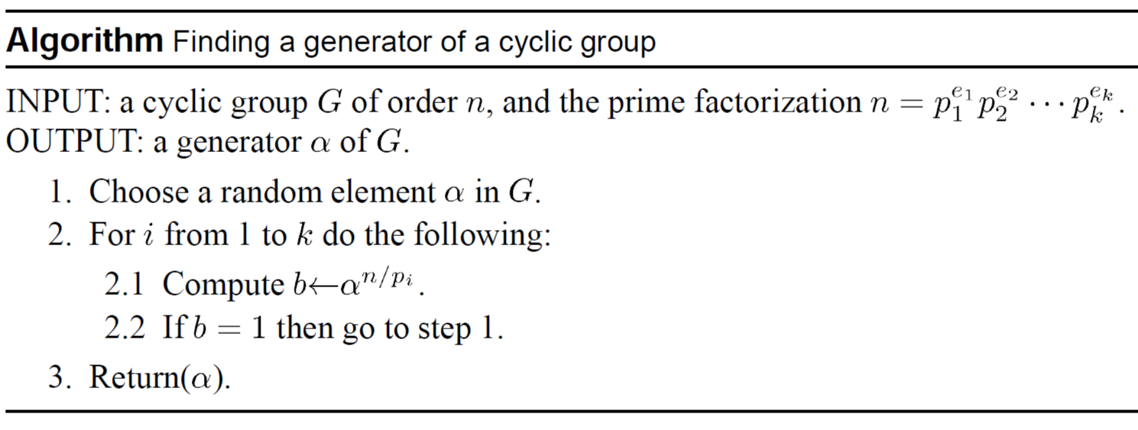

Slide 28
A simple trick
Generate p from known prime factors.
For eg : Choose p such that ( p - 1 = q * r ) , where p,q,r are all prime.
To find out the generator
while(flag = 0){
generate α randomly from [2, p-1]
if( α ^{q} mod p !=1 && α ^{r} mod p != 1)
α is your generator;
flag = 1;
}

Slide 29
Diffie-Hellman Key Exchange Algorithm
Global Public Elements
q = prime number(300 decimal, i.e. 1024 bits)
α = generator of field F_{q}
User A key Generation
Select private X_{a} , X_{a} < q
Calculate public Y_{a} , Y_{a} = α ^{Xa} mod q
User B Key Generation
Select private X_{b} , X_{b} < q
Calculate public Y_{b} , Y_{b} = α ^{Xb} mod q

Slide 30
Diffie-Hellman Key Exchange Algorithm
Generation of secret key by user A
K=(Y _{b}) ^{X a} mod q
Generation of secret key by user B
K=(Y _{a}) ^{X b} mod q

Slide 31
Key Exchange Example
users Alice & Bob who wish to swap keys:
agree on prime q=353 and α=3
select random secret keys:
A chooses x_{A}=97, B chooses x_{B}=233
compute respective public keys:
y_{A}=397 mod 353 = 40 (Alice)
y_{B}=3233 mod 353 = 248 (Bob)
compute shared session key as:
K_{AB}= y_{B} ^{xA} mod 353 = 24897 = 160 (Alice)
K_{AB}= y_{A} ^{xB} mod 353 = 40233 = 160 (Bob)

Slide 32
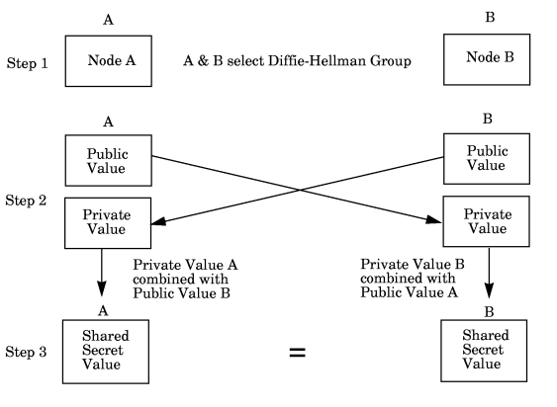
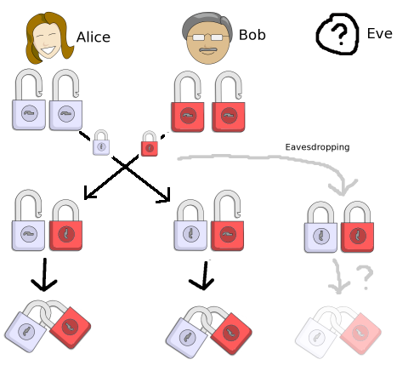
Diffie-Hellman Key Exchange
Fig-1 : Diffie-Hellman Key-Exchange Procedure

Slide 33
Assignment 4
Design Diffie-Hellman key exchange algorithm in gmp.

Slide 34
ElGamal Algorithm
Let p be a large prime
By “large” we mean here a prime rather typical in length to that
of an RSA modulus .
Select a special number g
The number g must be a primitive element modulo p.
Choose a private key x
This can be any number bigger than 1 and smaller than p-1
Compute public key y from x, p and g
The public key y is g raised to the power of the private key x
modulo p. In other words:
y = g ^{x} mod p

Slide 35
ElGamal Algorithm : Example
Step 1: Let p = 23
Step 2: Select a primitive element g = 11
Step 3: Choose a private key x = 6
Step 4: Compute y = 11⁶ (mod 23)
= 9
Public key is 9
Private key is 6

Slide 36
ElGamal Encryption
The first job is to represent the plaintext as a series of numbers
modulo p. Then:
Generate a random number k
Compute two values C₁ and C₂, where
C₁ = g ^{k} mod p and C₂ = M . y ^{k} mod p
Send the ciphertext C, which consists of the two separate values
C₁ and C₂.

Slide 37
ElGamal Encryption: Example
To encrypt M = 10 using Public key 9
1 - Generate a random number k = 3
2 - Compute C₁= 11³ mod 23 = 20
C₂= 10 x 9³ mod 23
= 10 x 16 = 160 mod 23 = 22
3 - Ciphertext C = (20 , 22 )

Slide 38
ElGamal Decryption
C₁ = g ^{k} mod p C₂ = M . y ^{k} mod p
1 - The receiver begins by using their private key x to transform
C₁ into something more useful:
C₁^{x} = (g ^{k} ) ^{x} mod p
NOTE: C₁^{x} = (g ^{k}) ^{x} = (g ^{x}) ^{k} = (y) ^{k} = y ^{k} mod p
2 - This is a very useful quantity because if you divide C₂ by it you
get M. In other words:
C₂ / y ^{k} = (M . y ^{k}) / y ^{k} = M mod p

Slide 39
ElGamal Encryption : Example
To decrypt C = (20 , 22 )
1 - Compute 20⁶ = 16 mod 23
2 - Compute 22 / 16 = 10 mod 23
3 - Plaintext = 10

Slide 40
Assignment 5
Design Elgamal cryptosystem using gmp.

Slide 41
Thank You…

