Slide 1

E-commerce Product Data Discovery System
Presented By:
Garima Singh (017428788)
Ishita Upadhyay (017431349)
Riddhi Vyas (016801928)
Sai Vivek Chunduri (017435301)

Slide 2

Motivation
Deep Business Insights for E-commerce Growth
Analyzing Performance and Identifying Trends
Data-Driven Decision Making and Competitive Advantage

Slide 3
Technology Stack
1. Data Integration & Storage
Azure Data Factory & Data Lake Storage Gen2: For data pipeline management and large-scale data storage.
2. Analytics & Processing
Azure Databricks & Synapse Analytics: For data engineering and large-scale analytics.
Amazon Redshift: Cloud data warehouse for high-performance analysis.
3. Development Tools
Python & Pandas: Programming language and data manipulation library for analysis and web development.
Jupyter Notebook: Interactive environment for code, visualizations, and text.
4. Interface & Management
Streamlit: For interactive web applications.
Trello/Agile: Project management using Agile principles.
5. Cross-Cutting Tools
Grammarly: Ensures quality of written content.
Amazon S3

Slide 4
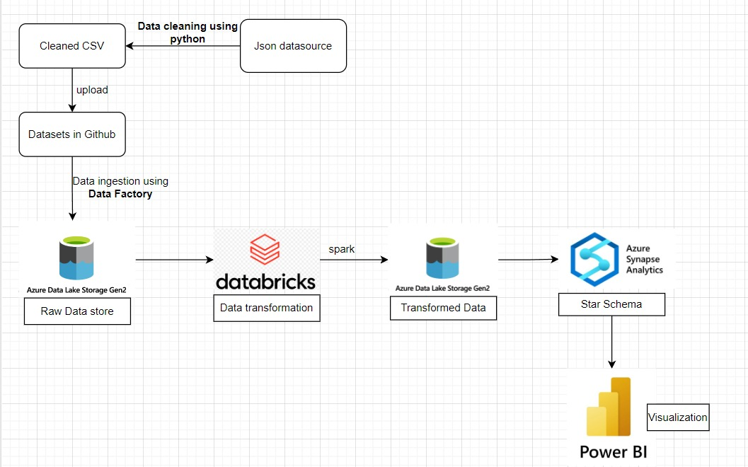
Workflow - 1

Slide 5
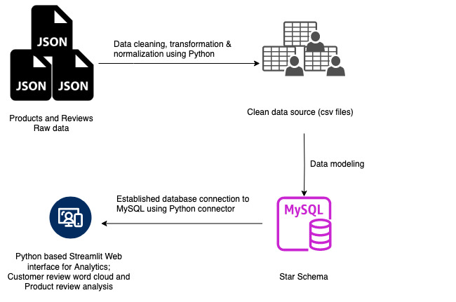
Workflow - 2

Slide 6
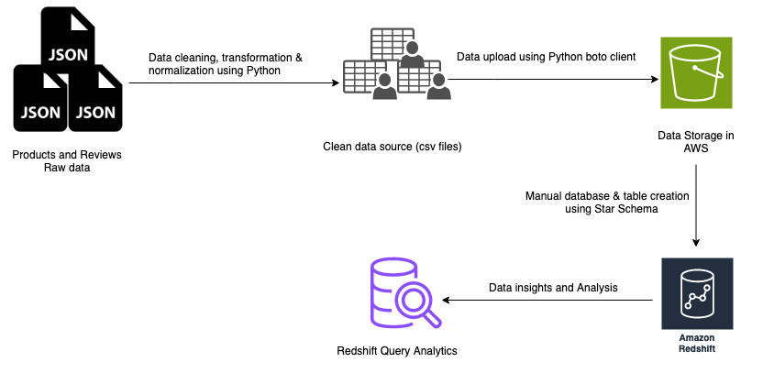
Workflow - 2

Slide 7
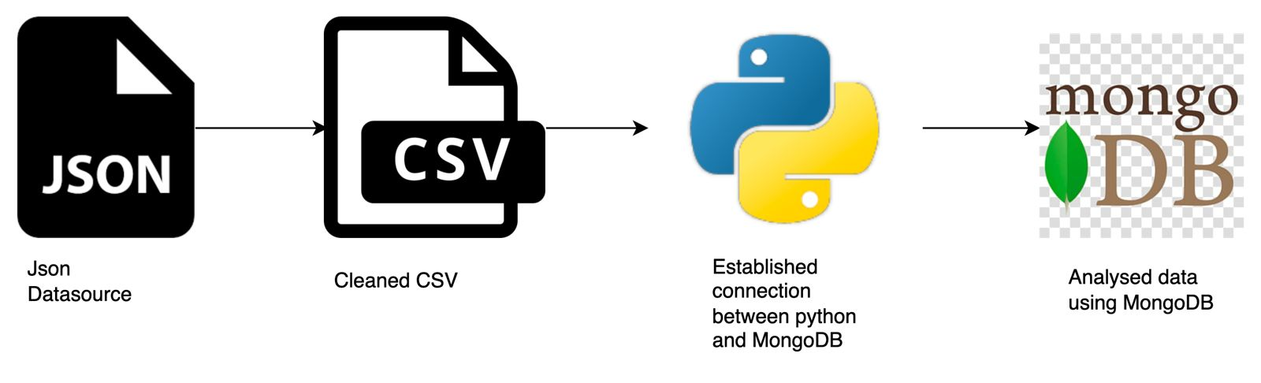
Workflow - 3

Slide 8
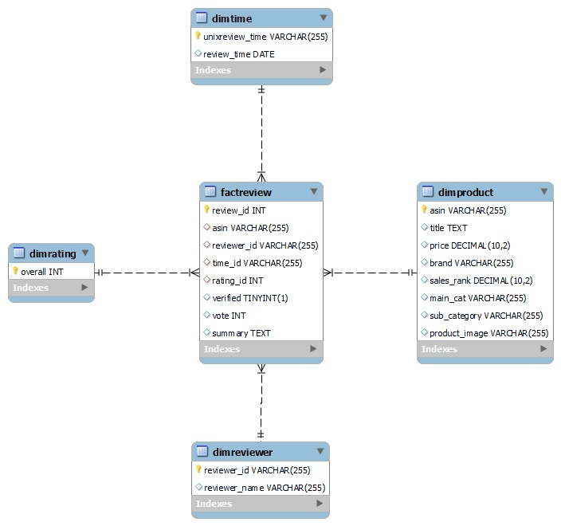
Data Model

Slide 9
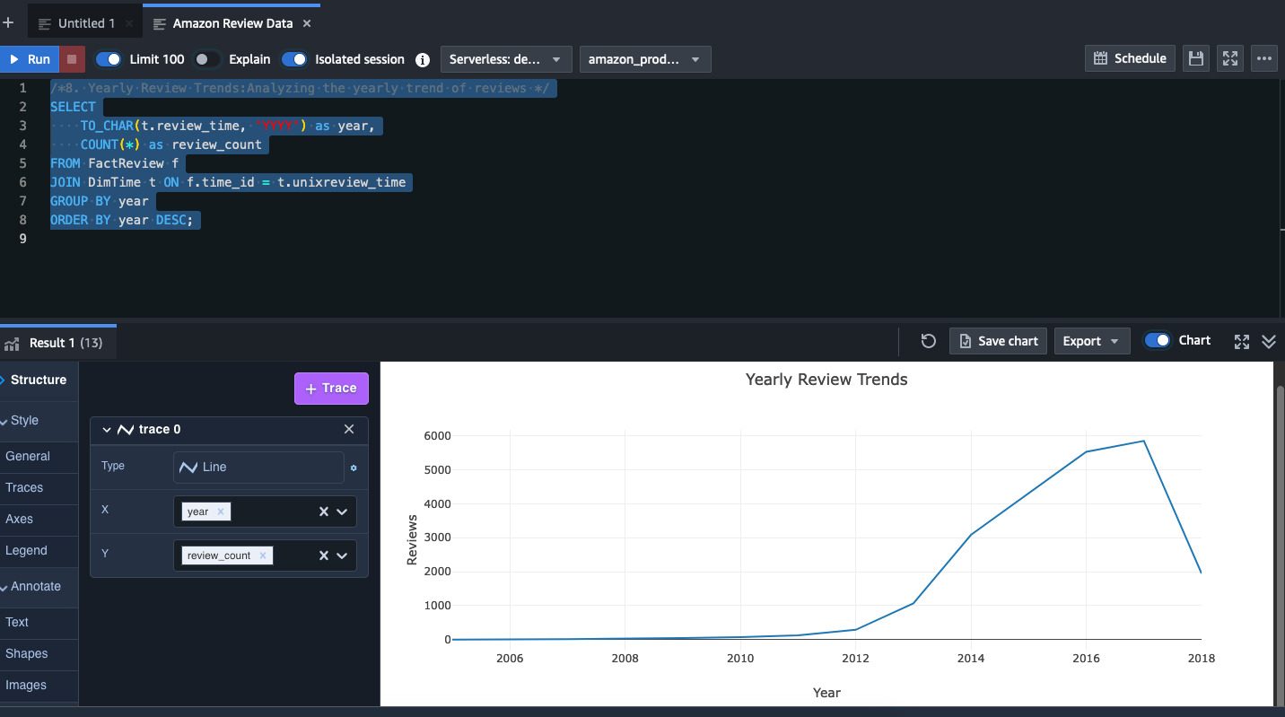
Results – Yearly Review Trends Analysis using Redshift Query Editor

Slide 10
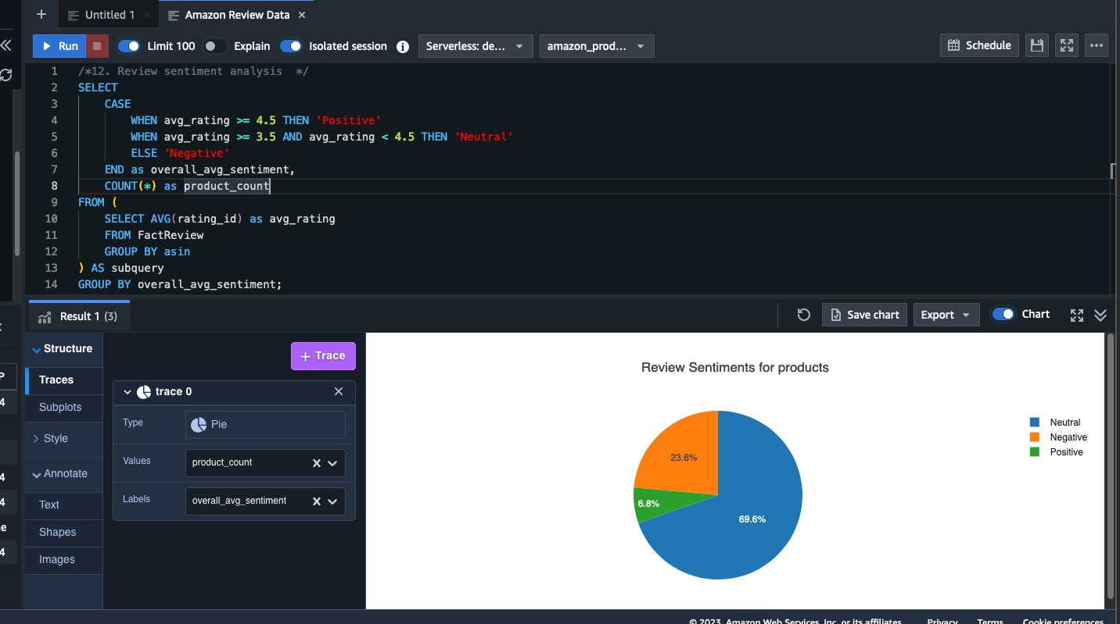
Results – Review Sentiment Analysis Analysis using Redshift Query Editor

Slide 11
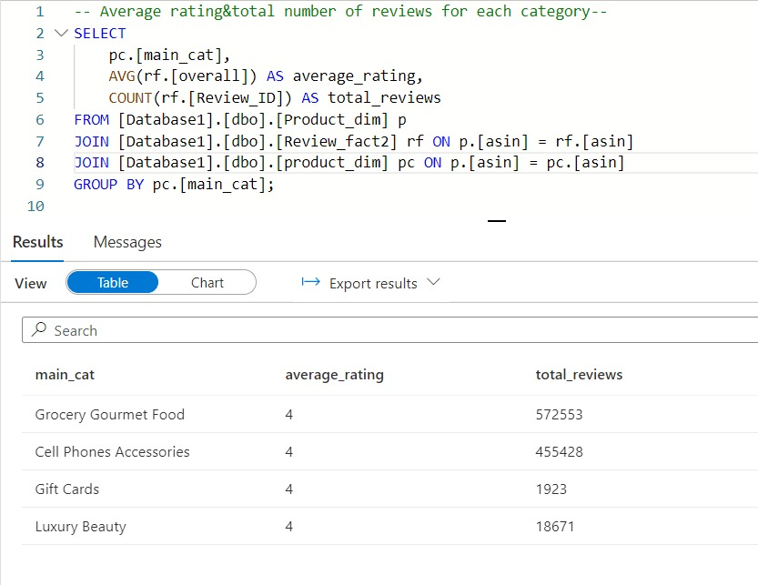
Results – Average Ratings & No. of reviews for each category in warehouse

Slide 12
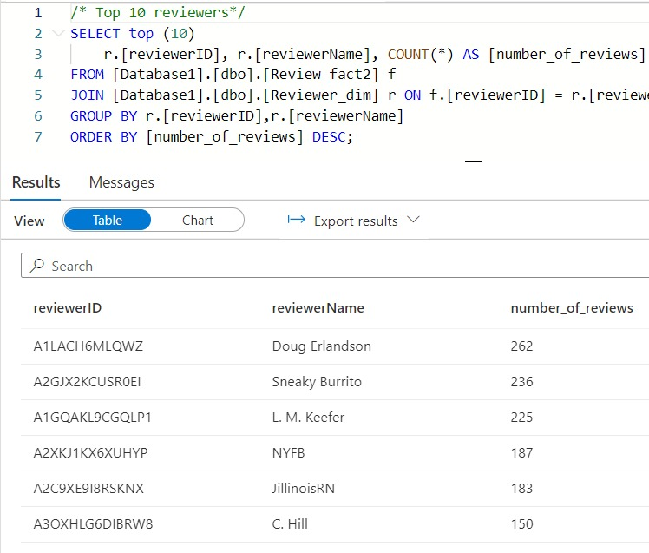
Results – Top 10 reviewers in warehouse

Slide 13
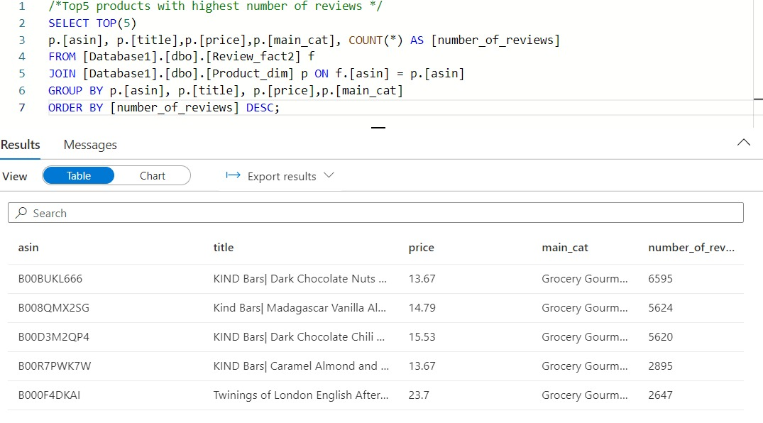
Results – Top 5 products with highest number of reviews in warehouse

Slide 14
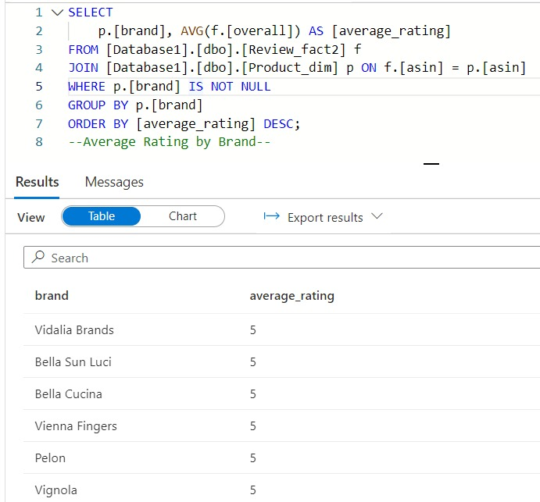
Results – Average review by brand in warehouse

Slide 15
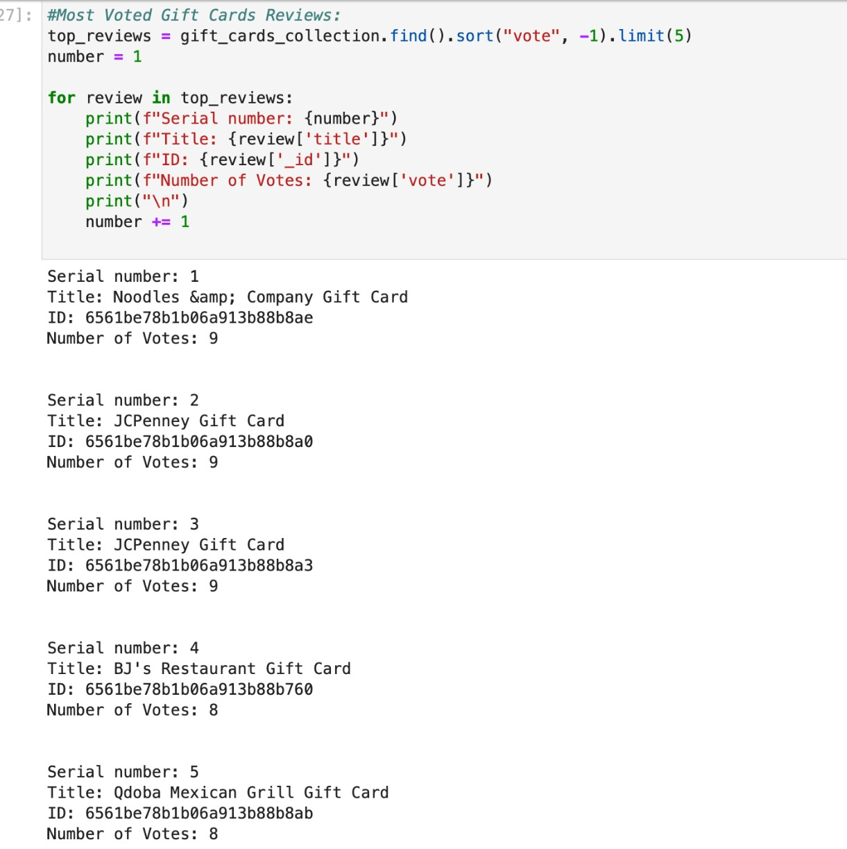
Results – Reviews with highest votes using NoSQL (MongoDB)

Slide 16
Key Learnings
Technical Integration: The difficulty of integrating tools such as SQL and Python highlighted the significance of tool selection.
Free vs. Premium Software: The limitations of free software were experienced, bringing to light the necessity of resource efficiency and tool selection.
Relationship mapping in databases demonstrated the importance of appropriate normalization and design in database design.
Dynamic Filtering in UI/UX: Using category-based filtering showed how to improve the way users search.
User Engagement: By concentrating on the process of product discovery, insights into enhancing user interaction on digital platforms were enhanced.

Slide 17
Technical Difficulties
Difficulties with Data Cleaning: Managing big datasets calls for a lot of computing power and knowledge.
Knowledge gaps: Poor comprehension of Azure Data Lake access role management and data warehousing.
Access Management: The difficulty of controlling user access to massive systems' data.
Due to computational limitations, the solution concentrated on important dataset categories.

Slide 18
Conclusion
Focus: Using information gleaned from Amazon reviews to support online businesses.
Utility: Assists companies in customizing offers based on actual client feedback and comprehension of product performance.
Impact: Provides an e-commerce competitive edge, aids in well-informed decision-making, and encourages a customer-centric mindset.
Goal: Using data-driven analysis to stimulate innovation and growth in online retail.

Slide 19
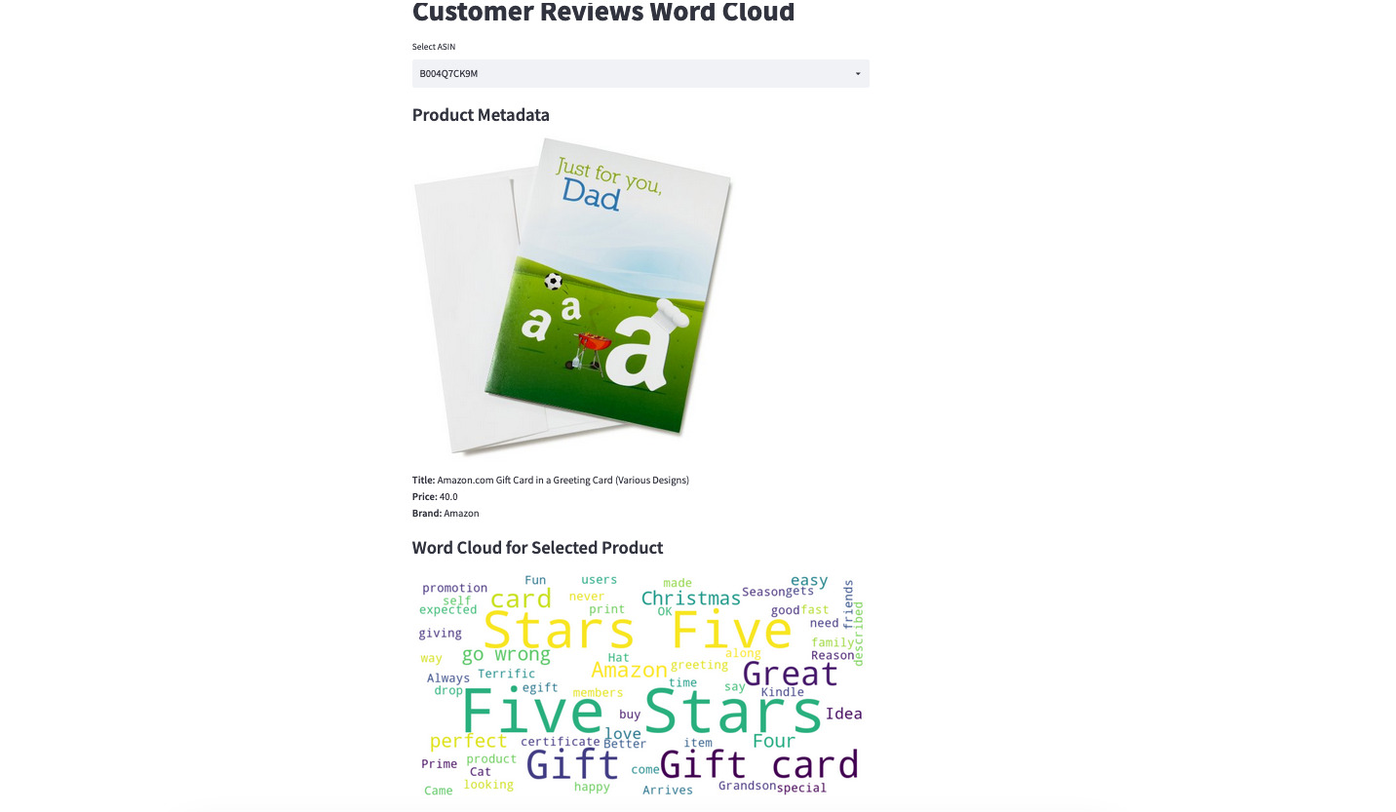
Demo: Expected Output

Slide 20
Future Work
Complex algorithms should be incorporated for in-depth sentiment analysis in advanced AI and ML.
Real-Time Analytics: Convert to processing data in real-time to gain instant insights.
Expansion of Data Sources: Increase the breadth of data integration by incorporating social media and various e-commerce platforms.
Create models to predict customer behavior and market trends using predictive modeling.
Enhance the user interface for improved accessibility and data interpretation (UI/UX).

Slide 21

Thank You, Any Questions?

