Slide 1
Campus Physical Bullying Detection Based on Sensor Data and Pattern Recognition
Saiwara Mahmud Tuhee ID - 20101465
CSE424
Section 1

Slide 2
Summary
Objective
Smartphone-based student status identification, with a focus on physical bullying detection.
Data Source
Smartphone's acceleration sensor and gyroscope.
Methods
Relief-F for feature selection, PCA for dimensionality reduction, k-NN for classification.

Slide 3
Introduction
Issue
Focus
Widespread campus bullying harms victims physically and mentally, often goes unreported due to fear, and requires preventive measures.
This paper introduces an automatic method for physical bullying detection using motion recognition.
Solution
Employ motion recognition technology driven by machine learning.

Slide 4
Existing methods
- Anti-bullying smartphone apps available.
- Current apps rely on manual reporting.
- Demand for automated bullying detection.
- Improved motion recognition technology.
- Proven suitability in smart home systems for campus bullying detection.

Slide 5
Methodology
Data Collection
Collected data cover both bullying (5 actions) and non-bullying (6 daily activities).
Data Types
Correcting data inaccuracies, including orientation correction, is performed.
Data Preprocessing
Correcting data inaccuracies, including orientation correction, is performed.
Noise Reduction
Wavelet filtering is applied to reduce noise in the data and improve its quality.

Slide 6
Experimental Setup
Feature Extraction
A comprehensive set of 57 features is extracted from the sensor data, encompassing both time and frequency domain statistical features.
Feature Selection
The Relief-F algorithm is used to select relevant features for classification.
Dimensionality Reduction
Cross-Validation
Principal Component Analysis (PCA) is employed to reduce the feature dimensionality while retaining essential information.
N-fold cross-validation is utilized to train and assess the classification model.

Slide 7
Data Processing
Classification Objective
Cross-Validation Protocol
Model Evaluation
The primary goal is to distinguish between bullying and non-bullying actions.
The N-fold cross-validation technique ensures robust model training and testing.
Results from multiple iterations are averaged to determine the system's overall performance and effectiveness.

Slide 8
Experiments
Sample Collection: A total of 299 samples, consisting of five bullying actions and six non-bullying actions, were collected.
Feature Extraction: 57-dimensional features were extracted for each sample.
Feature Selection and Reduction: Relief-F algorithm and PCA were used to select features and reduce dimensionality to four principal components.
Classifier Selection: The k-NN classifier was employed, and the optimal k value was determined through testing.
Accuracy Assessment: The classifier's performance was evaluated using a testing set.

Slide 9
Results
Optimal k Value: After comparison, the k-NN model with k = 5 was selected, demonstrating no over-fitting, and delivering satisfactory results.
Recognition Accuracy: The k-NN classifier achieved recognition accuracies of 84.13% for bullying actions and 76.92% for non-bullying actions.

Slide 10
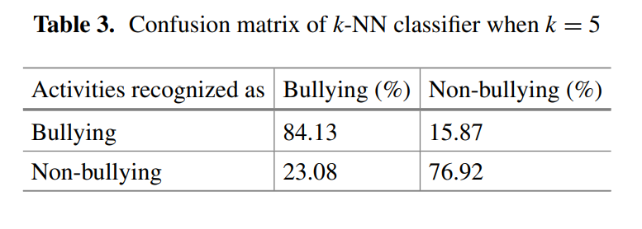
Results
Confusion Matrix: The classifier's performance is summarized in a confusion matrix, which is displayed in Table,
Performance Metrics: The provided statistics in percentage for a classification model are as follows: Accuracy = 80.46%
Precision = 77.94%
Recall = 84.13%
F1 Indicator = 80.92%.

Slide 11
Conclusion
- The feature extraction and reduction process effectively distinguishes bullying from non-bullying actions.
- The k-NN classifier achieves an average accuracy exceeding 80%, demonstrating its effectiveness.
- This approach holds promise for convenient and automated campus bullying detection using smartphones.
- The potential impact of this approach on addressing campus bullying and enhancing safety is significant.

