Slide 1
CSE6250_TEAM_L4
Temporal Self-Attention Network for Medical Concept Embedding

Slide 2
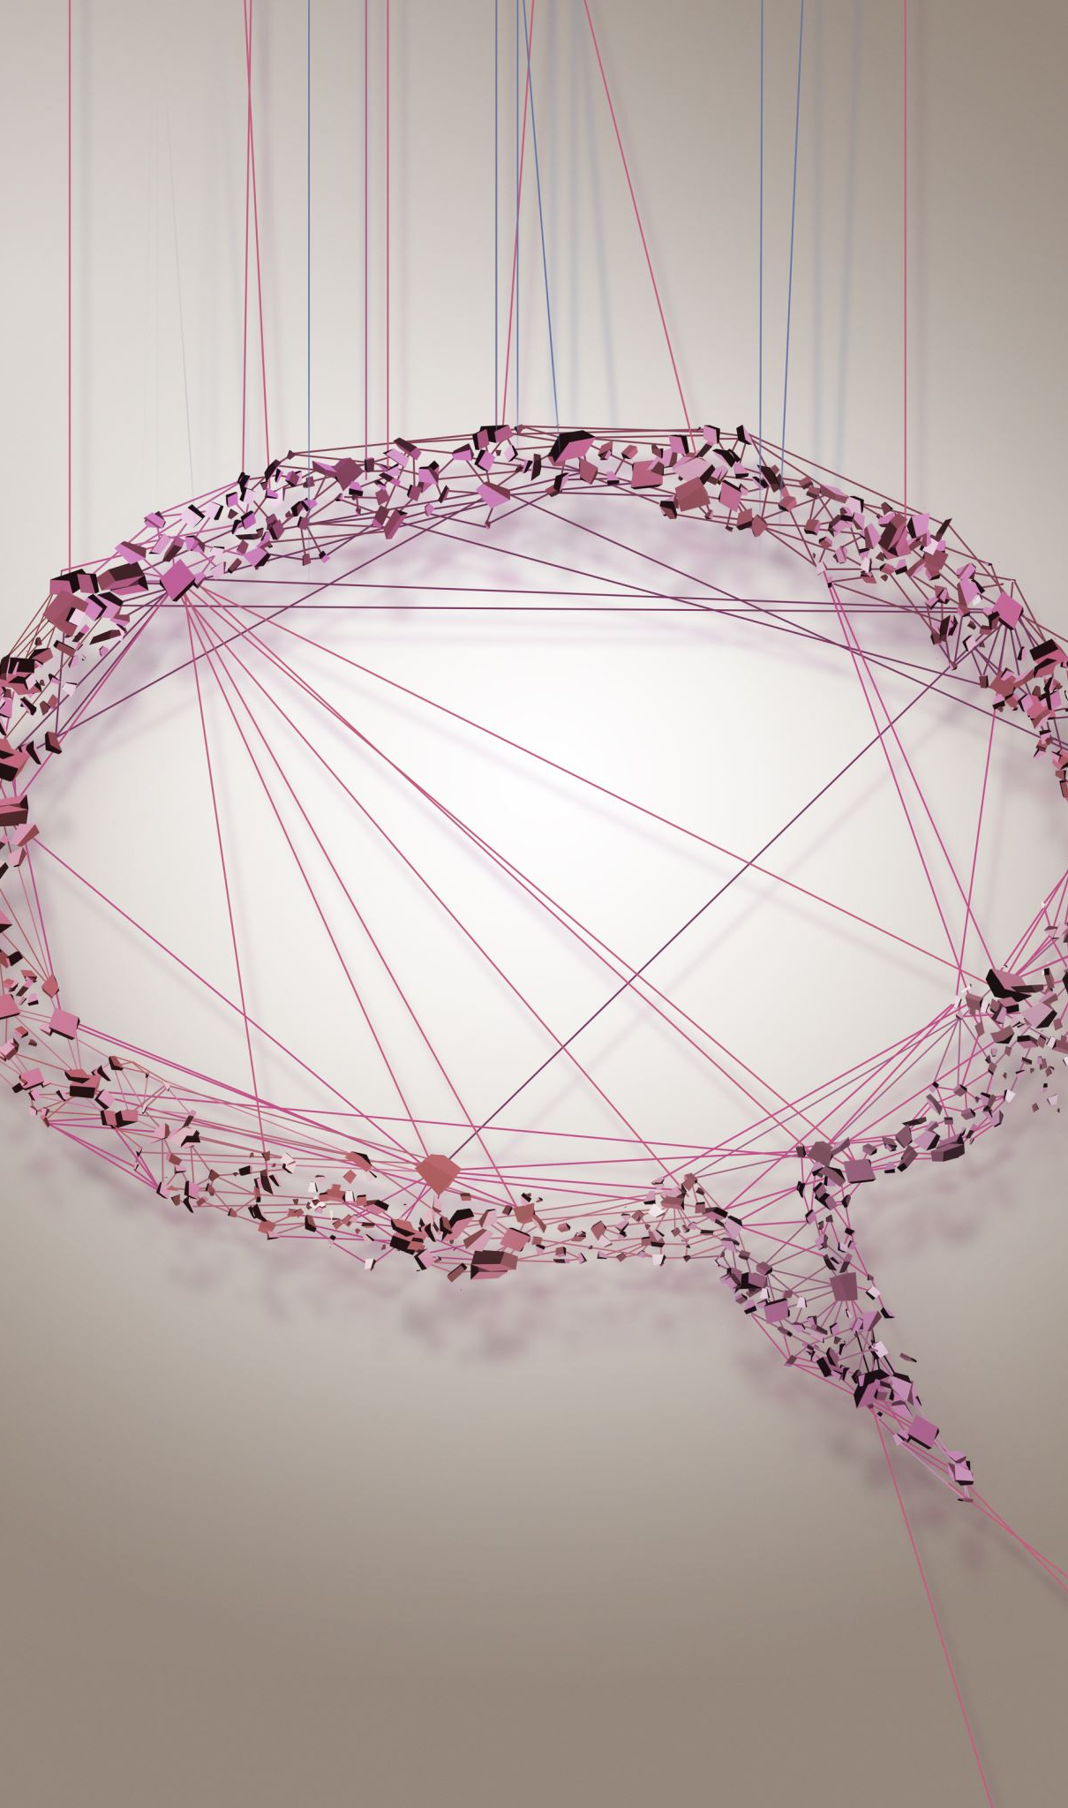
Introduction
The paper proposes a Temporal Self attention Network model named TeSAN. Given an input sequence of concept representation c, which is from concatenated visits in one patient journey, TeSAN first applies the TeSA block to capture the contextual relationship and temporal interval information.

Slide 3
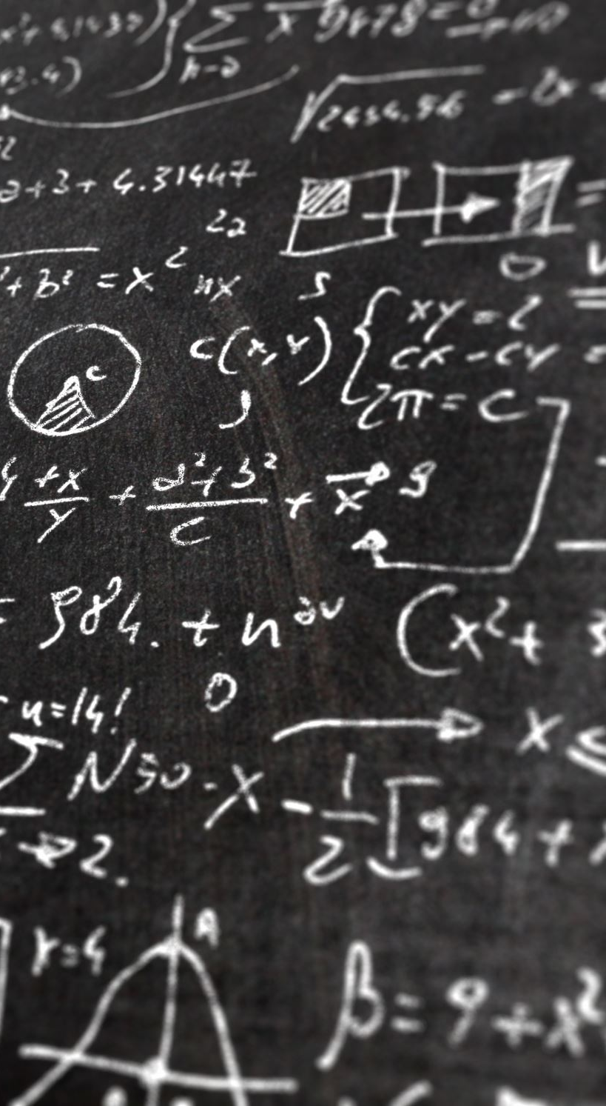
Hypothesis
Hypothesis 1:when using a smaler data pool comparedd to the research paper, TeSaN still has the better accuracy than CBOW on ICD encoding .
Hypothesis 2: when using a smaler data pool comparedd to the research paper, TeSAN has best performace for CCS Enoding.

Slide 4

Methodology
DATA
The Orignal paper performs the research on two seperate data sets MIMIC III and CMS dataset. Inorder to scale the research paper down and allow it to fit the timeframe and scope of the project, this recreation will only use the CMS dataset. CMS is a publicly available synthetic claims dataset, which includes four types of files: inpatient, outpatient, carrier and beneficiary summary. To replicate the data from the orignal paper, we will also only use a subset of inpatient files between 2008 and 2010.

Slide 5
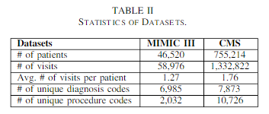

Slide 6
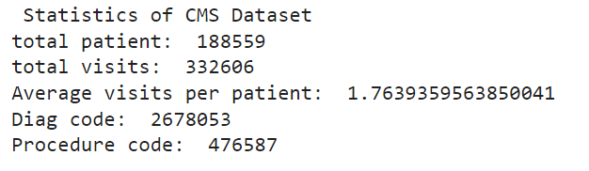

Slide 7
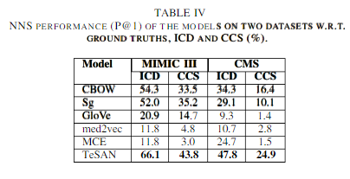
Notes:
best baseline model for NMI by 6.82% on ICD and 5.24%
on CCS over MIMIC III, and by 6.17% on ICD and 3.93%
on CCS over CMS; for P@1 by 11.8% on ICD and 8.6% on
CCS over MIMIC III, and by 13.5% on ICD and 8.5% on CCS
over CMS. The superior performance of TeSAN over the other
models can be explained by the introduction of the temporal
self-attention model and the incorporation of the contextual
information and temporal interval from the data, which creates
a better learner of the medical concept embeddings

Slide 8
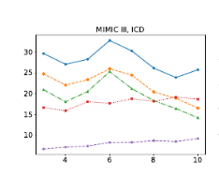

Slide 9
# Discussion
# Discussion
Through the research, it was found that although the paper is reproducible, the amount of work the paper puts in dn covers is enormous. Therefore only parts of the paper was reproducible or the scale of this class. Although similar results were achieved for the clustering algorithm, the Tesac algorithm was much harder to implement and could be said to not be easily reproducible.
For the next phase of my research i would like to continue the reproduction of this paper by implementing hte otehr algorithms other then clustering, also implementing the tesacc Algorithm to compare results to the original paper.

Slide 10
tesan/src/embedding/README.md at master · Xueping/tesan (github.com)
Xueping (Xueping Peng) (github.com)
tanlab/ConvolutionMedicalNer (github.com)
Computational Biology and Machine Learning lab @ TOBB ETU (github.com)

