Slide 1
Code Optimization Through Static Analysis
Course: CS 4TB3
McMaster University
By: Saiyam Sethi, Yash Patel, Jack Witek

Slide 2
Why Optimize Code?
Reduce code run-time
Reduce processor utilization
Improve portability of software across multiple systems.

Slide 3
Big – O Notation
Describes the running time of algorithms with respect to their upper bounds (worst case)
Used to analyze the overall efficiency of computer programs

Slide 4
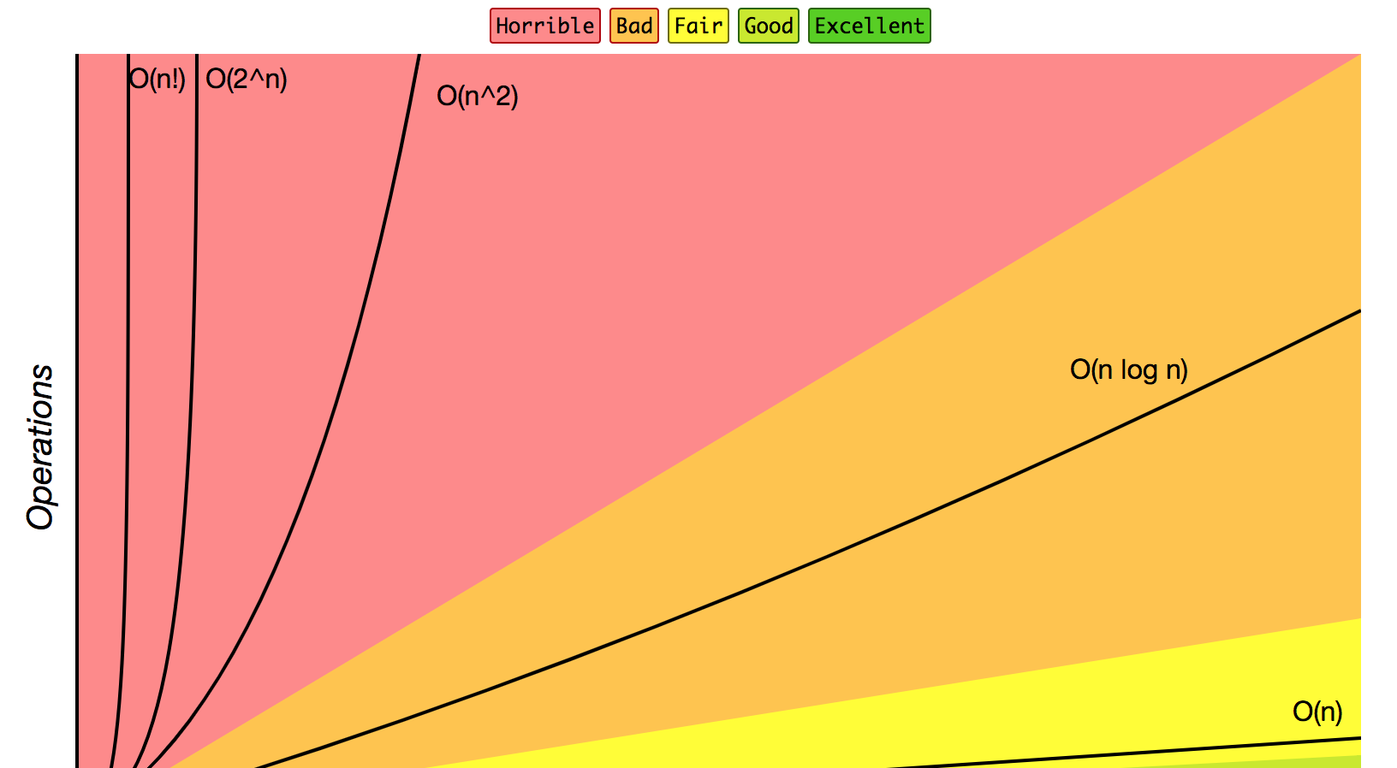
Notes:
http://bigocheatsheet.com/

Slide 5
Areas of Optimization
Nested for-loop optimization
If-else and removal of the else clause
Finite differences to avoid multiplication
Loop overhead optimization
Data type considerations

Slide 6
Nested For-Loop Optimization
Un - Optimized | Optimized
For (int i = 1; i <= N; i++) { for (int j = 1; j <= N; j++) { System.out.print(“foo”); } System.out.println(“Hello”); } | for(int i=1; i<=N*N; i++) { System.out.print(“foo”); if(i%N==0) { System.out.println(“Hello”); } }
Run Time Analysis (N = 10, 100, 1000)
Notes:
Talk about how the un-optimized code has a big O run time of O(N^2) and the optimized code has a big O run time of O(N*N)

Slide 7
If-Else Clause Optimization
Un - Optimized | Optimized
If (x >5) { y = True; } else { y = False; } | Y = false; If (x >5) { y = True; }
Run Time Analysis
Notes:
An “Else” clause results in branching in low-level assembler code. As such, removing the “Else” clause reduces the number of instructions a processor has to carry out during execution of the program.

Slide 8
Finite Differences To Avoid Multiplication
Un - Optimized | Optimized
for(i=0;i<10;i++) { printf(“%d\n”,i*10); } | for(i=0;i<100;i+=10) { printf(“%d\n”,i); }
Run Time Analysis
Notes:
Addition is faster than multiplication, however it depends on your machine. Addition usually takes about 1 CPU clock cycle to perform, while multiplication may take 2-4 CPU clock cycles. Nowadays, multiplication is in the same speed class as addition, but still not exactly as fast. However, as the complexities of programs get bigger, the change in computation speed is often noticeable.

Slide 9
Loop Overhead Optimization
Un - Optimized | Optimized
For(i=0;i<100;i++) { map[i].visited = 0; } | i=99; do { map[i].visited = 0; i--; } while(i >= 0);
Run Time Analysis

Slide 10
Live Demo

