Slide 1

Inventory Management System
By Saiyash Poojari

Slide 2

Index
Problem Statement
Your solution
Working (Method/Mind map)
Conclusion.
Note: Slides (excluding Thank-you and Introduction slide) should not be more than 4.

Slide 3
Problem Statement
Inventory Management System (C++)
Many small businesses and stores manage inventory manually, which can lead to errors, incorrect stock tracking, and difficulty managing product information.
Problems with manual inventory management:
Difficult to track product quantity
Chances of human error
Time-consuming stock updates
Hard to monitor total inventory value
Therefore, a simple Inventory Management System is needed to manage products, update stock, and display inventory efficiently.

Slide 4
Your Solution
To solve this problem, we developed a menu-driven Inventory Management System using C++.
The system allows users to:
Add new products
Update stock quantities
View inventory details
Calculate total inventory value
Technologies and concepts used:
C++ programming language
Structures for product data
Arrays to store multiple products
Loops and conditional statements
Menu-driven console interface
This system improves accuracy, efficiency, and inventory tracking.

Slide 5
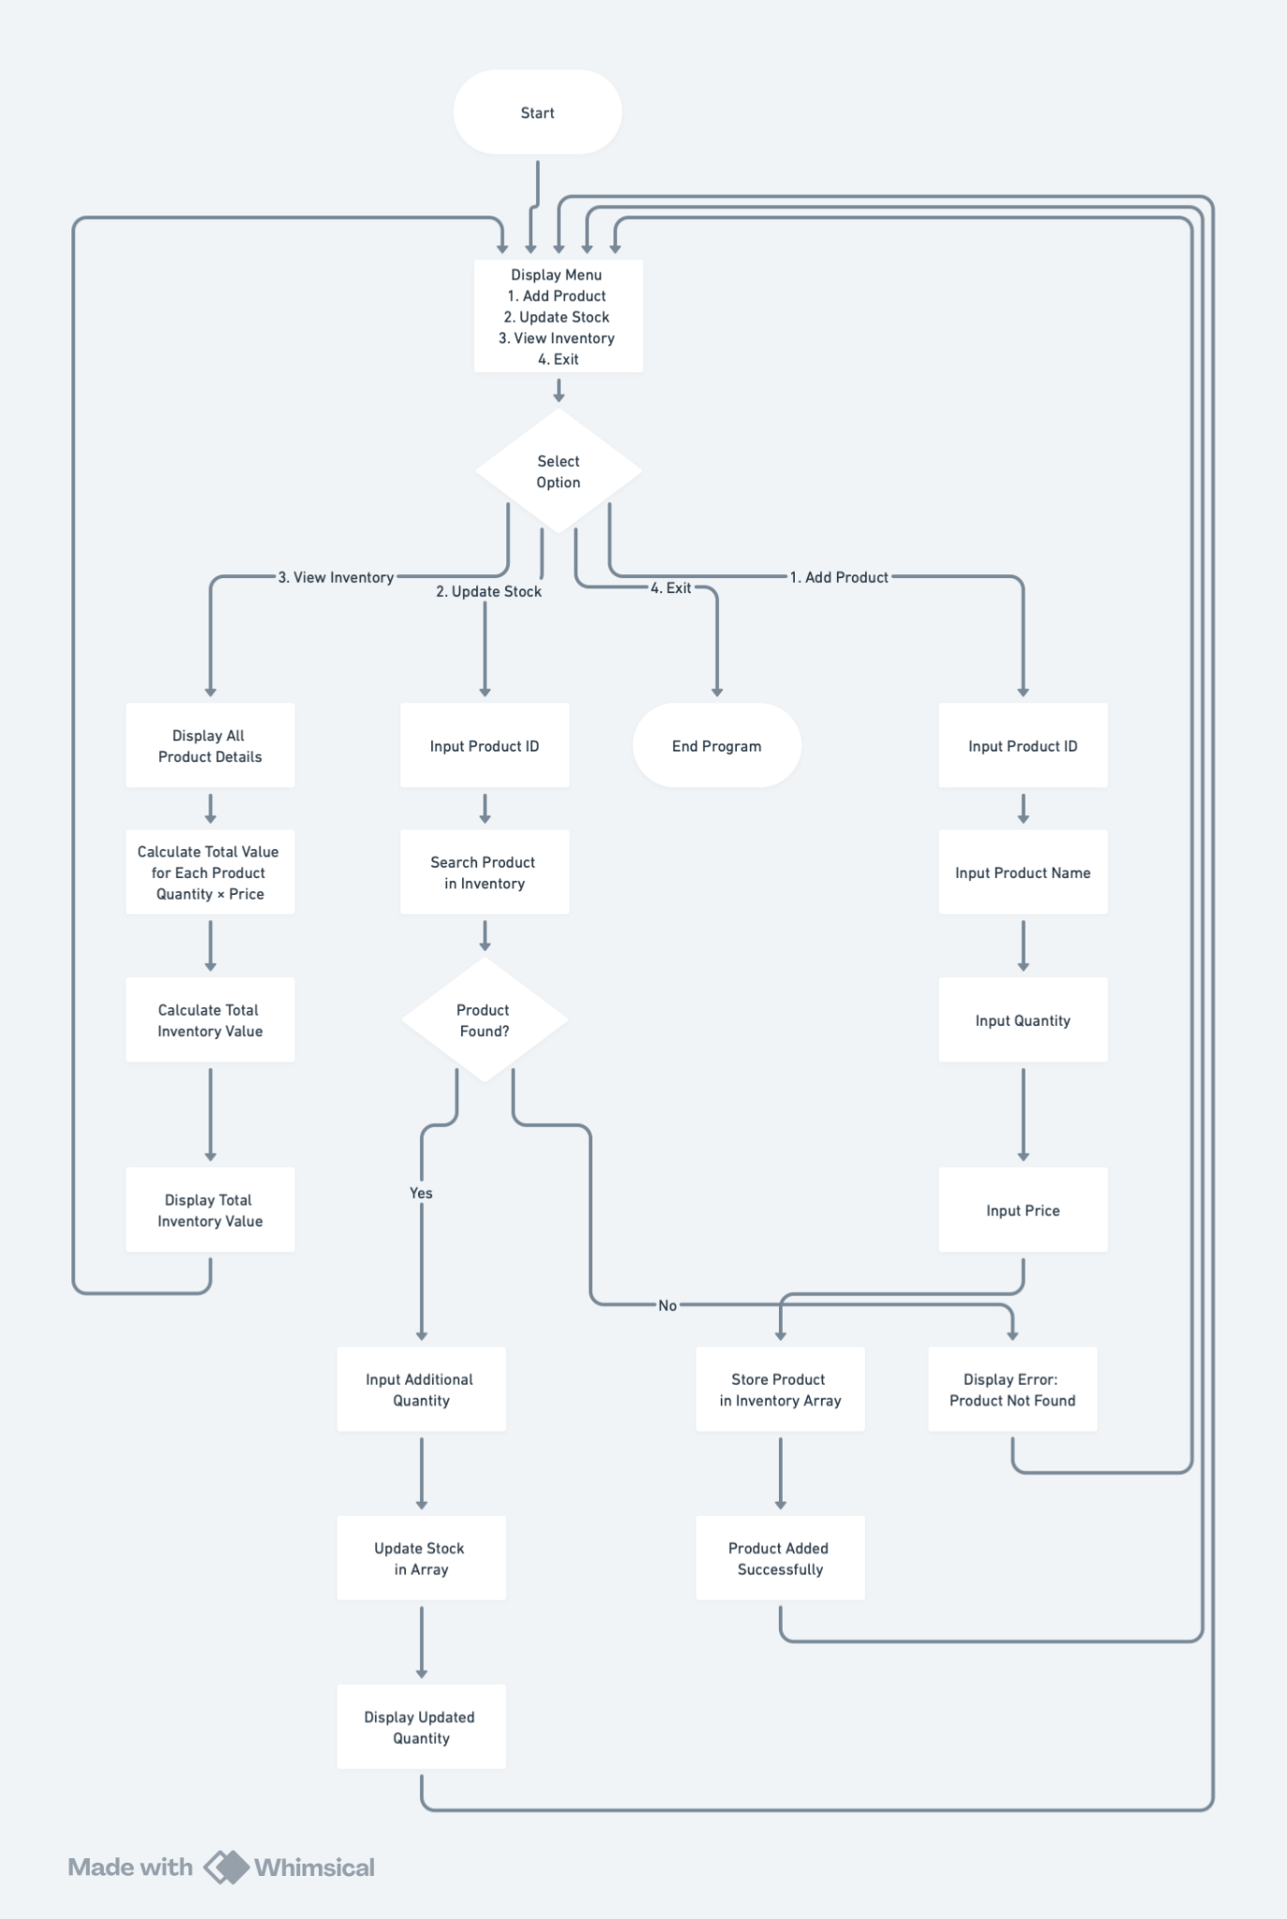
Working (Mind Map)
Working (Mind Map)

Slide 6
Conclusion
The Inventory Management System successfully demonstrates how basic C++ programming concepts can be used to build a practical application.
Achievements of the system:
Efficient product management
Accurate stock updates
Organized inventory data
Calculation of total inventory value
This project provides a foundation for more advanced systems, such as database-based inventory management or graphical user interface applications.

Slide 7
Thank You

