Slide 1
Sparse Identification for Non-linear Dynamical systems(SINDy)
Current Topics in Numerical Analysis

Slide 2

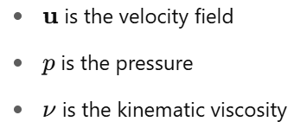
Necessity for sparse models in applications
Turbulent fluid flows—such as those around aircraft wings, engine inlets, or fuselages—are governed by the Navier–Stokes equations, which capture the rich and often chaotic dynamics of fluid motion.
However, solving or even interpreting them analytically is rarely feasible due to their nonlinearity and high dimensionality.
Some real-time control systems (such as to adjusting fuel injection) requires computation of such complex non-linear dynamical equations to be made in milliseconds.
where:

Slide 3
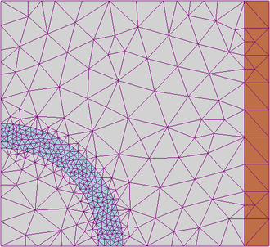
Background and Motivation
Challenges with Traditional Methods:
1. First-Principles (CFD – Computational Fluid Dynamics):
Solves full Navier–Stokes equations numerically on millions of mesh elements.
Problems:
Extremely expensive – takes hours/days on supercomputers.
Hard to interpret – doesn’t yield compact, low-order models.
Not real-time – infeasible for control or onboard applications.
2. Symbolic Regression
Searches over combinations of mathematical operations to fit dynamic equations to data.
Problems:
Combinatorially explosive – too slow to scale.
Overfitting risk – grows unstable as search space expands.
Motivation: To enable such real-time control applications, we need fast, low-dimensional models that approximate the dominant behavior of the fluid with enough accuracy, while being interpretable and computationally efficient.
Figure1: Finite Element Mesh for a 2D Circular Inclusion[1]

Slide 4
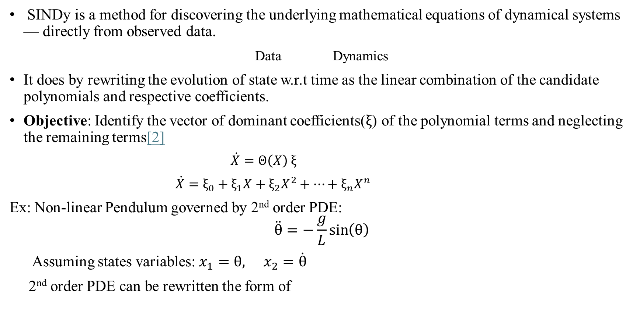
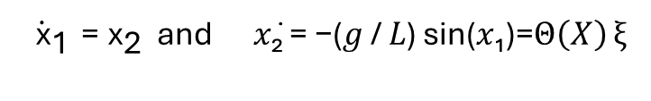
Idea of Sparse Identification for Non-linear Dynamical systems(SINDy)
SINDy is a method for discovering the underlying mathematical equations of dynamical systems — directly from observed data.
Data Dynamics
It does by rewriting the evolution of state w.r.t time as the linear combination of the candidate polynomials and respective coefficients.
Objective: Identify the vector of dominant coefficients($ξ$) of the polynomial terms and neglecting the remaining terms[2]
$\dot{X}=Θ\left(X\right)$ $ξ$
$\dot{X}=ξ_{0}+ξ_{1}X+ξ_{2}X^{2}+⋯+ξ_{n}X^{n}$
Ex: Non-linear Pendulum governed by 2nd order PDE:
$$\ddot{θ}=−\frac{g}{L}\sin\left(θ\right)$$
Assuming states variables: $x_{1}=θ, x_{2}=\dot{θ}$
2nd order PDE can be rewritten the form of
$\dot{{ \text{x}}_{\text{1}}}\text{ = }{\text{x}}_{\text{2}}$ and 𝑥̇₂ = −(𝑔 / 𝐿) sin(𝑥₁)=$Θ\left(X\right)$ $ξ$

Slide 5
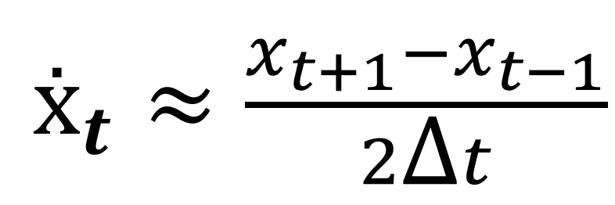
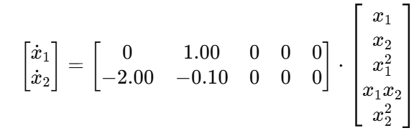
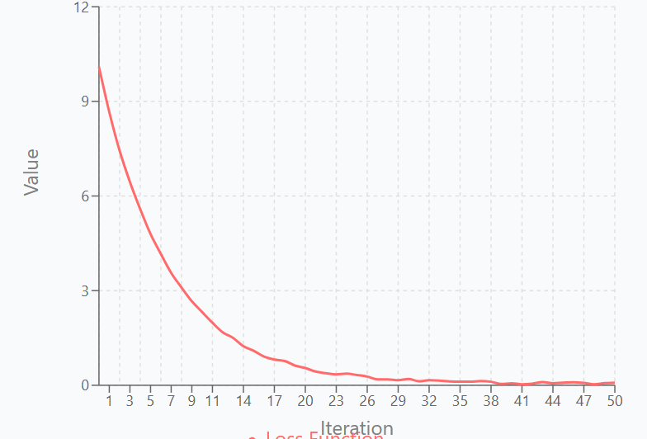
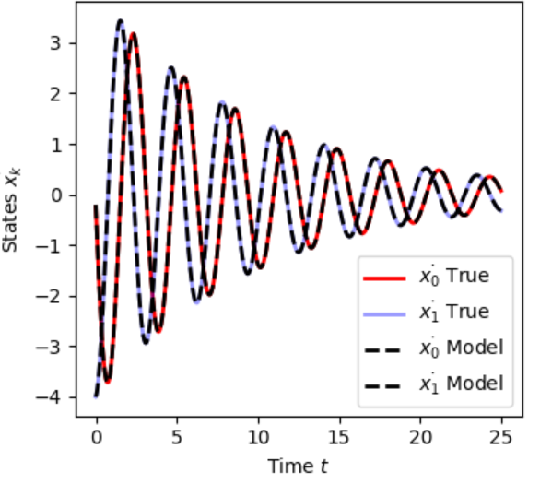
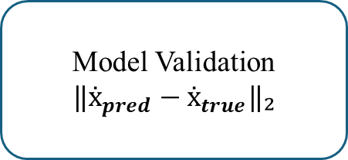
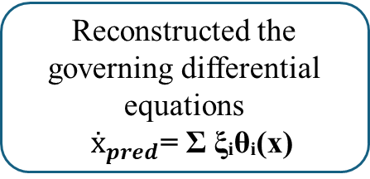
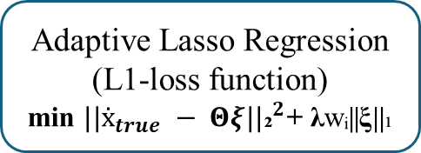
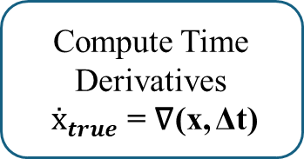
Working: Overview of SINDy algorithm
Time Series Measurements of state variables
x(t), t ∈ [0, Δt,2Δt,…,T]
Generate combinations of exponents
E = [(0,0), (1,0), (0,1), (2,0), (1,1), (0,2), ...]
Build Function library Matrix Θ
Θ = [1, x₁, x₂, x₁²,...]
Compute Time Derivatives
$ẋ_{true}$ = ∇(x, Δt)
Model Validation
$$‖ẋ_{pred}−ẋ_{true}‖₂$$
Reconstructed the governing differential equations
$ẋ_{pred}$= Σ ξᵢθᵢ(x)
Identify active sparse coefficients
(ξᵢ ≠ 0)
Adaptive Lasso Regression
(L1-loss function)
min ${||ẋ_{true} − Θξ||\text{₂}}^{2}$+ λwᵢ||ξ||₁

Slide 6

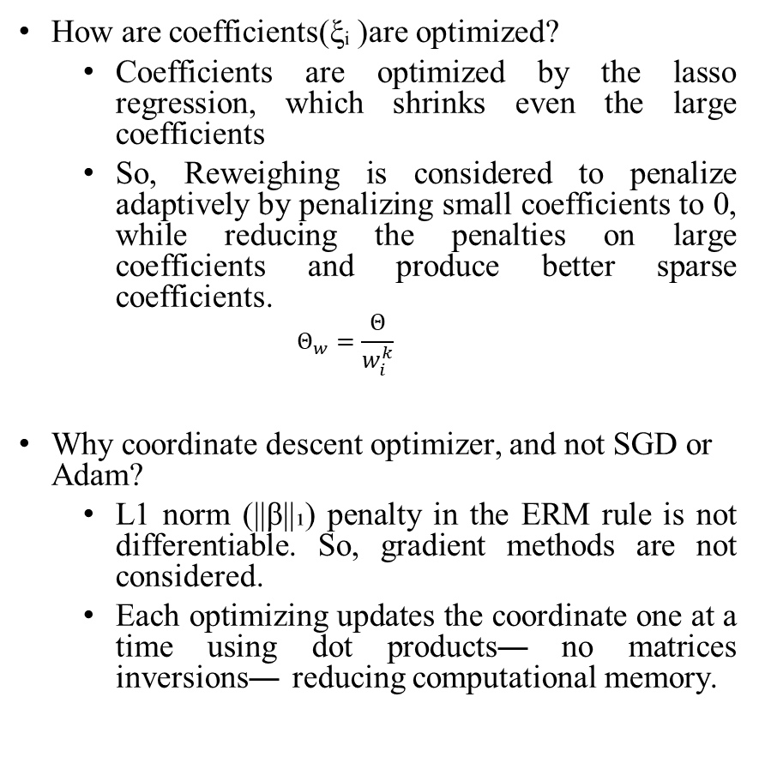

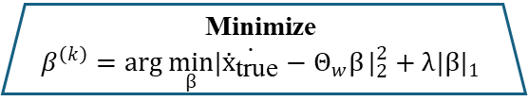




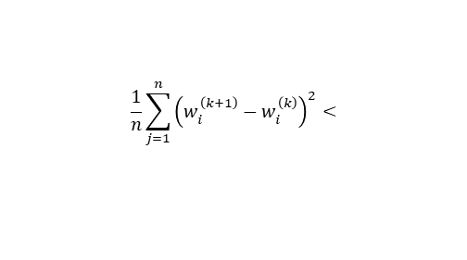
Working: Optimization of coefficients
Start
Initialize weights and $β$
$w_{0}$=[1,1,1…,1]
How are coefficients(ξᵢ )are optimized?
Coefficients are optimized by the lasso regression, which shrinks even the large coefficients
So, Reweighing is considered to penalize adaptively by penalizing small coefficients to 0, while reducing the penalties on large coefficients and produce better sparse coefficients.
$$Θ_{w}=\frac{Θ}{w_{i}^{k}}$$
Why coordinate descent optimizer, and not SGD or Adam?
L1 norm (||β||₁) penalty in the ERM rule is not differentiable. So, gradient methods are not considered.
Each optimizing updates the coordinate one at a time using dot products— no matrices inversions— reducing computational memory.
Reweighed matrix
$Θ_{w}$= Θ/$w_{i}^{k}$
Minimize
$$β^{\left(k\right)}=\arg{\min_{β}\left.|\dot{ẋ_{\text{tr}\text{ue}}}−Θ_{w}β\right.}|_{2}^{2}+λ|β|_{1}$$
Recover unweighted coefficients
ξᵢ⁽ᵏ⁾ = $β^{\left(k\right)}$/ $w_{i}^{k}$
$β,\text{ξ}$ optimized
i=i+1
Update weights
wᵢ⁽ᵏ⁺¹⁾ = 1 / (${\text{|}\text{ξ}\text{ᵢ⁽ᵏ⁾|}}^{δ}$ + ε)
N
Max Iteration reached?
N
$$\frac{1}{n}\sum_{j=1}^{n}{{\left(w_{i}^{\left(k+1\right)}−w_{i}^{\left(k\right)}\right)}^{2}}<$$
$${\text{ε}}_{tol}$$
Y
Y
Final coefficients ξ.
Max. iterations reached
Converged with final coefficients ξ

Slide 7

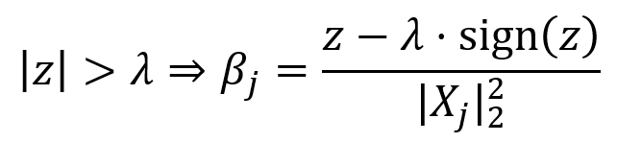
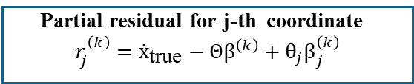
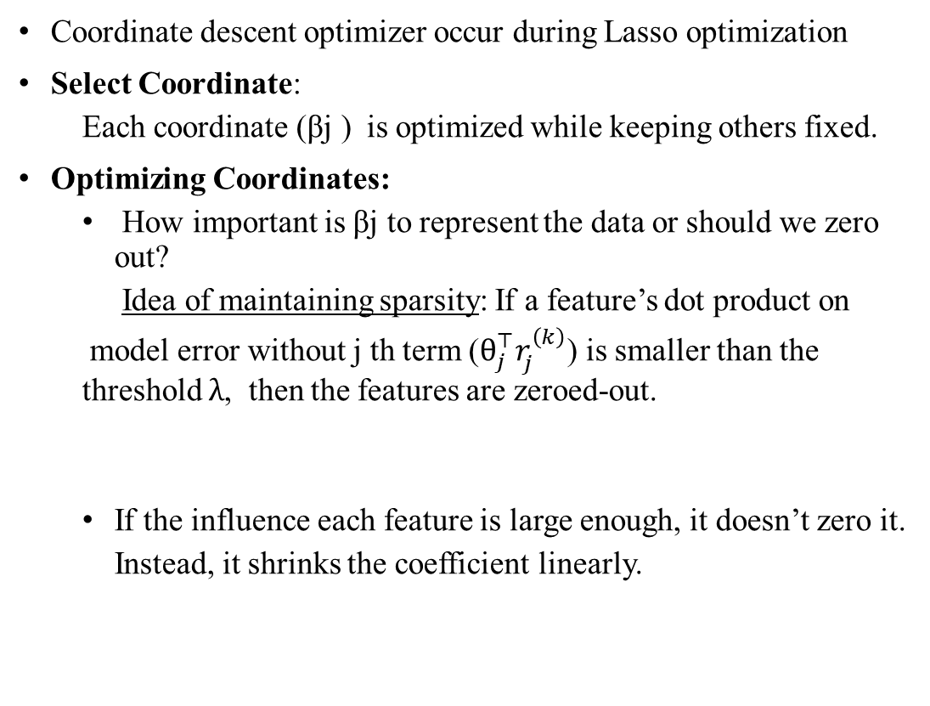
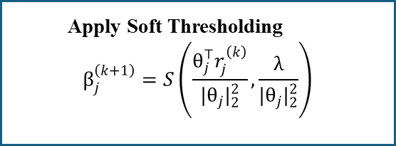
Working: Sparsity threshold in Coordinate-descent optimizer
START
Input: Θ , Ẋ
Coordinate descent optimizer occur during Lasso optimization
Select Coordinate:
Each coordinate (βj​ ) is optimized while keeping others fixed.
Optimizing Coordinates:
How important is βj​ to represent the data or should we zero out?
Idea of maintaining sparsity: If a feature’s dot product on
model error without j th term ($θ_{j}^{⊤}r_{j}^{\left(k\right)}$) is smaller than the threshold $λ$, then the features are zeroed-out.
If the influence each feature is large enough, it doesn’t zero it.
Instead, it shrinks the coefficient linearly.
Initialize Coefficients
Iterate through each coefficient
j = 1, 2, ..., p
Partial residual for j-th coordinate
$$r_{j}^{\left(k\right)}=ẋ_{\text{true}}−Θβ^{\left(k\right)}+θ_{j}β_{j}^{\left(k\right)}$$
j= j+1
Apply Soft Thresholding
$$β_{j}^{\left(k+1\right)}=S\left(\frac{θ_{j}^{⊤}r_{j}^{\left(k\right)}}{|θ_{j}|_{2}^{2}},\frac{λ}{|θ_{j}|_{2}^{2}}\right)$$
Update weights and compute ξ
N
Y
Converged with final coefficients ξ

Slide 8
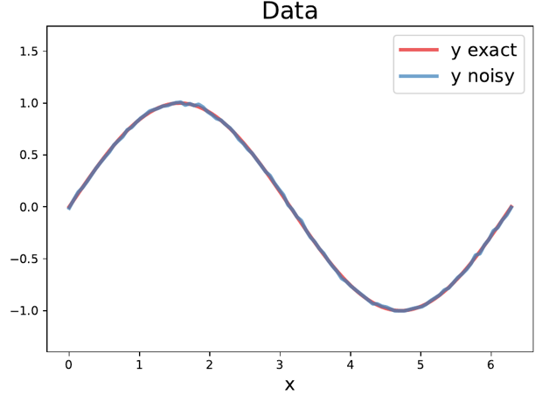
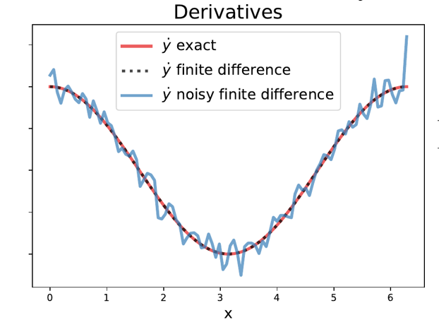

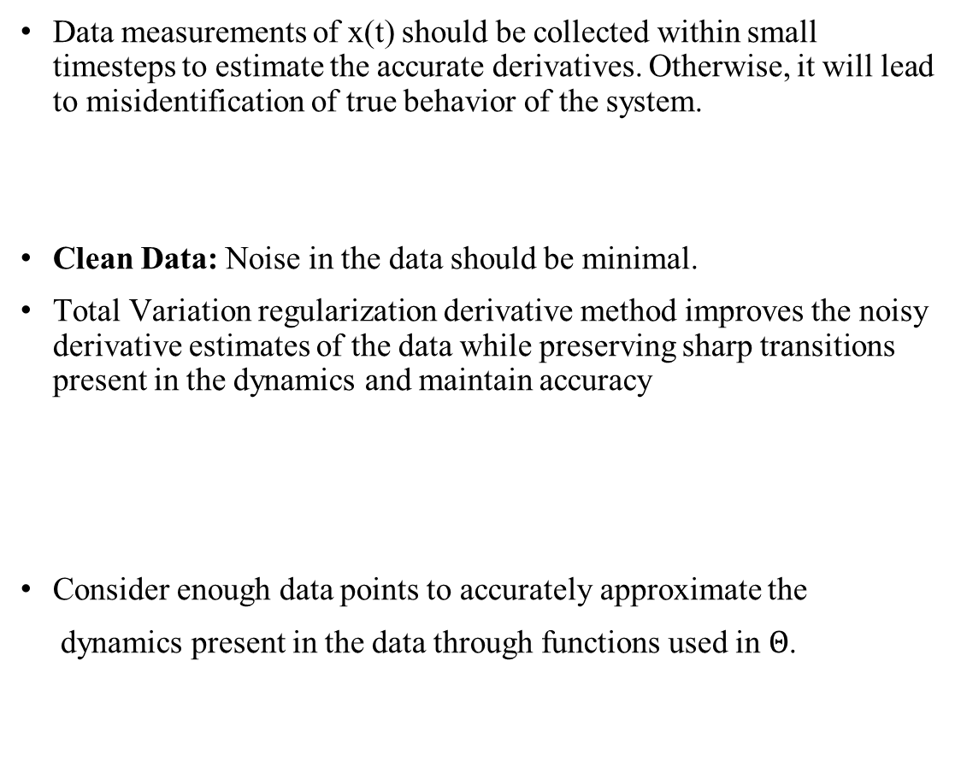
Data Considerations for SINDy
Data measurements of x(t) should be collected within small timesteps to estimate the accurate derivatives. Otherwise, it will lead to misidentification of true behavior of the system.
Clean Data: Noise in the data should be minimal.
Total Variation regularization derivative method improves the noisy derivative estimates of the data while preserving sharp transitions present in the dynamics and maintain accuracy
Consider enough data points to accurately approximate the
dynamics present in the data through functions used in $Θ$.
Figure2: Effect of noise on derivatives computed through finite differentiation [3]

Slide 9
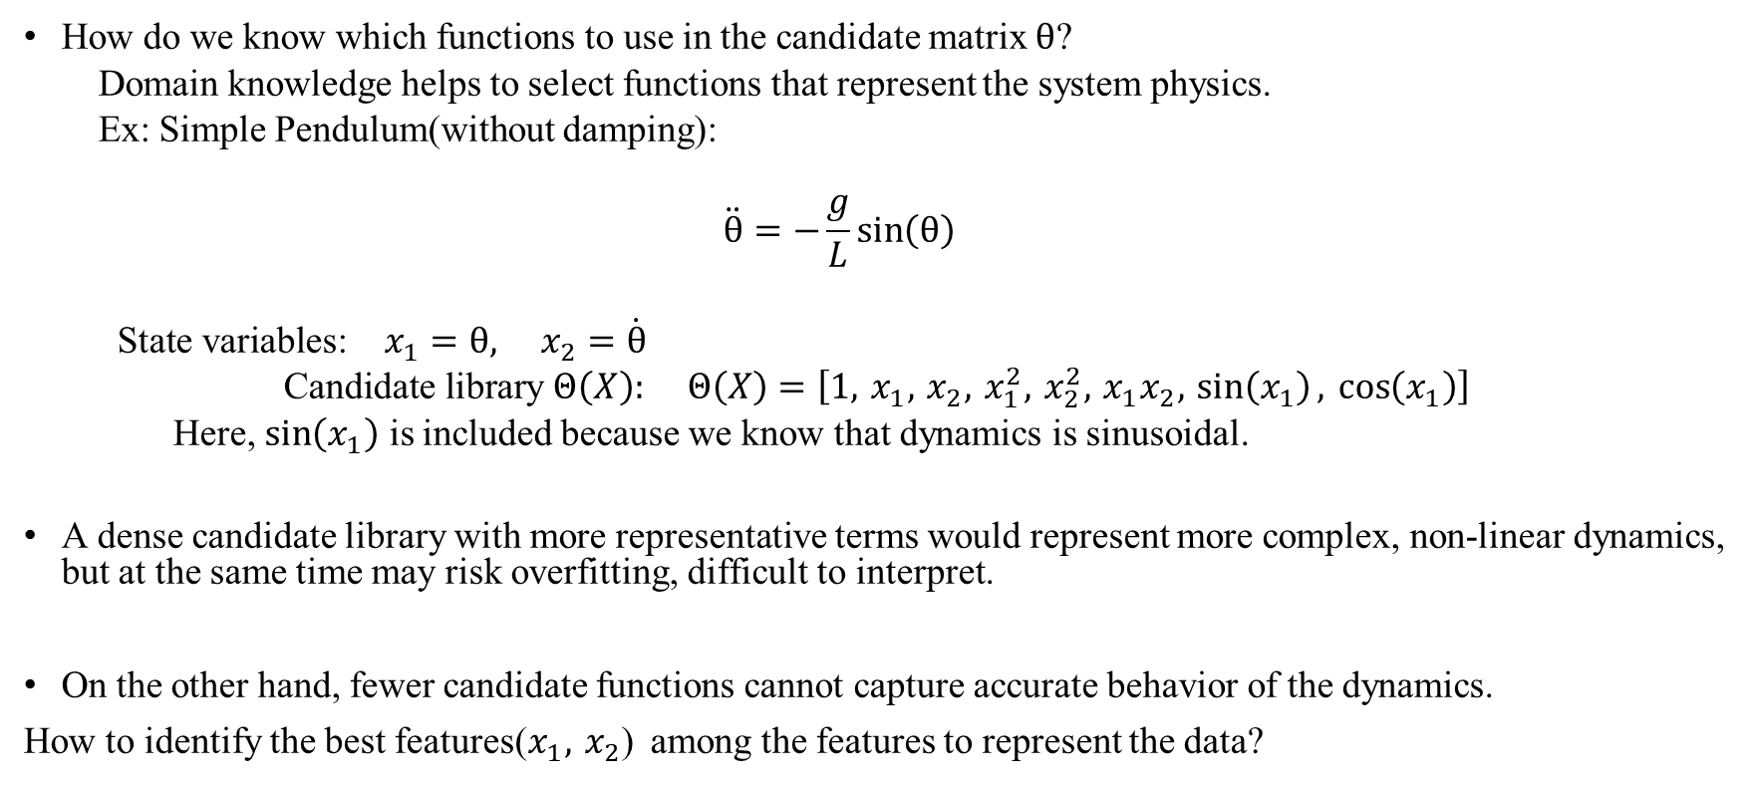


Construction of Candidate matrix $Θ$ in SINDy
How do we know which functions to use in the candidate matrix $θ$?
Domain knowledge helps to select functions that represent the system physics.
Ex: Simple Pendulum(without damping):
$$\ddot{θ}=−\frac{g}{L}\sin\left(θ\right)$$
$\text{State} \text{variables}\text{:} x_{1}=θ, x_{2}=\dot{θ}$
$$\text{Candidate} \text{library} Θ\left(X\right): Θ\left(X\right)=\left[1, x_{1}, x_{2}, x_{1}^{2}, x_{2}^{2}, x_{1}x_{2}, \sin\left(x_{1}\right), \cos\left(x_{1}\right)\right]$$
Here, $\sin\left(x_{1}\right)$ is included because we know that dynamics is sinusoidal.
A dense candidate library with more representative terms would represent more complex, non-linear dynamics, but at the same time may risk overfitting, difficult to interpret.
On the other hand, fewer candidate functions cannot capture accurate behavior of the dynamics.
How to identify the best features($x_{1}, x_{2}$) among the features to represent the data?
$\dot{{\text{x}}_{\text{1}}}\text{ = }{\text{x}}_{\text{2}}$ and 𝑥̇₂ = −(𝑔 / 𝐿) sin(𝑥₁)

Slide 10
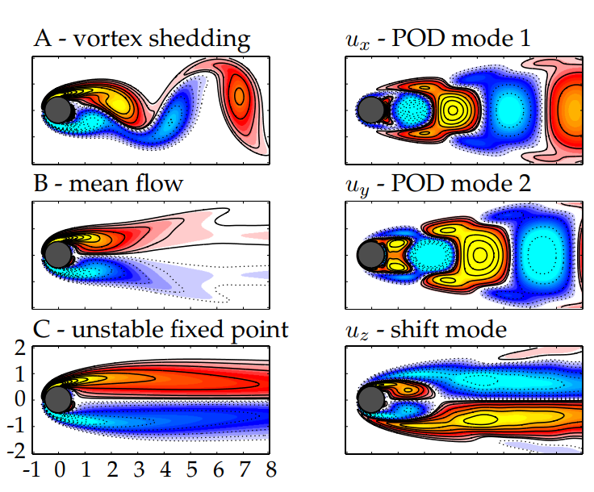

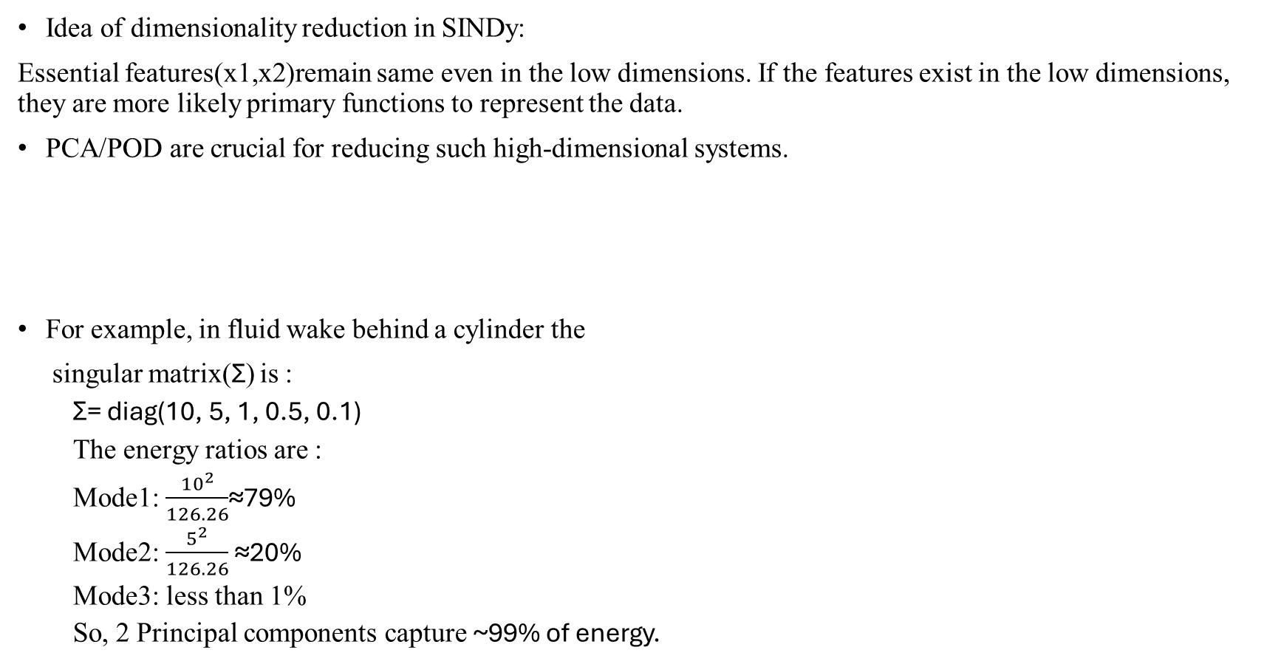

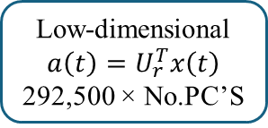
Dimensionality reduction of candidate features
Idea of dimensionality reduction in SINDy:
Essential features(x1,x2)remain same even in the low dimensions. If the features exist in the low dimensions, they are more likely primary functions to represent the data.
PCA/POD are crucial for reducing such high-dimensional systems.
For example, in fluid wake behind a cylinder the
singular matrix(Σ) is :
Σ= diag(10, 5, 1, 0.5, 0.1)
The energy ratios are :
Mode1: $\frac{{10}^{2}}{126.26}$​≈79%
Mode2: $\frac{5^{2}}{126.26}$ ≈20%
Mode3: less than 1%
So, 2 Principal components capture ~99% of energy.
Data Matrix X
(292,500x10,000)
Centering
Singular Value Decomposition
$$\overline{X}=UΣV^{T}$$
Select the no. of PC’s with max. variance in U
Low-dimensional $a\left(t\right)=U_{r}^{T}x\left(t\right)$
292,500 × No.PC’S
$$\overline{X}=X−μ$$
Figure3: Periodic vortex shedding behind a circular cylinder at low Reynolds number, Re = 100 [2].

Slide 11
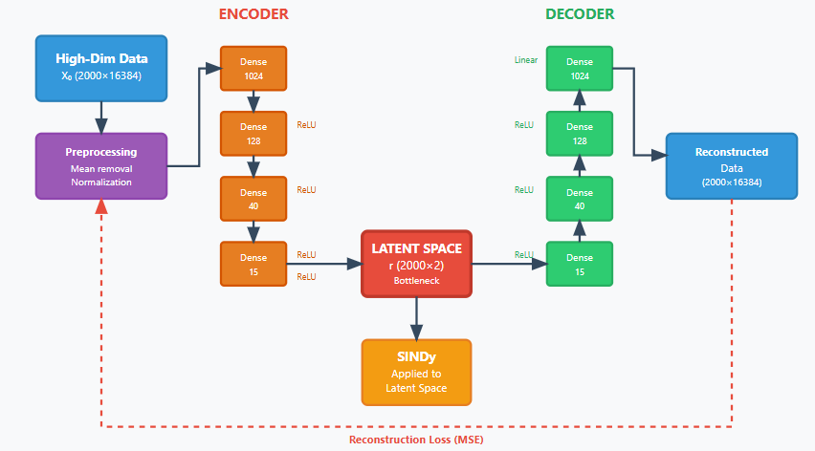
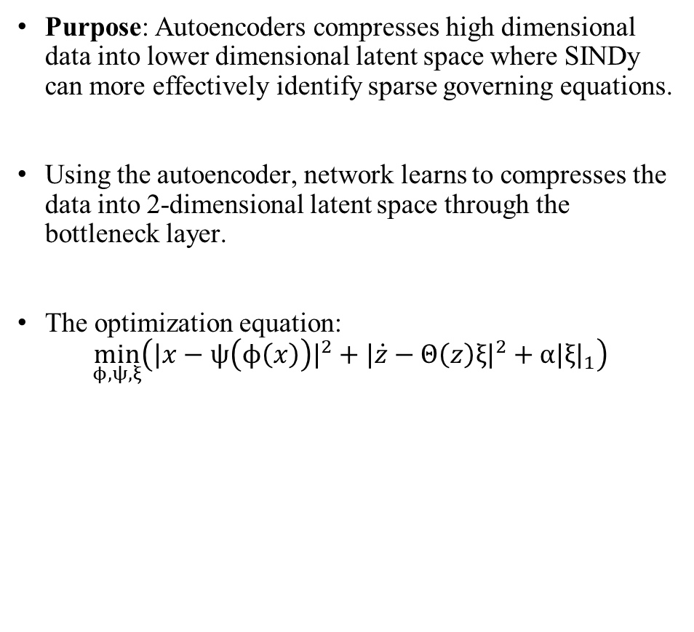

Autoencoders for dimensionality reduction
Purpose: Autoencoders compresses high dimensional data into lower dimensional latent space where SINDy can more effectively identify sparse governing equations.
Using the autoencoder, network learns to compresses the data into 2-dimensional latent space through the bottleneck layer.
The optimization equation:
$$\min_{ϕ,ψ,ξ}\left(|x−ψ\left(ϕ\left(x\right)\right)|^{2}+|\dot{z}−Θ\left(z\right)ξ|^{2}+α|ξ|_{1}\right)$$
x: original high-dimensional state
ϕ(x)=z: low-dimensional latent code from encoder
ψ(z): reconstructed data via decoder
$\dot{z}$: time-derivative of latent variables
Θ(z) $ξ$ : candidate-function library with sparse coefficients
$α$: weight controlling sparsity (ℓ1 ​-penalty)
Figure4: Compression of the polynomial equation in latent space through autoencoder [4].

Slide 12
Limitations of SINDy
Sensitive to noise data: SINDy is sensitive to the noisy data as it relies on numerical differentiation to compute derivatives
Library Function Selection: Success of SINDy depends on choosing appropriate library of candidate functions. Even if only a subset of state variables is observed, SINDy may fail to identify the complete dynamics or may identify incorrect equations.
Sparsity Assumptions: For systems that are not naturally sparse, the terms contribute significantly and SINDy may struggle.
Scaling and Convergence: For complex systems with multiple timescales or large state spaces, SINDy may have difficulty converging to the correct solution.

Slide 13
References
[1] Faircloth, Daniel. “Technological Aspects: High Voltage.” CAS-CERN Accelerator School: Ion Sources - Proceedings, 3 Apr. 2014, doi:10.5170/CERN-2013-007.381.
[2] Brunton, Steven L., Joshua L. Proctor, and J. Nathan Kutz. "Discovering Governing Equations from Data: Sparse Identification of Nonlinear Dynamical Systems." Proceedings of the National Academy of Sciences, vol. 113, no. 15, 2016, pp. 3932–3937. doi:10.1073/pnas.1517384113.
[3] de Silva, Brian M., et al. "PySINDy: A Python Package for the Sparse Identification of Nonlinear Dynamics from Data." Journal of Open Source Software, vol. 6, no. 66, 2021, p. 3396. doi:10.21105/joss.03396.
[4] Champion, Kathleen, Bethany Lusch, J. Nathan Kutz, and Steven L. Brunton. "Data-Driven Discovery of Coordinates and Governing Equations." Proceedings of the National Academy of Sciences, vol. 116, no. 45, 2019, pp. 22445–22451. doi:10.1073/pnas.1906995116.

